Slide 1


Agricultural Sustainability and Nitrous Oxide (N₂O) Markets
11th Annual NSF LTER Mini-Symposium
How Long-Term Ecological Research Informs Sustainability Science and Action
March 1, 2012
Phil Robertson
Kellogg Biological Station LTER Site
W.K. Kellogg Biological Station and
Dept. of Crop and Soil Sciences
Michigan State University
robertson@kbs.msu.edu

Slide 2
Interacting Dimensions of Sustainability for Agriculture
Economic
Profitability
Economic well-being (wealth)
Economic
Social
Food and energy security
Rural community health
Human health & nutrition
s
Social
Environmental
Environmental
Climate security
Biogeochemical health
Biodiversity benefits

Slide 3
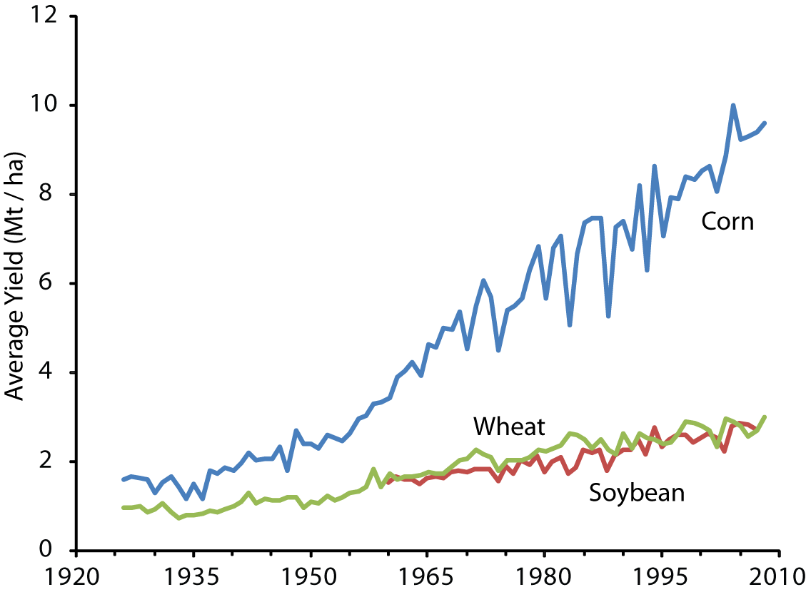
U.S. Average Yields for Major Grain Crops from 1930

Slide 4

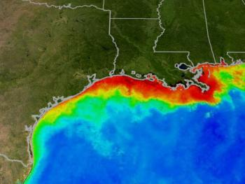
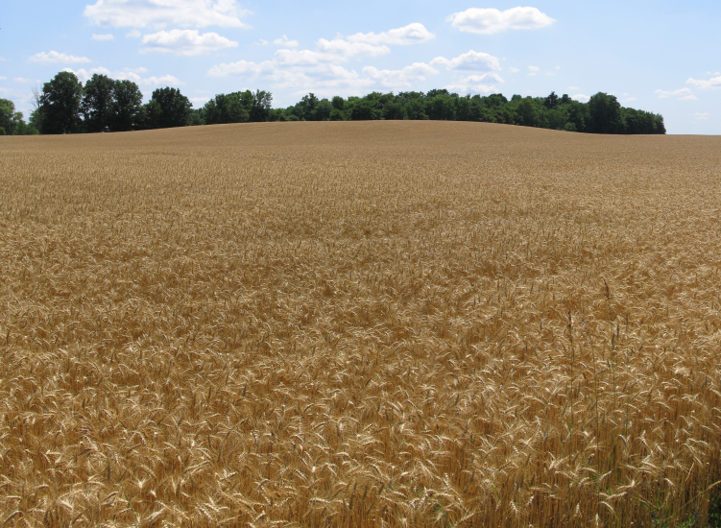
Environmental Signals of
Agricultural Intensification
Inland
Phosphorus
Coastal Nitrate
Habitat loss

Slide 5
U.S. Average Yields for Major Grain Crops from 1930
Global N Fertilizer Consumption
150 kg N/ha
60 kg N/ha
<10 kg N/ha
From USDA ERS (2011), FAO (2011), Robertson & Vitousek 2009 Ann .Rev.

Slide 6
Sources of information used by Michigan farmers to
determine nitrogen fertilizer application rates to corn
 | % Getting Information From Source | % Using as Most Important Source
Fertilizer dealers | 69.6 | 36.5
Seed company agronomist | 44.7 | 17.9
University recommendations | 31.1 | 15.8
Other farmers | 33.1 | 7.9
Magazines | 23.3 | 3.4
Private consultant | 18.7 | 7.4
Other | 12.9 | 10.2
D. Stuart et al. 2012 (submitted)

Slide 7




MSU-EPRI Nitrous Oxide Reduction Protocol
Partner Utilities
American Electric Power
Detroit Edison Co.
Duke Energy
Hoosier Energy Rural Electric Coop
Oglethorpe Power Corporation
PNM Resources Inc.
Salt River Project
Southern California Edison
Tri-State Generation and Transmission Coop

Slide 8
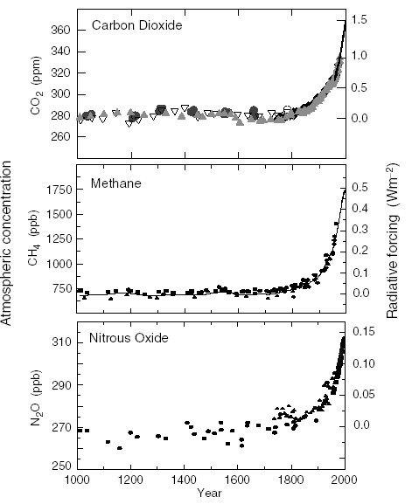
Atmospheric Concentrations from 1000 C.E.
Atmospheric N₂O is increasing at rates similar to the other 2 major biogenic gases
CO₂
Methane
Nitrous Oxide
N₂O
From IPCC (2001, 2007)

Slide 9
Global Warming Potential (GWP)
Biogenic Gases
Global Warming Potential
20 yr 100 yr 500 yr
Lifetime
yr
CO₂ variable 1 1 1
CH₄ 12 62 23 7
N₂O 114 275 296 156
Source: IPCC 2002; 2007

Slide 10
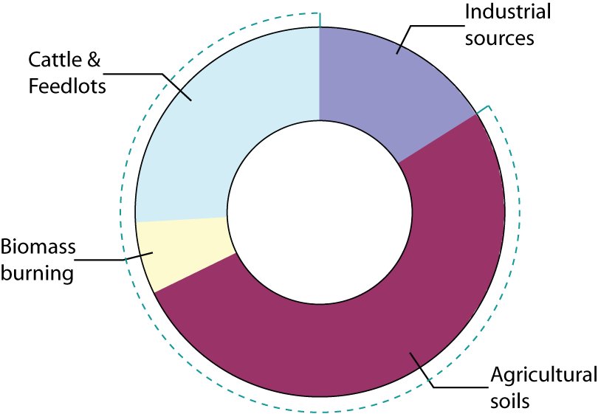
Atmospheric N₂O from 1976
The contemporary N₂O increase is largely due to agricultural intensification
N₂O
with a total annual impact ~ 1.2 Pg C_{equiv}
(compare to fossil fuel CO₂ loading = 4.1 PgC per year)
Industry is responsible for ~16% of the anthropogenic source
Agriculture for the remainder
with most of the agricultural increase (~60%) from cropped soils
Agriculture
Source IPCC 2001, 2007; Prinn 2004; Robertson 2004

Slide 11
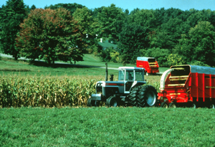
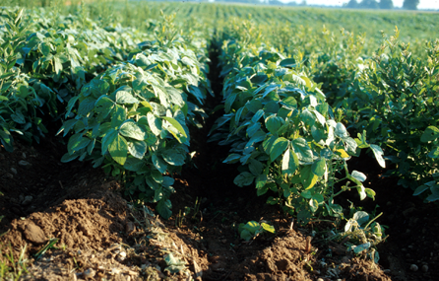

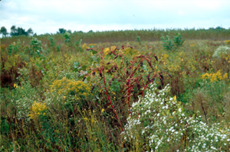
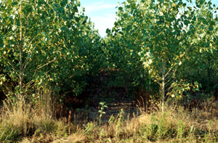
KBS Long-Term Ecological Research (LTER) Site
Ecosystem Type
Management Intensity
Annual Grain Crops (Corn - Soybean - Wheat)
Conventional tillage High
No-till
Low-input with legume cover
Organic with legume cover
Perennial Biomass Crops
Alfalfa
Hybrid poplars
Unmanaged Communities
Early successional old field
Mid successional old field
Late successional forest Low

Slide 12
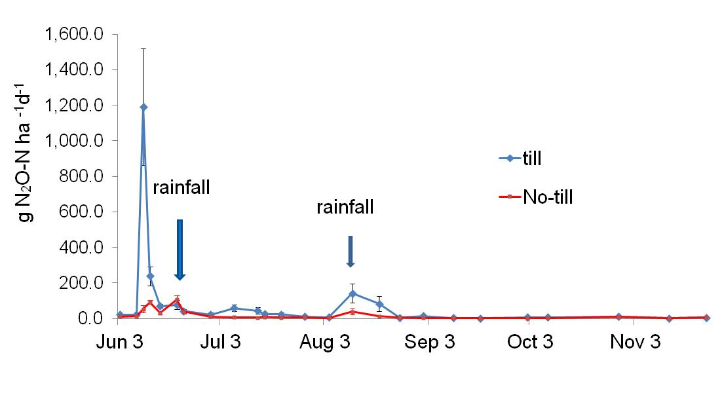
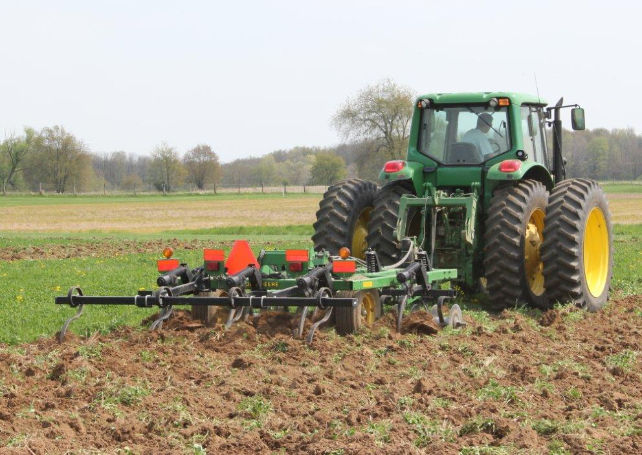
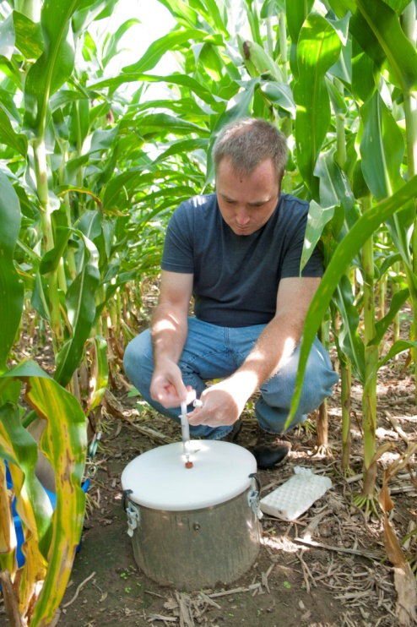
N₂O Measurements are relatively simple but labor intensive
Seasonality and environmental events are important
tillage
First year CRP Conversion at KBS
Ruan and Robertson 2011

Slide 13
Nitrous Oxide Fluxes at KBS are related to
the amount of N cycling in the system
IPCC N₂O Tier 1 Emission Factor
Emission Factor
IPCC 2006
Tier 1 Linear Emission Factor
EF = 1.0% (0.25 – 2.25%)
Bouwman et al. 1996
Robertson et al. 2000; Bouwman et al. 1996; IPCC 2006

Slide 14
Sources of Global Warming Impacts
in KBS Cropping Systems (1992-2010)
Annual Crops
Perennial
Gelfand et al. in prep.

Slide 15
Sources of N₂O in soil
Terrestrial N Cycle
Robertson & Groffman 2007

Slide 16
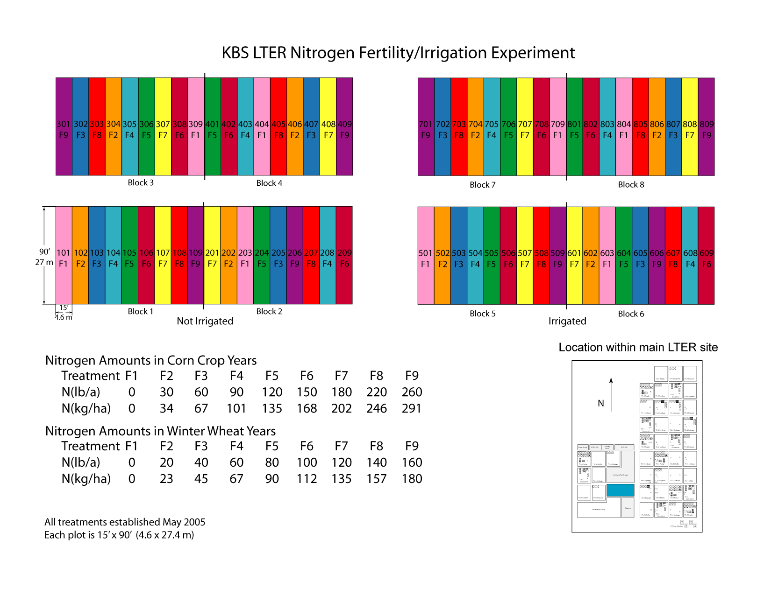
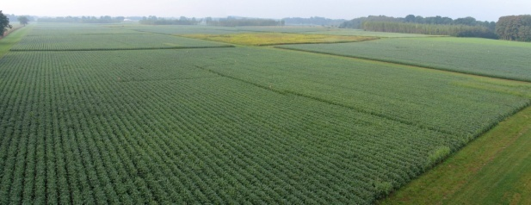
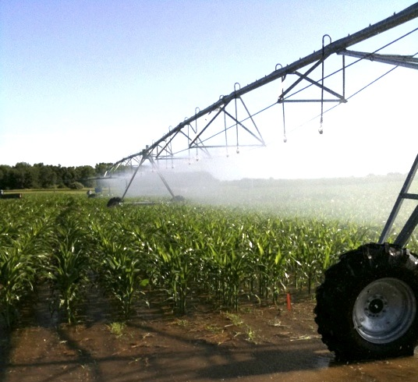
KBS corn yields at different N rates (2008)

Slide 17
N₂O fluxes across different N rates (KBS 2010 wheat)
Emissions factors vary with N-rate – especially above crop optimum
Millar et al., submitted

Slide 18
N₂O flux × crop yield
246 kg N
N₂O fluxes accelerate at N-fertilizer rates greater than yield response
Implication – N₂O savings can be substantial where fertilizer rate exceeds crop needs
202
168
134
0 kg N
34
101
67
Millar et al. 2012; McSwiney & Robertson, Global Change Biology, 2005.

Slide 19
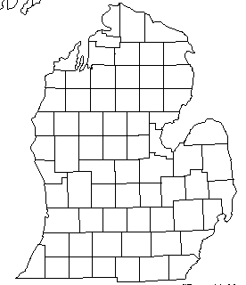
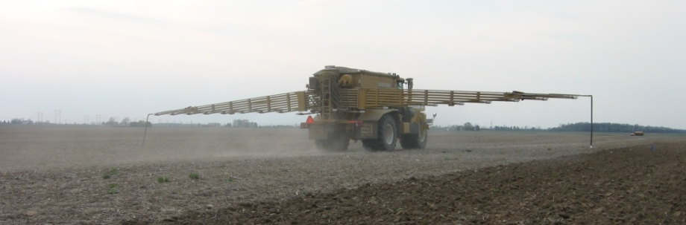
Cross-state test of non-linear N₂O response to N-fertilizer
Fairgrove, MI
N-Fertilizer
(kg N ha⁻¹)
KBS
Hoben et al., 2011, Global Change Biology

Slide 20
Implications for N₂O reductions for a given N rate reduction
For a given N rate reduction,
very different N₂O outcomes
N rate reduction (50 kg N)

Slide 21

Trading and Offsets
Offset traded
Baseline
Offset provided
Practice
Change
GHG emissions
Before
After
Before
After
Regulated entity
Electric Power Plant
Offset provider
Agriculture

Slide 22
Emerging Offset Opportunities
Benefits
Reduce agricultural GHGs
Reduce reactive N
Incentivize conservation using current technology
Incentivize new technology
Market Issues
Baseline establishment
Permanence
Additionality
Leakage

Slide 23
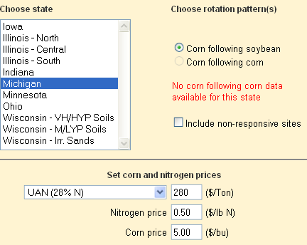
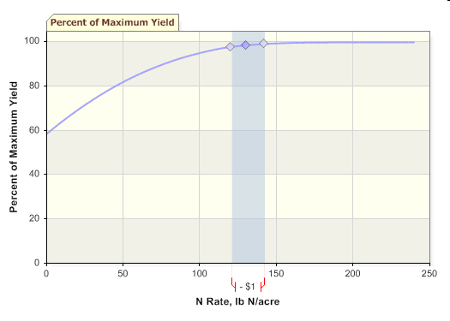
How to reduce N-fertilizer rates without affecting yields
Calculators are available for better economic estimates
100
80
120
143
60
Percent of Maximum Yield (%)
40
MRTN Rate
20
0
0
50
100
150
200
N fertilizer rate (lb N acre⁻¹)
Mean Return to Nitrogen (MRTN) Calculator
http://extension.agron.iastate.edu/soilfertility/nrate.aspx

Slide 24
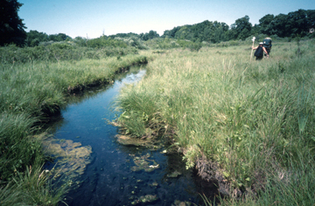
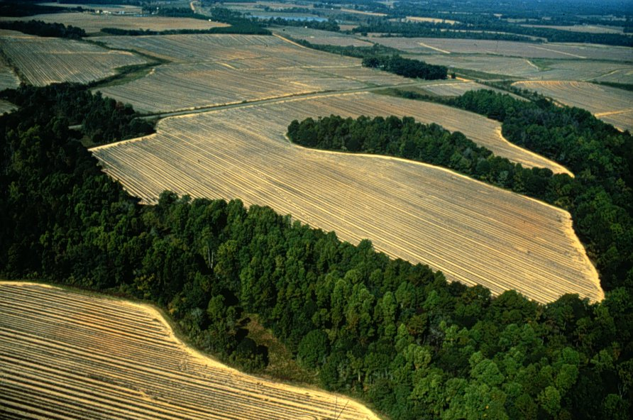
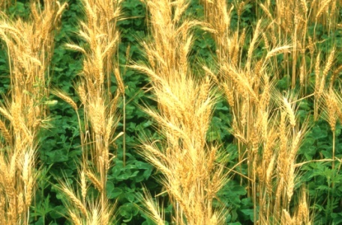
Conclusions
Reactive nitrogen escaping to the environment is a major and recalcitrant problem challenging the sustainability of row-crop agriculture
Nitrous oxide is the most important source of greenhouse gas impact in fertilized crops
  Fluxes can be reduced with closer attention to crop needs and adoption of technology that maximizes crop uptake
  Carbon market payments may be sufficient to incentivize conservation efforts
Reducing N₂O loss through better fertilizer management will provide co-benefits related to the loss of other forms of nitrogen – nitrate, ammonia, and nitric oxides, in particular

