Slide 1
Many Hands: Fostering Ecological Data Sharing through ILTER Information Management Collaborations
John Porter

Slide 2
LTER Information Management
Goal: “To inform the LTER and broader scientific community by creating well designed and well documented databases”
Enabling New Science
Long Term
Regional and Global
Comparisons of diverse ecological systems
Synthesis – combining data in new ways
Multidisciplinary
Notes:
The key aspect of LTER Information management is to enable new scientific discoveries by making the sorts of data available that are required to address long term, regional, global and multidisciplinary questions

Slide 3
Information Management
Ecology
Social Dynamics
Informatics
Notes:
Ecological Information management is a challenging field that needs to integrate a diverse array of activities in order to be successful.

Slide 4
U.S. LTER Success Stories
The U.S. LTER Network now provides over 10,000 individual data files organized into over 6,000 datasets
Collaborated on the development and adoption of metadata standards (Ecological Metadata Language) and tools (e.g., “Metacat” data catalog, “Morpho” editor) that use those standards to allow interoperability
Helped develop a culture of Data Sharing
Given these successes, why is International Collaboration on Information Management needed?
Notes:
We’ve come a long way since 1994 when the LTER network started sharing data over the web. Key features have been tool and standard development and helping to foster a culture of data sharing.

Slide 5
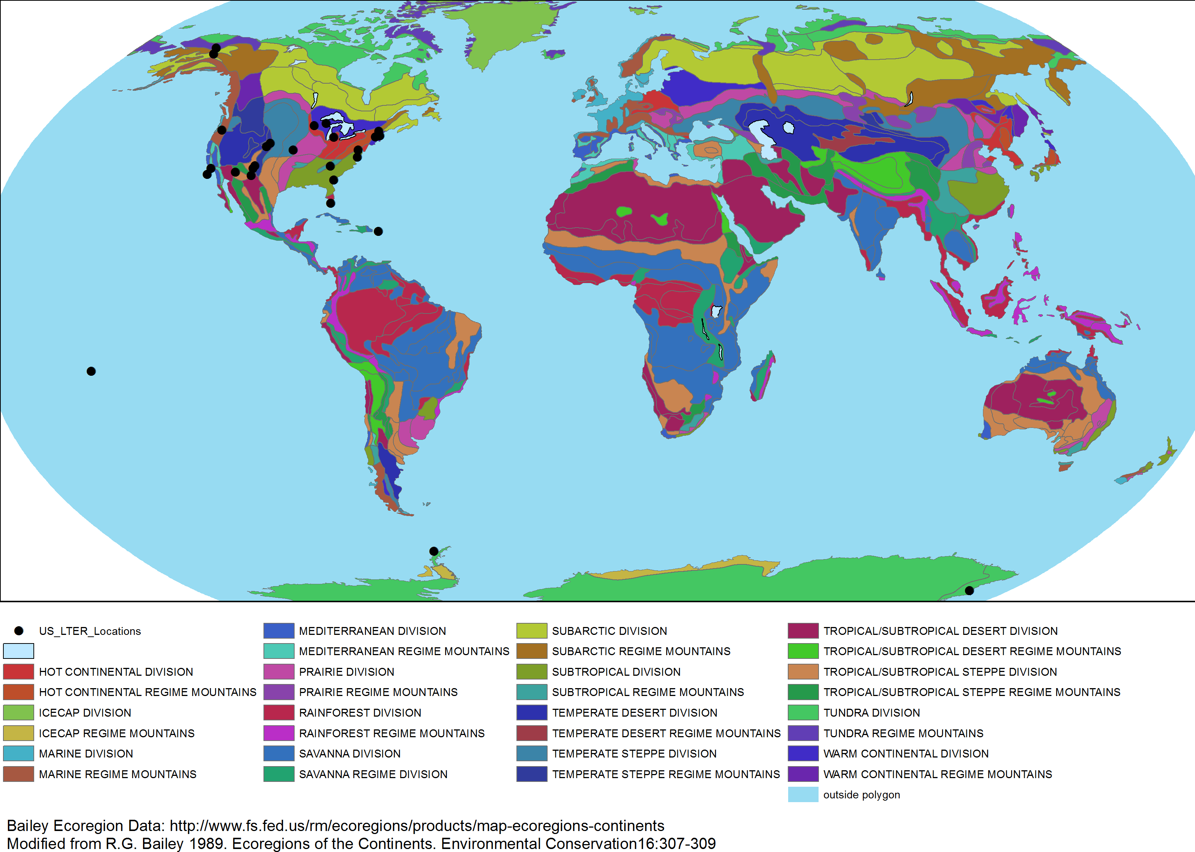
Why International?
Notes:
US LTER sites sample only a subset of the world’s important ecosystems

Slide 6
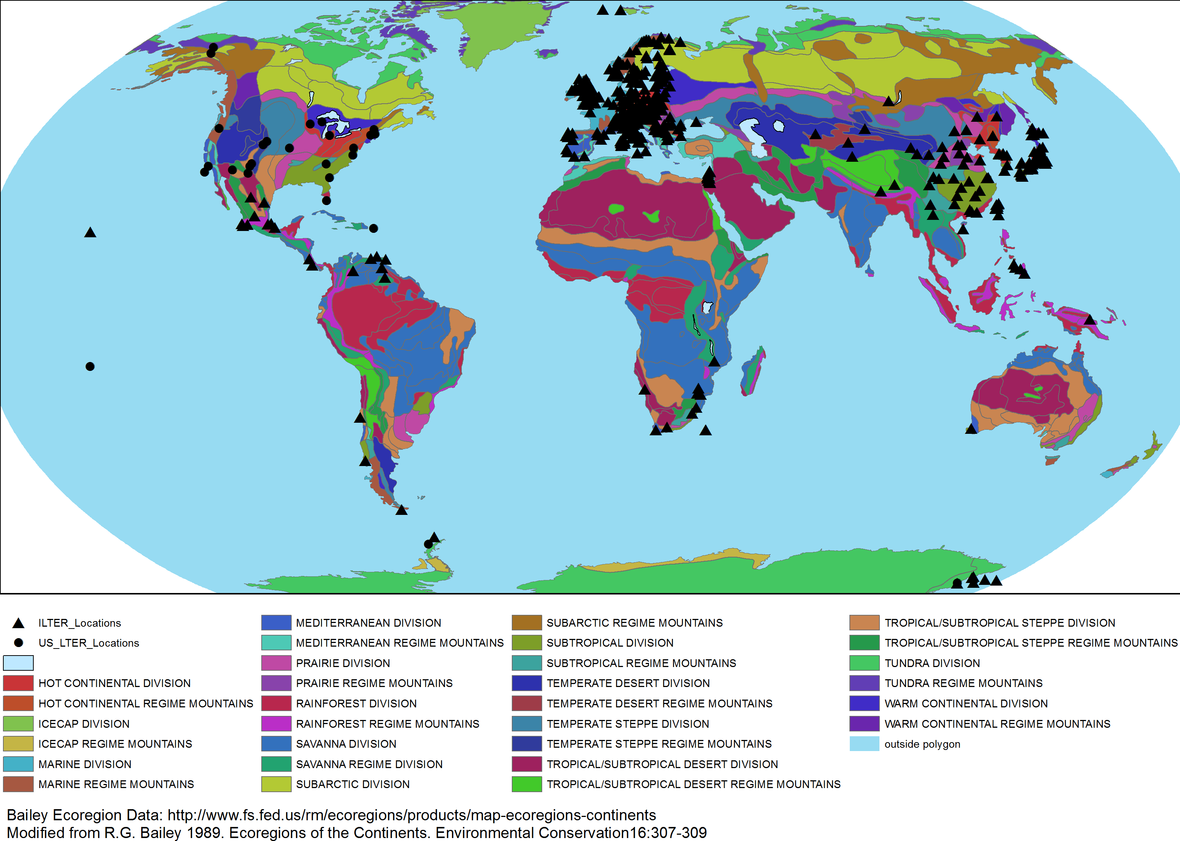
Why International?
Notes:
Broader ecosystem coverage, more opportunities for comparison when ILTER sites are added

Slide 7
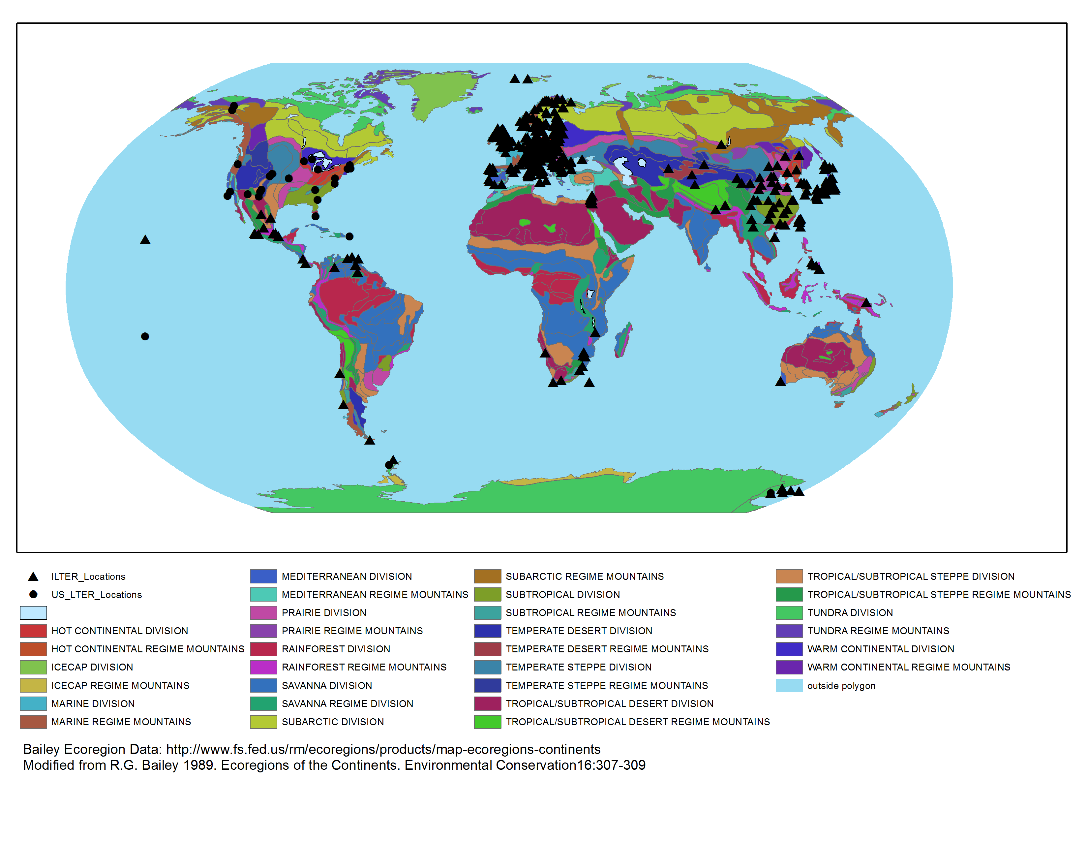
Why International Information Management?
Having data collected in a wider array of ecosystems is good, but not if you lack ways to share data!
Not all good ideas are home-grown
Many hands make light work
Notes:
That data exists is good, but it’s much better when it can be shared. We’ve also gotten some good ideas from our collaborators about tools, techniques and opportunities. Lastly, there is a lot to be done and more people contributing really helps!

Slide 8
ILTER Contributions
Data from Different Ecosystems
Tool Development
New Approaches
Partners for Collaborations

Slide 9
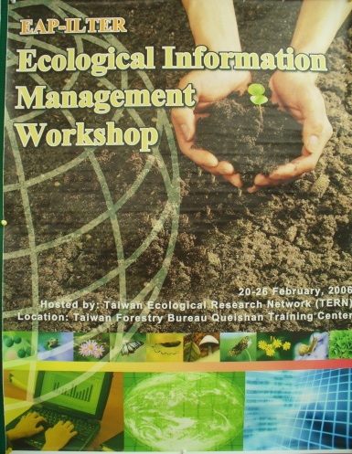
A Personal View
I won’t be able to cover ALL the collaborations, so I’ll focus on some specific collaborations I’ve been involved in. This gives short shrift to many other productive collaborations elsewhere in ILTER
The Early Days (1995-2003)
ILTER sponsored a series of Information Management (IM) training workshops
“Planting Seeds”
Eastern Europe, East-Asia Pacific, Middle East,
Latin America, Africa
Many partners had little experience with formal
information management or resources committed
to IM
These were a valuable exercise – and a necessary precursor – but they were not sufficient to lead to tangible developments for ILTER
Notes:
I’ll be neglecting many great efforts in this talk. There simply isn’t time to cover them all….
In the early days, there were few partners who were already thinking about the need for information management or had the resources to do so. Early efforts focused on the “Why” of information management more than the “How”.

Slide 10
Extended Interactions with Taiwan
In 2004 the Taiwan Ecological Research Network wanted to develop their Information Management capabilities
They sent a team to 4 of the US LTER sites to help identify possible collaborators for extended IM Training
2004-05 – Sent two information managers to North Temperate Lakes and Virginia Coast Reserve (VCR) LTER sites, respectively, for 90 days each
Paid for by Taiwan National Science Council
2005-2007 – Additional information managers were sent to the VCR/LTER for specific training
Local expenses covered by an NSF Supplement to VCR/LTER
Notes:
This effort was initiated by Hen-biau King and Chau-Chin Lin. The first trip was a whirlwind exercise, jumping from site-to-site. The 2005-2007 visits were supported thanks to Bill Chang.

Slide 11
90-day Working Visits to US
2004- Sheng Shan Lu – Work with North Temperate Lakes LTER Site
2005- Meei-ru Jeng – Information exchange on Ecological Metadata Language (EML) and uses of metadata
training of EAP IM’s in EML, Chinese translations of Morpho metadata editor manuals etc.
2005- Chien-Wen Chen – Wireless computer networks and web cameras
webcams in botanical garden, Shan-ping wireless network and wasp/bee camera
Data turbine, image databases
2006- Chi-Wen Hsaio – Metadata tools
EML to Google Maps
EML checker and quality control
EML to R web interface
2007- Chau-Chin Lin – Presentation and papers on EML metadata, preparation for synthesis workshops

Slide 12
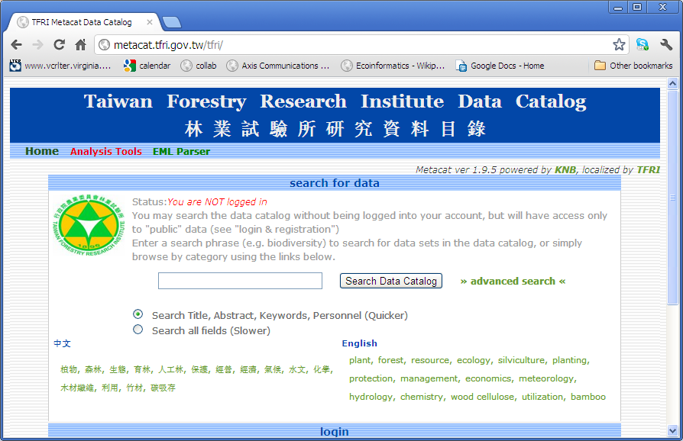
Interactions led to development of data catalogs for at least 5 ILTER Network member networks

Slide 13
Training for ILTER Scientists
The Taiwan LTER group translated the documentation for the Morpho Metadata Editor into Chinese and conducted a series of training workshops for their scientists

Slide 14
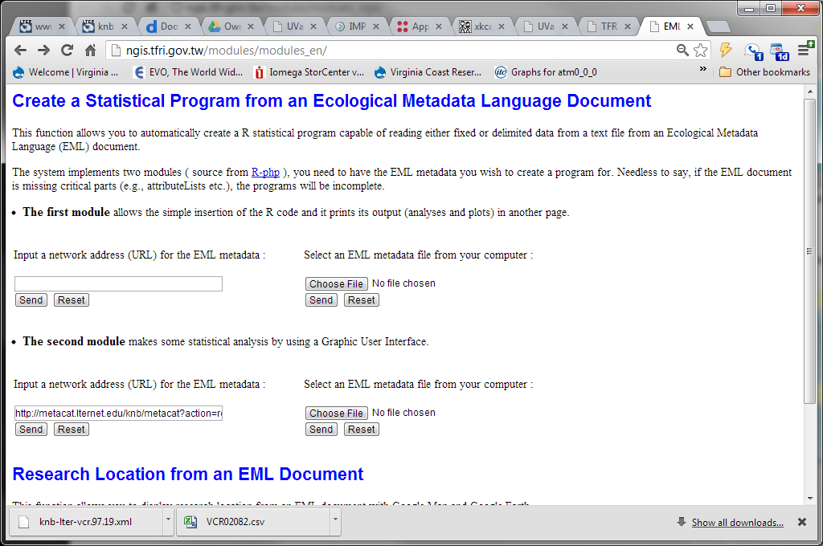
Example Collaboration Product
A web application that uses Ecological Metadata to automate quality checking and basic analysis
Notes:
The slides on this application will be gone through quickly!

Slide 15
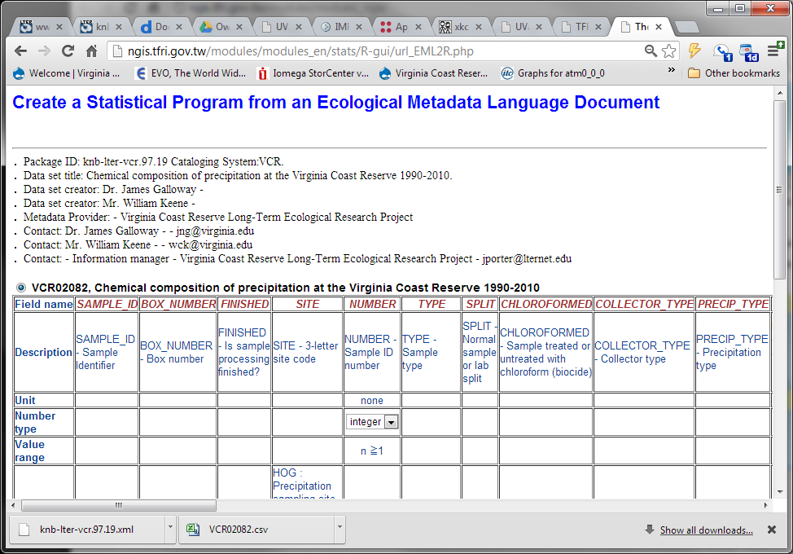
Ingests the metadata and displays the data table

Slide 16
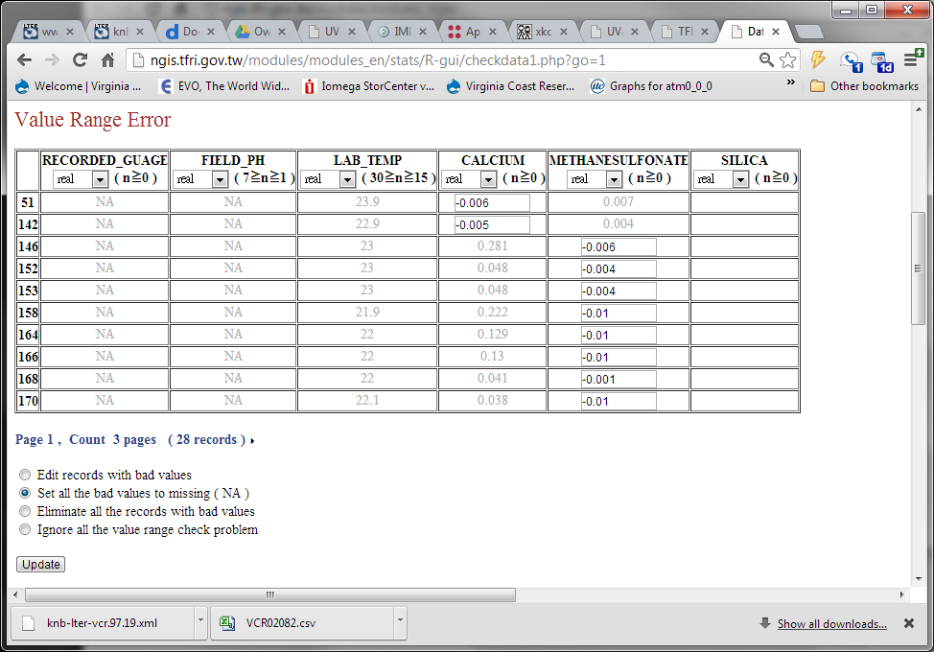
Flagged small, negative concentrations due to round-off error in analytical procedures
Ingests the data and performs a quality assurance analysis based on the metadata

Slide 17
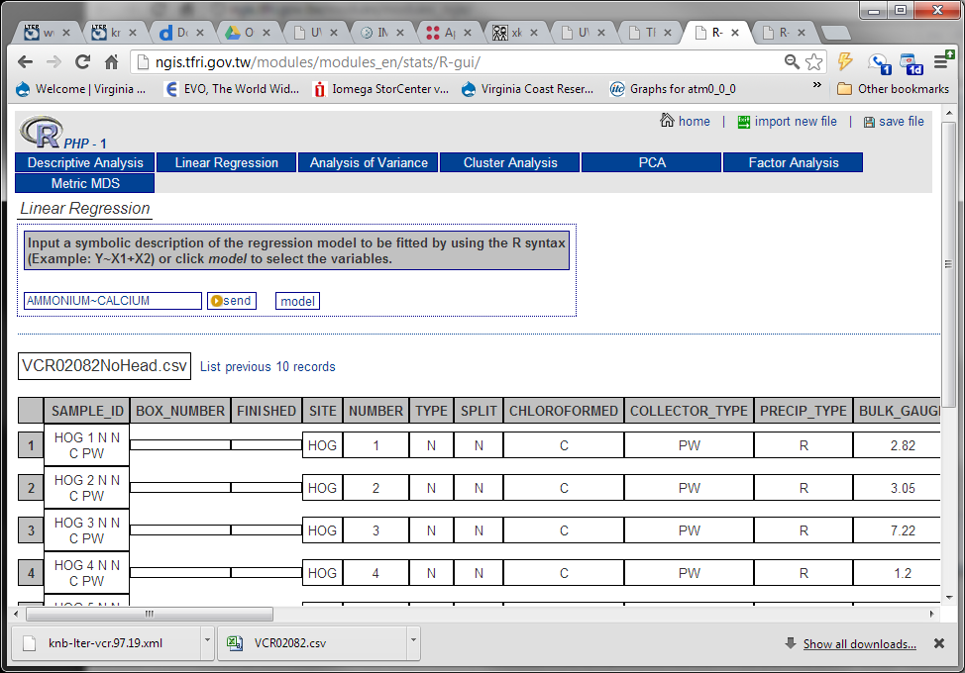
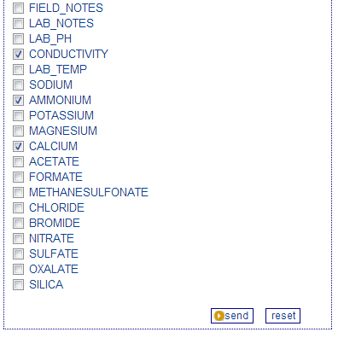
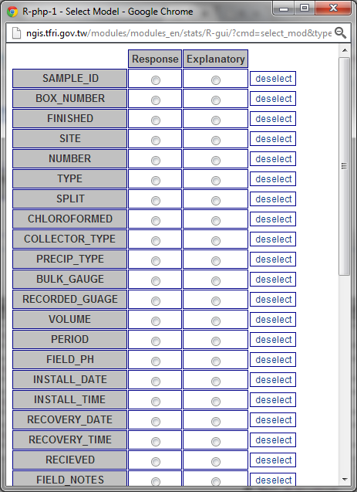
Specify Analysis to be run

Slide 18
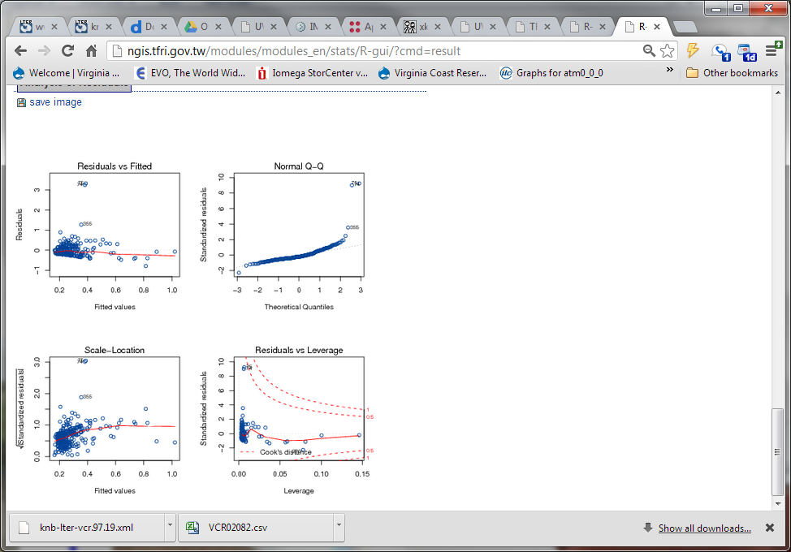
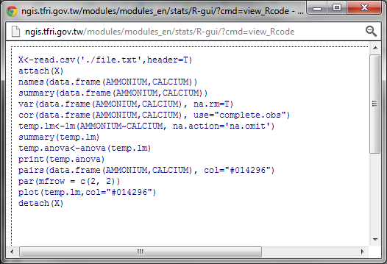
Results, and the R program used to create them

Slide 19
Taiwan East-Asia-Pacific Region Activities
Year | Activity
2005 | First EAP-ILTER IM workshop in China (with US LTER and CERN)
2006 | First US LTER-TERN ecoinformatics workshop in Taiwan; Second EAP-ILTER IM workshop in Taiwan; EAP-ILTER IM committee Meeting in Japan; ILTER IM committee Meeting in Namibia; IM workshop in Philippines
2007 | EAP-ILTER IM committee meeting in Taiwan; The third EAP-ILTER IM workshop in Korea; Reciprocal visits between Australia LTER and TERN on ecoinformatics issues; LTER IM workshop in Malaysia; LTER IM workshop in Thailand
2008 | First ILTER IM data sharing workshop in China; Participation in DataOne project
2009 | First Forest Dynamic Plot information application workshop in Taiwan (with Malaysia LTER, JaLTER, US LTER, CTFS)
2010 | Korea LTER IM workshop; The Second Forest Dynamic Plot Data Application workshop in Malaysia (with Malaysia LTER, Korea LTER, Singapore DP, Vietnam Biodiversity Center, US LTER); The Second US LTER-TERN IM workshop in Taiwan
2011 | Finland LTER and TERN information System analysis project in Taiwan
2012 | ILTER Information Management Workshop on Semantic Approaches to Discovery of Multilingual ILTER Data in Shanghai China
Notes:
Too many Activities to explain in detail

Slide 20
Training
Year | Activity
2005 | First EAP-ILTER IM workshop in China (with US LTER and CERN)
2006 | First US LTER-TERN ecoinformatics workshop in Taiwan; Second EAP-ILTER IM workshop in Taiwan; EAP-ILTER IM committee Meeting in Japan; ILTER IM committee Meeting in Namibia; IM workshop in Philippines
2007 | EAP-ILTER IM committee meeting in Taiwan; The third EAP-ILTER IM workshop in Korea; Reciprocal visits between Australia LTER and TERN on ecoinformatics issues; LTER IM workshop in Malaysia; LTER IM workshop in Thailand
2008 | First ILTER IM data sharing workshop in China; Participation in DataOne project
2009 | First Forest Dynamic Plot information application workshop in Taiwan (with Malaysia LTER, JaLTER, US LTER, CTFS)
2010 | Korea LTER IM workshop; The Second Forest Dynamic Plot Data Application workshop in Malaysia (with Malaysia LTER, Korea LTER, Singapore DP, Vietnam Biodiversity Center, US LTER); The Second US LTER-TERN IM workshop in Taiwan
2011 | Finland LTER and TERN information System analysis project in Taiwan
2012 | ILTER Information Management Workshop on Semantic Approaches to Discovery of Multilingual ILTER Data in Shanghai China
Notes:
Lots of training activities, many early on to set the stage for later workshops

Slide 21
Testing IM Tools for Science
Year | Activity
2005 | First EAP-ILTER IM workshop in China (with US LTER and CERN)
2006 | First US LTER-TERN ecoinformatics workshop in Taiwan; Second EAP-ILTER IM workshop in Taiwan; EAP-ILTER IM committee Meeting in Japan; ILTER IM committee Meeting in Namibia; IM workshop in Philippines
2007 | EAP-ILTER IM committee meeting in Taiwan; The third EAP-ILTER IM workshop in Korea; Reciprocal visits between Australia LTER and TERN on ecoinformatics issues; LTER IM workshop in Malaysia; LTER IM workshop in Thailand
2008 | First ILTER IM data sharing workshop in China; Participation in DataOne project
2009 | First Forest Dynamic Plot information application workshop in Taiwan (with Malaysia LTER, JaLTER, US LTER, CTFS)
2010 | Korea LTER IM workshop; The Second Forest Dynamic Plot Data Application workshop in Malaysia (with Malaysia LTER, Korea LTER, Singapore DP, Vietnam Biodiversity Center, US LTER); The Second US LTER-TERN IM workshop in Taiwan
2011 | Finland LTER and TERN information System analysis project in Taiwan
2012 | ILTER Information Management Workshop on Semantic Approaches to Discovery of Multilingual ILTER Data in Shanghai China
Notes:
Training paved the way for workshops that combined IM tools with science questions

Slide 22
No US Involvement
Year | Activity
2005 | First EAP-ILTER IM workshop in China (with US LTER and CERN)
2006 | First US LTER-TERN ecoinformatics workshop in Taiwan; Second EAP-ILTER IM workshop in Taiwan; EAP-ILTER IM committee Meeting in Japan; ILTER IM committee Meeting in Namibia; IM workshop in Philippines
2007 | EAP-ILTER IM committee meeting in Taiwan; The third EAP-ILTER IM workshop in Korea; Reciprocal visits between Australia LTER and TERN on ecoinformatics issues; LTER IM workshop in Malaysia; LTER IM workshop in Thailand
2008 | First ILTER IM data sharing workshop in China; Participation in DataOne project
2009 | First Forest Dynamic Plot information application workshop in Taiwan (with Malaysia LTER, JaLTER, US LTER, CTFS)
2010 | Korea LTER IM workshop; The Second Forest Dynamic Plot Data Application workshop in Malaysia (with Malaysia LTER, Korea LTER, Singapore DP, Vietnam Biodiversity Center, US LTER); The Second US LTER-TERN IM workshop in Taiwan
2011 | Finland LTER and TERN information System analysis project in Taiwan
2012 | ILTER Information Management Workshop on Semantic Approaches to Discovery of Multilingual ILTER Data in Shanghai China
Notes:
Many of the activities were catalyzed by interactions with the US LTER, but did not require US LTER involvement

Slide 23
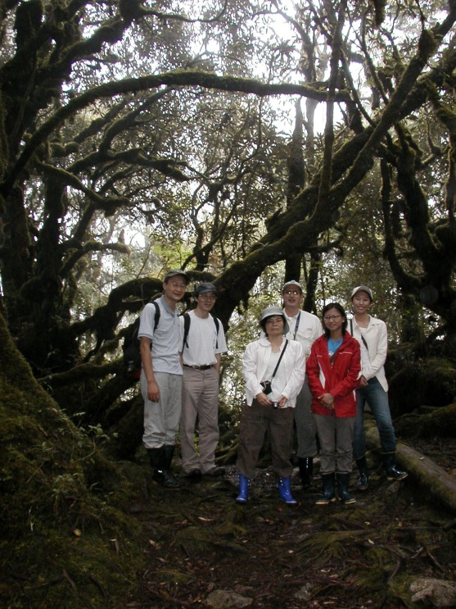
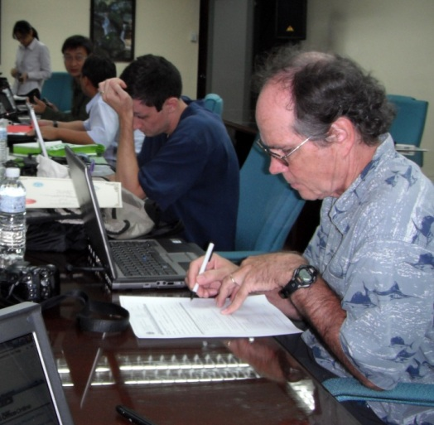
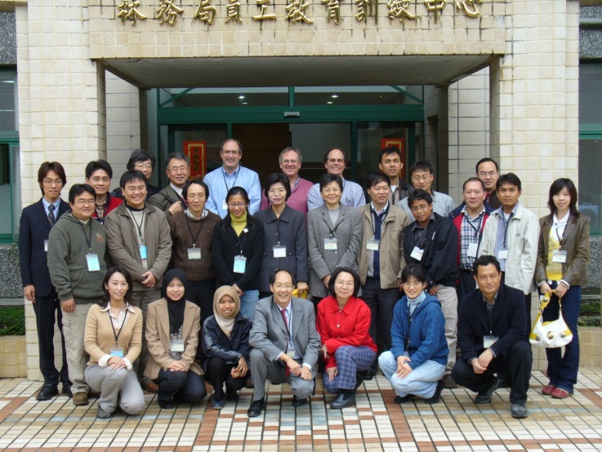
Visits by US Information Managers
Travel expenses paid by supplement from NSF, all local costs borne by workshop hosts
Collaboration on Ecological Metadata Language training workshops, EML tools
Linking of Taiwan meteorological stations and LTER ClimDB Climate Database
Joint training on Kepler and other advanced tools
Forest Plot data integration workshops – Kepler workflow development
Multilingual data searching – web service and linked data approaches-> translation into 4 Asian languages (Chinese – traditional and simple, Korean, Japanese)
Notes:
US information managers and other investigators and graduate students also participated in a series of workshops. Note Peter McCartney, now at NSF in the back row.

Slide 24
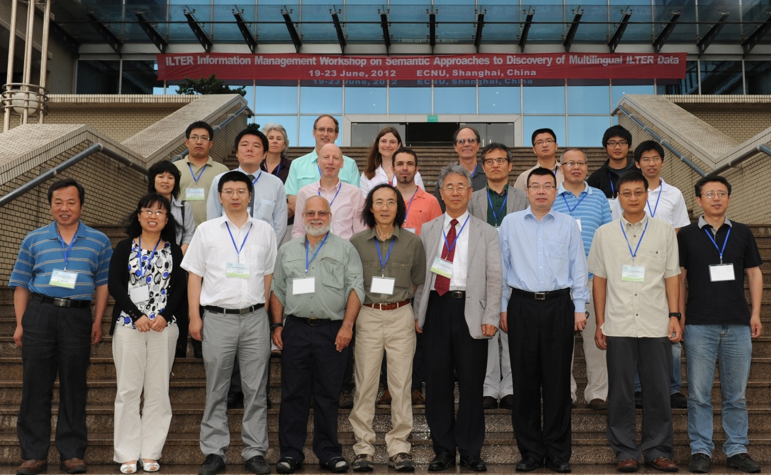
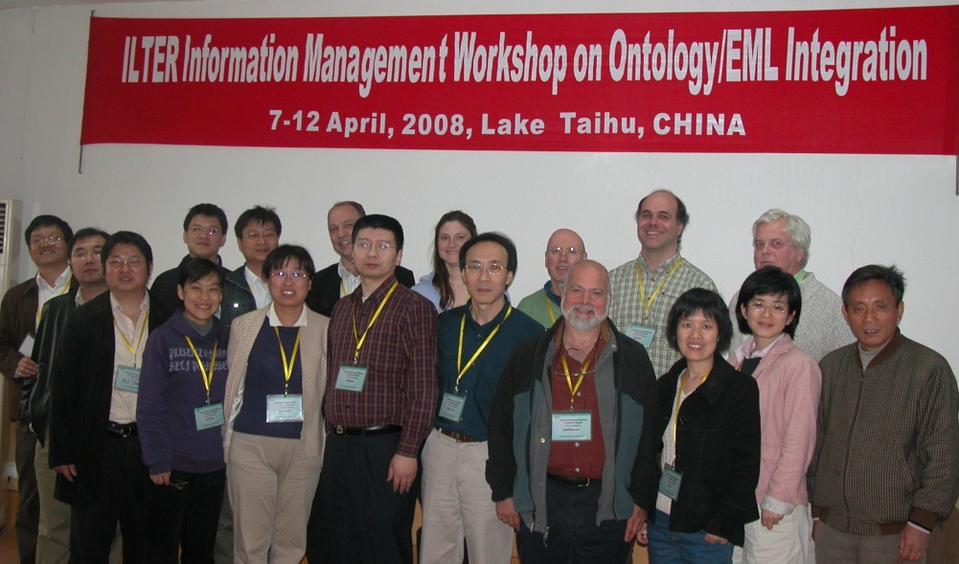
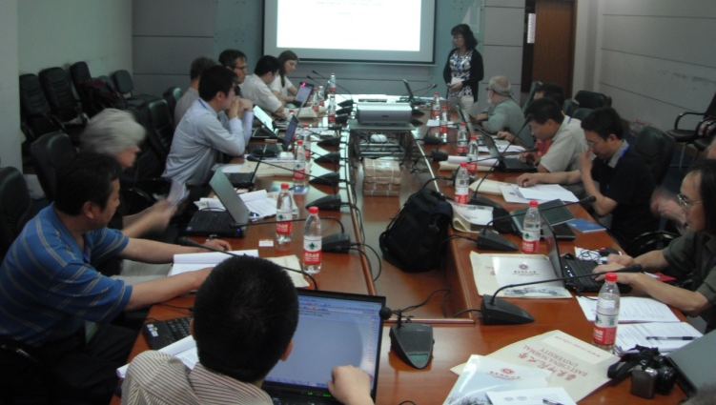
2008 & 2012: Making ILTER Data Searchable
ILTER Information Management Workshop on Semantic Approaches to Discovery of Multilingual ILTER Data
Regions Represented
East Asia Pacific
Europe
US
Goal: see if semantically augmented searches can help to find data across multiple ILTER regions

Slide 25
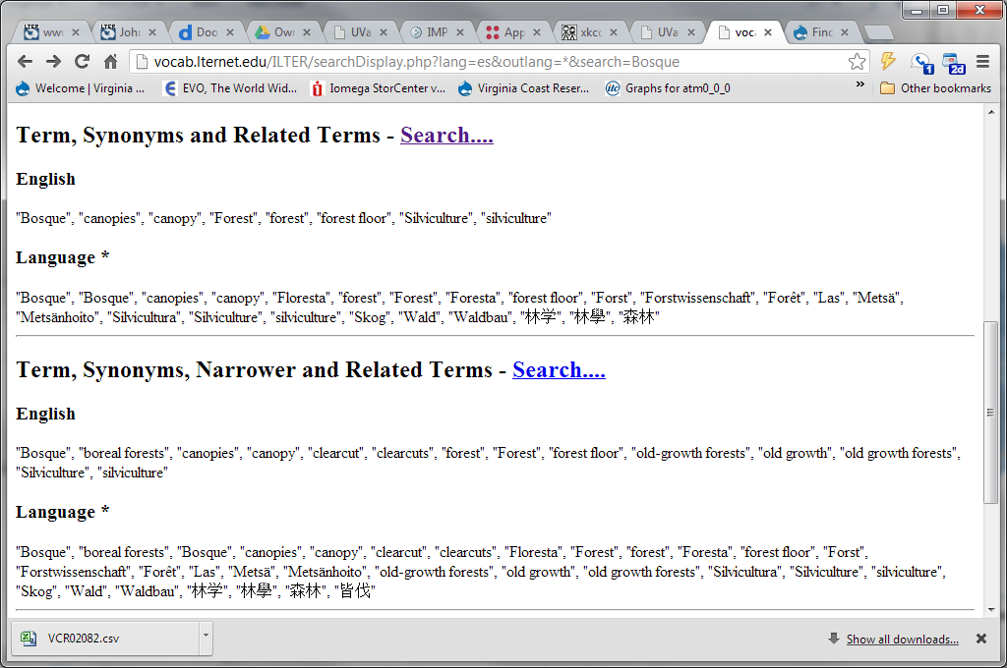
Prototype Multilingual ILTER Data Search
The workshop developed a prototype search interface that allows augmented data searches in 12 languages, coupling the US LTER Controlled Vocabulary and the European ILTER EnvThes Thesaurus with ILTER data catalogs
Notes:
The search interface uses lexical relationships to get around problems with inexact equivalences and other problems that arise with multilingual data

Slide 26
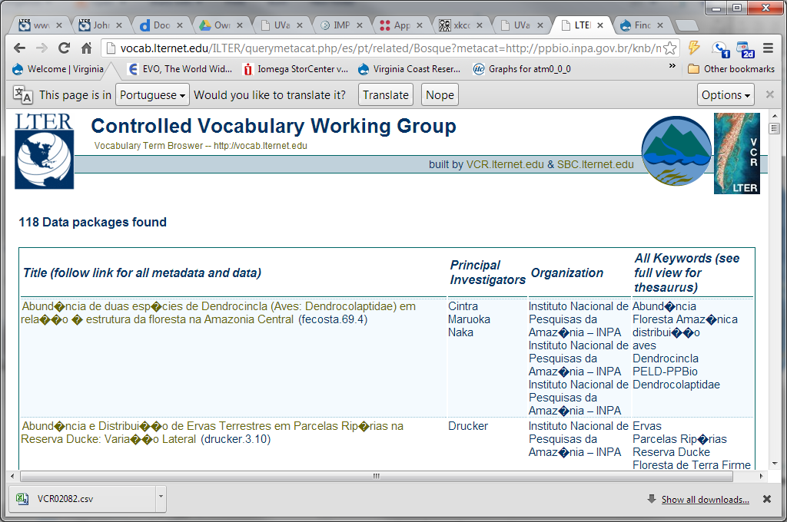
Notes:
We searched on Bosque (spanish) and came up with 118 datasets for forests in Brazil (Portuguese) - finding “Floresta”

Slide 27
Big Picture
Solid collaboration with each group contributing to final products
Good complementarity of research groups
Taiwan has spearheaded support of multiple languages and character sets in the tools related to EML (prior to Taiwanese developments, the Morpho and Metacat tools worked only with latin character sets), and were the first to port the Metacat data catalog from a Linux to a Windows environment.
Taiwan has been a leader in use of advanced tools
Multilingual Metacat and Morpho
Kepler
Data Turbine
Linked Open Data/RDF
Continued Collaborations on Metadata-based Tools
Notes:
There have been may contributions that would not have happened within the US alone. Notably EML has been expanded to include multilingual support.

Slide 28
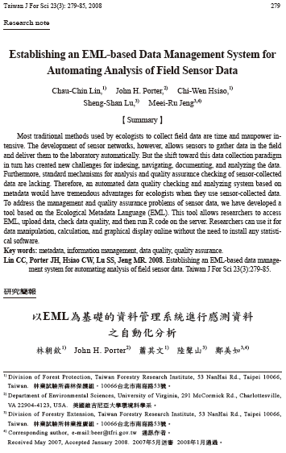
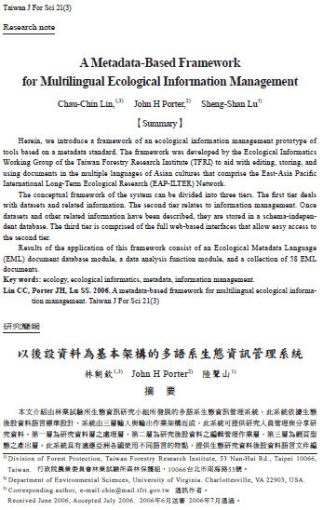
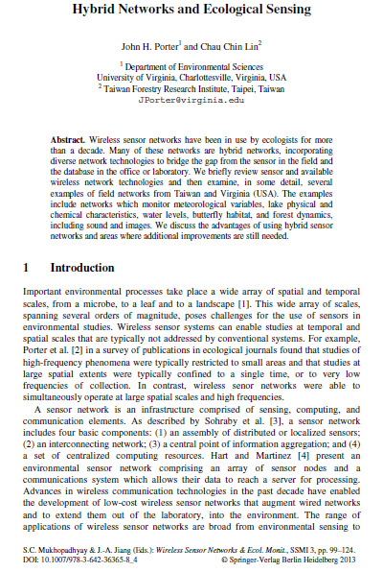
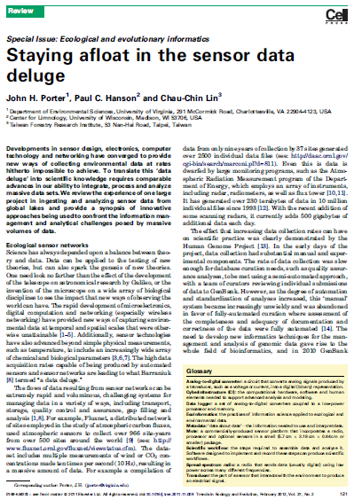
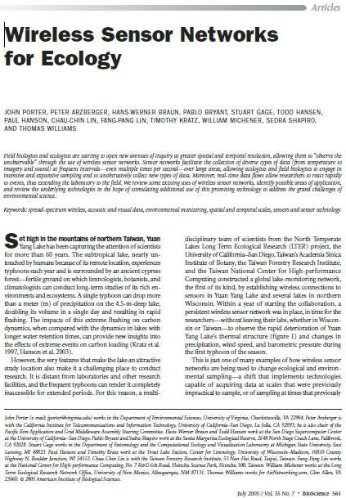
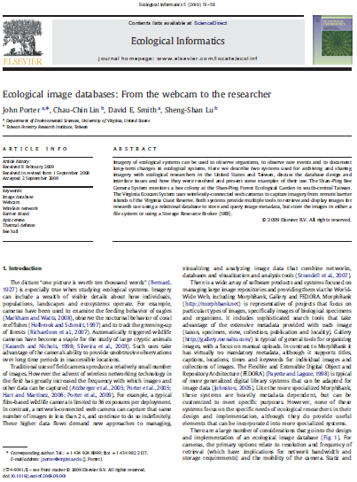
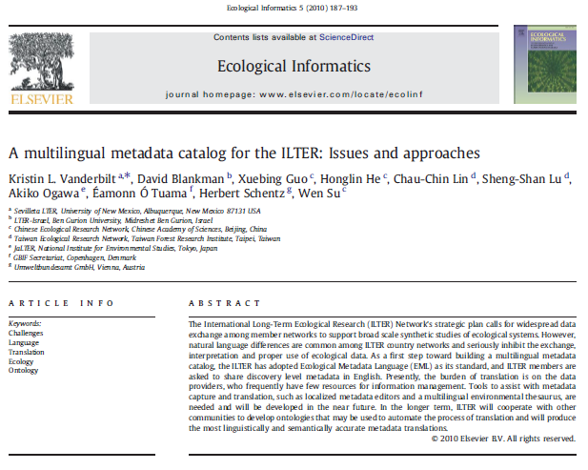
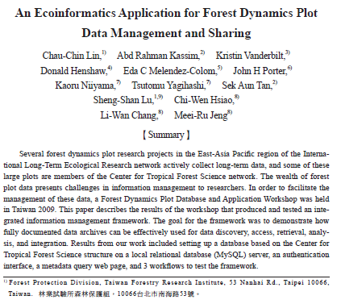
Apart from software products there have also been a series of publications in both Asian and Western journals, including TREE, Bioscience and Ecological Informatics

Slide 29
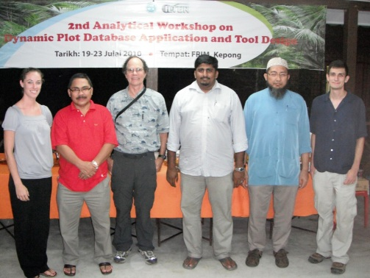
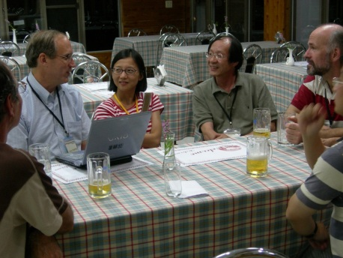
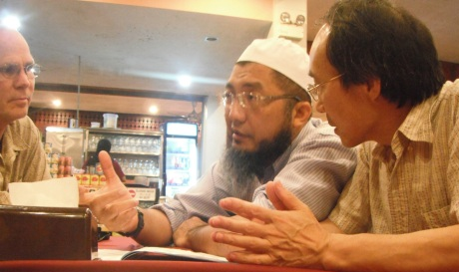
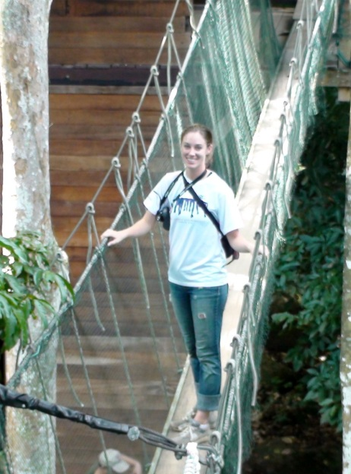
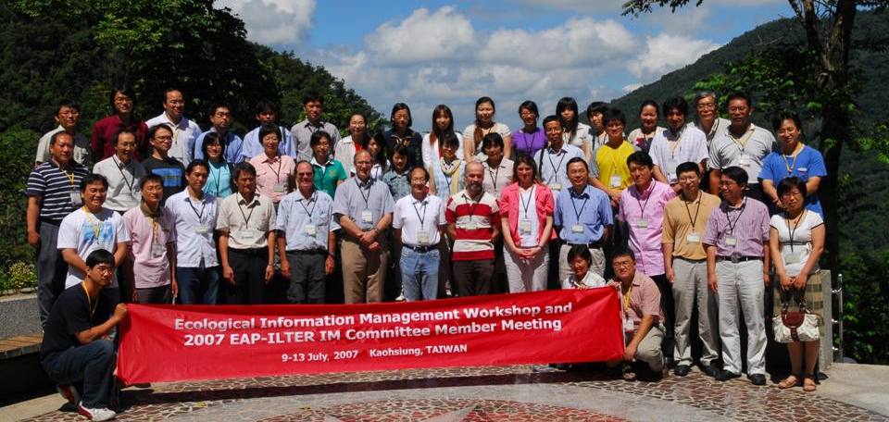
Keys to Success
Finding the Right Partners
Focus on Products we can all benefit from
Multiple Opportunities for Interaction
Product-oriented workshops
Overall strategy meetings
Notes:
The chance to get together and work on projects over a long time frame has been a critical element. We now have a good idea of each other’s interests and capabilities that make interactions more productive.

Slide 30
Future
Strong Momentum
Possible areas for additional collaboration
Data Integration
Scientific Workflow development
Specific science data products
Additional work on multilingual approaches to data discovery and integration
Semantic Approaches to Data Discovery
Linked Open Data, Onotologies
Unexpected opportunities??!!!!

Slide 31
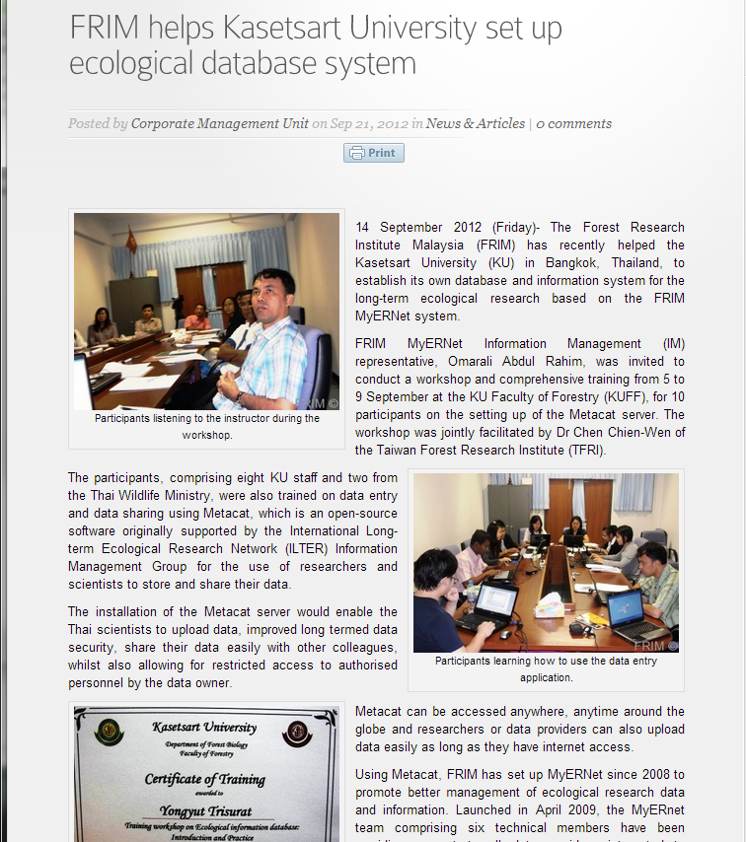
Taiwan LTER
U.S. LTER
Forestry Research Institute of Malaysia
Many hands make light work!
Kasetsart University Thailand
Notes:
A news story on training in Ecological Informatics. We had no direct role in this workshop, but it would never have happened without ILTER

Slide 32
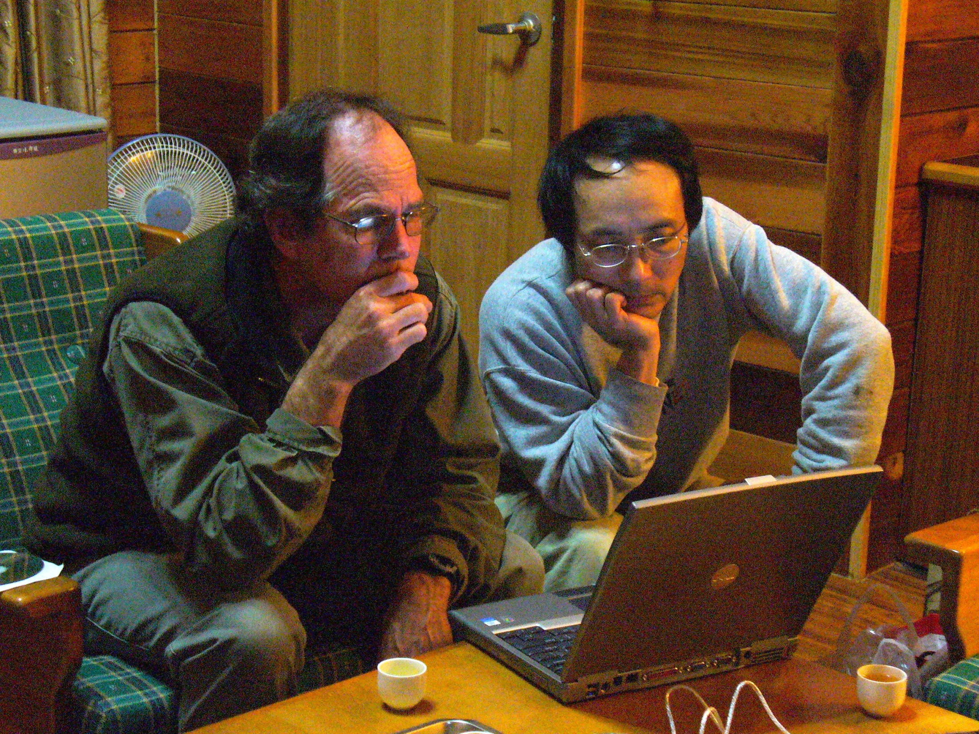
Questions?
jporter@lternet.edu
http://www.vcrlter.virginia.edu
Notes:
Thanks – especially to Chau-Chin Lin, Hen-biau King and all the other participants in the East-Asia Pacific ILTER efforts!

