Slide 1

A focus on tropical systems: international LTER research highlights from the Florida Coastal Everglades (FCE)
Tiffany Troxler, FCE LTER
LTER Research Beyond US Borders: Celebrating the 20th Anniversary of the International LTER Network (ILTER), LTER Mini-Symposium,
National Science Foundation, Arlington, VA
February 28, 2013

Slide 2
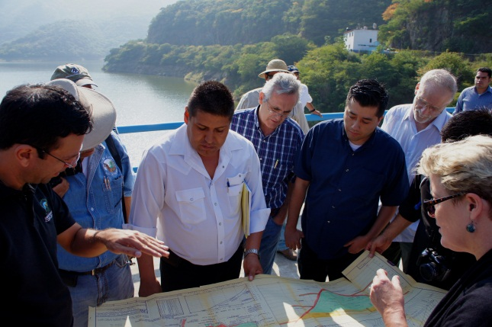
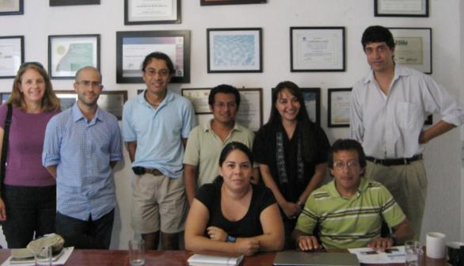
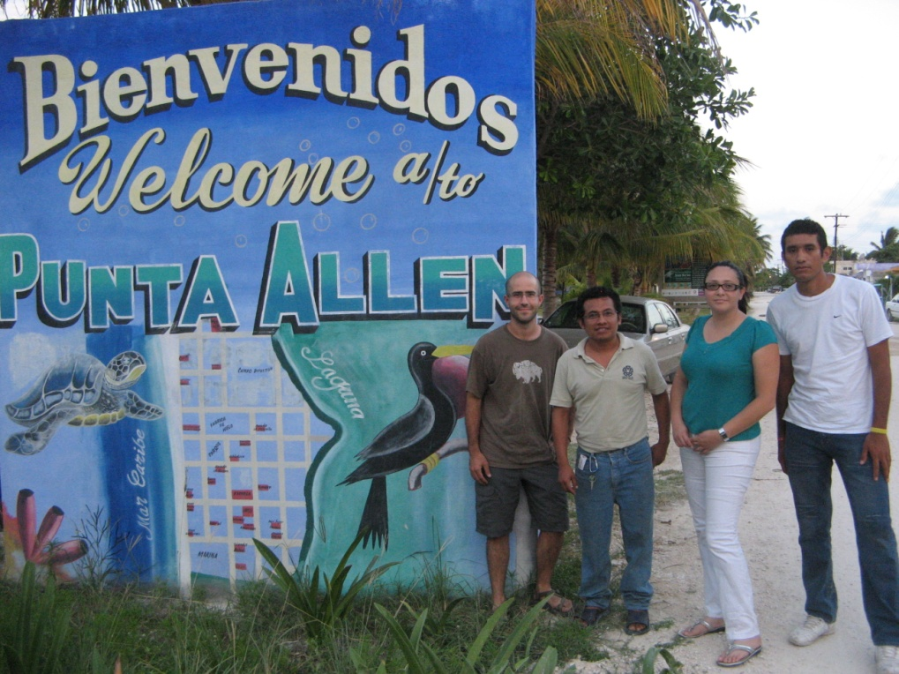
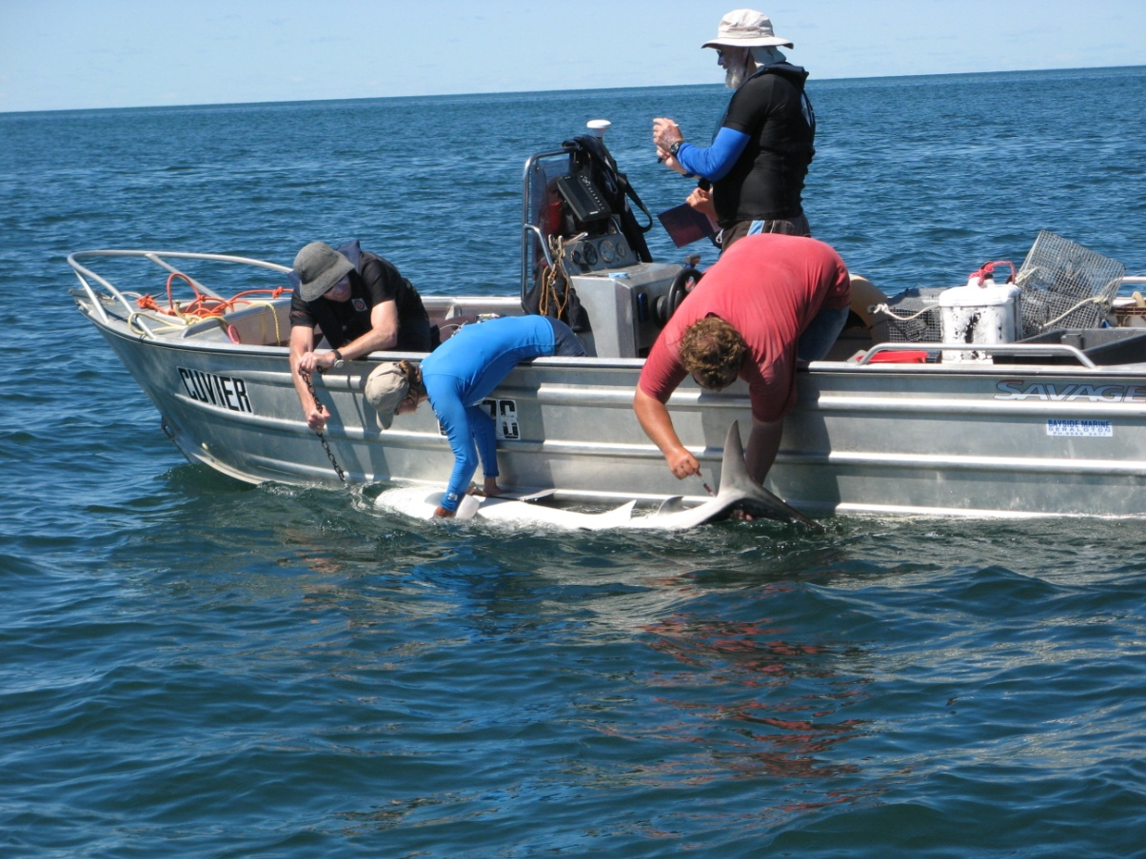
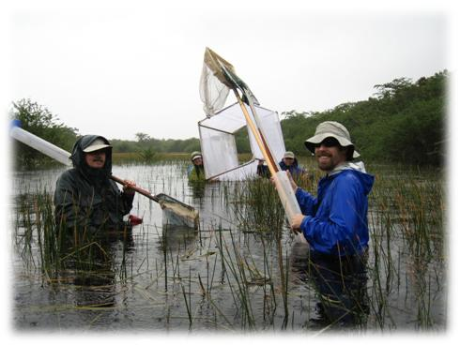
Expanding the scope for US LTER research
Leveraging international contacts developed through ILTER to expand the geographic, ecological and social scales for investigation
Broadening the platform to address new, high impact research questions and contributing to general ecological theory to explain ecosystem pattern and process
Expanded policy relevance

Slide 3
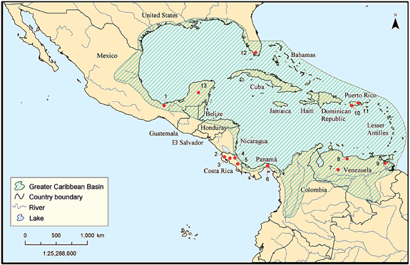
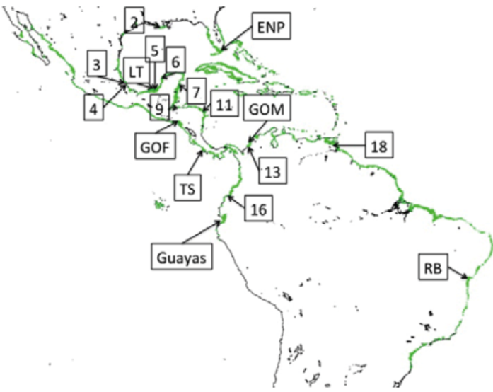
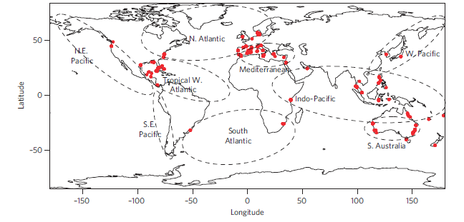
FCE collaborative research in the
Caribbean Basin and beyond
Earlier initiatives motivated by understanding the ecology of FCE ecosystems because of commonalities (Rivera-Monroy et al. 2004) as well as a perceived uniqueness (Noe et al. 2001).
Caribbean Hurricane Network
Advancing hydrogeology and ecology of the Everglades and wetland systems in general
Leveraging these relationships, this work has expanded to new initiatives, research, and student opportunities while broadening the geographic scope to the Americas as well as several recent global assessments.
Rivera-Monroy et al. 2004. A conceptual framework to develop long-term ecological research and management objectives in the wider Caribbean region. BioScience . Noe et al. 2001. Phosphorus biogeochemistry and the impact of phosphorus enrichment: Why is the Everglades so unique? Ecosystems.

Slide 4
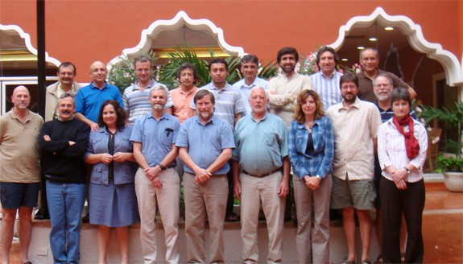
Caribbean Hurricane Network (CHurN)
In 2009, two workshops held in Mérida, Yucatán, Mexico and Miami, FL, US with 40 scientists from US and MEX LTER and collaborators from several institutions.
Discussed mechanisms for developing a coordinated network of sites to address hurricane effects and responses on a variety of coastal and terrestrial ecosystems in the wider Caribbean region.
RCN proposal submitted to coordinate future measurements and experiments to advance our understanding of systems structured by hurricanes and other kinds of disturbance.
Paper submitted.
Above: Cumulative cyclone tracks (R. Twilley) Below: Hurricane Network meeting in Merida, MX.
RCN proposal submission – Building an integrated socio-ecological Caribbean Hurricane Research Network; Rivera-Monroy et al. Submitted. The Large Spatial Footprint of Hurricane Impacts on the Yucatan Peninsula Coastal Region (Mexico): Implications for Coastal Management. Ocean and Coastal Management.

Slide 5
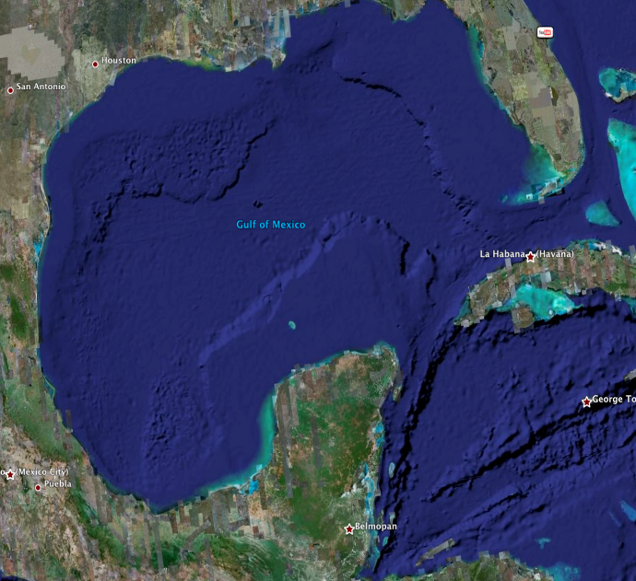



Advancing hydrological science in the Caribbean Basin
FCE-LTER researchers are collaborating with MEX LTER colleagues at two sites in the Yucatan, Mexico
Celestún Estuary
Ecosistemas Costeros de la Peninsula de Yucatan (ECOPEY) Mex-Long Term Ecological Research (LTER)
Sian Ka’an
Biosphere Reserve
Proposed MexLTER site

Slide 6


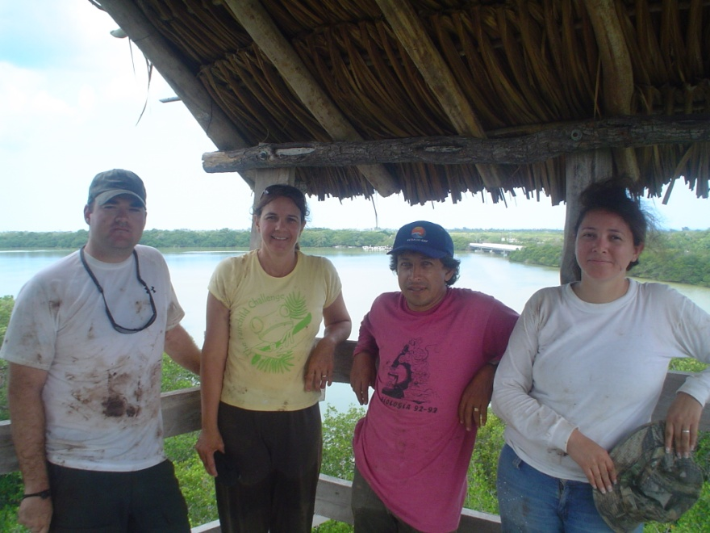
The Geochemistry of Celestun Estuary,
Yucatan, Mexico
Engaging students in international research and contributing to water sustainability goals in the Mexican Yucatan
FCE researchers and students conducted a large-scale geochemical study with MEX LTER collaborators in the Celestun Estuary lagoon following protocols developed at FCE.
Using naturally occurring tracers and stable isotopes to calculate the relative ratio inputs of fresh groundwater, brackish groundwater, and seawater to the lagoon.
Dr. René Price – FIU-FCE-LTER; Jeremy Stalker – FIU PH.D. Student; Dr. Jorge Herrera-Silveira – Centro De Investigacion y de Estudios Avanzados del IPN, Unidad Merida (CINVESTAV); Sara Morales – CINVESTAV Student; Dr. Victor Rivera-Monroy – LSU –FCE-LTER
Stalker J.C, Price, R. M, Rivera-Monroy, V. H. Herrera-Silveira, J. et al. In revision. Hydrologic Dynamics of a Subtropical Estuary Using Geochemical Tracers, Celestun, Yucatan, Mexico. Estuaries and Coasts
Notes:
Field work was conducted in Celestun Estuary in in April, 2008 and June, 2009.
We used naturally occurring tracers, the stable isotopes of oxygen and hydrogen and strontium to mixing models to calculate the relative ratio inputs of fresh groundwater, brackish groundwater, and seawater to the lagoon. Resulted in a paper submitted to Estuaries & Coasts, now in revision.
"Hydrologic Dynamics of a Subtropical Estuary Using Geochemical Tracers, Celestun, Yucatan, Mexico, Stalker J.C, Price, R. M, Rivera-Monroy, V. H. Herrera-Silveira, J., Morales, S., Benitez, J. A, Alonzo-Parra, D.

Slide 7
FCE LTER
Rainfall is the dominant source of freshwater to Biscayne Bay (50-55%) with canal inputs between 30-40% of freshwater inputs from coastline to central Bay
Fresh groundwater inputs range from 5-10% along the coastline
Stalker, J C, R. M. Price, P.K. Swart, 2009. Estuaries and Coasts
Celestun, MEX LTER
Seawater was the dominant source of water to Celestun lagoon (40-43%)
Brackish and fresh groundwater accounting for 31-35% and 25-26% of water in the lagoon with greater contribution in different parts of the lagoon.
Stalker, J C, R. M. Price, Rivera-Monroy, V. H., Herrera-Silveira, J. In revision. Estuaries and Coasts

Slide 8
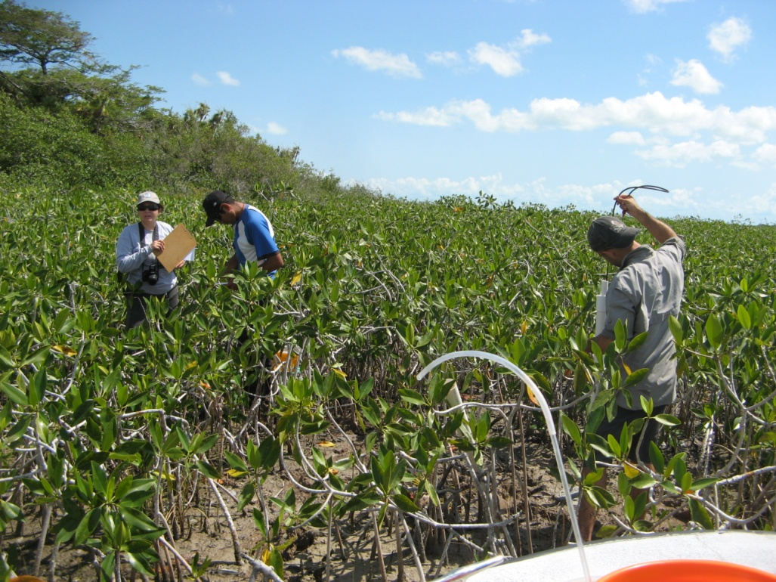
Meeting at the headquarters of Amigos de Sian Kaán in Cancun, Mexico to collaborate research on ecohydrological conditions in the Sian Ka’an Biosphere Reserve (May 7, 2012)
FIU FCE-LTER, Comisión Nacional de Áreas Naturales Protegidas (CONANP), and
Centro de Investigación y de Estudios Avanzados (CINVESTAV-Unidad Mérida)
From left to right in the back: Dr. René Price (FIU), David Lagomasino (FIU), Angel Moreno (CONANP), Juan Sosa (CINVESTAV), Yadira Gomez (CONANP). In the front row from left to right are Gonzalo Alonso (ASK) and Dr. Jorge Herrera (CINVESTAV).
FIU FCE-LTER Researchers David Lagomasino (Ph.D. Student) and René Price (Co-PI) working with students from CINVESTAV Juan Sosand, Sara Morales and Edward in Sian Ka’an

Slide 9

Special Session H08. Recent Advances in Ecohydrology of Coastal Wetlands
Session conveners include:
René Price (FIU FCE-LTER)
Fernando Miralles-Wilhelm (FIU FCE-LTER)
Shimon Wdowinski (UM FCE-LTER)
Jorge Herrera Silveira (CINVESTAV, MexLTER)
Notes:
FCE LTER researchers are co-chairing a special session with Mexican LTER researcher Jorge Herrera Silveira (CINVESTAV)
at the AGU Meeting of Americas meeting in Cancun, Mexico on 14-17 May 2013. The special session is focused on the Ecohydrology of Coastal Wetlands around the world.

Slide 10
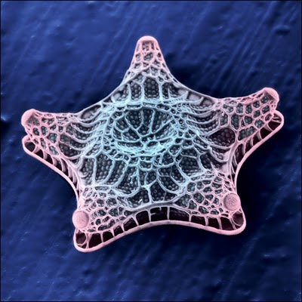
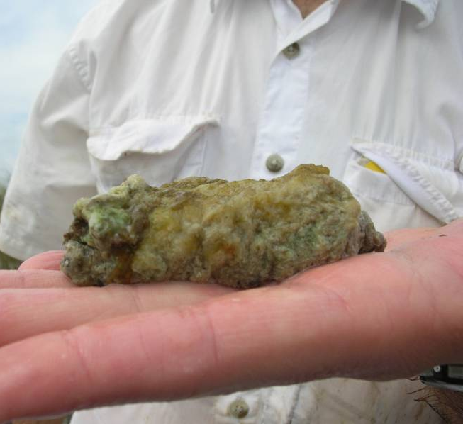
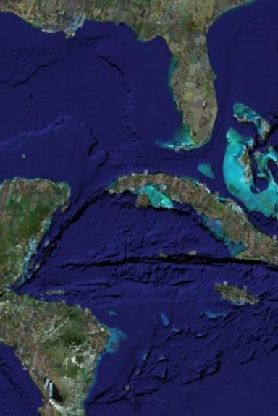
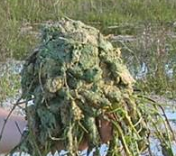
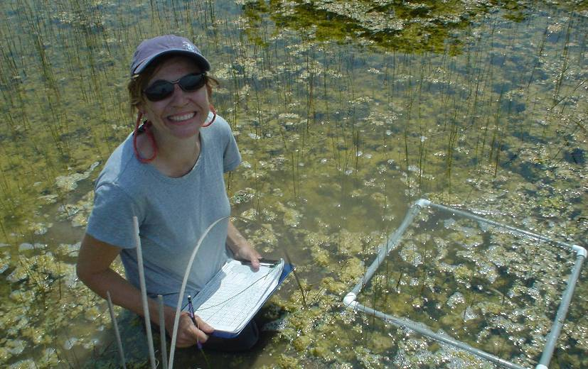
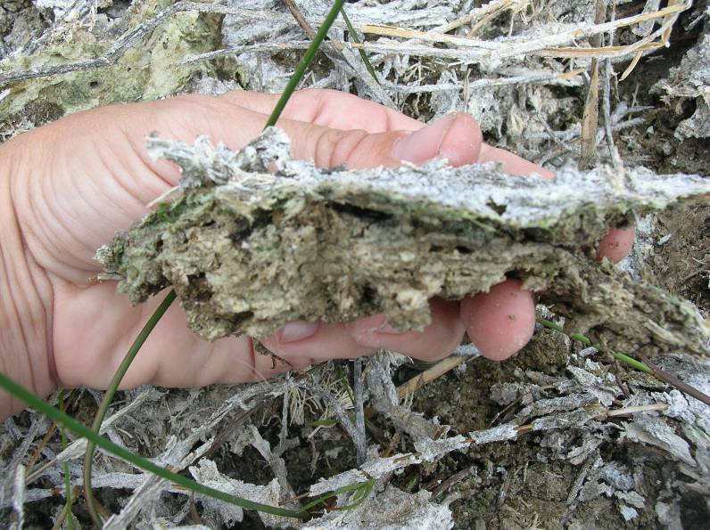
Advancing the ecology of wetland systems Karstic Wetland Periphyton
Florida Everglades
Sian Ka’an,
Mexico
New River,
Belize
Black River Morass,
Jamaica
La Hée, J. and E. Gaiser. 2012. Benthic diatom assemblages as indicators of water quality in the Everglades and three tropical karstic wetlands. Freshwater Science. 31: 205-221.
Gaiser, E., J. Trexler and P. Wetzel. 2012. The Everglades. In Batzer, D. and A. Baldwin (Eds.), Wetland Habitats of North America: Ecology and Conservation Concerns. University of California Press, Berkeley. pp. 231-252.

Slide 11
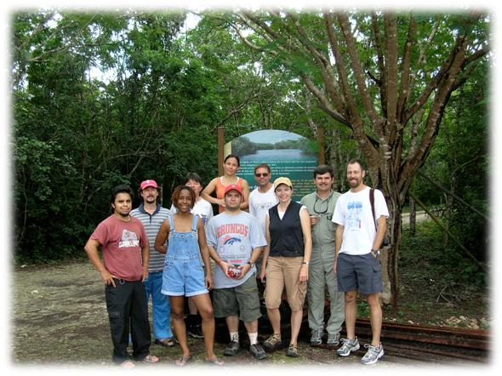
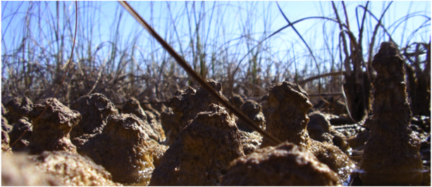

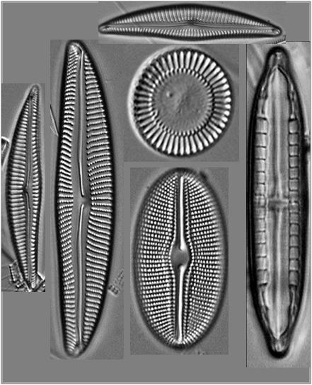
Karstic Wetland Periphyton
patterns in benthic diatom flora and food web structure
Similar ecological conditions (shallow, calcareous, phosphorus-deficient, plant species and abundance of periphyton) as the Everglades
Benthic diatom flora of marine coastal habitat in the Caribbean basin is poorly explored
Research sought to provide a broader bio-geographic context
PERIPHYTON BIOMASS & DIATOM DIVERSITY
Photo: F. Tobias
FOOD WEB STRUCTURE
Karstic wetland field team (students and post docs from FIU and UNAM, led by PIs Gaiser & Trexler) pictured here at the Sian Ka’an Biosphere Reserve in Quintana Roo, Mexico

Slide 12
How does Everglades wetland periphyton biomass & nutrient status compare among ecosystems?
g/m²
Biomass
Data from Vymazal, 1995 and Goldsborough and Robinson, 1996
√
Everglades periphyton structure resembles structure of periphyton of other karstic systems
ug/g
Phosphorus
High periphyton biomass
Low periphyton phosphorus content
Effluent
Lakes
Ponds
Rivers
Streams
Marshes
Everglades
Canada
Salt Marshes
Caribbean
Artificial Stream

Slide 13

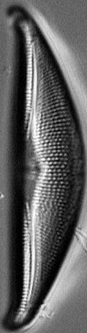



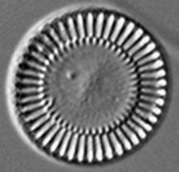

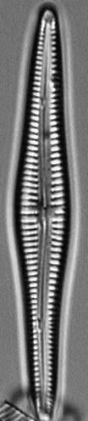
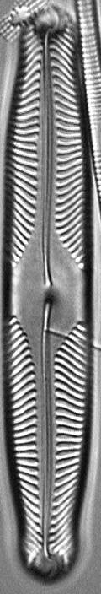
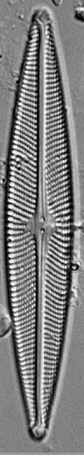
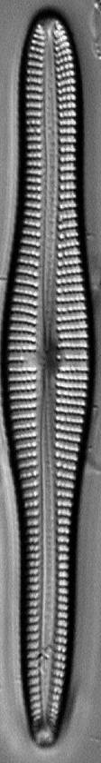
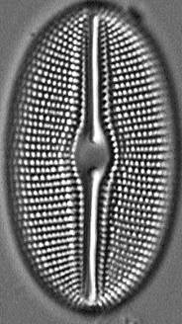





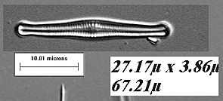
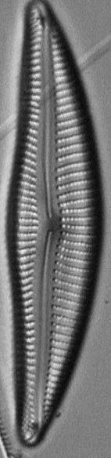
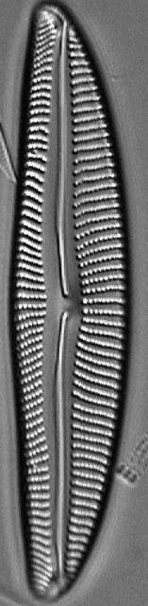

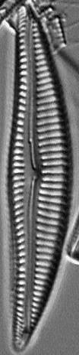



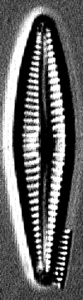
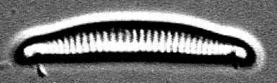
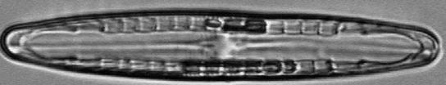
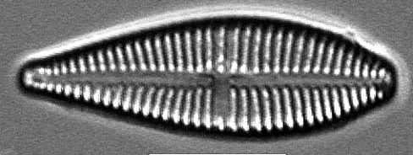

Is Everglades periphyton also compositionally similar among karstic systems but unique as compared to other wetlands?
Alpha Diversity (spp/sample)
60
40
20
0
Other
Wetlands
Everglades
Caribbean
Canada
unique
novel
distinctive?
√

Slide 14
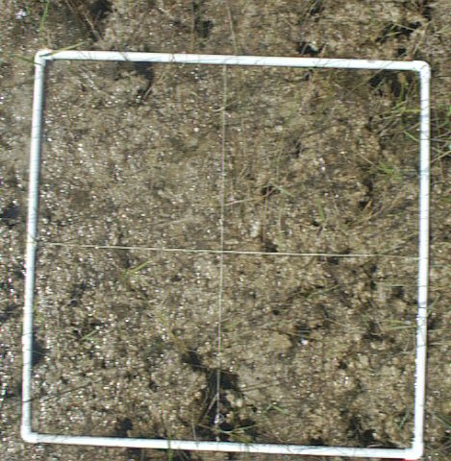
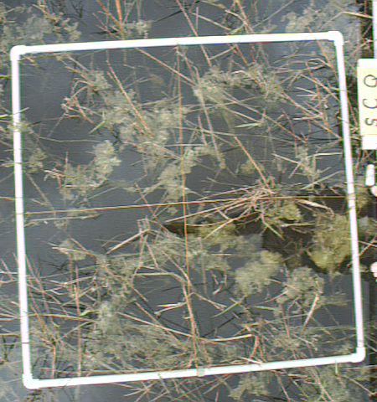
Is low P status linked to patterns in biomass and diversity?
g/m²
Biomass
ug/g
Phosphorus
+ 30 ppb TP
Lakes
Rivers
Effluent
Ponds
Canada
Marshes
Streams
Caribbean
Salt Marshes
Everglades
Artificial Stream
Everglades +P

Slide 15
Phosphorus enrichment in P-deficient, low diversity assemblages leads to unique species assemblages
Species per sample
60
40
20
0
Other
Wetlands
Canada
Caribbean
Everglades
Everglades +P
unique
novel
distinctive?
√

Slide 16

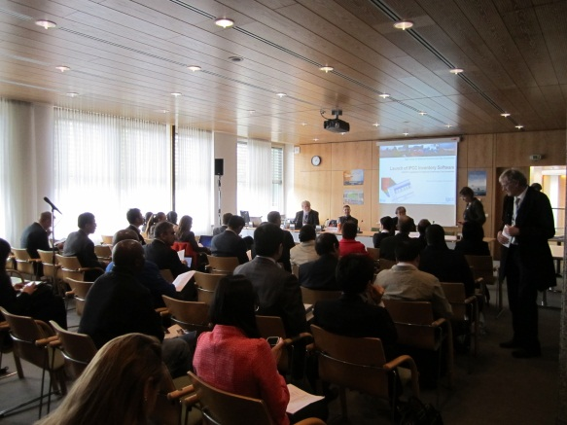
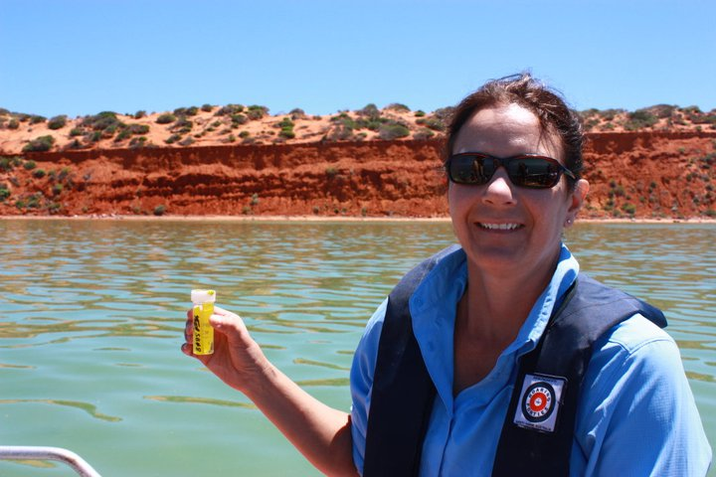
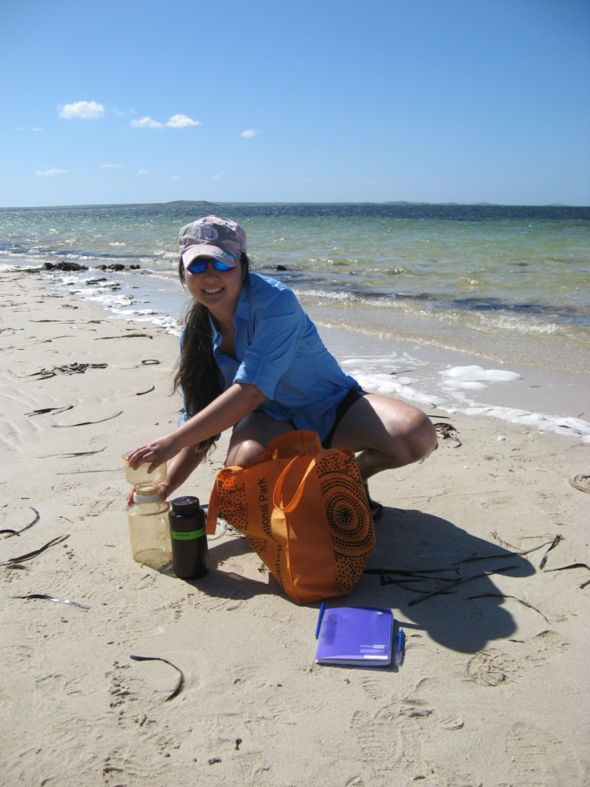
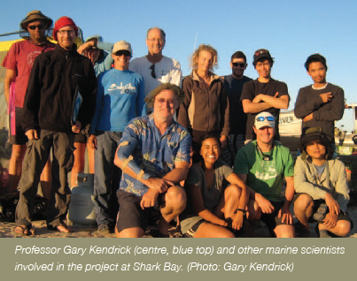
Broadening the scope and socio-ecological context of US LTER research to the Americas and the globe

Slide 17
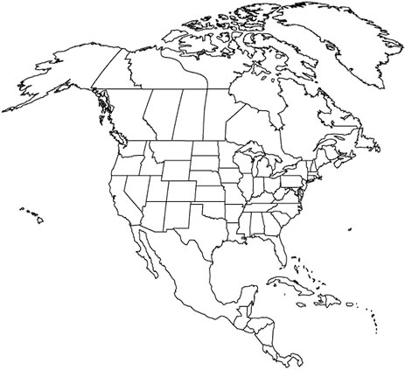



US-Mexico Workshop: Catalyzing international collaborations to develop a platform for ecohydrological research
Chamela, Jalisco, Mexico, October 2012; Bill McDowell, PI
Examine how climatic conditions, geology, and social systems drive the balance of two primary ecosystem services in aquatic systems: 1) water abstraction to serve direct human needs and 2) maintenance of aquatic ecosystems to support aquatic biota and other ecosystem services provided by a functioning aquatic ecosystem in paired US and MEX LTER sites chosen to cover a range of bioclimatic conditions.
Some variables included:
Precipitation
Temperature
Discharge
Soil
Land Use
Population (effective population of water users)
Economic Activities (industrial, agricultural)
32 participants from 12 MEX and US LTER sites – Chamela, Alchichica, Manantlan, Mapimi, Ecopey, Gracilis, CAP, LUQ, FCE, CWT, SEV
www.worldatlas.com/webimage/countrys/na.htm

Slide 18
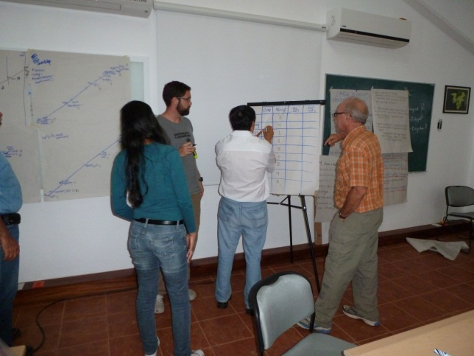
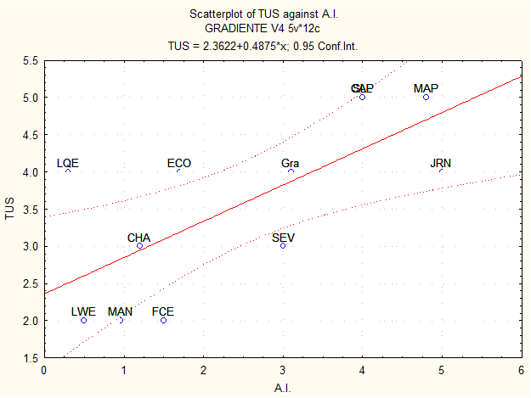
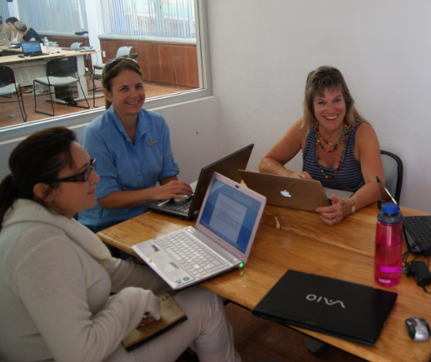
US-Mexico Workshop: Catalyzing international collaborations to develop a platform for ecohydrological research
Chamela, Jalisco, Mexico, September 2012
How do biophysical and social attributes facilitate or limit the ability to build the resilience of social ecological systems such that sustainability of water is ensured in the face of internally and externally driven changes?
Preliminary analyses that stratified each of the sites by social and ecological indices revealed strong patterns in, for example, aridity and water use. This gradient approach was proposed for development as manuscript and proposal.
Notes:
Preliminary analyses that stratified each of the sites by social and ecological indices revealed strong patterns in, for example, aridity and water use. The approach, to develop a matrix of indices to characterize these sites was proposed as the basis for a socio-ecological research. – Need to include the proposal name and PI and co-Pis, participants – 2 slides

Slide 19
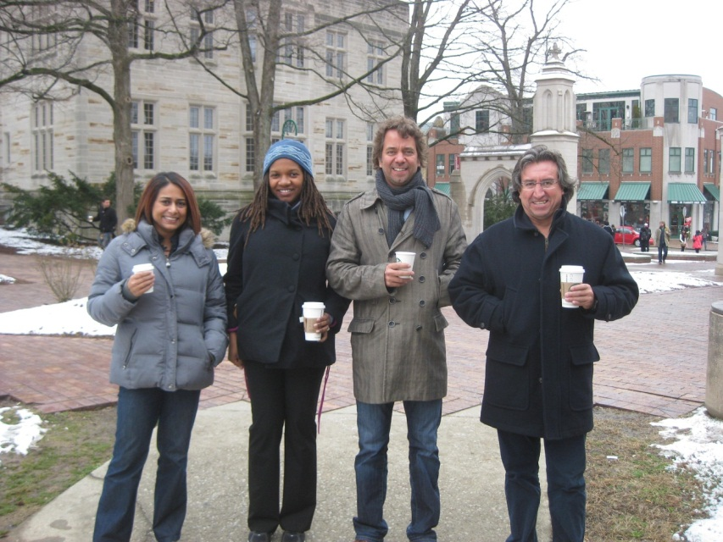
Vulnerability Assessment of Mangroves in the Americas
Marc Simard (Jet Propulsion Laboratory), Rinku Roy-Chowdhury (Indiana University & FCE), Temilola Fatoyinbo (Goddard Space Flight Center), Victor- H. Rivera-Monroy (Louisiana State University & FCE)
We will develop spatially explicit models of mangrove forest vulnerability across North, Central and South America by integrating socioeconomic coarse datasets and local surveys with multi-sensor remote sensing of mangrove use and cover change.
Extensive studies of mangrove forests (derived from remote sensing) will be coupled with commensurate, extensive ecological and social (census) datasets for the 17 regions, and used to develop regional-scale models of mangrove vulnerability.
Intensive assessments will be conducted for calibration and validation of the regional-scale models, relating socioeconomic activity with local changes in mangrove forest use and cover.
From L to R: Rinku Roy-Chowdhury (Indiana University & FCE); Temilola Fatoyinbo (NASA-Goddard Space Flight Center) Marc Simard (Jet Propulsion Laboratory) Victor- H. Rivera-Monroy (Louisiana State University & FCE)
Funded by NASA’s Land Cover Land Use Change Program (Spring 2012-Winter 2015)

Slide 20
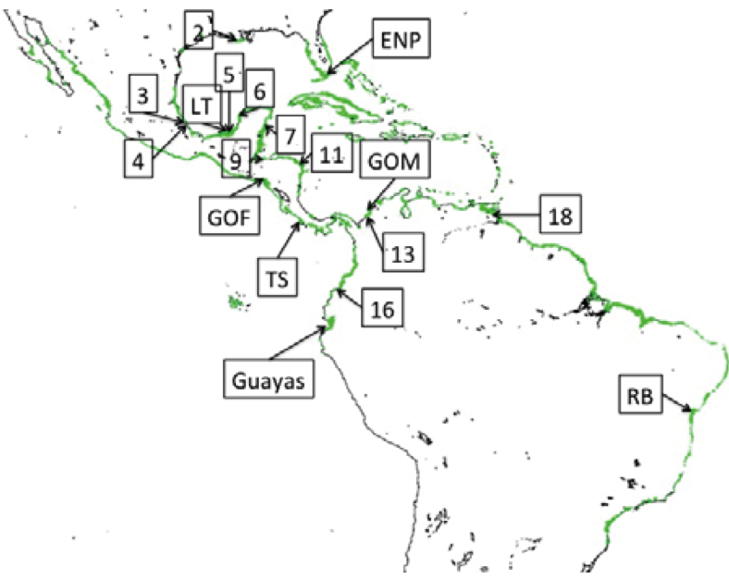
Vulnerability Assessment of Mangroves in the Americas
To develop the model of mangrove use/loss, we leveraged our existing collective databases, collaborations and expertise, and selected two nested sets of sites for extensive (17) and intensive (7) sampling, representing a wide range of socio-demographic, economic, policy and ecogeomorphic contexts found throughout the Americas.
MEX-LTER
Intensive Sites | Planned dates for field campaigns
Celestun/Campeche | August 2012
Brazil (Caraguatuba region) | November 2012
Golfo de Morosquillo, Colombia | 2013
Terraba Sierpe, Costa Rica | 2013
Everglades National Park, USA | ongoing
Guayas, Ecuador | 2013
Gulf of Fonseca, Honduras | 2014
FCE LTER
Planned ILTER
Funded by NASA’s Land Cover Land Use Change Program (Spring 2012-Winter 2015)
Notes:
We will develop spatially explicit models of mangrove forest vulnerability across North, Central and South America by integrating socioeconomic coarse datasets and local surveys with multi-sensor remote sensing of mangrove use and cover change.
The models will synthesize the relationships among remote sensing derived parameters, including the type of change (i.e. the proximate source: mangrove conversion to shrimp ponds, agriculture, urban expansion) and its extent (e.g. loss, degradation, volume), with the driver of that change (e.g., eco-climatic characteristics, sea level rise, climate events, population growth, local/global markets for fisheries or agricultural commodities, policies, land tenure, etc). The mangrove vulnerability models will be developed through a nested approach, entailing the compilation of existing spatially extensive socioeconomic datasets (e.g., census), for 17 regions, and field-based social and ecological surveys for spatially intensive assessments of mangrove uses and their drivers in a smaller subset of 7 regions. The remote sensing aspect of the proposal is spatially exhaustive as it will cover all mangrove regions of the Americas. To provide useful models of mangrove vulnerability, the remote sensing data products will be coupled with ancillary social and biophysical data capturing multi-scalar drivers of forest use and change.

Slide 21
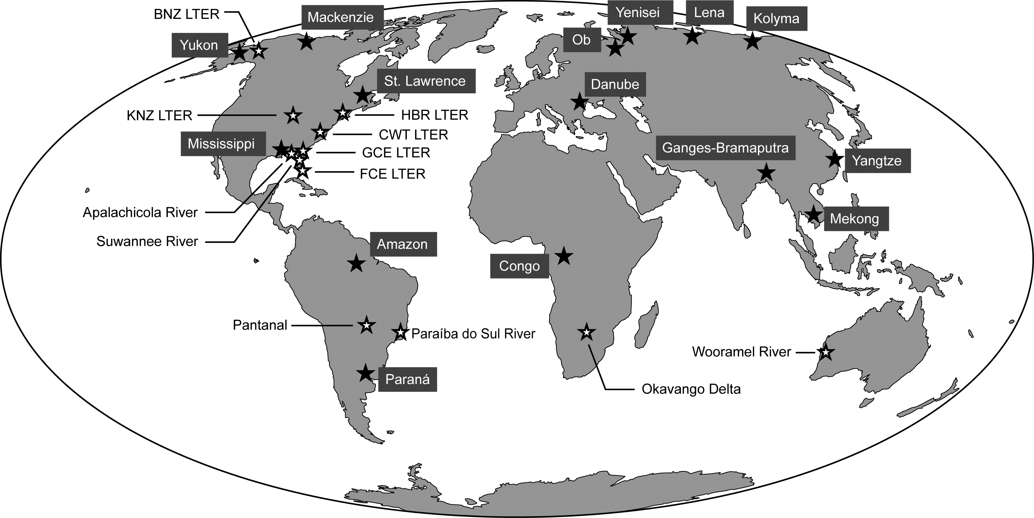
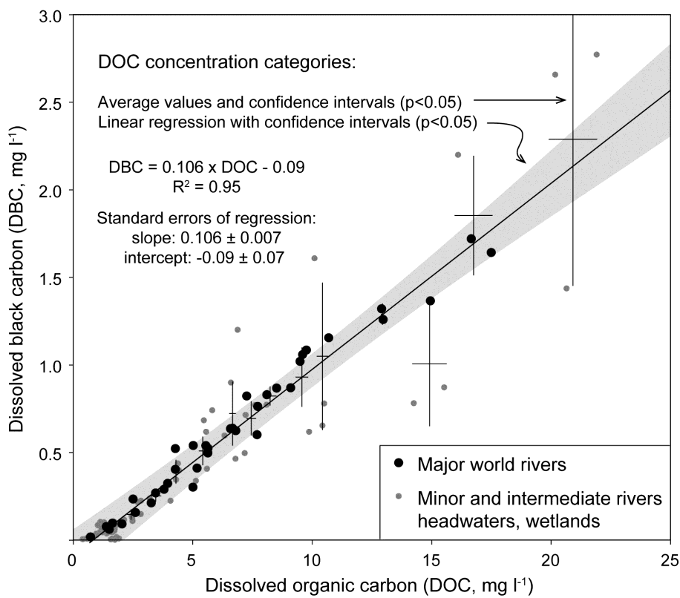
Global pattern of Dissolved Organic Carbon and
Dissolved Black Carbon
(Jaffe, Ding, Niggemann, Vähätalo, Stubbins, Spencer, Campbell, Dittmar, Science, draft)
Charcoal from biomass burning is less stable in the environment than often assumed, because a major fraction of the global production leaches out of soils and is transported to the oceans
quantified dissolution products of charcoal in a wide range of rivers worldwide
globally a major portion of the annual charcoal production is lost from soils via dissolution and subsequent transport to the ocean
global flux of soluble charcoal = 26.5 ± 1.8 million tons per year, ~10% of the global riverine flux of DOC
closes a major gap in the global charcoal budget

Slide 22


James Fourqurean (FCE) and Karen McGlathery (VCR) along with international collaborators gathered organic carbon data from over 900 seagrass meadows around the world.
the amount of carbon stored per unit area of seagrass meadow is equivalent to forests
Notes:
James Fourqurean (FCE LTER) and Karen McGlathery (VCR) along with international collaborators gathered
organic carbon data from over 900 seagrass meadows around the world. In a recent paper in Nature Geosciences, they concluded that the amount of Carbon stored per unit area of seagrass meadow is equivalent to forests.

Slide 23

Broadening the relevance and impact of LTER Science – increasingly vital to addressing global policy issues
Since FCE I, our research has been broadened and enhanced through collaboration with the ILTER through large-scale investigations and high impact research not otherwise possible
The US research community can overcome difficulties inherent to understanding ecosystem drivers, patterns and processes with an approach that leverages collaborative initiatives and continues to develop long-term research with the ILTER
These collaborations broaden the ecological, geographical and social contexts that enable long-term, broad-scale interdisciplinary studies necessary to reduce uncertainties and predict change. For example, the Global Land Project has recently recognized and endorsed the ILTER

Slide 24
Broadening the relevance and impact of LTER Science – increasingly vital to addressing global policy issues
Intergovernmental Panel on Climate Change (IPCC) Task Force on National Greenhouse Gas Inventories (TFI)
Develops methodological guidance and data synthesis reports for use by countries to quantify and report national-scale net GHG emissions associated with anthropogenic activities including land use and land-use change
Data synthesized provides global values of annual net CO₂, CH₄, and N₂O fluxes disaggregated by, for example, climate, soil type, and management activity for land use change assessments
The IPCC TFI has also developed an “Emission Factor Database” http://www.ipcc-nggip.iges.or.jp/EFDB/) that provides updated and country-specific data for improved data quality and national-level estimates and is endorsed by the United Nations Framework Convention on Climate Change
National Inventory Reports contribute to national mitigation and emission reduction plans
Leveraging data products within US LTER and among international LTER Networks will contribute vital ecosystem research for addressing critical global policy issues, advance research and education beyond what could otherwise be accomplished and continue to engender globally-engaged US scientists

Slide 25
Acknowledgments
Contributions for this talk were made by Victor Rivera-Monroy, Rene Price, Evelyn Gaiser and Rudolf Jaffe
Funding for FCE LTER and several of the research projects and initiatives highlighted here is provided by the
US National Science Foundation

