Slide 1



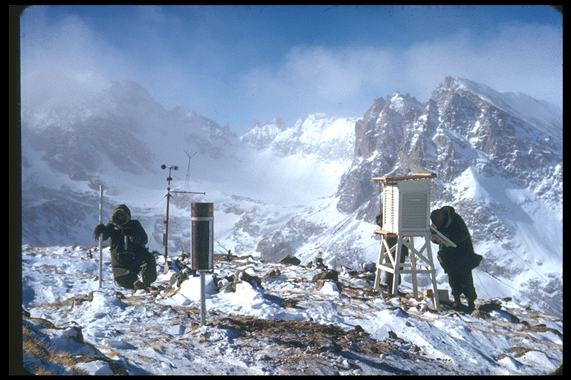
Establishing the International Mountain
LTER Network
Mark Williams, University of Colorado

Slide 2
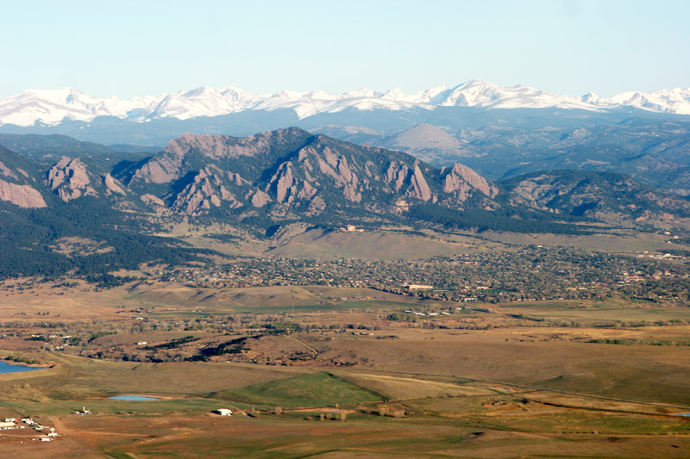
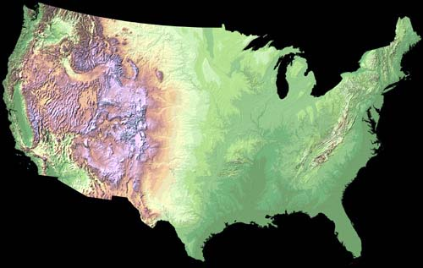
LTER Mountain Initiative: Resilience and Sustainability of Complex Mountain Landscapes
Organizations: US LTER, ILTER, MRI, LTER Europe, GBMA, and CML RCN

Slide 3
Overview
Why mountains are important
Italian LTER
Nepal-ILTER Italian-NWT LTER
Nepal-PEER award
High Asia (USAID funding)
Mountain LTER initiative

Slide 4
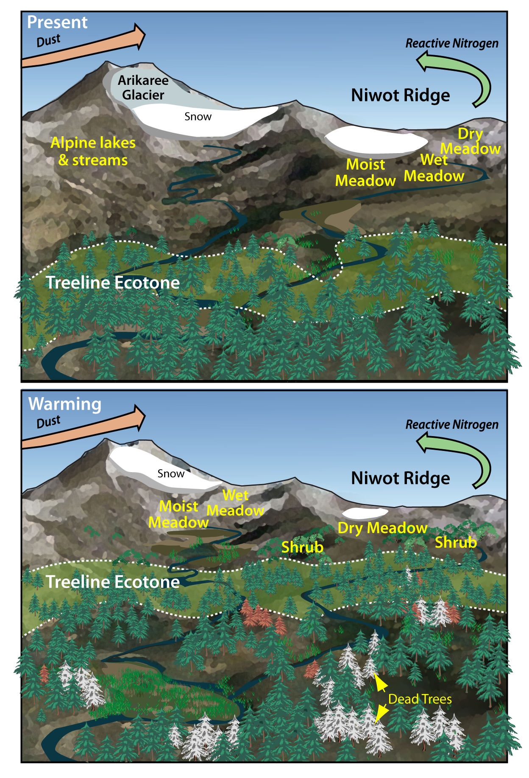
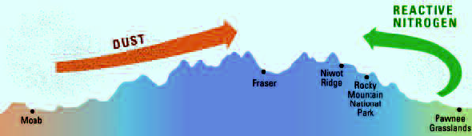
Mountains are
early-warning
sentinels
NEON
CZO
Ameriflux
DOE
WSC
CHN
Robertson et al. 2012

Slide 5

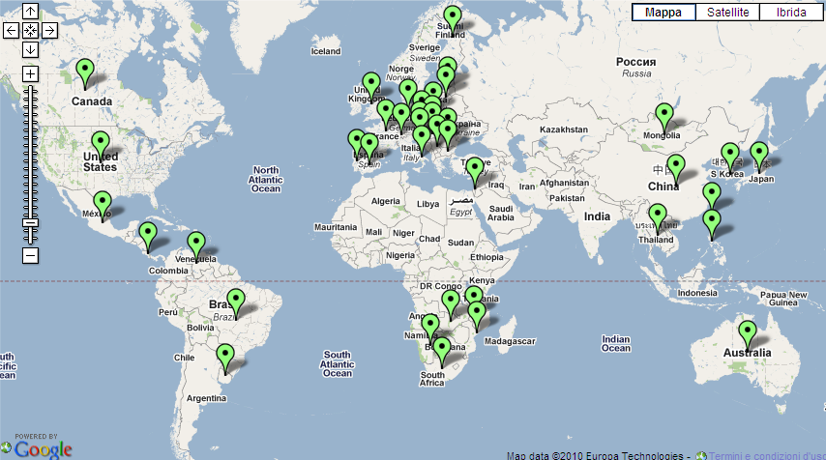
ILTER Sites
2. L’attività di ricerca nella Rete LTER
NWT LTER analogues are with other mountain sites around world

Slide 6
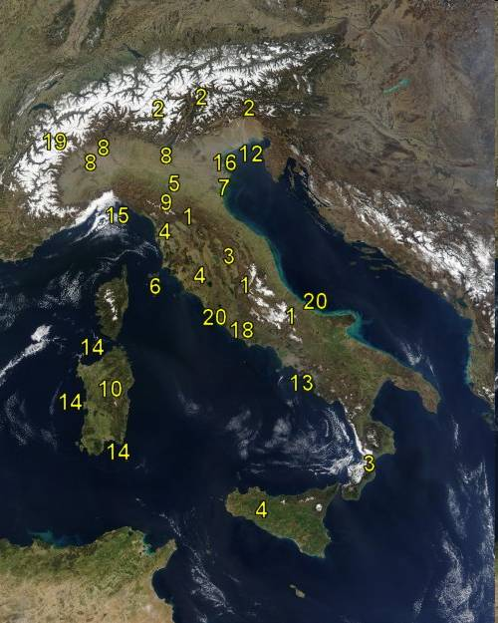
2. L’attività di ricerca nella Rete LTER
LTER - Italy
www.lteritalia.it
20 sites
Research stations also in Antarctica, K2, and Everest
Since 2008: “High elevation sites in the Northwestern Alps”
NWT LTER helped start those sites

Slide 7



Funding
Italian Environmental Regional Agency and National Research Council

Slide 8
Overview
The role of seasonal snow
Thermal insulator for soil
Trigger for soil biological activity
Specific microbial communities, high microbial biomass, significant C and N transformations in soil, emission of CO₂ and N₂O
What are the main processes involving soil C and N?
What is the magnitude of pools and fluxes?
What parameters control such fluxes?
Notes:
Moreover the snow acts as a insulator for the subnivean soil. Snow has an insulation capacity that is 6 times more effective than soils, for equivalent depths. If the snowpack is deep enough to provide insulation, the geothermal heat from the underground may warm the soil up to 0°C, regardless how cold is the air temperature. Therefore, soils under the snowcover accumulating early in the winter may have surface temperature at 0°C for many months during winter. This relatively warm and fairly constant environment promotes biological activity in soil.
Several studies have demonstrated that responsible for this high biological activity is a specific microbial community, philogenetically and phisiologically distinct from that of the growing season, that can reach its maximum biomass under the snow pack and that can contribute to significant transformations of C and N compounds, including the emission of CO2 and N2O. CO2 emissions in these ecosystems have been quite deeply studied, while N2O emission has not received the same attention. Contrastingly, subalpine peatland dynamics during the winter season have been poorly studied.
The questions that we will try to answer are:
Which are the main processes involving C and N? What is the magnitude of the pools and the fluxes? What parameters control fluxes and transformations?

Slide 9
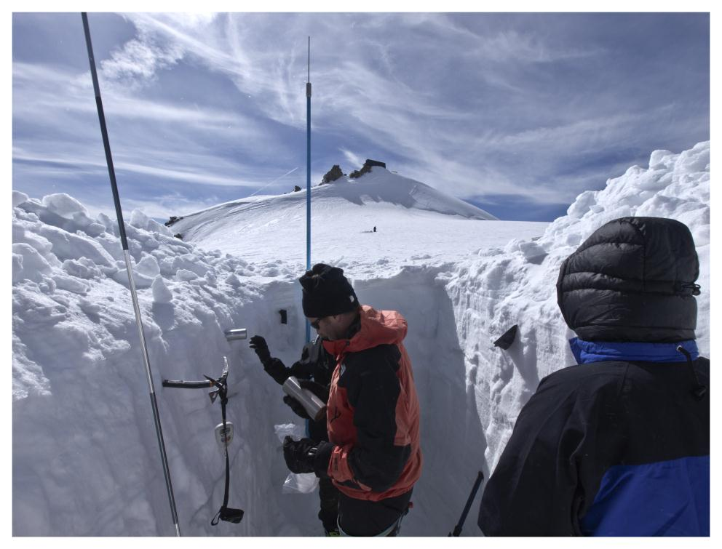
Snowpit near summit of Monte Rosa
Mountain hut in background

Slide 10
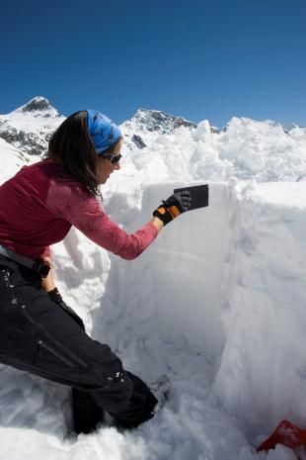
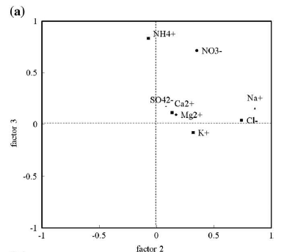
Snow chemistry: Aosta Valley near Mt Blanc
Filippa G., Freppaz M., Williams M.W., Zanini E. (2010) Major element chemistry in inner alpine snowpacks (Aosta valley Region, NW Italy) Cold Regions Science and Technology. doi:10.1016/j.coldregions.2010.07.005

Slide 11
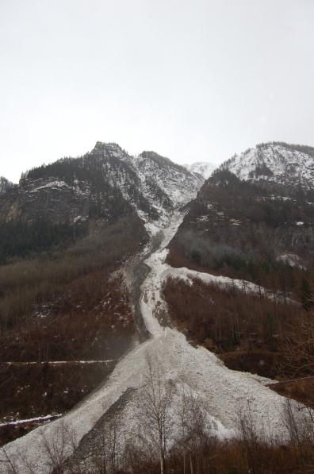
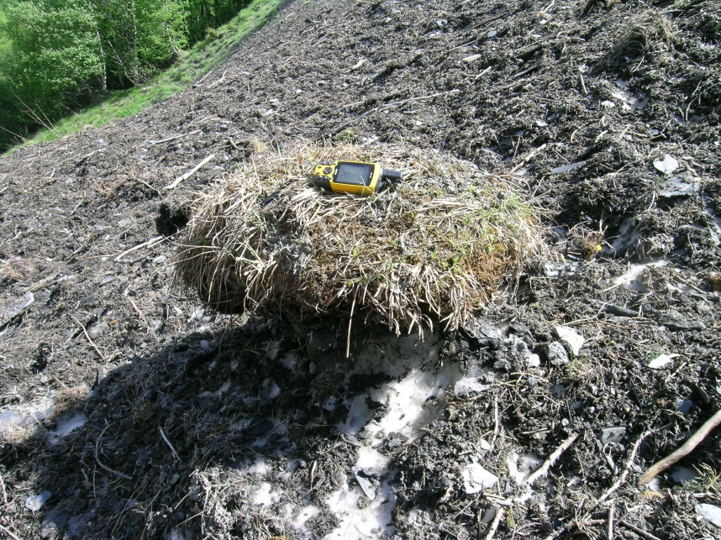
Avalanches and soil formation
Avalanches can transport soil and sediment over an elevational range of 1,000 m or more.
Soil formation? C-N cycling?

Slide 12
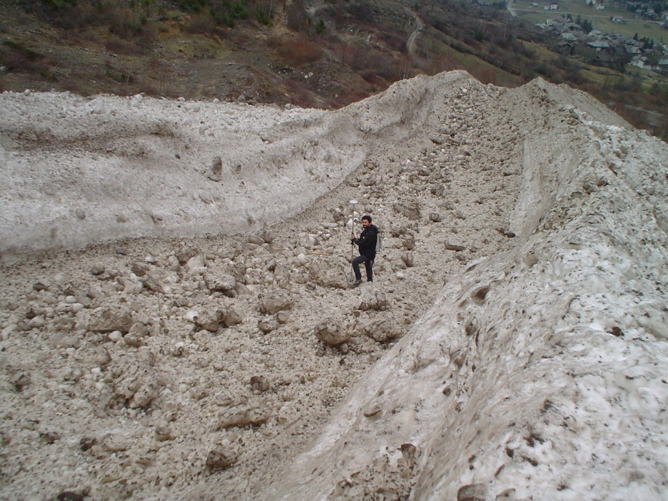
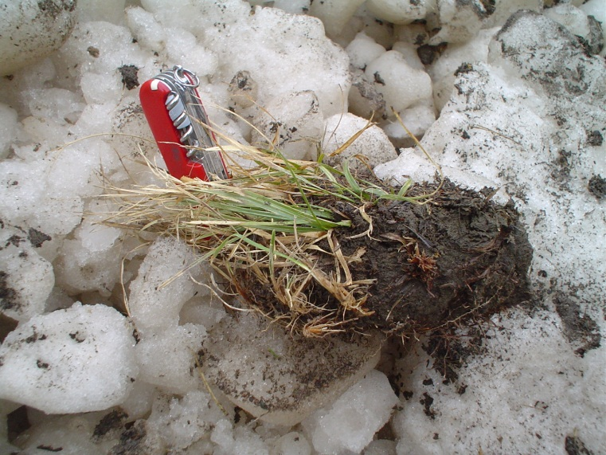

Avalanches an important soil forming factor
March, 2007
Freppaz M., Godone G., Filippa G., Maggioni M., Lunardi S., Williams M.W., Zanini E. (2010) Soil Erosion Caused by Snow Avalanches: a Case Study in the Aosta Valley (NW Italy). Arctic, Antarctic, and Alpine Research, Vol. 42, No. 4: 412–421

Slide 13
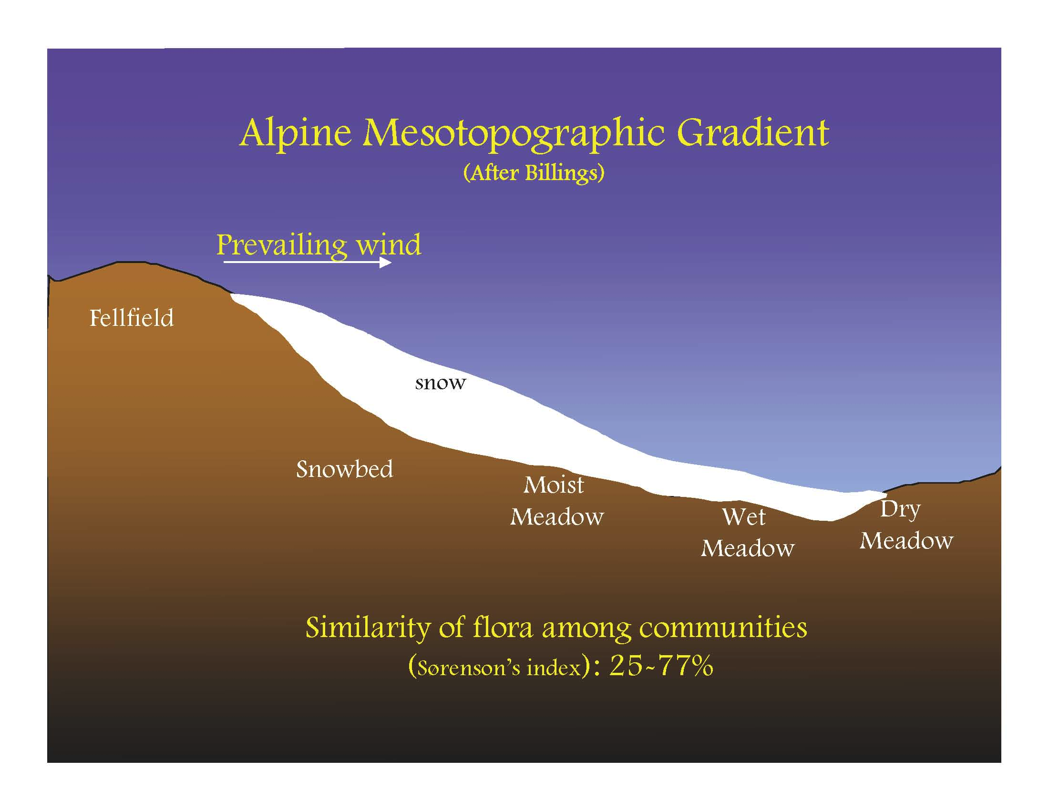
NWT LTER: Snow/plant interactions

Slide 14
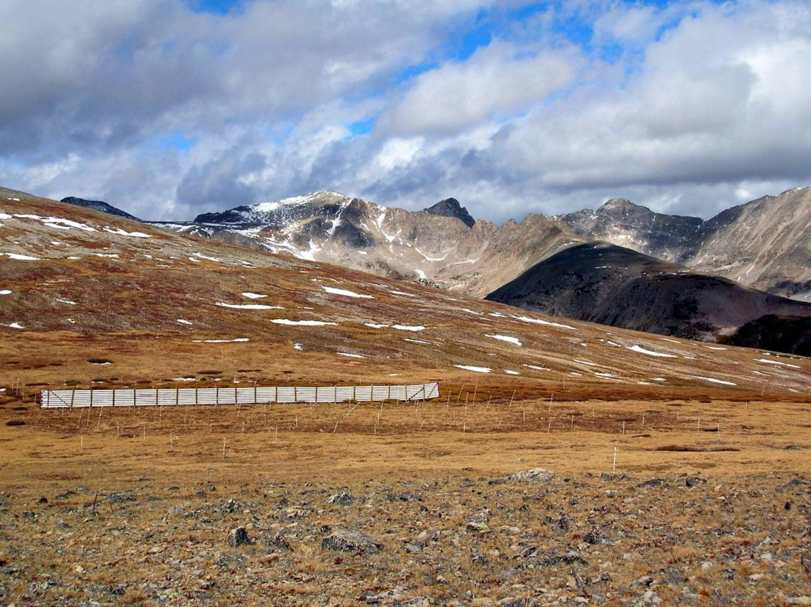
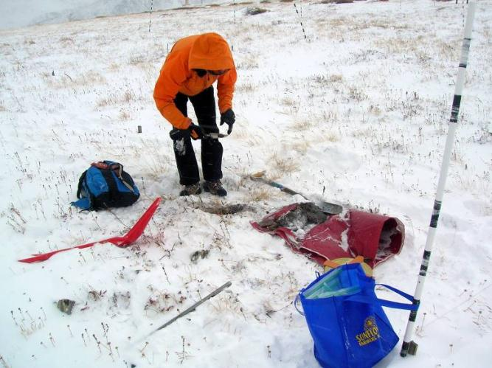


Saddle Snow Fence Experiment: 16 years
Does snow affect soil formation?

Slide 15
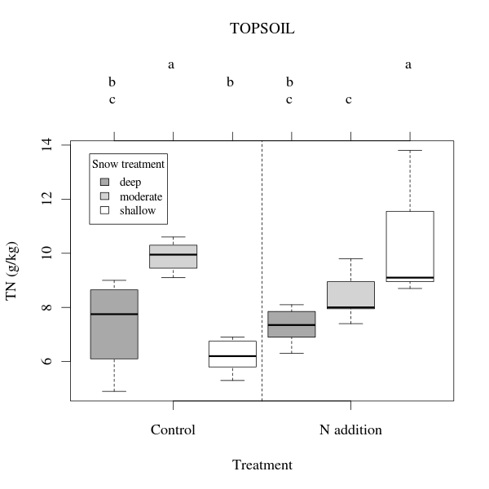
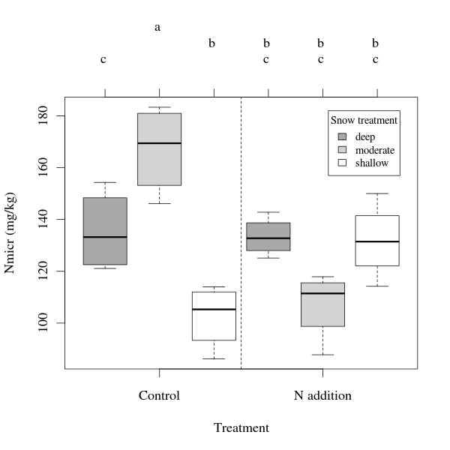
Differences in snow accumulation patterns over 16 years resulted in large and significant differences in soil nutrients
bc a b bc c a
Michele Freppaz∗, Mark W. Williams, Timothy Seastedt, Gianluca Filippa,
Response of soil organic and inorganic nutrients in alpine soils to a 16-year factorial
snow and N-fertilization experiment, Colorado Front Range, USA,
Applied Soil Ecology xx (2012) in press

Slide 16
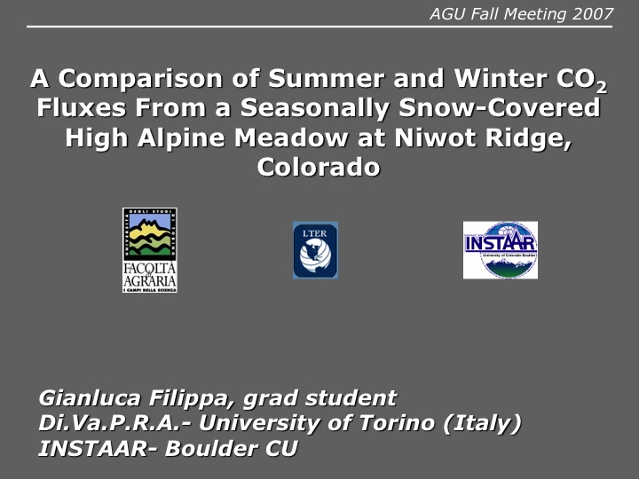
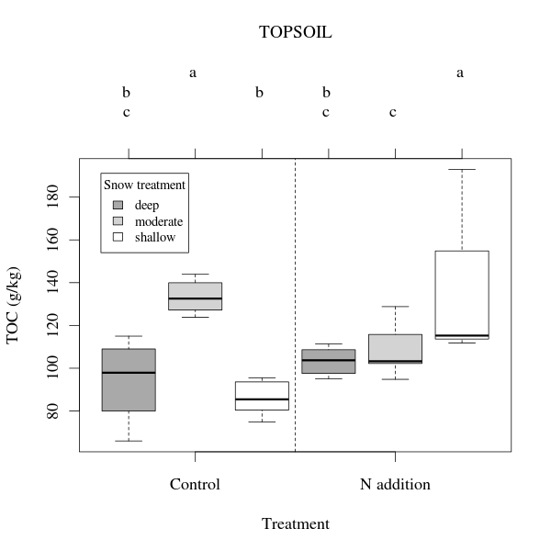
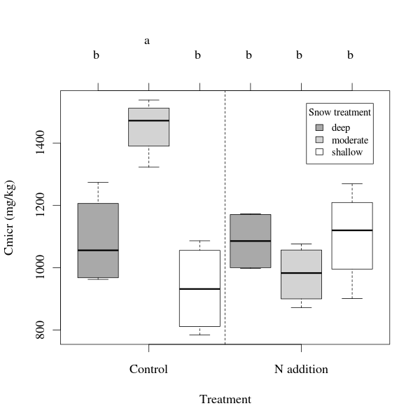
NWT SNOW FENCE
bc a b bc c a
Freppaz M, Williams MW, Seastedt T, Filippa G (2012) Response of soil organic and inorganic nutrients in alpine soils to a 16-year factorial snow and N-fertilization experiment, Colorado Front Range, USA. Appied Soil Ecology 62: 131-141

Slide 17
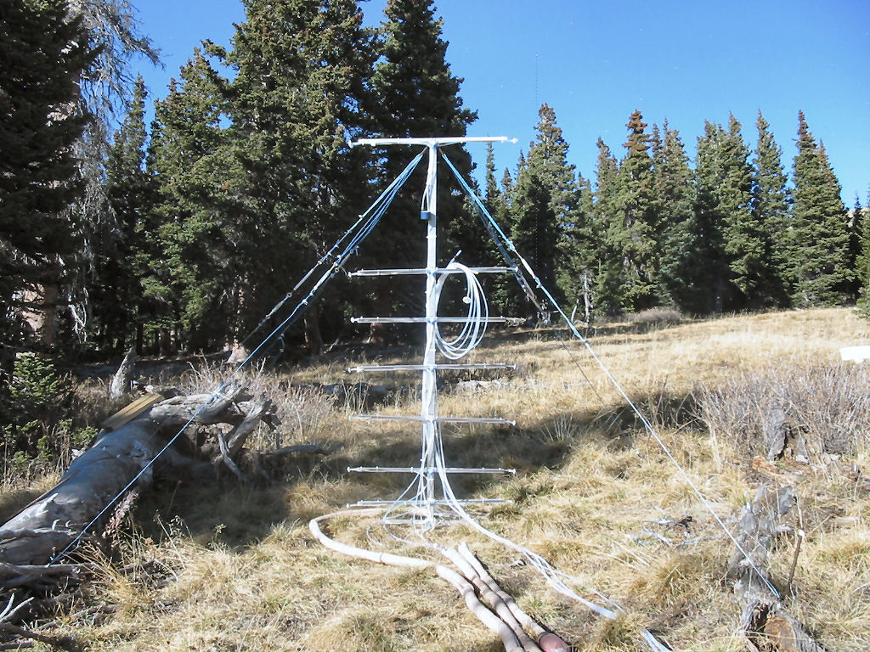
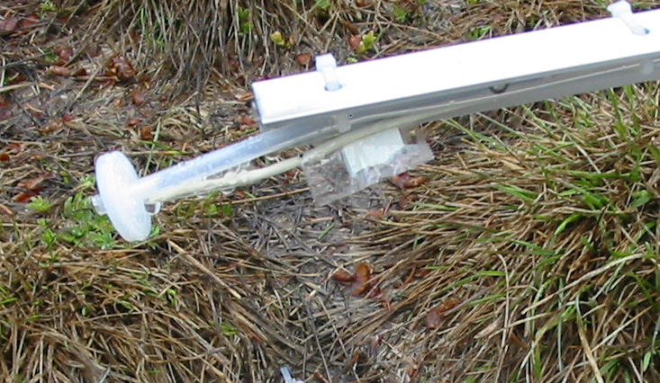
sampling inlet w/ syringe filter
245 cm
thermocouple
150 cm
120 cm
90 cm
60 cm
30 cm
10 cm
0 cm
from the ground
sampling line goes to underground lab
Notes:
The following is the snowpack gas sampling tower installed in an open meadow area at the Soddie. The sampling tower consists of 16 sampling inlets with each pair at 8 different levels.
The sampling lines goes to an underground lab where our gas analyzers, datalogger, and valve controls are stored.
Each of the sampling inlets are fitted with a syringe filter to prevent debris from entering the sampling line as you can see in the photo in the upper-right hand corner here. We also have thermocouples installed at each level to measure the temperature at each of those heights in the snowpack.
Since we only have one instrument for each gas species we are sampling (i.e. one CO2 instrument for measuring CO2), we are cycling through the each inlet pairs from top to bottom at 10-minute intervals. One complete cycle takes 80 minutes.
Our system—here—is completely automated, allowing us to continuously sample gases in the snowpack 24/7; and with this setup, no surrounding snow was disturbed throughout the entire season.

Slide 18
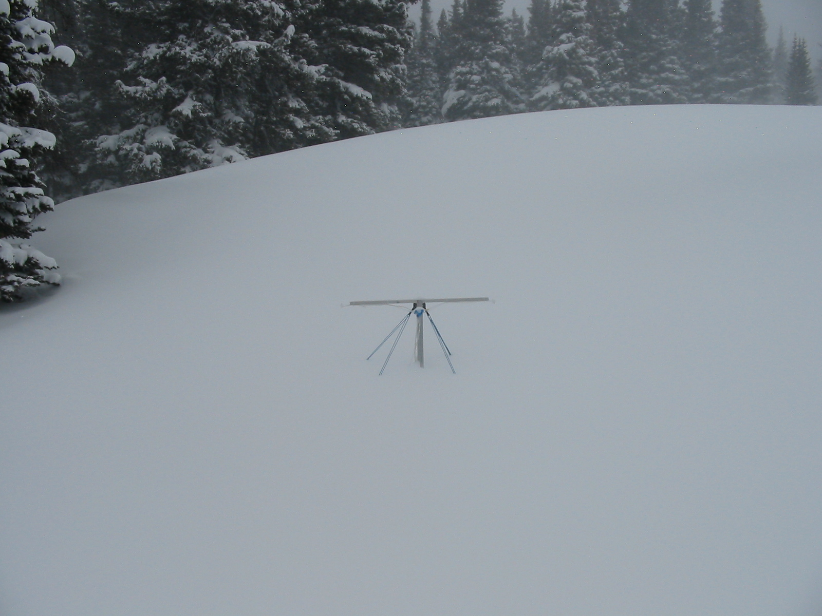
On March 11, 2007, we had...
202 cm of snow~!
Notes:
Here is a photo of what the Soddie looks like in mid-March. This is to show you how much snow we get (or can get) in that area during the winter.
In the following slides, I will show you the results from our CO2 measurements.

Slide 19

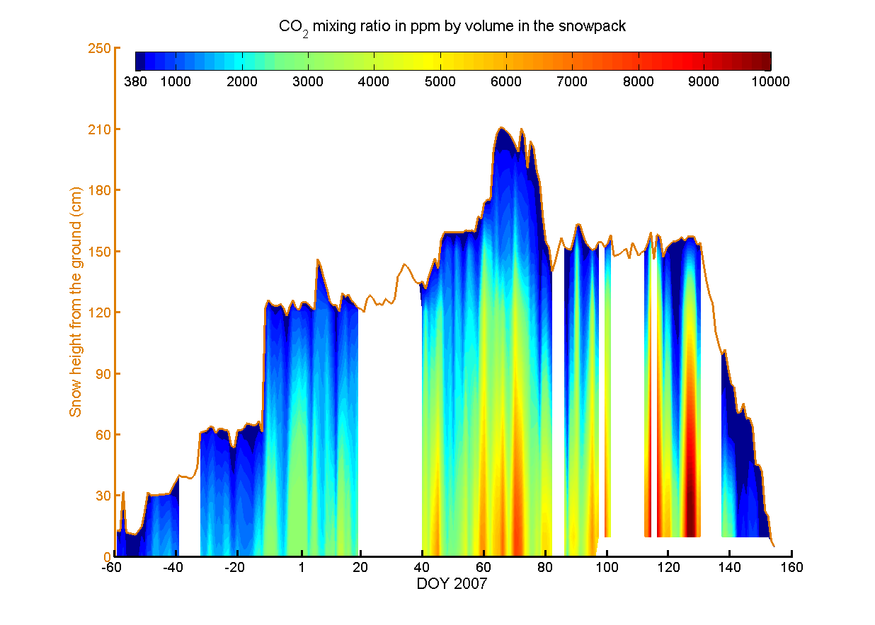
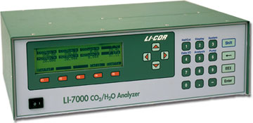
ambient
Wow~!
10,000 ppm?!
Wow~!
10,000 ppm?!
380 ppm
Notes:
This is a timeseries plot of the CO2 mixing ratio profile in the snowpack. The x-axis is the time in day of year 2007. The negative day of year values mean days in 2006. The cappuccino colored y-axis denotes the snow height from the ground in centimeters, so the matching colored line in the plot—here—is the snow height. The color gradient is the CO2 mixing ratio in parts per million by volume. Notice that the color bar scale goes from ambient (380 ppm) to 10,000 ppm. We used this instrument by LICOR to monitor the CO2 levels in the snowpack.
What is significant in this figure? Well, notice the contrast of the CO2 level in the snowpack between the snow surface and within the snowpack. The snow surface is near ambient (380 ppm) while the lower layer near the ground is much greater as evident in the color gradient between top and bottom.
Now, I want you to look at the mid-May period. CO2 level is at 10,000 ppm near the ground. If anyone has seen CO2 mixing ratios greater than this in any forest snowpack, please let me know!
One thought on why CO2 mixing ratios are greater near the ground than the snow surface is due to microbial and plant/tree root respiration, which are promoted by the warmth and moisture the snowpack provides, especially from this deep subalpine snowpack. Our snowpack turns isothermal during day 70, supplying more moisture to the soil via snow melt-water.
To our flux calculation.

Slide 20
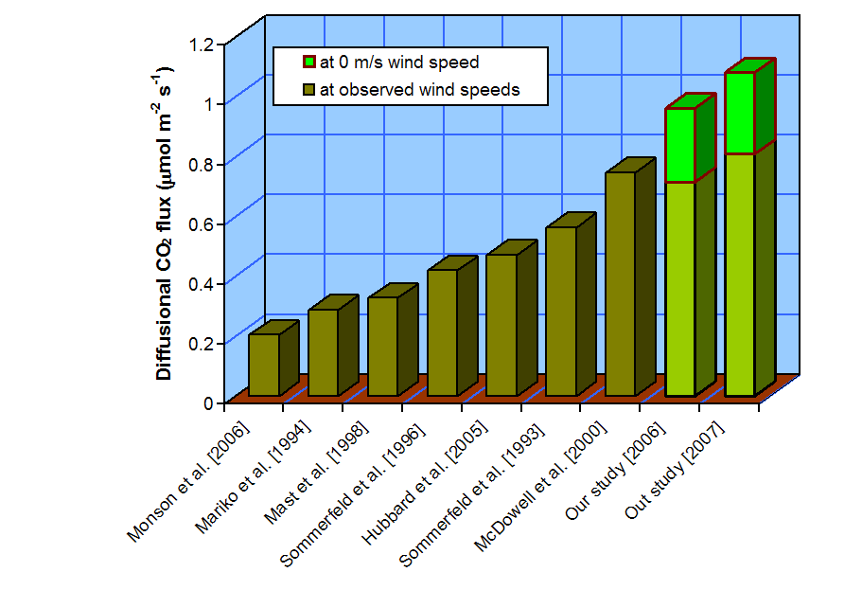
Reported diffusional CO₂ flux from measured concentration gradients in snow in evergreen coniferous forests. Modified from Suzuki et al. [2006]
Our Study [2006]
Our Study [2007]
Seok et al 2009
Filippa et al 2009
Notes:
If we compare our CO2 flux values with other studies, our CO2 fluxes are generally greater for either corrected or uncorrected for wind.
There are a few explanation for this.
Our study site, the Soddie, is a possible hotspot for soil respiration in the area. It lies in the path of a water drainage basin making the soil more moist than its surrounding.
The Soddie soil in the summer is under extreme stress of dryness and large temperature variations (hot during the day and cold at night). But in the winter, due to the deep snowpack, it keeps the soil conditions more constant with moisture (through snowmelt water) and temperature (warmth) promoting soil respiration. So, winter soil respiration should be greater than that in the summer. Our next speaker will demonstrate this point.
Our measurements were taking in an open meadow rather than under canopy. There are evidence that under canopy soil is drier and more nutrient deficient than the open due to the trees.
There maybe a measurement bias. Most studies use a chamber method to obtain the CO2 flux, which is non-continuous, short-term, and disturbs the snowpack during sampling. With the chamber method, it is possible by to constantly sample during periods when CO2 flux is either above or below normal. But our method is continuous, long-term, and does not change the snowpack. So, we are able to see the variations and filter it out through averaging the entire season.

Slide 21
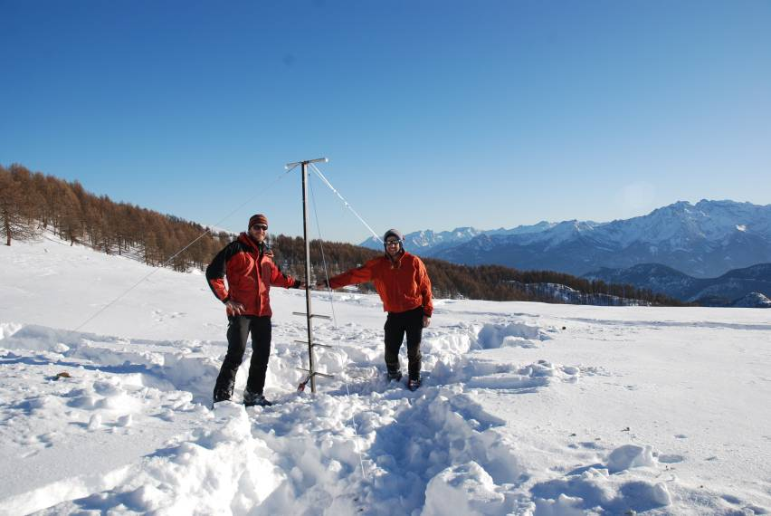
Using NWT LTER method for measuring trace gas fluxes through snow at Italian mountain LTER sites
NWT LTER methods incorporated in Italian LTER mountain sites

Slide 22
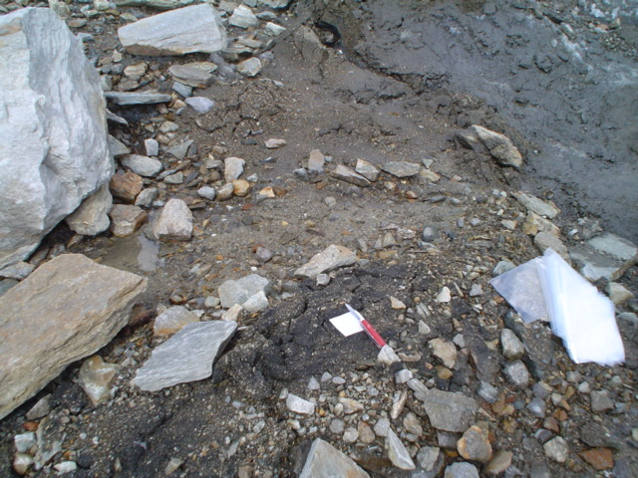
Indren Glacier and OM: Italian LTER

Slide 23
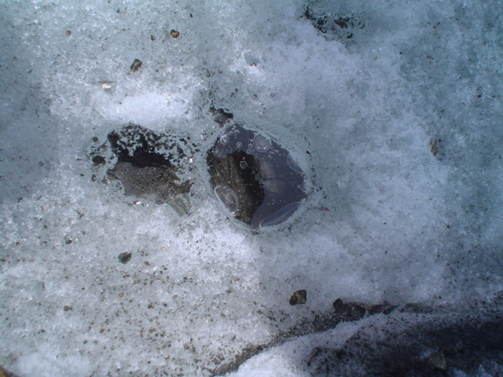
Cryoconite holes in Italy
Fountain et al., McMurdo Dry Valley LTER

Slide 24
Italians using state-of-the-art biological markers to characterize DOC that NWT LTER is learning
Freppaz M., Williams M.W., Gabrieli J., Gorra R., Ascher J., Zanini E., Celi L. Organo-mineral deposits in a glacier foreland of the Alps (Indren Glacier, NW Italy) submitted to Quaternary Research

Slide 25
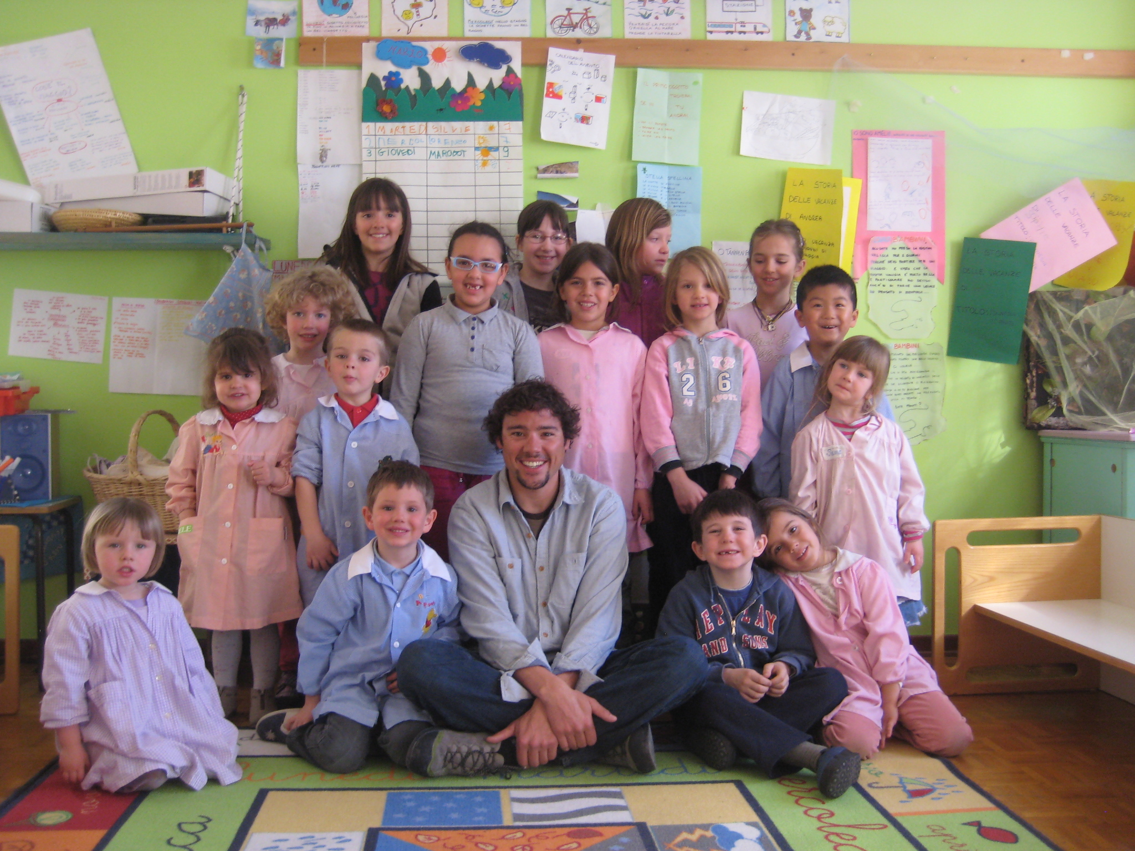
Teaching English to 3-6 year olds, Aosta Valley

Slide 26
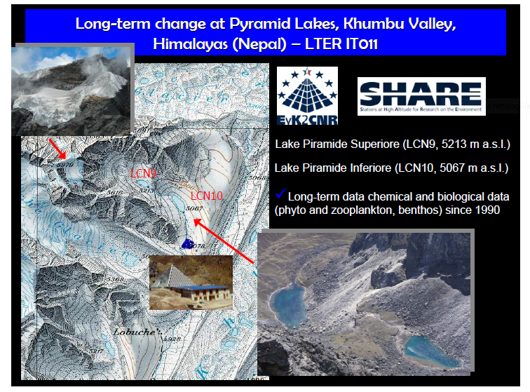

Slide 27
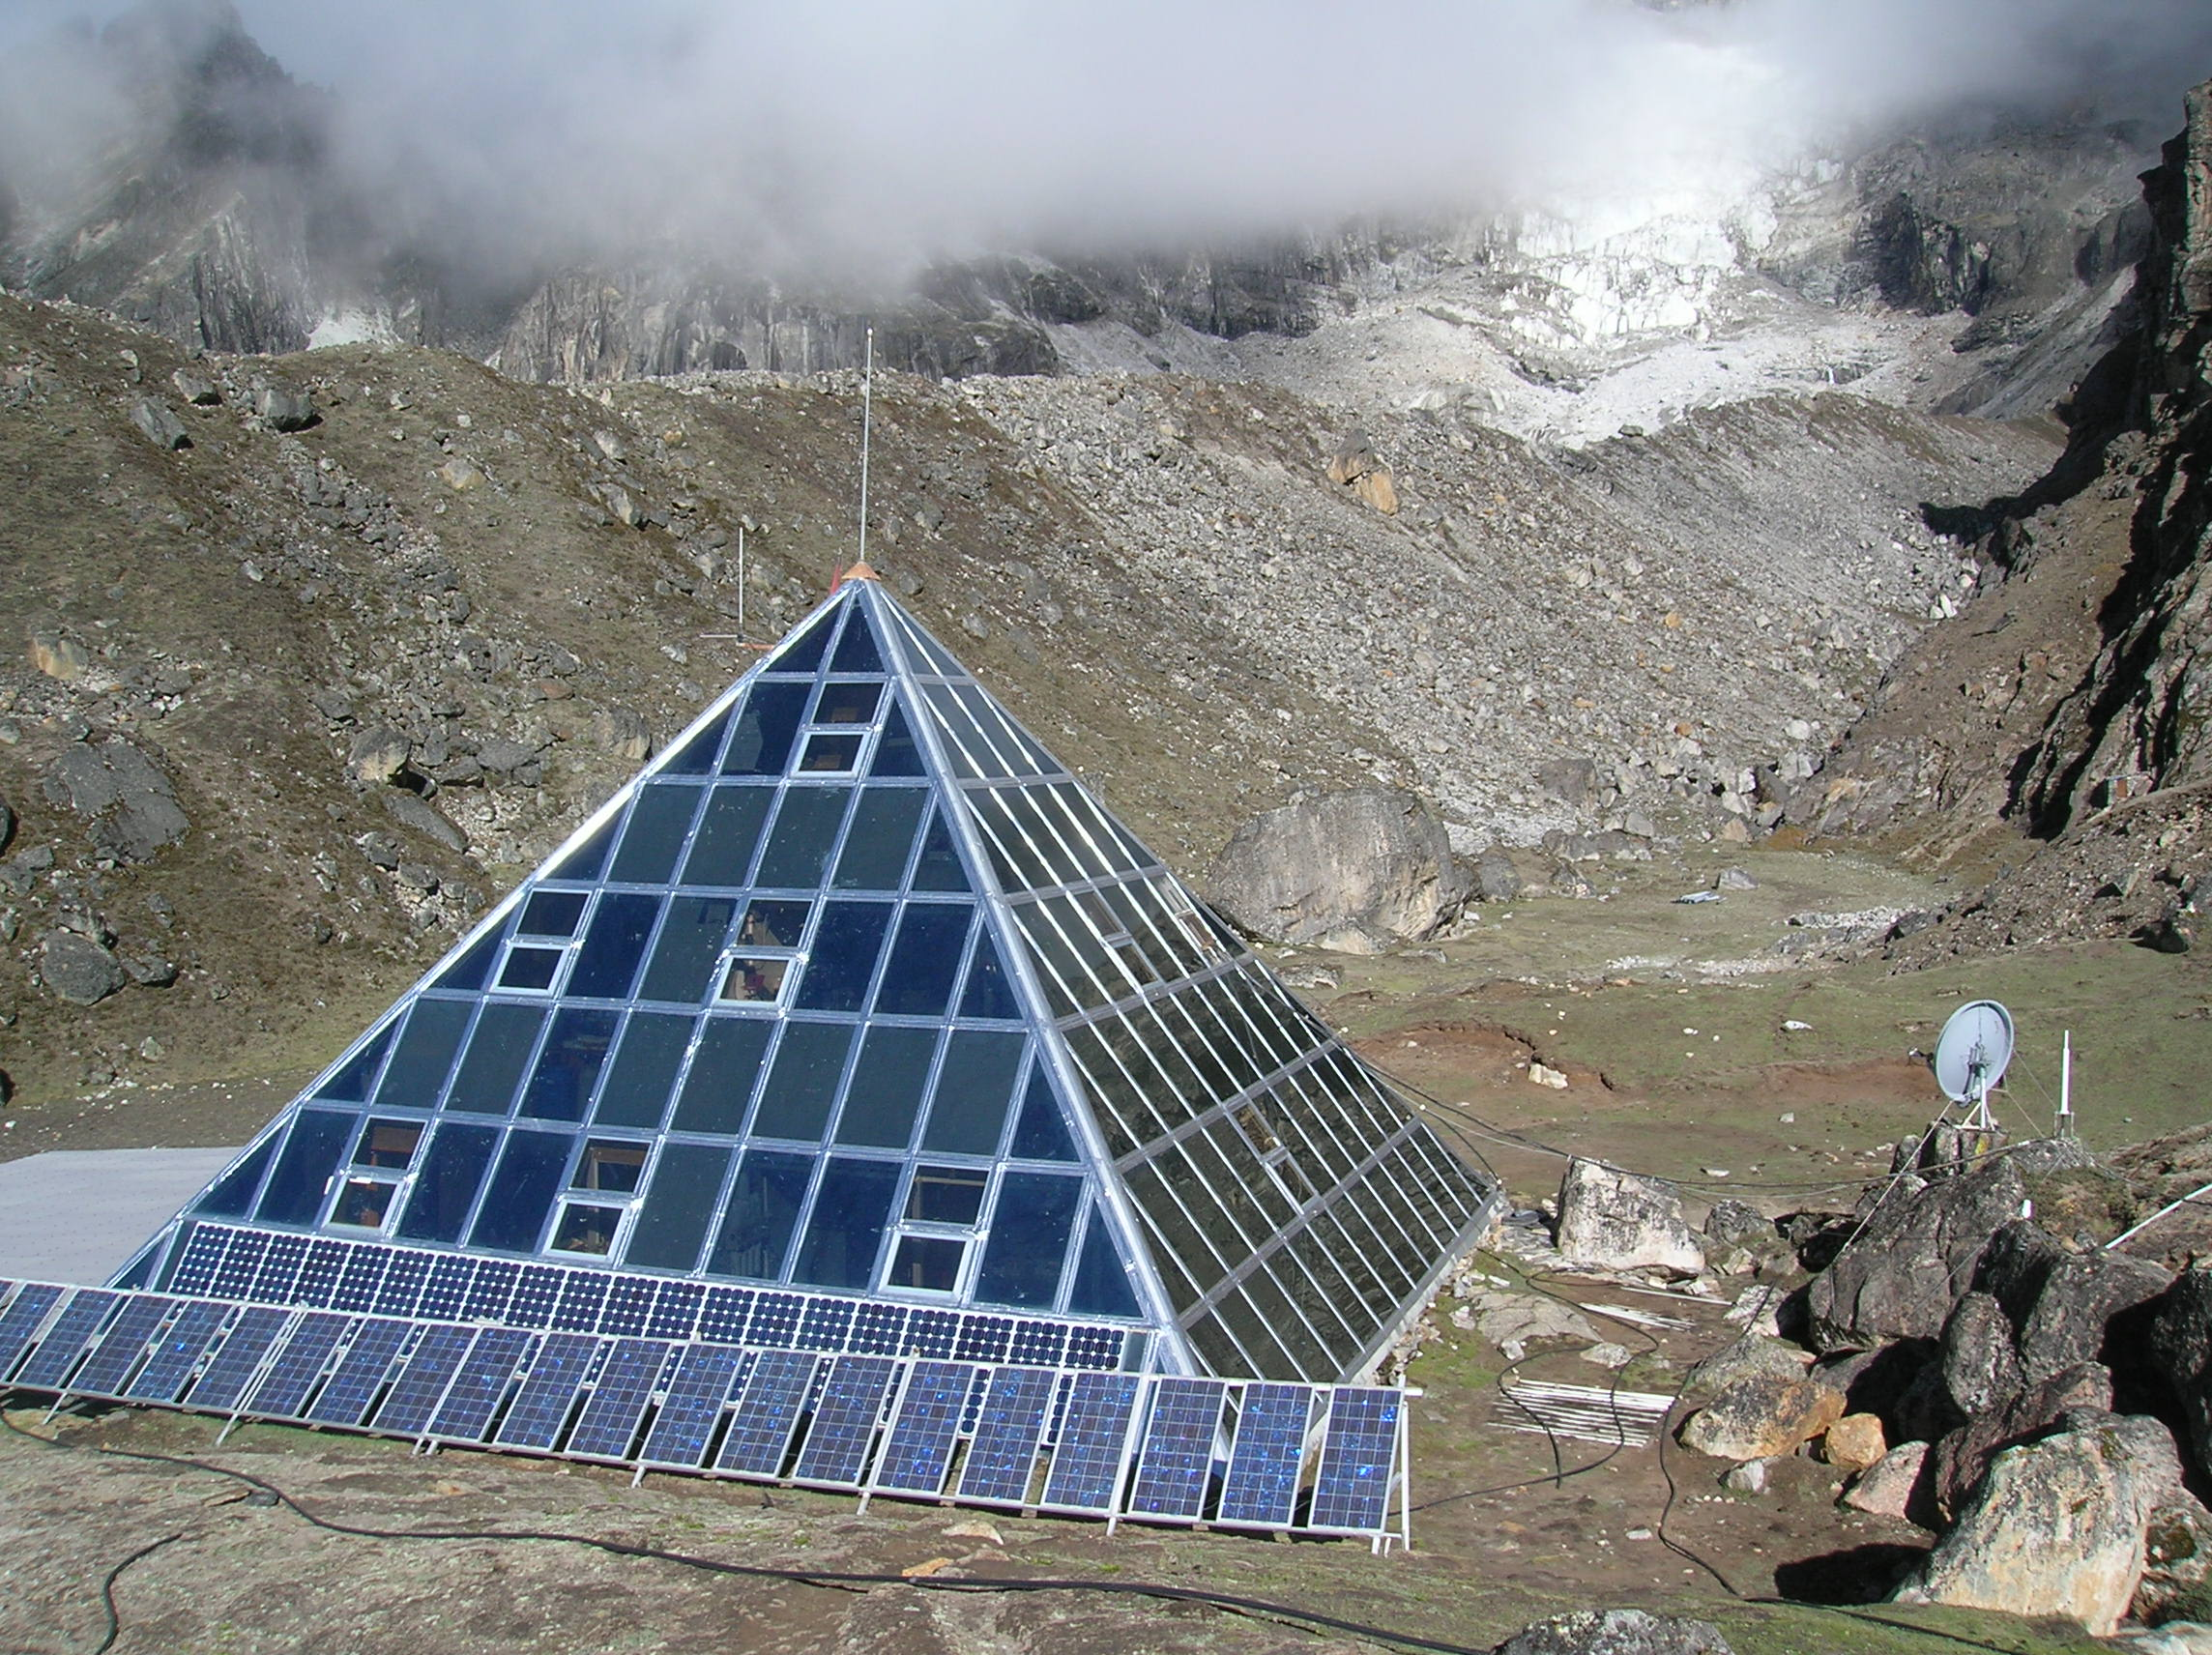
Pyramid field station, Khumbu Nepal, 5,000 m

Slide 28
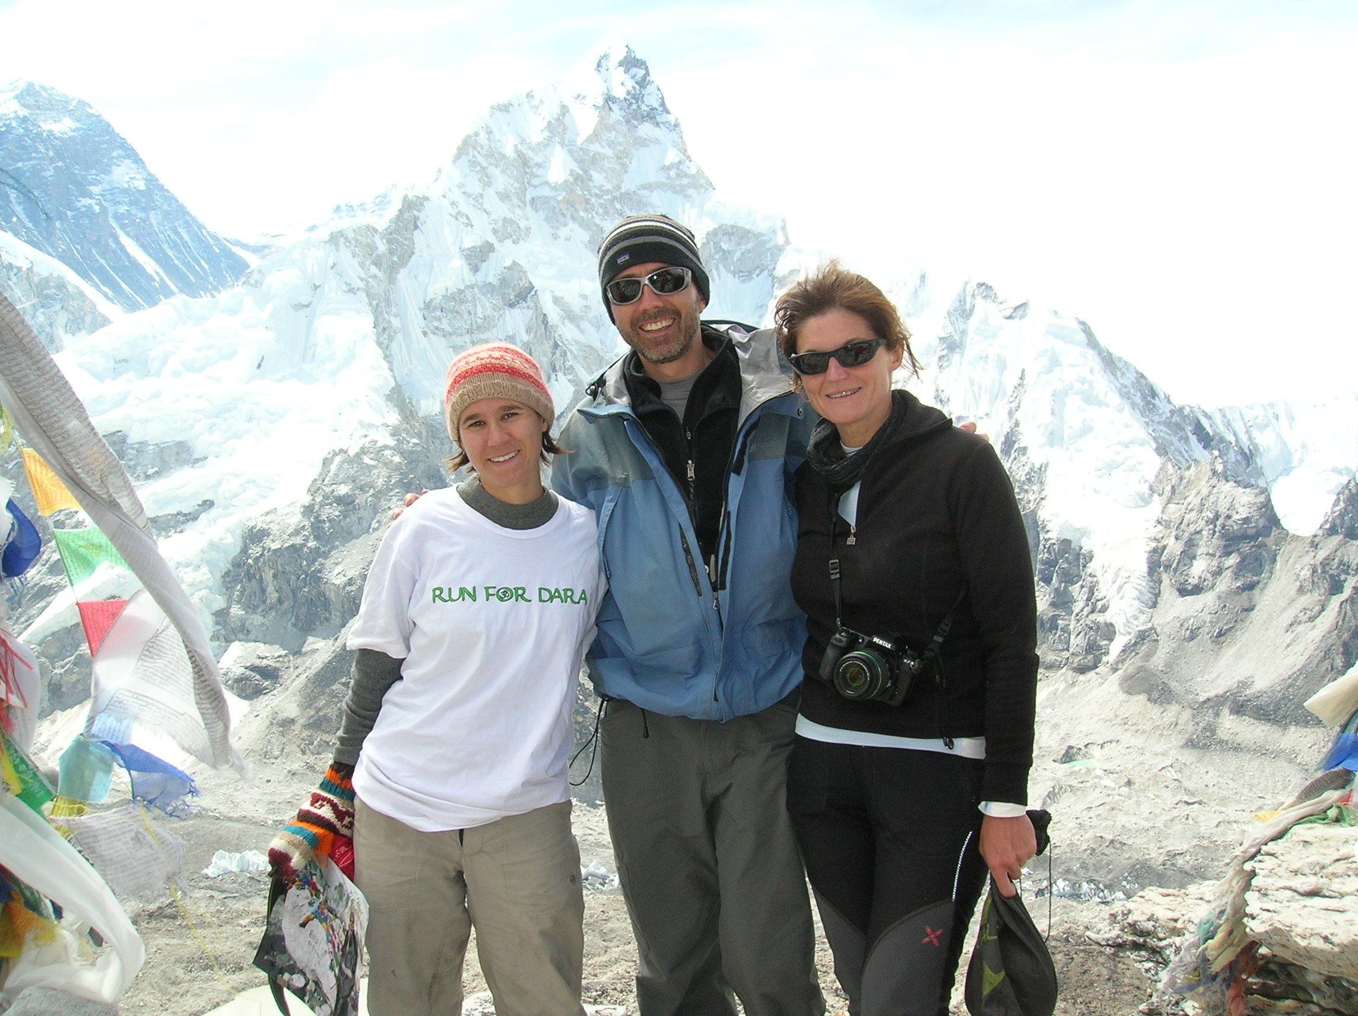
Italian-Americans in Khumbu, 2012

Slide 29
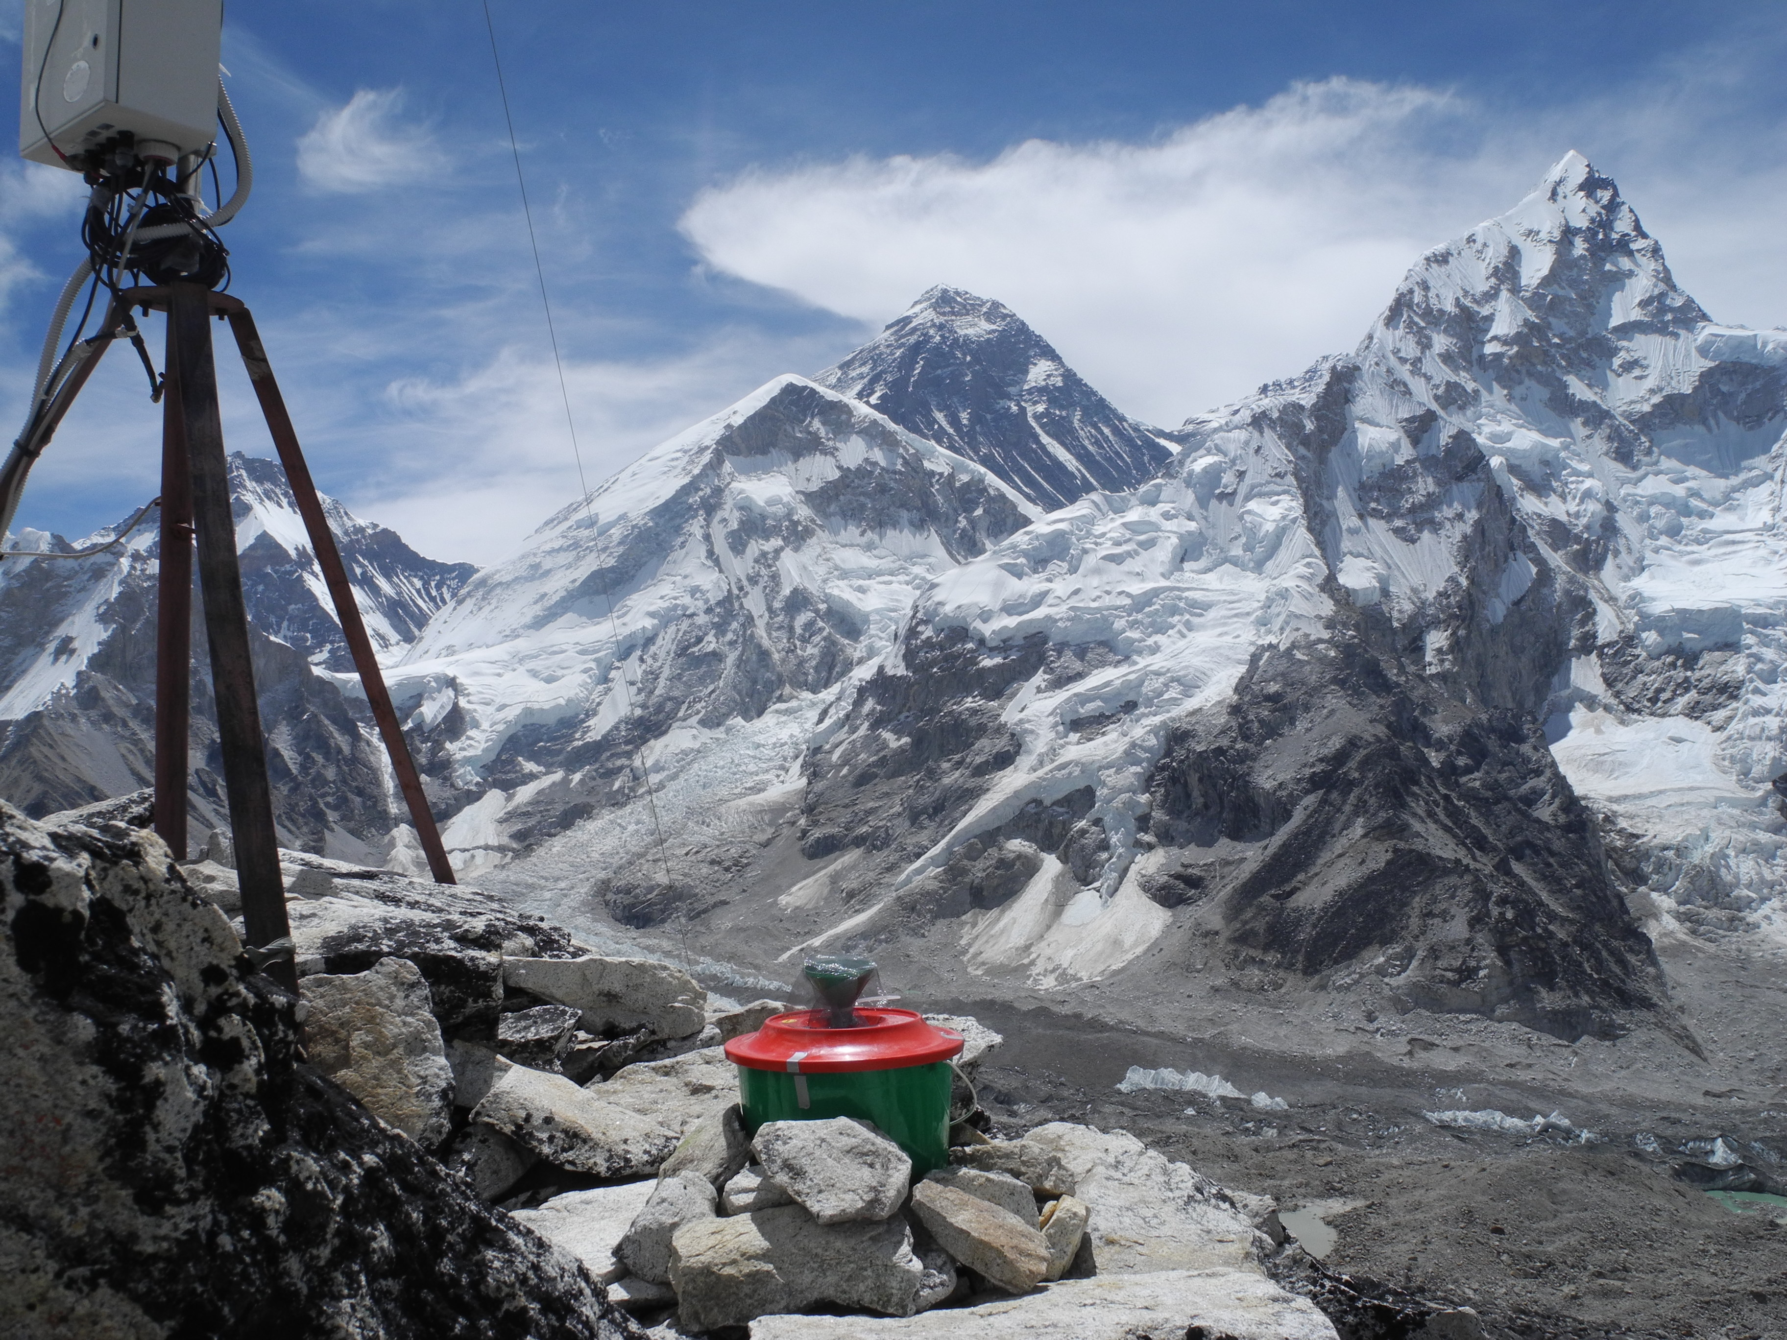
Precip bucket KalaPatthar Everest in back

Slide 30
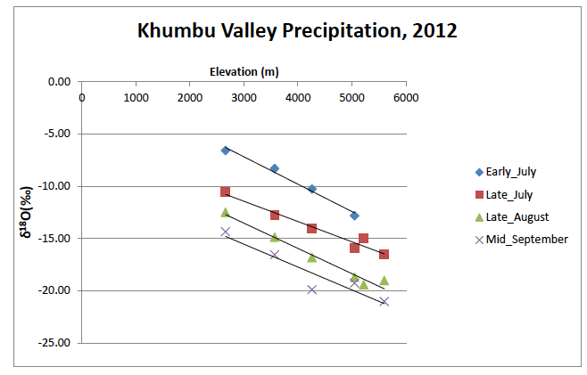
Isotopic values of precipitation: will allow us to
run mixing models: Italian-American cooperation

Slide 31
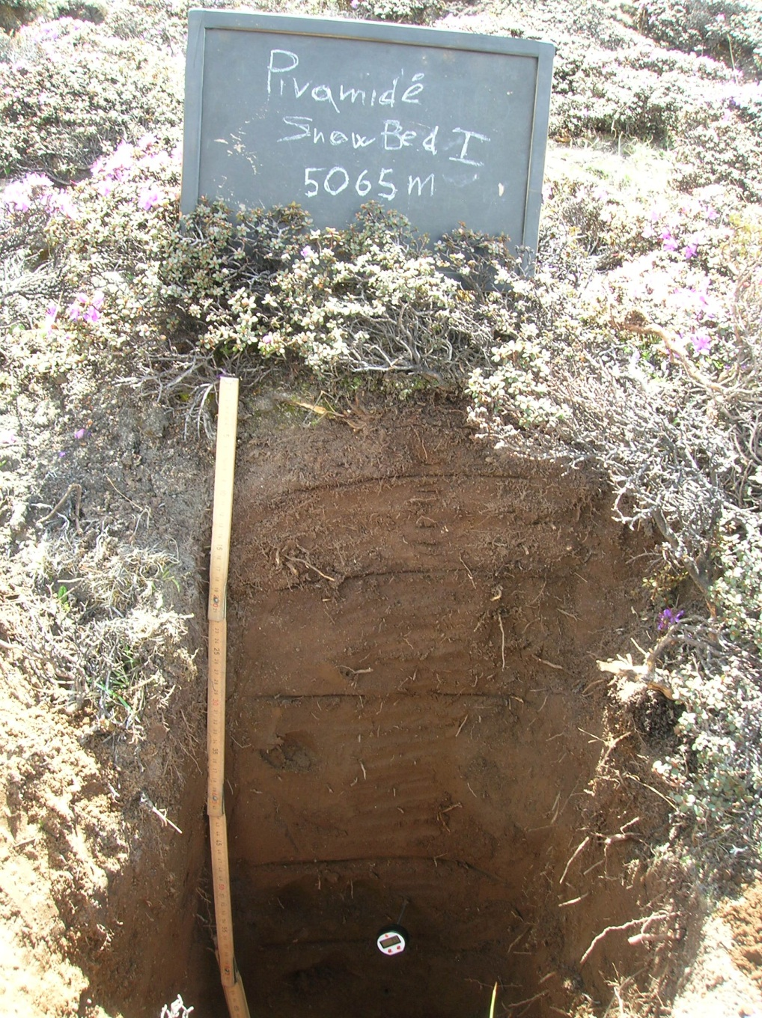
Soils in the Everest
Region, 5065 m
Very well-developed
We’ll cooperate on
investigating C and
N cycling in the
subsurface in the
Khumbu

Slide 32
How Nepal Research Started:
Joint LTER-OISE Workshop
WORKSHOP ON SNOW AND ICE HYDROLOGY, KATHMANDU UNIVERSITY, OCT 28- 31, 2009
This workshop built on the theme of examination of cryospheric change by the LTER program by initiating a new collaboration between the NWT LTER program and research scientists in the Himalayas.
Kathmandu University, ICIMOD, DHM

Slide 33
Partnerships for Enhanced Engagement in Research (PEER) Science
Partnership between USAID and NSF; administered by National Academy of Sciences
Invites scientists in developing countries to apply for funds to support research and capacity-building activities on topics of importance to USAID and conducted in partnership with their NSF-funded collaborators.

Slide 34
Establishing a collaborative assessment of the impacts of climate change on the hydrological regime of the Langtang River Basin, central Nepal,
Rijan Kayastha, Kathmandu University
Mark Williams, NWT LTER
Funded in first round in 2011

Slide 35
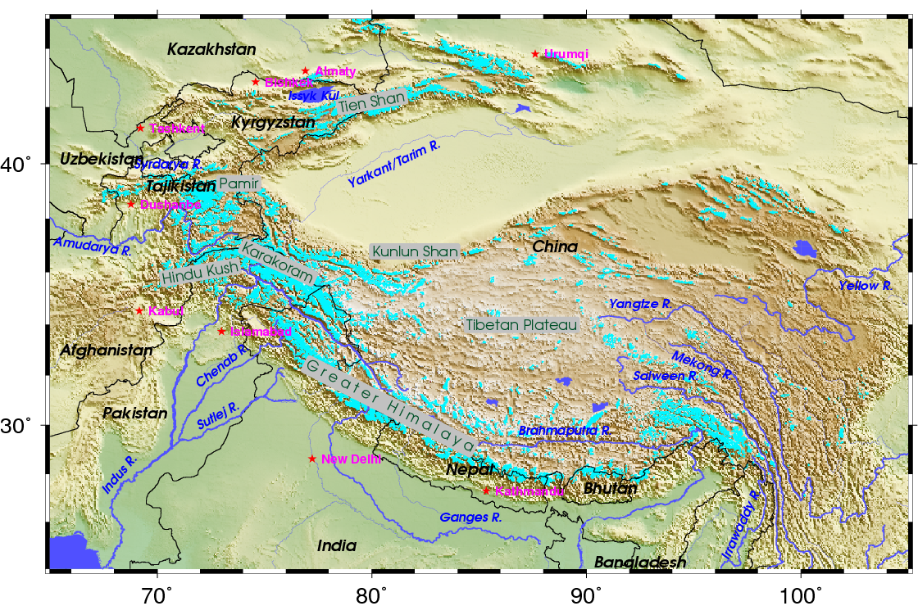
CHARIS - Contribution to High Asia Runoff of Ice and Snow
The CHARIS project began in 2011 with funding from USAID to the University of Colorado
PI:
Richard Armstrong, NSIDC
Co-I:
Mark Williams, INSTAAR
Our study region includes the
Amu Darya, Syr Darya, Indus, Ganges, and Brahmaputra river basins
Map courtesy B. Raup. Glacier coverage from the RGI and GLIMS is in cyan light blue color (See http://www.glims.org/ for information on RGI and other glacier outline data)
http://nsidc.org/charis/

Slide 36
Love to use the 5-year CHARIS project as the basis for long-term research in High Asia

Slide 37


A High mountain LTER Network
Laszlo Nagy, Eva Spehn, Mark Williams, Francisco Bonet, Patrick Bourgeron
http://gmba.unibas.ch/mountainLTER/mountainLTER.htm

Slide 38
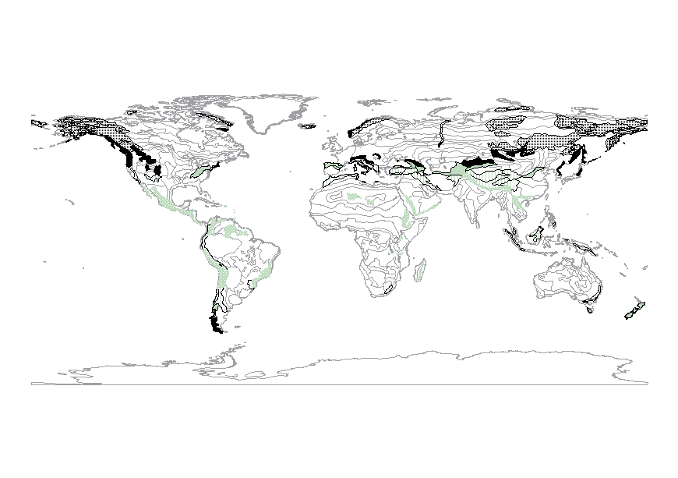
The Diversity of Mountains (Environmental Contrasts / Gradients) – the need for a network of sites
Temperature seasonality
  Aseasonal -> seasonal
Precipitation
  Arid -> perhumid
Land use history
  None -> long / intensive
Geological history
  bedrock (Ca vs. Si)
Glaciation history
  (+ / -)
  Consequence: differences in ecosystem structure
  and functioning
http://gmba.unibas.ch/mountainLTER/mountainLTER.htm

Slide 39
Ordination of mountain ranges using PCA
PCA analysis shows the large range in mountain parameters: 210 mountain ranges

Slide 40
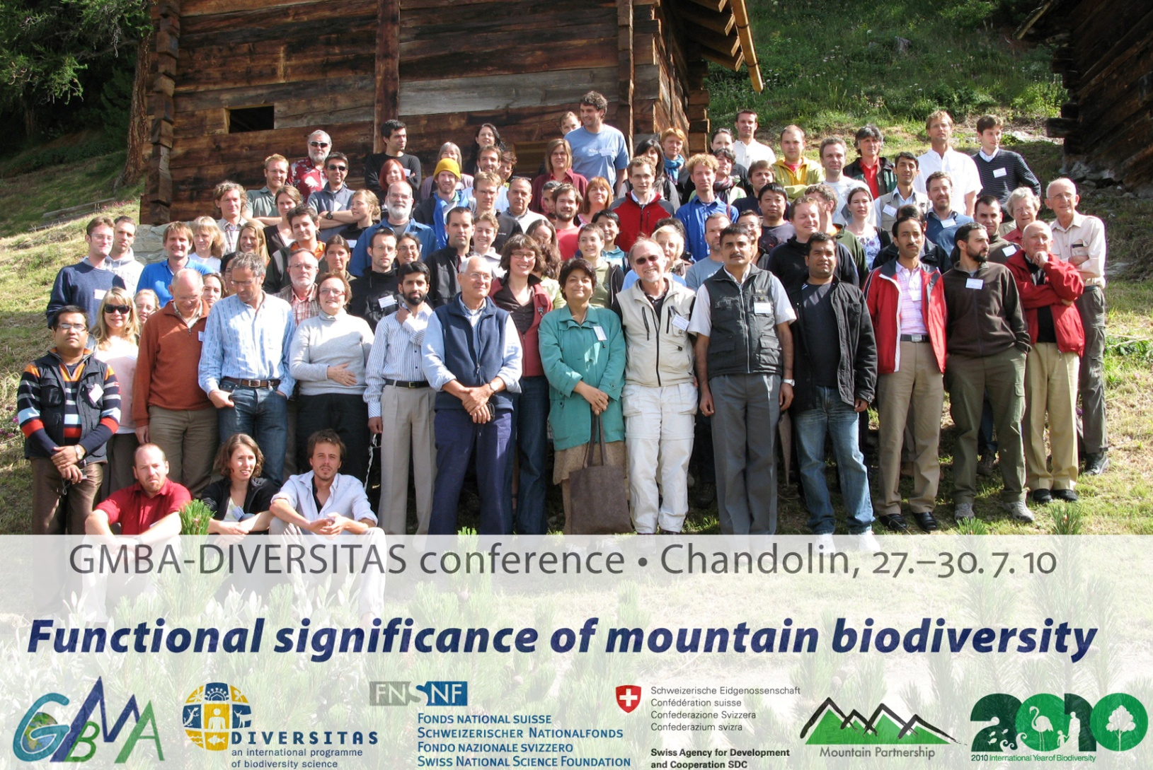
LTERs in the Alpine and their influence on biodiversity research
NWT LTER as a prototype for understanding the controls on alpine biodiversity: the challenge of converting long term monitoring into science (Williams M.)
Converting field data into knowledge: towards adaptive management in Sierra Nevada LTER site (Bonet F.)
LTER in the Austrian Central Alps: scientific relevance and outlook (Erschbamer B.)
Chandolin, 2010
http://gmba.unibas.ch/mountainLTER/mountainLTER.htm

Slide 41


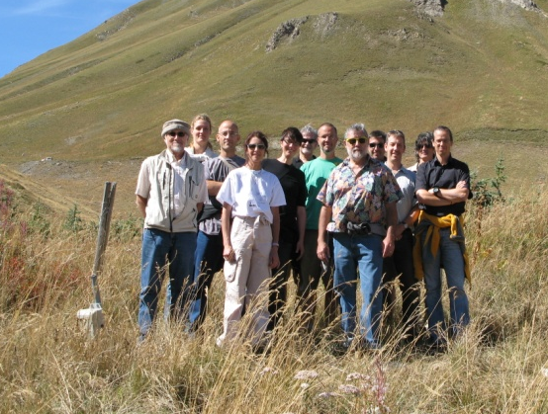
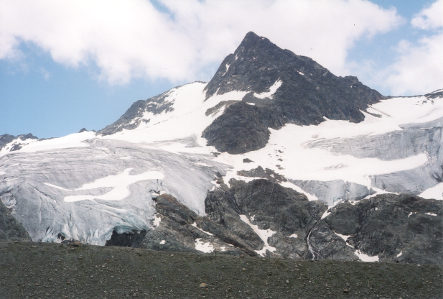

Global Network of alpine LTER sites
Lautaret, 2011
Nucleus of core sites to use common
protocols to ensure comparability of data
GMBA provides the framework and coordination
Niwot Ridge, Rocky Mountains USA
Sierra Nevada, Spain
Aosta valley, Italy
Lautaret, Grenoble, France
Tyrol, Austria
Furka region, Switzerland
www.gmba.unibas.ch
GMBA aims to:
● explore and explain the great biological richness of the mountains of the world
● increase the amount and quality of high quality geo-referenced data on mountain biodiversity
● provide input to policy makers and stakeholders for the conservation and sustainable use of mountain biodiversity
http://gmba.unibas.ch/mountainLTER/mountainLTER.htm

Slide 42
Workshop at ASM 2012 (LTER, ILTER, Mountain LTER, and the CLM RCN)http://asm2012.lternet.edu/working-groups/resilience-and-sustainability-complex-mountain-landscapes
Key research topics identified:
  Characterization of the global range of variability in mountain systems, including the elevation gradient: gradient analysis, classification, boundaries
  Characterization of the services (economic and otherwise) provided by mountain systems: global distribution, model(s)
  Land use
  Ecological legacies: imprints of legacies on system dynamics
  Atmospheric deposition
  Change in species distribution

Slide 43
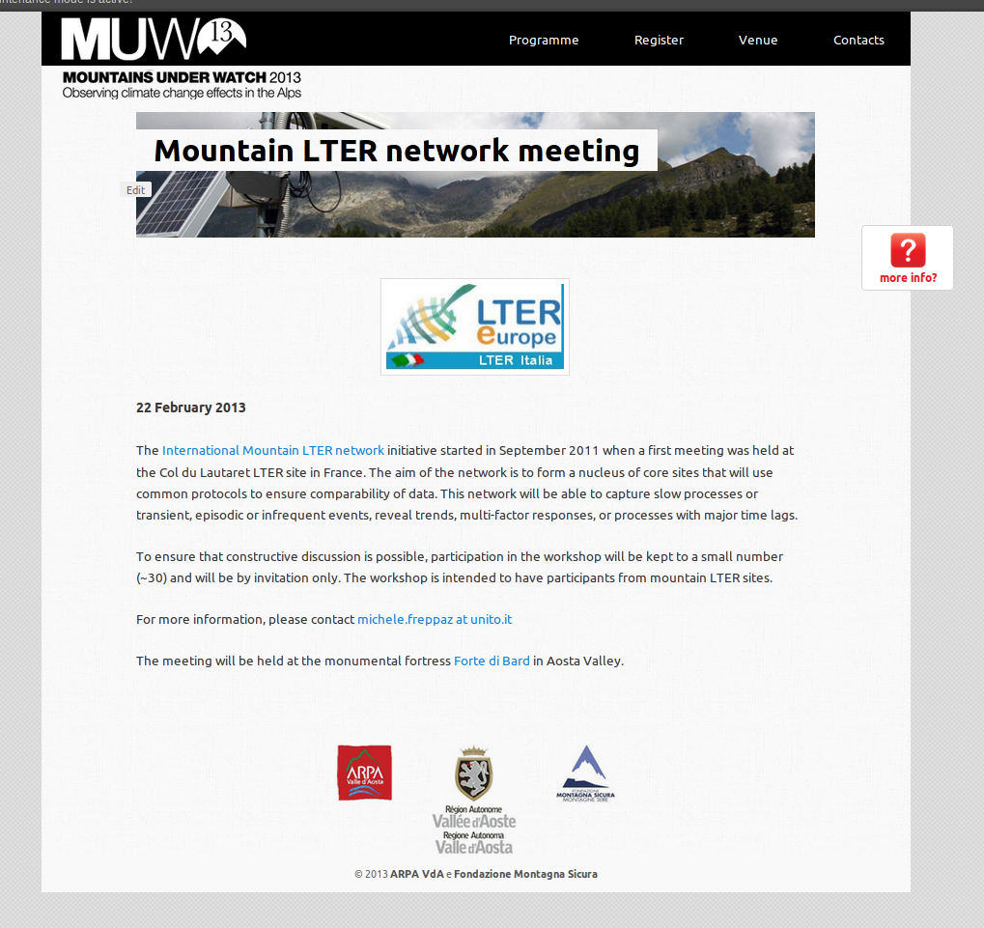

Slide 44
Next steps
Posting on the GMBA LTER webportal list of recommended common protocols
Posting of a background document
Building on other initiatives
Putting out to consultation the system of proposed classification of moutains for site selection and comparative research planning
Establishment of a mountain database, following the consolidation of the classification system
Last group meeting: Mountains Under Watch - February 2013, Aosta Valley, Italy

Slide 45
Long-term ecological research (LTER):
the challenge of converting long term
monitoring into science
Mark Williams, University of Colorado

Slide 46
What are the spatial attributes of mountains?
What is the range of these attributes?

Slide 47
Parameters
Lat-long
air density class
altitude class
mean annual minimum and maximum precipitation
land use intensity (average value per mountain area)
seasonality.

Slide 48
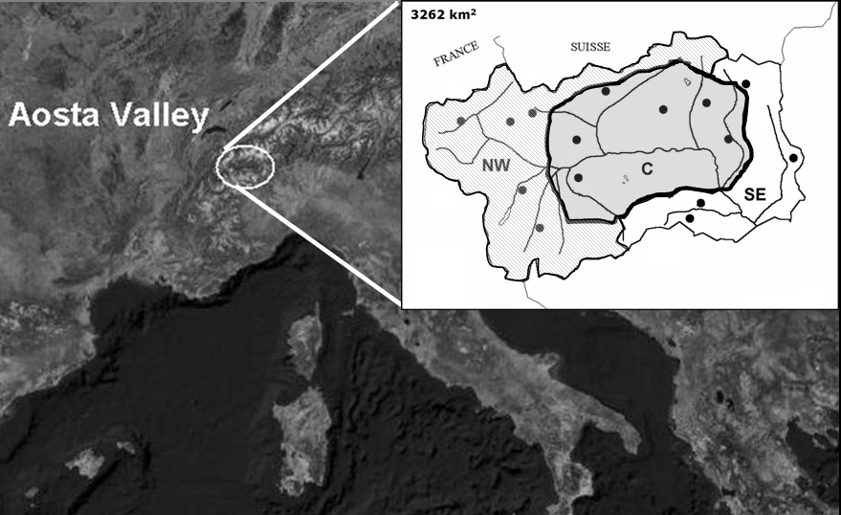
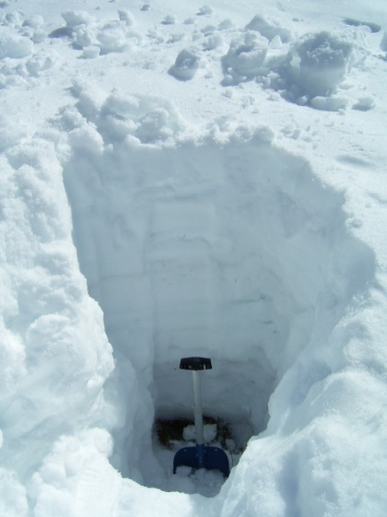
Snow chemistry
15 sampling sites
at ~ 2000 m a.s.l.
3 sub-regions
(NW, C, SE)
2 sampling dates
(Early March, April)
10 cm increments
Physical Analyses
Snow density, temperature, grain size & type
Chemical analyses
pH, EC, NH₄⁺, Ca²⁺, Mg²⁺,
Na⁺, K⁺, NO₃⁻, SO₄²⁻, Cl⁻
Notes:
We chose 15 study sites distributed over the Aosta Valley Region so to provide comprehensive coverage of the three subregions that you see in the small picture. We sampled snow at 10 cm increments before and during the snowmelt process. Snow physical and chemical properties were determined.

Slide 49
DRY
High land use
Low land use
WET

Slide 50
Next steps
Posting on the GMBA LTER webportal list of recommended common protocols
Posting of a background document
Building on other initiatives
Putting out to consultation the system of proposed classification of moutains for site selection and comparative research planning
Establishment of a mountain database, following the consolidation of the classification system
Next group meeting: Mountains Under Watch - 2013

Slide 51
LTER ITALY
University,
National Research Council,
Environmental Regional Agencies
General Assembly
By election:
Coordination Committee: 6 people (2 years + 2 years)
Coordinator: (2 years + 2 years)
LTER Italy involved into 2 EUProjects:
Enveurope
Lifewatch

Slide 52
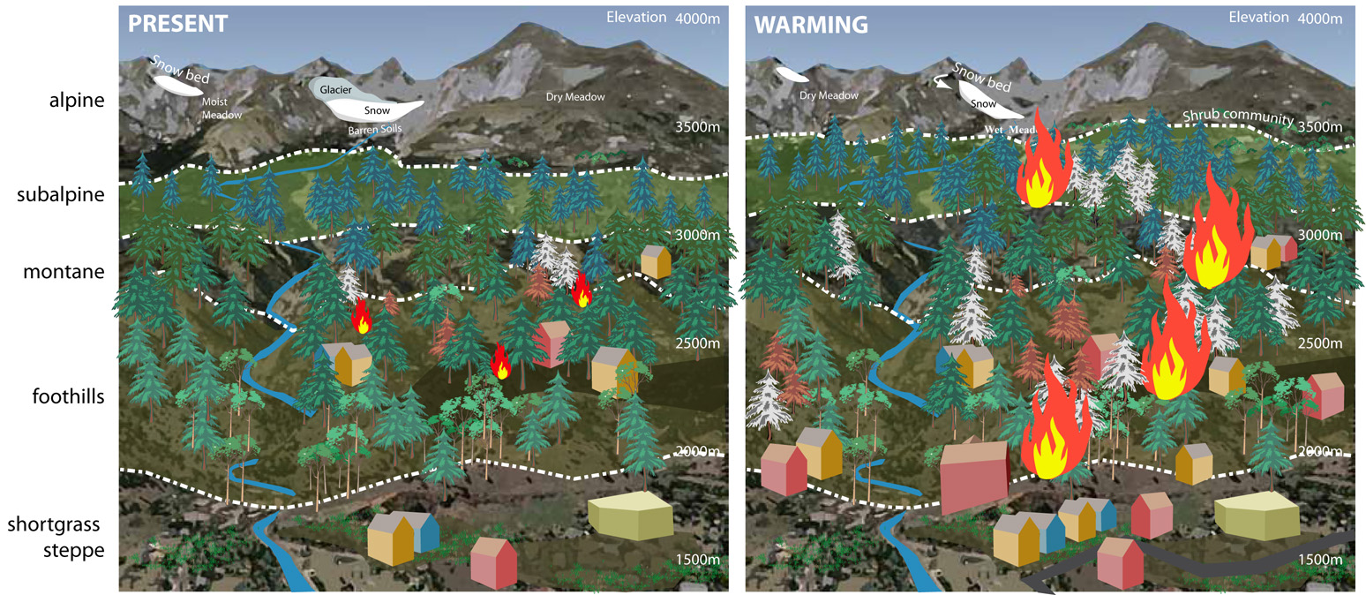
Expected Changes In Connectivity Among Elevation Zones and Disturbance Regimes Related To Climate And Land Use Change

Slide 53
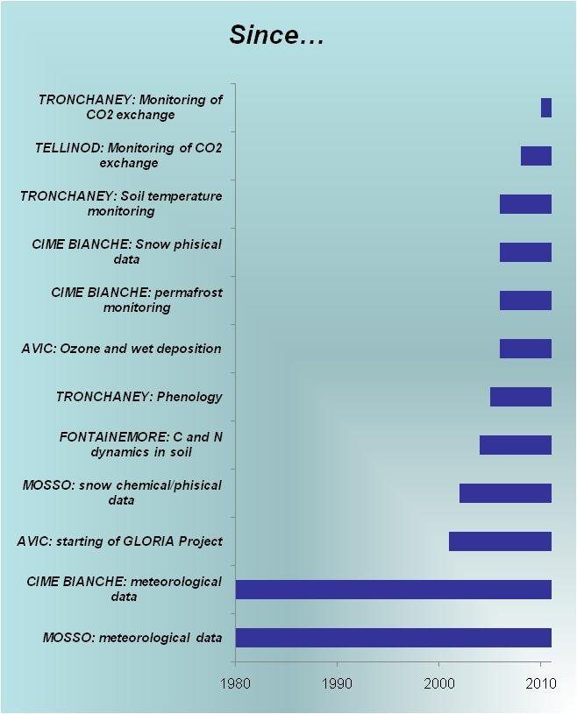
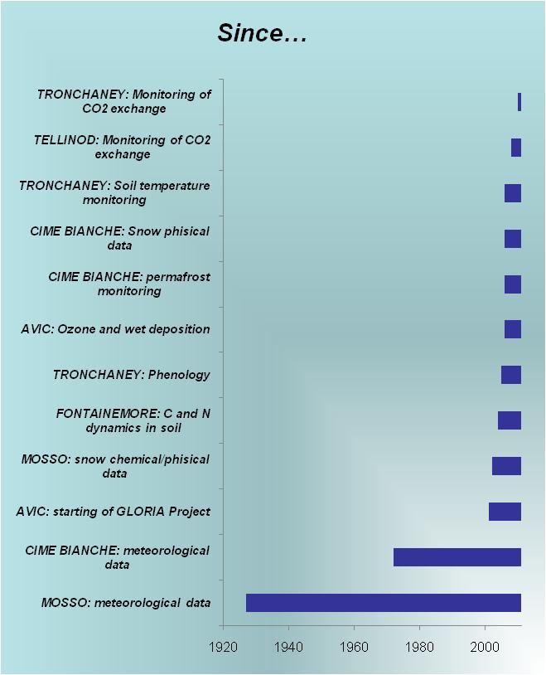
Italian mountain LTERs
Shared protocols
Monitoring of abiotic parameters: Soil/substrate Temperature
Meteorological parameters
Basic chemical-physical properties
Routine soil/substrate characterization
Recording of snow properties

Slide 54
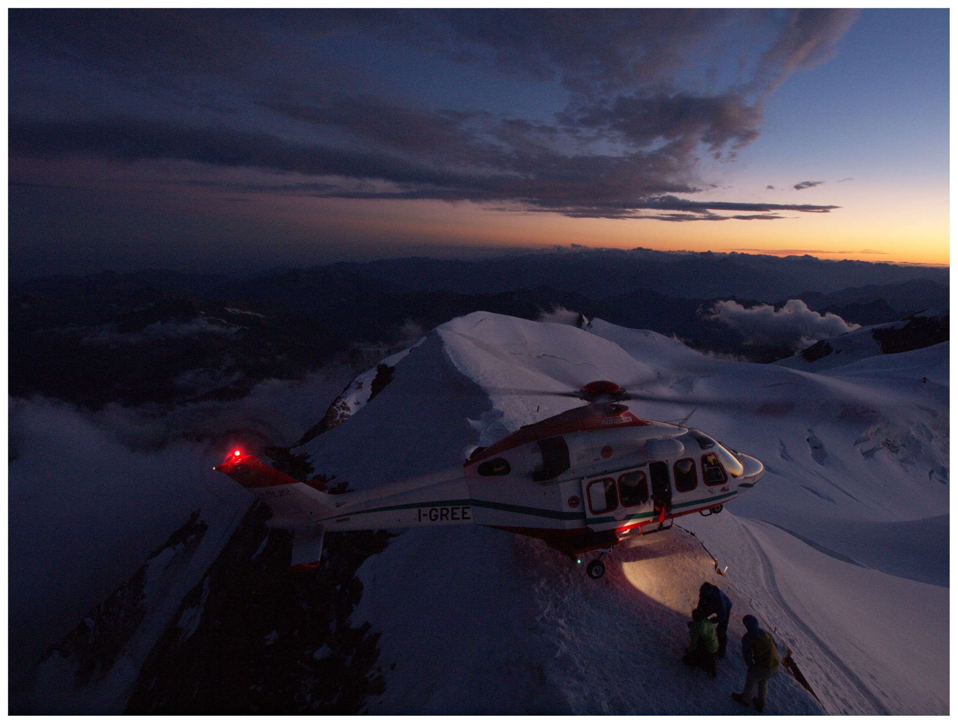
Helicopter rescue on summit of Monte Rosa

Slide 55


2. L’attività di ricerca nella Rete LTER
ILTER Network
Nasce nel 1993
ILTER comprende ora 38 reti nazionali, distribuite nei 5 Continenti
LTER-Italy: istituita nel 1996, comprende 20 siti.
Finanziamenti dal Progetto EU ALTER-Net (A Long–Term Biodiversity, Ecosystem and Awareness Research Network – Sesto Programma Quadro; www.alter-net.info) e dal National Forest Service – Conecofor Office (Corpo Forestale dello Stato – Ufficio Conecofor)

Slide 56







Research Questions
What is the amount of soil that a snow avalanche could transport?
What is the influence that snow movements could exert on soil properties, including C and N availability?
What is the contribution of soil properties to snow movements?
EU Project - RISKNAT - Gestione in sicurezza dei territori di montagna transfrontalieri
EU Project - DYNAVAL - Dynamique des avalanches
EU Project - MAP3 - Monitoring for the Avalanche Prevision, Prediction and Protection

