Slide 1
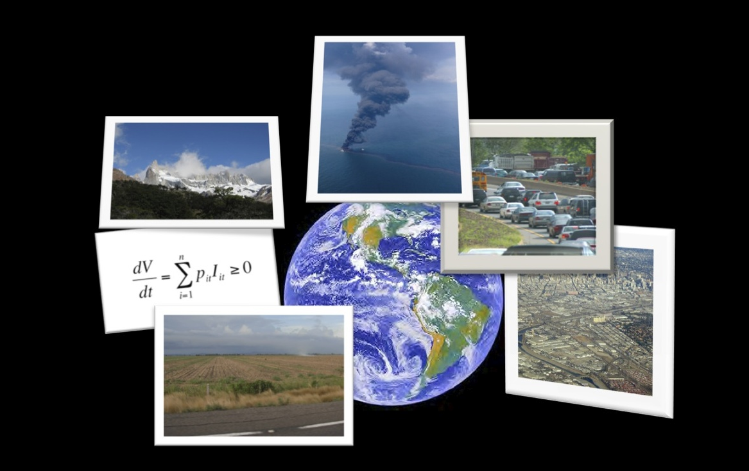
Innovations and lessons learned in distributed graduate education on sustainability science
Jeannine Cavender-Bares
University of Minnesota
Cedar Creek Long-Term Ecological Research Site

Slide 2

2012-03-03
Johan Rockström and Carl Folke, Stockholm Resilience Centre
Notes:
Why a distributed graduate seminar in sustainability science?
In the face of human dominion of Planet Earth, shown in this image of Earth at night from space that reveals the presence of humans everywhere,
Fostering a transition toward sustainability – toward patterns of development that promote human well-being while conserving the life support systems of the planet – is one of the central challenges of the twenty first century (NRC, 1999a).
there is a pressing need for a theoretical and pedagogical framework for studying and teaching sustainability science.
Sustainability Science: Use-inspired research aimed at addressing the sustainable development challenge:
Provide for decent standard of living for all people
Food, energy, shelter, material goods, culture…
Maintain the Earth’s life support systems (natural capital)
Climate, oceans, air and water quality, biodiversity

Slide 3
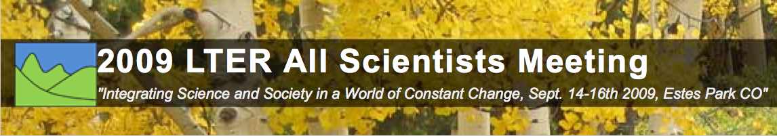
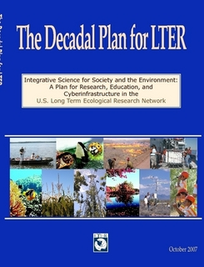
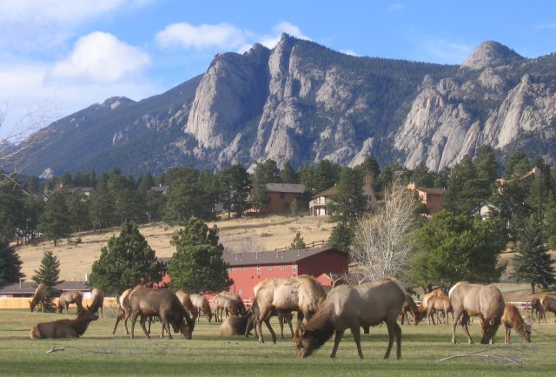
Work Group:
Integrating Science, Society, and Education for Sustainability
Nancy Grimm, Jeannine Cavender-Bares, Ted Gragson, Morgan Grove, Scott Collins, Charles Redman, Chris Boone
Supported by a grant from the National Science foundation (NSF) DEB 0435546
Notes:
integrate the ISSE (Integrative Science for Society and Environment) framework and existing sustainability science frameworks – how are they different/similar?how the objectives of sustainability science can be met using the power of long-term research AND the LTER network

Slide 4
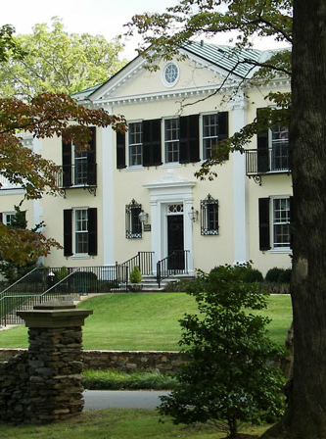


Need for integration of communities working on sustainability science
Arlie Center Warrenton, Virginia
November 29 – December 2, 2009
Notes:
Recommendation: Short courses on the current theories, data, methods and unresolved questions of sustainability science
The motivation for the seminar is the need to integrate the various communities working on
sustainability science. The fragmentation of those communities – partly by discipline, partly by
institution, partly by applications focus – was noted as a major impediment to its growth and maturation
at a recent workshop held by NSF to identify priority needs in the field. In response to this finding, we are
experimenting with this distributed, interdisciplinary graduate seminar on sustainability science. Its goal
is to bring together faculty and graduate students from different universities and disciplinary backgrounds
to discuss key concepts, findings and controversies in the field.

Slide 5
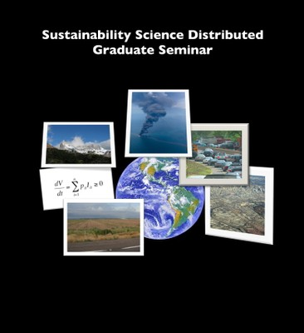
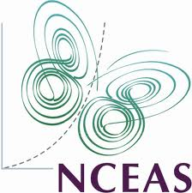
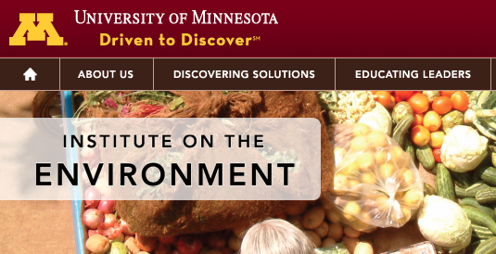
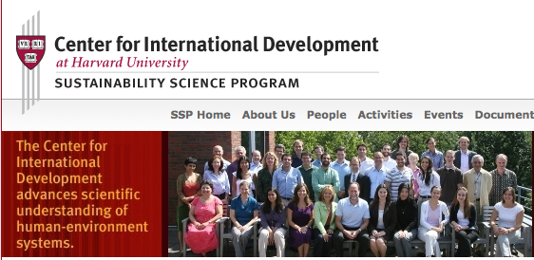
Notes:
Over the two years, there were a total of ~180 participants (7 campuses), including enrolled graduate and upper level undergraduate students, faculty, post docs and auditing students

Slide 6
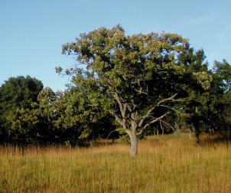
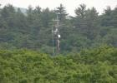
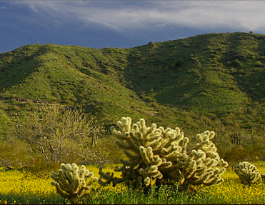
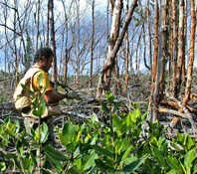
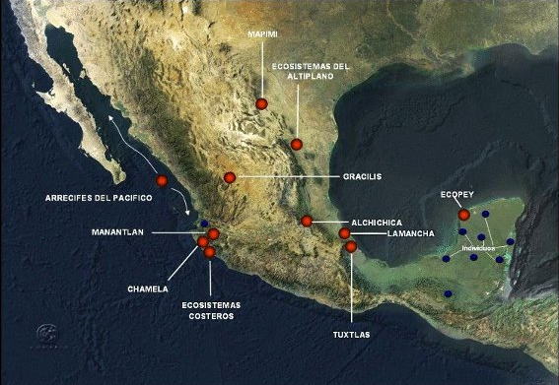
University of Minnesota
Jeannine Cavender-Bares
Stephen Polasky
Harvard University
William Clark
Missy Holbrook
Arizona State University
Billie Turner
Ann Kinzig (yr1)
Osvaldo Sala (yr2)
Florida International University
James Heffernan
Laura Ogden
Princeton University
Elizabeth King
Simon Levin
CDR
HFR
CAP
FCE
Universidad Nacional Autónoma de México
Patricia Balvanera
Omar Masera
Mex-LTER
Notes:
Over the two years, there were a total of ~180 participants (7 campuses), including enrolled graduate and upper level undergraduate students, faculty, post docs and auditing students
The seminar is an ongoing experiment in developing approaches to the sorts of collaborative, distributed, travel-minimizing networking that almost certainly must be part of any sustainable future.

Slide 7
University of Minnesota
Jeannine Cavender-Bares
Stephen Polasky
Harvard University
William Clark
Missy Holbrook
Arizona State University
Billie Turner
Ann Kinzig (yr1)
Osvaldo Sala (yr2)
Florida International University
James Heffernan
Laura Ogden
Princeton University
Elizabeth King
Simon Levin
CDR
HFR
CAP
Columbia University
Ruth DeFries
Maria Uriarte
FCE
Universidad Nacional Autónoma de México
Patricia Balvanera
Omar Masera
~180 participants over 2 years:
Grad students, post docs, undergrads, faculty, staff
Mex-LTER
Notes:
Over the two years, there were a total of ~180 participants (7 campuses), including enrolled graduate and upper level undergraduate students, faculty, post docs and auditing students
The seminar is an ongoing experiment in developing approaches to the sorts of collaborative, distributed, travel-minimizing networking that almost certainly must be part of any sustainable future.

Slide 8
Format
90 min joint session + local session each week
Expert – prerecorded lecture! + Readings
Brief expert overview in 90 min joint session
Student-prepared questions (Campus A, B, C)
Open discussion
Online discussion
Student projects
Notes:
The seminar meets twice a week. The first session each week is held jointly, with all participants linked through web conferencing technology. The second session each week will be conducted by each university on its own to promote more focussed discussion.90 min. together, 90 min. individual campus

Slide 9
Central Challenge
Framing and integrating the core theories and topics within the emerging field of sustainability science
Notes:
A field centered on use-inspired research
Obtaining a decent standard of living for humans while maintaining the Earth’s life support systems
Conflict among traditional conservation approaches to sustainability that emerge from ecology with approaches that stem from the development side and consider human well-being first
“Ecology” bias
“Humans only” bias

Slide 10
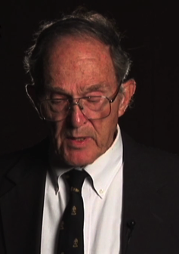
Long-term trends and transitions in nature and society
Population
tool-making
agriculture
industry
Years ago
Robert Kates
Notes:
a sampling of the long term trends and large scale patterns in the human-environment system

Slide 11
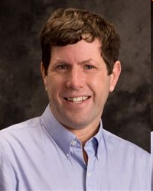
Inclusive wealth:
A framework for sustainable development
Inclusive wealth
= Combined value of all assets
Savings/investment
Sustainability
= Non-declining inclusive wealth
Stephen Polasky
Notes:
Inclusive wealth measures the combined value of ALL capital assets
Aggregate well-being of all individuals in society
Where K(t) = (K₁(t), K₂(t), …, K_{H}(t))
And M is the “evolving political economy” or “resource allocation mechanism (i.e., institutions)
P_{h}(K(t),M) is the “shadow price” of capital asset h
Value of assets is determined by how they contribute to the current and future production/provision of goods and services
Non-declining human well-being is equivalent to non-declining inclusive wealth
A welfare function for various forms of capital
P it is the shadow price for capital stock i at time t
Iit is the net investment in capital stock i at time t
Sustainability is achieved if the change in inclusive wealth is non-declining – if inclusive savings is positive

Slide 12
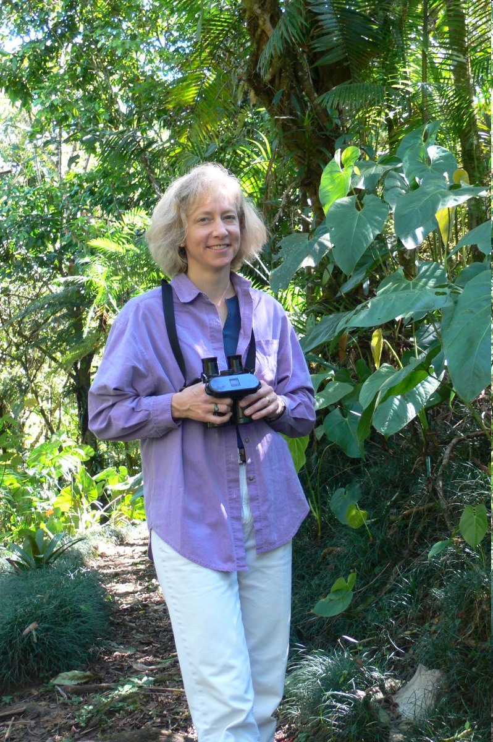
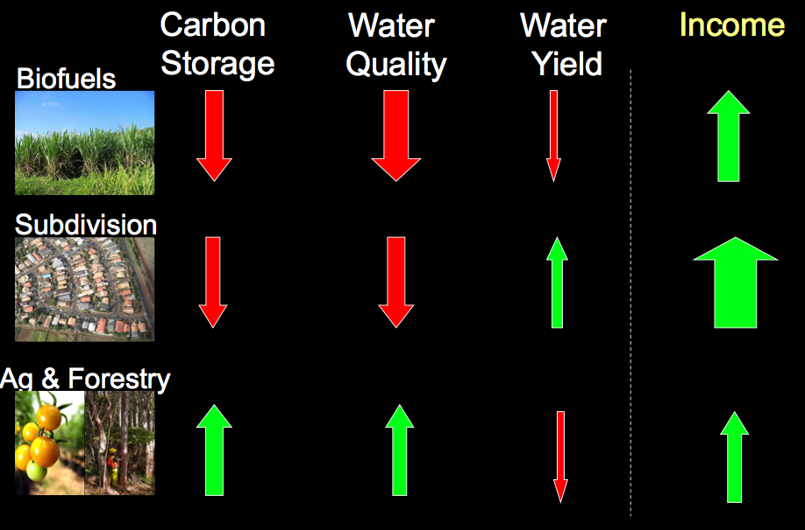
Natural Capital:
Ecosystem services and their contribution
to sustainable development
Gretchen Daily

Slide 13
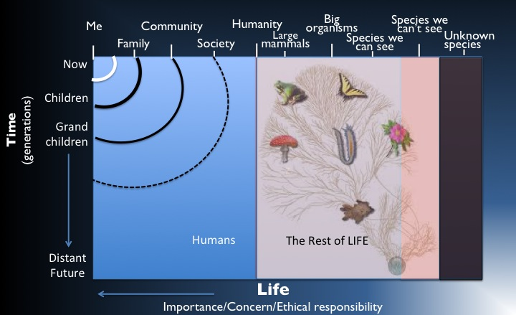
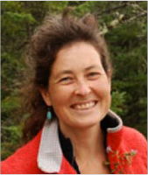
Biodiversity as a component of natural capital
Anthropocentric v. biocentric perspectives
Jeannine Cavender-Bares

Slide 14
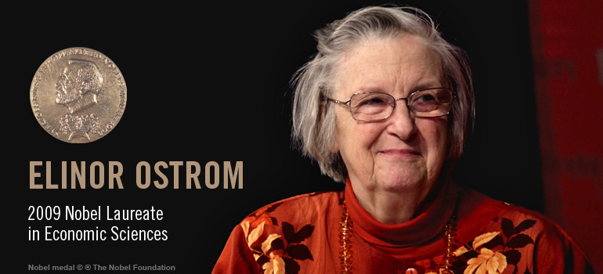
Institutions (Social Capital):
Polycentric Governance of Complex Economic Systems
Elinor Ostrom
Notes:
Institutions are the formal and informal rules, norms and expectations that shape human interactions with one another and the environment.
What are the Institutional challenges for sustainable development posed by the need to create or protect public goods/ecosystem services
Can we desig institutions that promote cooperation in the production of global public goods?

Slide 15
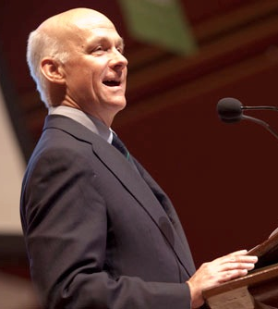
Knowledge for sustainable development
Farmers, local communities
Policymakers and Public Policy Shapers
Boundary Organization: ASB
Other Private Sector Managers and Investors
NGOs,
Civil Society
William C. Clark
Notes:
‘Knowledge’ makes contributions to human well-being that are every bit as important as those provided by various capital assets or institutions.
Key points:
involve users to identify the knowledge most needed to promote sustainability
integration of practitioner (or indigenous) knowledge and expert knowledge

Slide 16
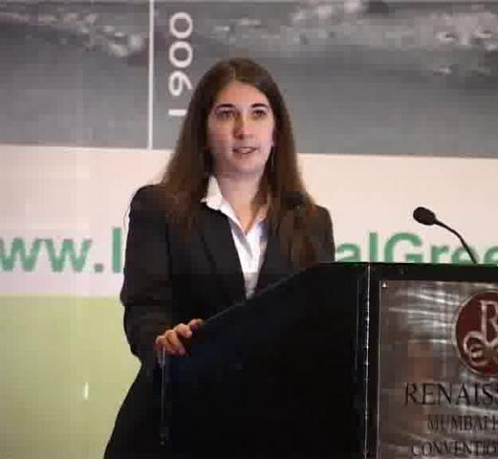
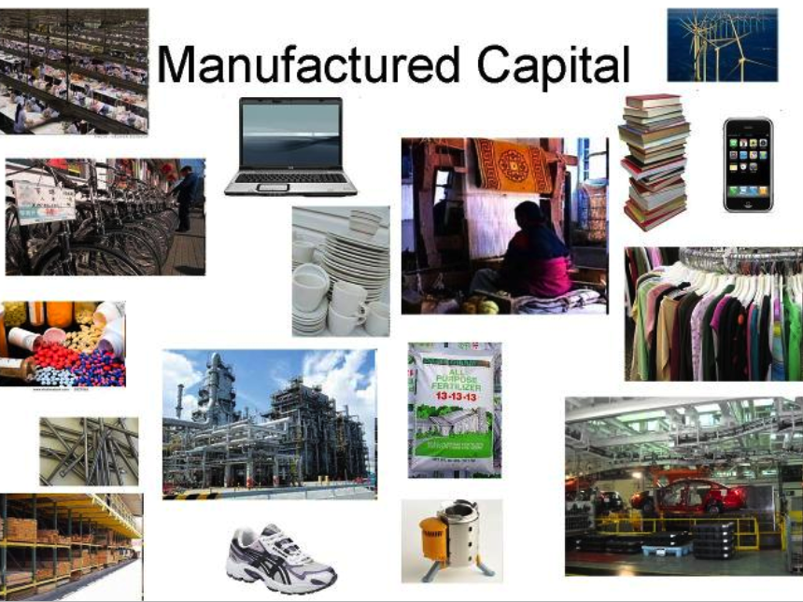
Manufactured capital:
Industrial ecology perspectives on reducing the environmental footprint
Kira Matus
Notes:
Manufactured capital includes our cities, factories, transportation networks, water and sanitation systems, housing and the like. It powers income growth and provides jobs, and is an essential component of development strategies to improve human well-being. But manufactured capital can be designed and operated in ways that are more or less conserving of natural capital and environmental services. We focus here on recent advances in “industrial ecology,” “green chemistry” and similar programs regarding how systems of manufactured capital can be constructed that achieve their aims with lower environmental “footprints” and are thus more likely to promote sustainable development.

Slide 17

Human capital:
i) The education and health dimensions of sustainable development
ii) Population and inclusive wealth
Notes:
Human capital is thought of as the attributes of individuals (rather than society) that contribute directly to development.
how environmental degradation affects human mortality and and human well-being
the role of values and knowledge in shaping people’s behavior relevant to sustainable development, and the role of education in changing those factors
people are a source of the creation of the capital assets, knowledge and institutions but also the denominator by which total wealth must be divided to
determine overall human well-being. Population change is both a cause of and a response to environmental change.

Slide 18
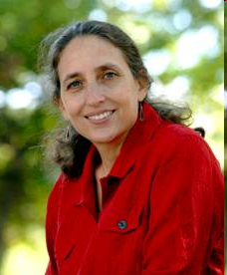
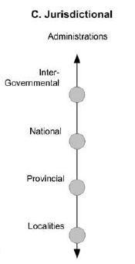
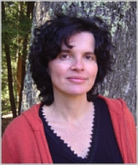
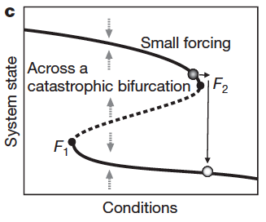
Ruth Defries
Complex System Dynamics
Cross-scale dynamics in time and space
Jurisdictional scale
Administrations
Inter-
governmental
Critical Transitions
National
Provincial
Localities
Maria Uriarte
Scheffer et al 2009
Cash et al 2005
Notes:
Challenges in adaptive approaches to management are in part due to cross-scale dynamics: temporal lags between human actions and environmental response, spatial heterogeneity, and the embedding of human environment systems in multiple scales of interaction from the local to global. Beyond these issues of scale are problems raised by discontinuities or tipping points, Irreversibilities and multiple equilibria. Such factors make trial-and-error adaptation difficult and highlight the importance of a better understanding of systems vulnerability and resilience.

Slide 19
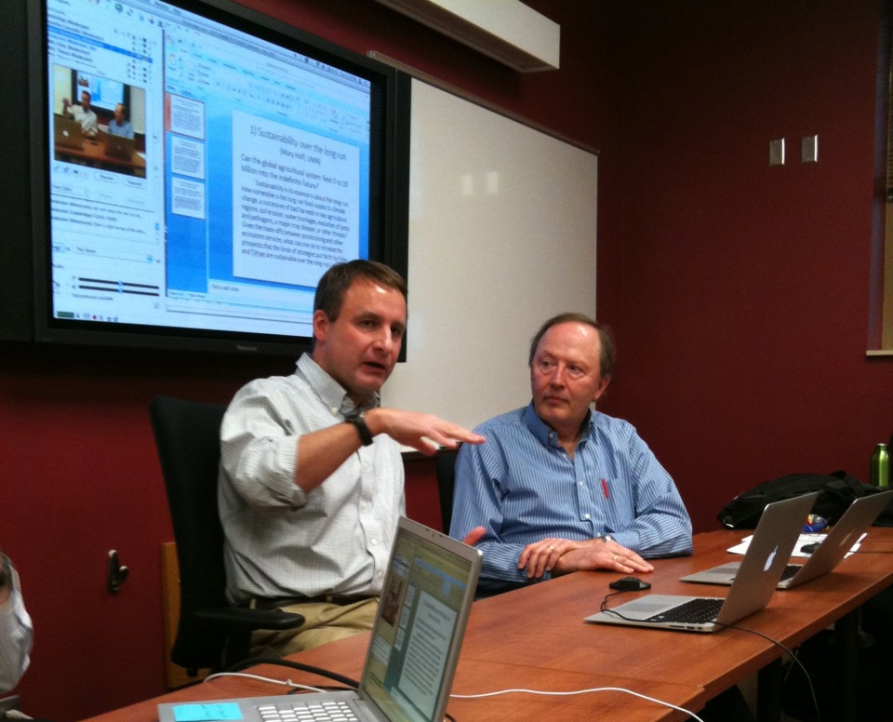
Grand Challenge I:
Feeding 9 billion people while sustaining the Earth’s life support systems
Jon Foley
Dave Tilman
Notes:
We then focus on applying sustainability science concepts and knowledge to evaluate options for addressing a sample of the grand challenges of sustainable development.

Slide 20
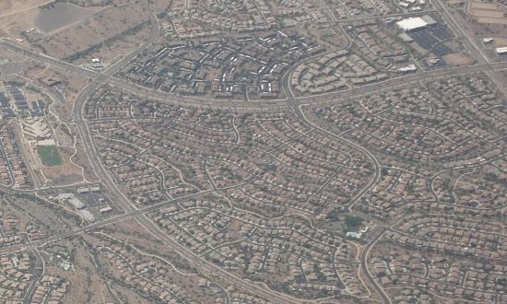
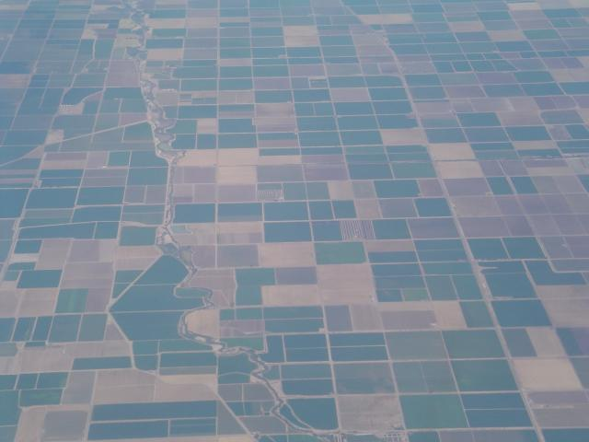
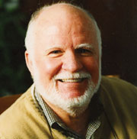
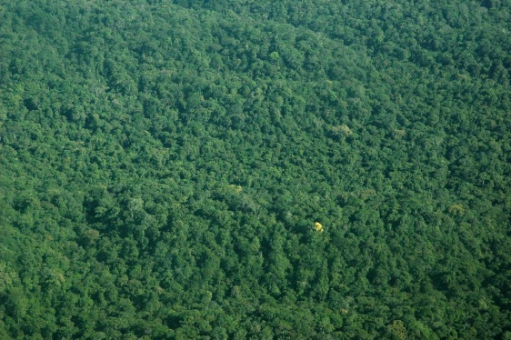
Grand Challenge 2:
Sustainable landscapes for mitigating and adapting to global environmental change
Billie Turner II
Notes:
To date much attention has been given to technological and geo-engineering solutions to global and local environmental change. Far less attention has been given to meso-scale and land-based solutions, save for specific purposes, such as REDD+. The design of landscapes not only affects environmental services and some human outcomes, their reshaping will surely follow as a de facto adaptation strategy, if ignored as a mitigating strategy, to climate and other environmental changes. The landscape approach permits multiple environmental services and human outcomes to be in play and offers a means to address up and down scalar interactions.

Slide 21
Is an interdisciplinary, cross-institution, cross-cultural course more than the sum of its parts?
Notes:
Add quotes here.

Slide 22
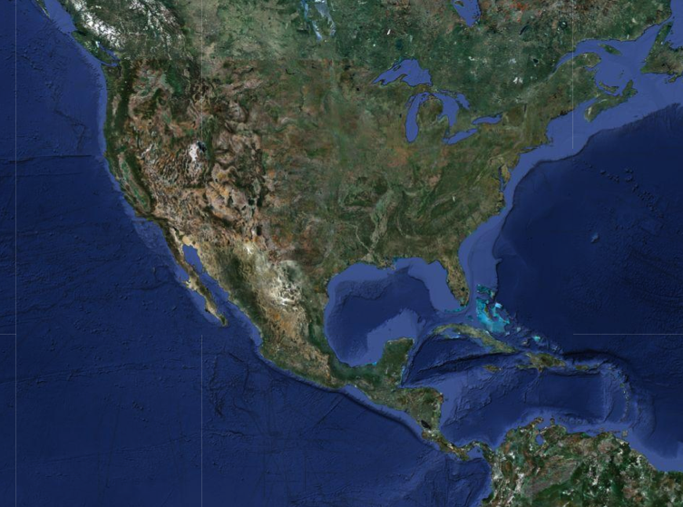
Insight #1: Finding common ground across contexts
Notes:
Sustainability goals can be grounded in a common framework recognizing that constraints and values change with context

Slide 23
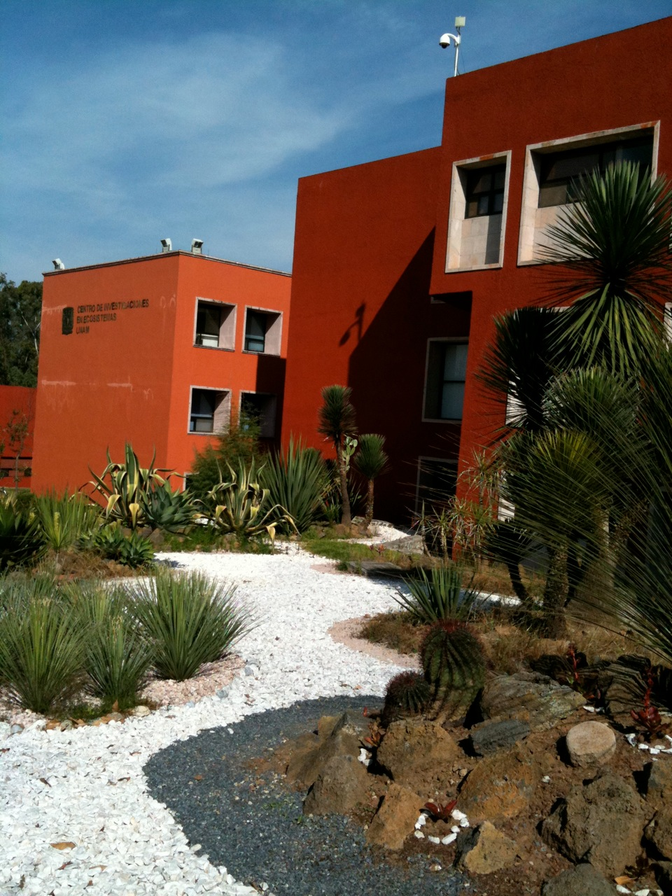
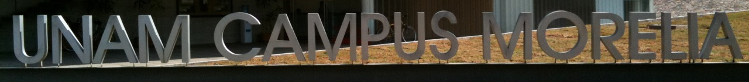

Slide 24
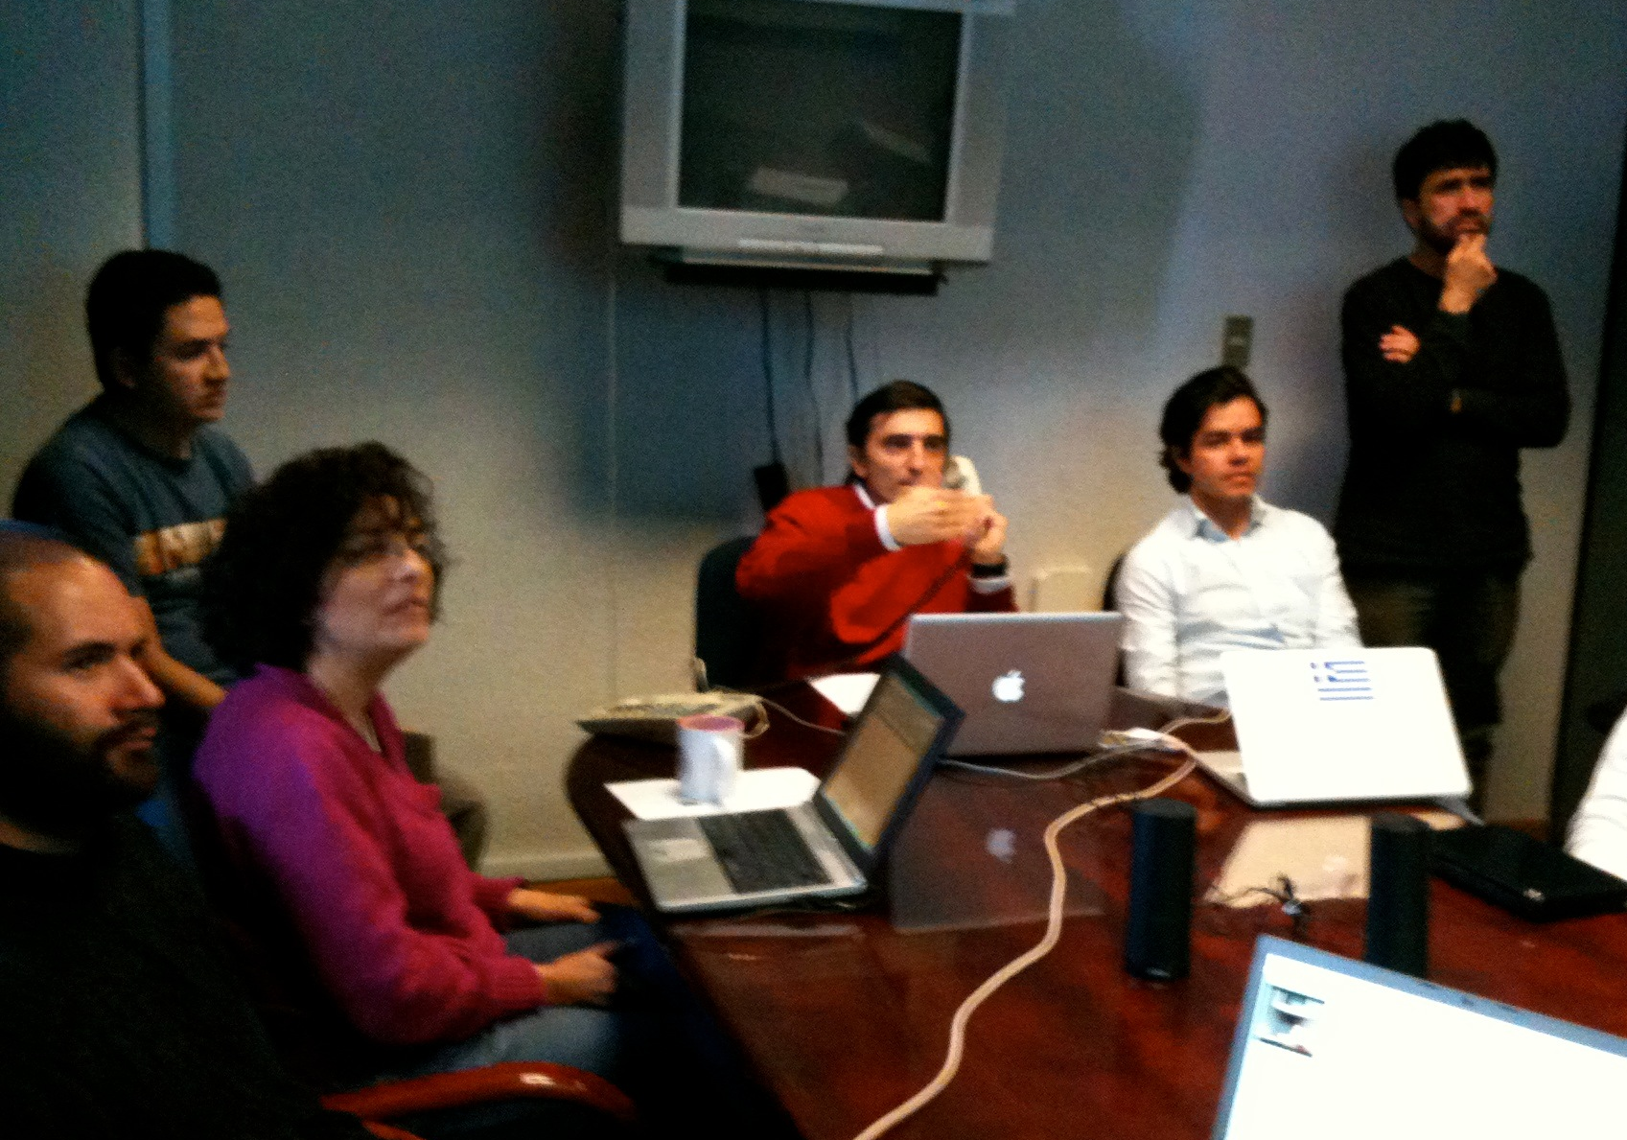
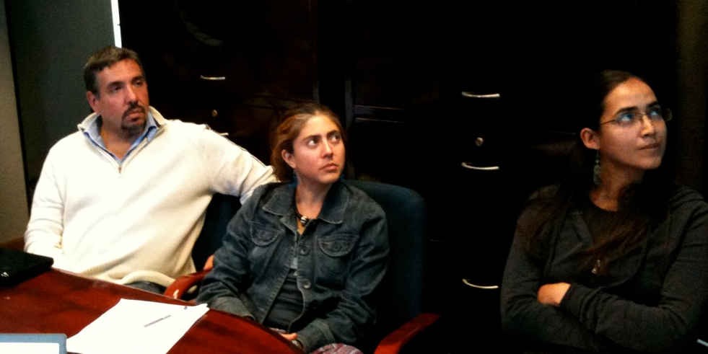
Omar Masera
Patricia Balvanera
Notes:
* Technology – unreliable internet connections and band-width problems
Language barrier
I visited them during one one of the semester and was astonished to find that their local session was 5 hours long! – necessary to work through lectures and readings provided in English only, to interpret and to discuss them.
Contrasting perspectives – conflict arose around issues of 1) development pathways and 2) how to evaluate sustainability

Slide 25
Biophysical constraints create trade-offs between ecosystem services
(Food production)
Notes:
Based on simple models in ecology and economics we can derive biophysical constraints on a human-environment system

Slide 26
Biophysical constraints can change with context and scale
Southern Mexico
Minnesota
(Food production)
(Food production)

Slide 27
Values can also change with context and scale
Local Community
National Government
High well-being
Low well-being
Notes:
Indifference represent isolines of equal utility (all values of x and y that give the same utility). The three indifference curves indicate three increasing levels of utility.

Slide 28
Efficient decisions about ecosystem service trade-offs reflect the intersection of constraints and values

Slide 29
Well-being reflects both constraints and values

Slide 30
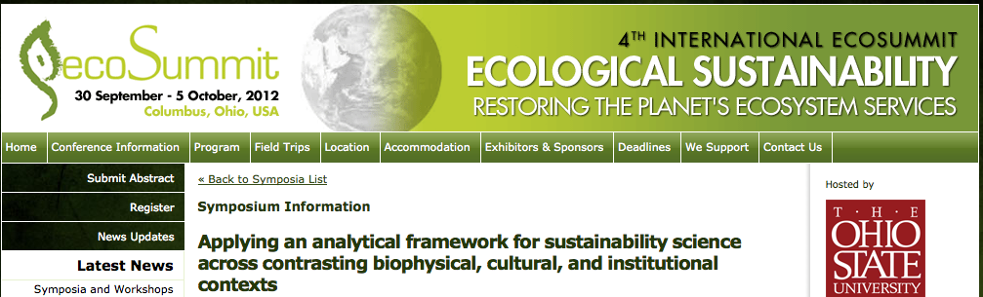

Slide 31
Insight #2: Constrasting sustainability criteria use the same fundamental components
Notes:
Under the hood, sustainability criteria have common ground

Slide 32
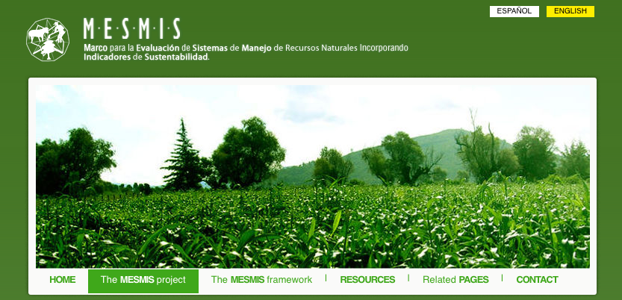
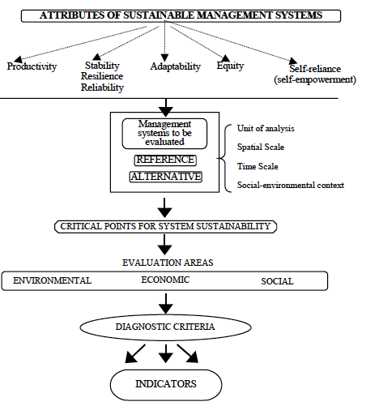
Sustainability criteria
http://mesmis.gira.org.mx/
Notes:
Sustainability criteria

Slide 33
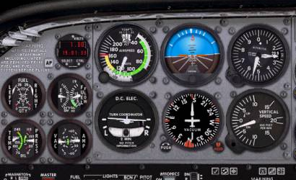
Sustainability criteria
http://mesmis.gira.org.mx/
“Dashboard” approach
Notes:
Sustainability criteria

Slide 34
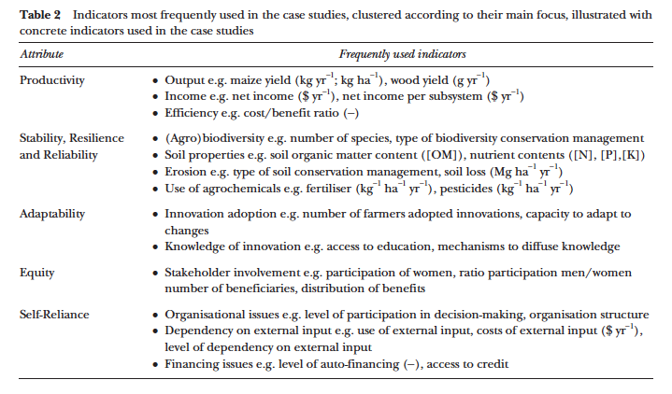
Notes:
Natural capital framework seeks to avoid double counting since all capital components get added up. Unique endpoints of human well-being.
MESMIS framework is more of a dashboard approach – not a concern if there is double counting
un

Slide 35

Under the hood – the approaches are similar

Slide 36
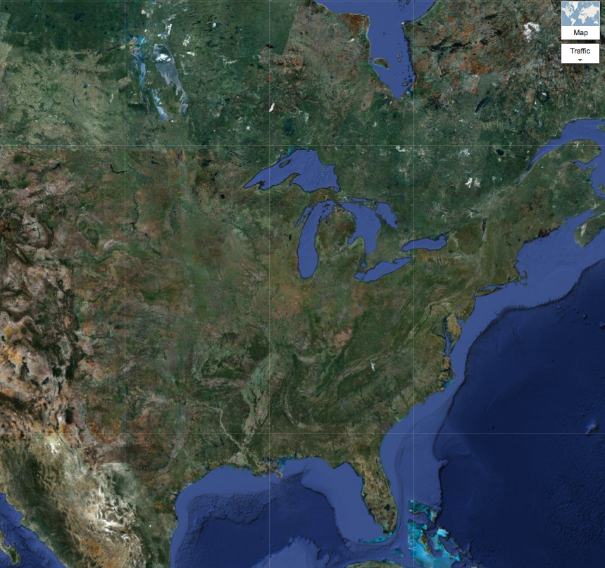
Insight #3: Merging perspectives across institutions yields novel thinking
Notes:
: Applying knowledge systems the heartland

Slide 38
Notes:
Following approach of McCullough and Matson 2011 presented in Bill Clark’s session on knowledge systems.
Boundary organizations and boundary objects in yellow
Green are most widely used sources of information

Slide 39
Major Outcomes
A community and network of sustainability scientists
Cross-cultural, cross-institutional, cross-disciplinary insights
Website, publications, symposium
Notes:
Conflict among traditional conservation approaches to sustainability that emerge from ecology with approaches that stem from the development side and consider human well-being first

Slide 40
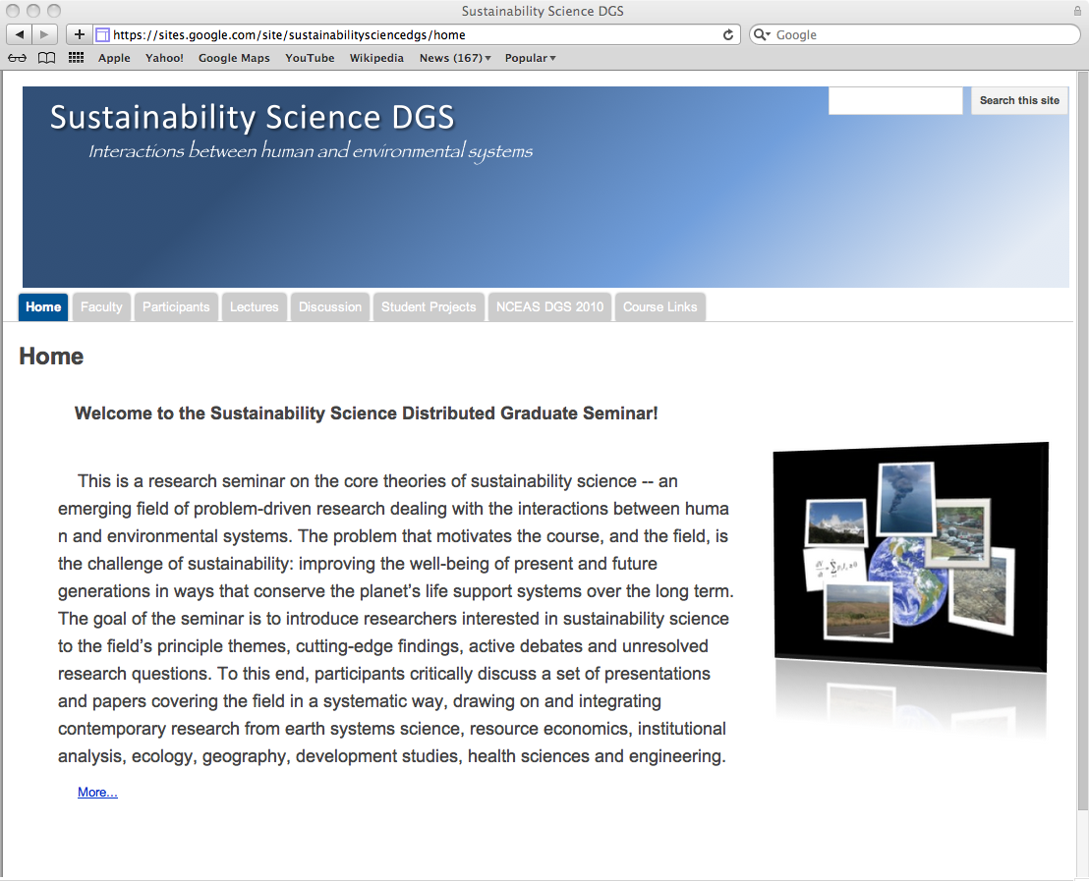
Sites.google.com/site/sustainabilitysciencedgs

Slide 41
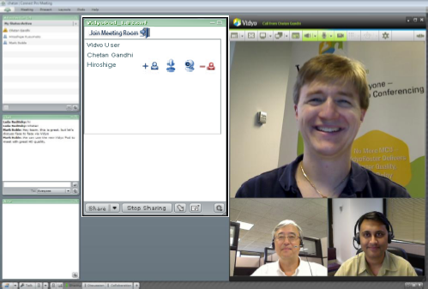


Recommendations: Technology
Have adequate technical support on all campuses
Keep it simple
  surveys indicated clearly that slides and audio are the only essentials
Lower barriers for faculty
  e.g., make recording videos easy and fail-safe
Be prepared for hiccups in technology
  Have good backup in-place for slides/audio
Be able to handle sharing large files
Back-ups: phone + slides

Slide 42
Recommendations: Process
Face-to-face organizational meeting
  faculty + student reps
Weekly local session is critical
Consider pre-recorded lectures
  more time for discussion
Create interaction opportunities for students
  Interactive Website

Slide 43
Recommendations: Process
International collaboration – takes a great deal of effort but pay-off is high
Multiple post-course meetings allow products and publications to develop

