Slide 1
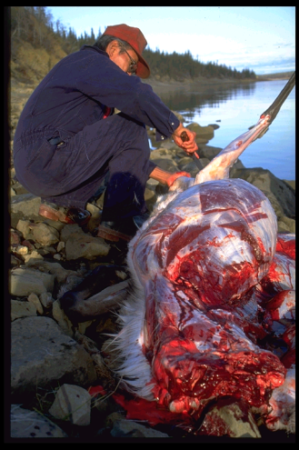
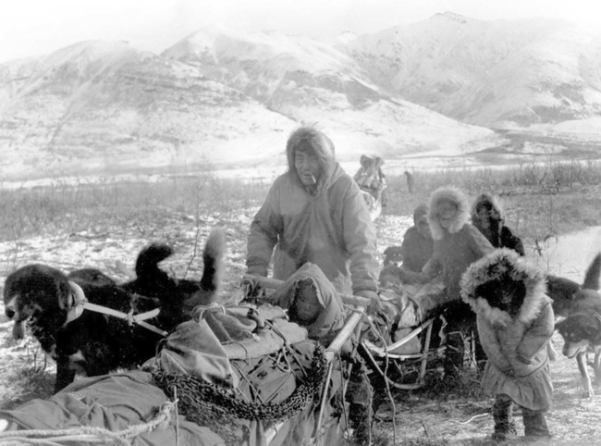
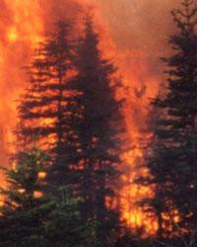
Local Knowledge for the Study of Sustainability and Resilience in Indigenous Villages of Northern Alaska
Gary Kofinas
University of Alaska Fairbanks Bonanza Creek and Arctic LTERs

Slide 2
Recommendations and comments from NSF’s 30 year review of LTER
“.. . . we are not convinced that social science research is, in its own right, a central value-added component for the network as a whole. . .
  explore ways to conduct meaningful research on theory-driven, fundamental questions that relate to both human and natural system dynamics
“Citizen science shows increasing promise as an outreach and educational tool to local communities. . . Success is partially predicated on increasing the diversity of scientists, staff and students at each site as role models to the citizen scientists and each site must enhance its efforts in this area.”

Slide 3
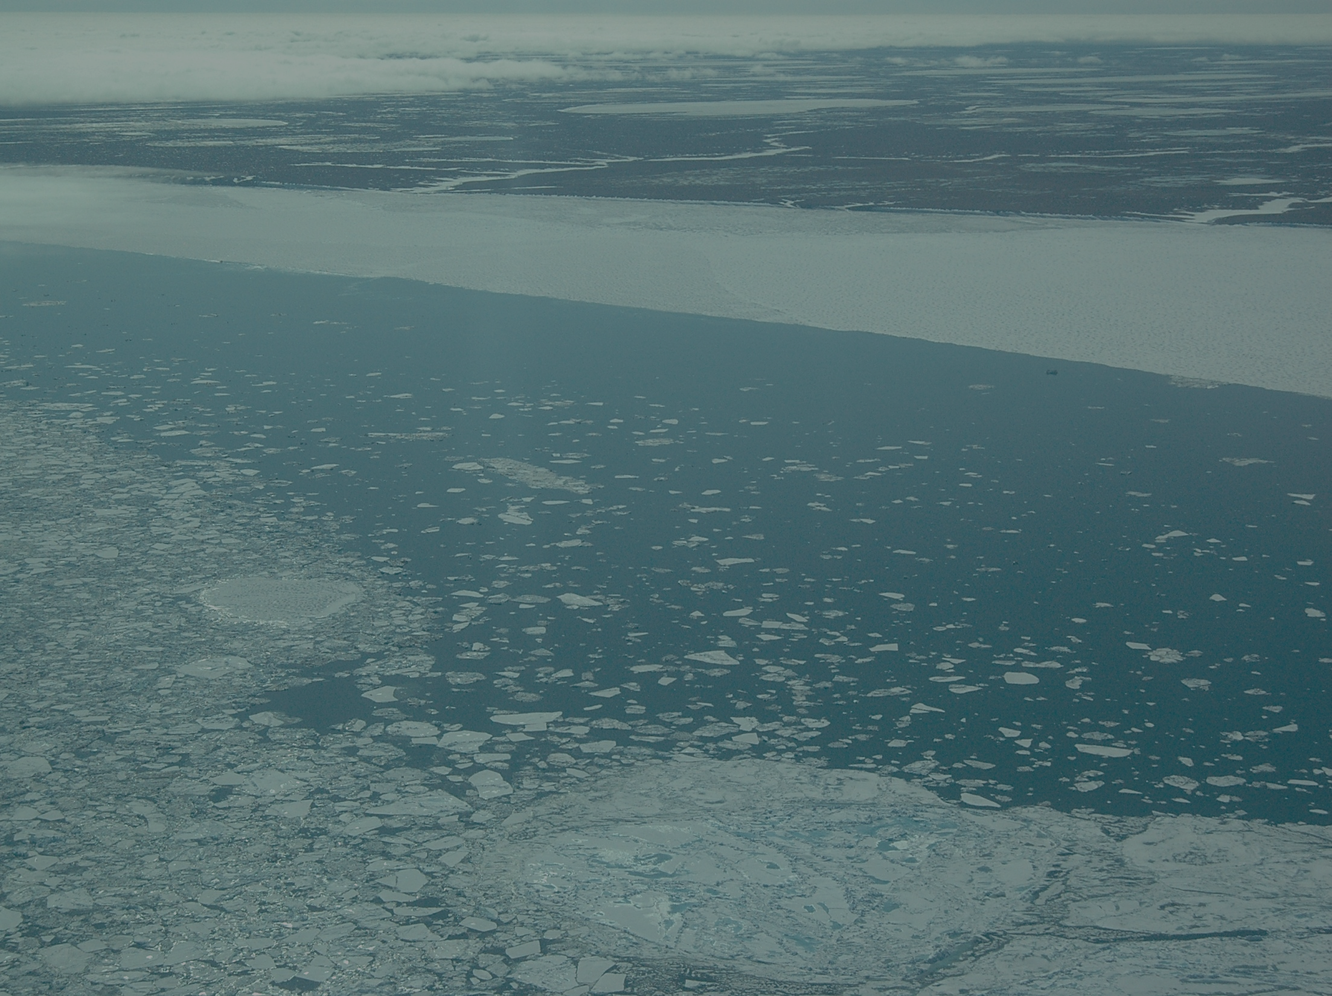
Inclusion of LK in LTER.…
Contributes to resilience of an SES by
helping to implement and add an epistemological and methodological dimension to LTER’s ISSE/ Pulse - Press Framework
improving understanding of social-ecological dynamics
linking science with policy
redefining “Outreach” to be more meaningful to citizens
has inherent and irreconcilable challenges.
comes with limitations related to resource deficiencies (time, people, money)

Slide 4
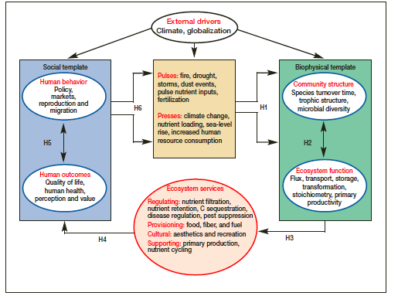
Collins et al 2010

Slide 5
Collins et al 2010

Slide 6
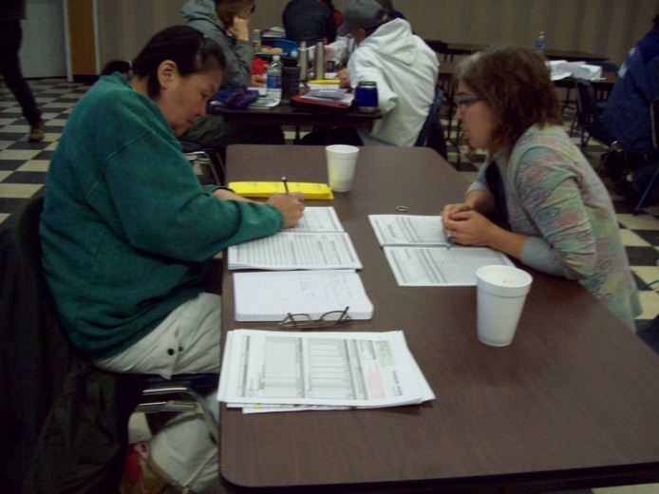
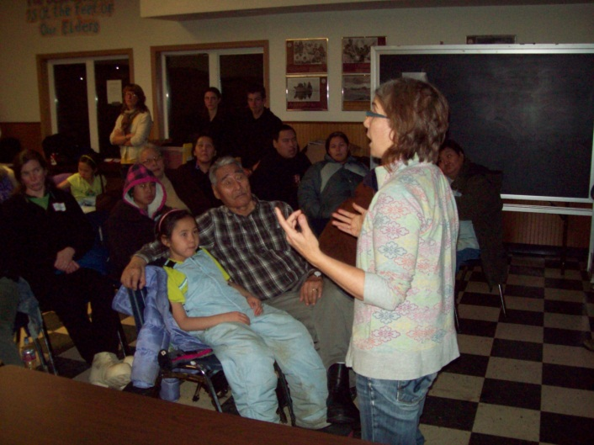
PROJECTS
Regional consequences of changing climate-disturbance interactions for the resilience of Alaska’s boreal forest (BNZ)
Maps and Locals: (MALS) Project Arctic & BNZ and the LTER Network NSF
Study of Sharing Networks to Assess Vulnerability of Coastal Communities to Oil and Gas Development / BOEM
IPY: Climate Change, Ecosystem Services, and Society NSF
Modeling harvesting behavior to understand adaptation, mitigation, and transformation in northern subsistence systems, NSF

Slide 7
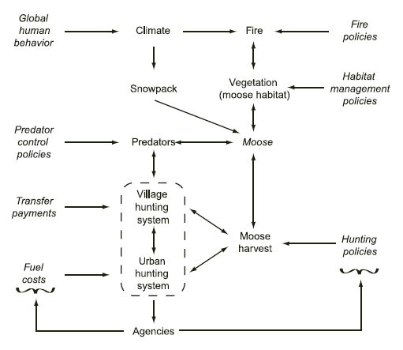
Kofinas et al 2010

Slide 8
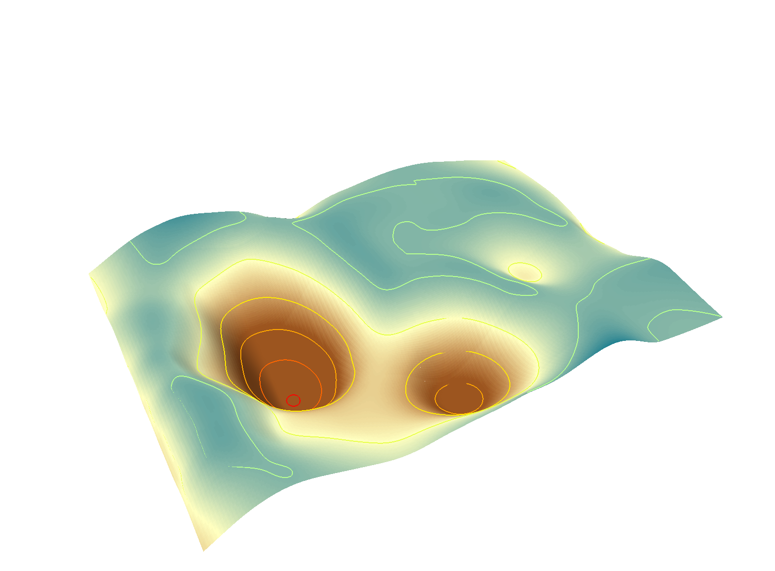
resilience
Resilience defined:“The ability of a system to absorb disturbance and re-organise so as to retain the same structure, function, feedbacks and (therefore) identity.”
(Walker et al 2002)
Regime shifts
Specified Resilience
General Resilience
Tradeoffs

Slide 9
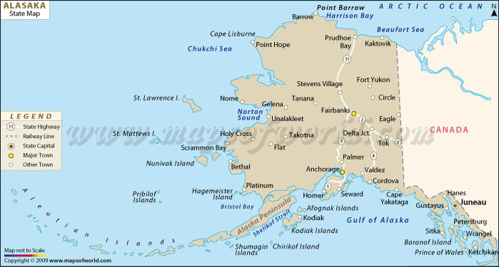
Community partners in research
Wainwright
Anaktuvik Pass
Kaktovik
Venetie
Selawik
Ft Yukon
Nenana
Yakutat

Slide 10
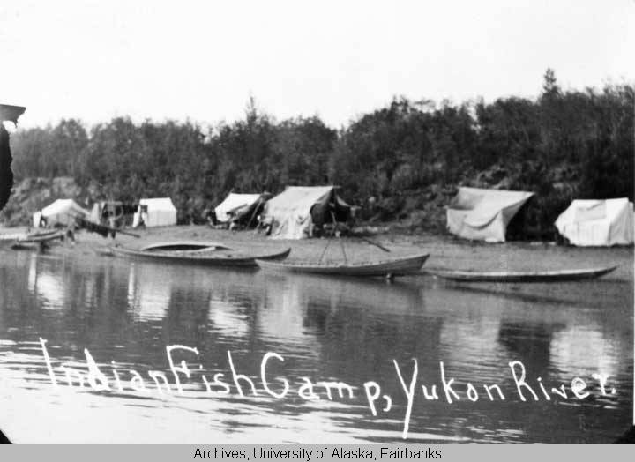
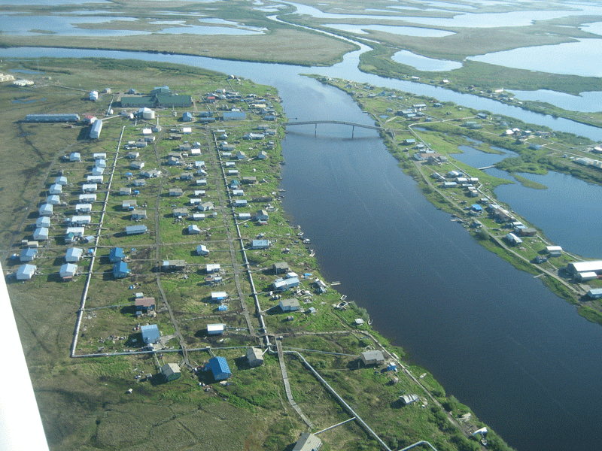
Communities & Settlement
Nunamiut family, early 1900 century
Indian Fish Camp, Yukon River (Stevens Village)
c. 1910-1912.
Selawik, Alaska
2008

Slide 11
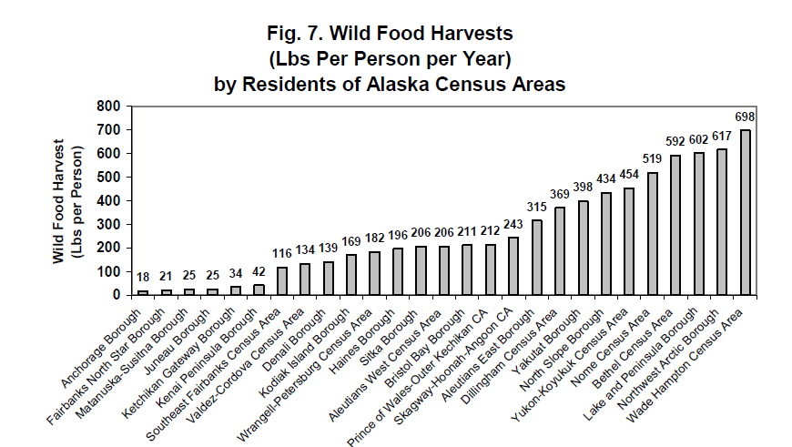
Local ecological knowledge as product of experience
Wolfe et al 2004

Slide 12
Speculated village-level transformations
Ecological Transformations: Δ in key species and mode of subsistence harvesting
Economic Transformations: Mixed to cash/jobs based economy
Ethnic Transformation: Indigenous to community of mixed ethnicity
Cultural Transformation: loss of indigenous spoken language and identity
Settlement Transformation: Permanent -> to holiday settlement or unviable settlement

Slide 13
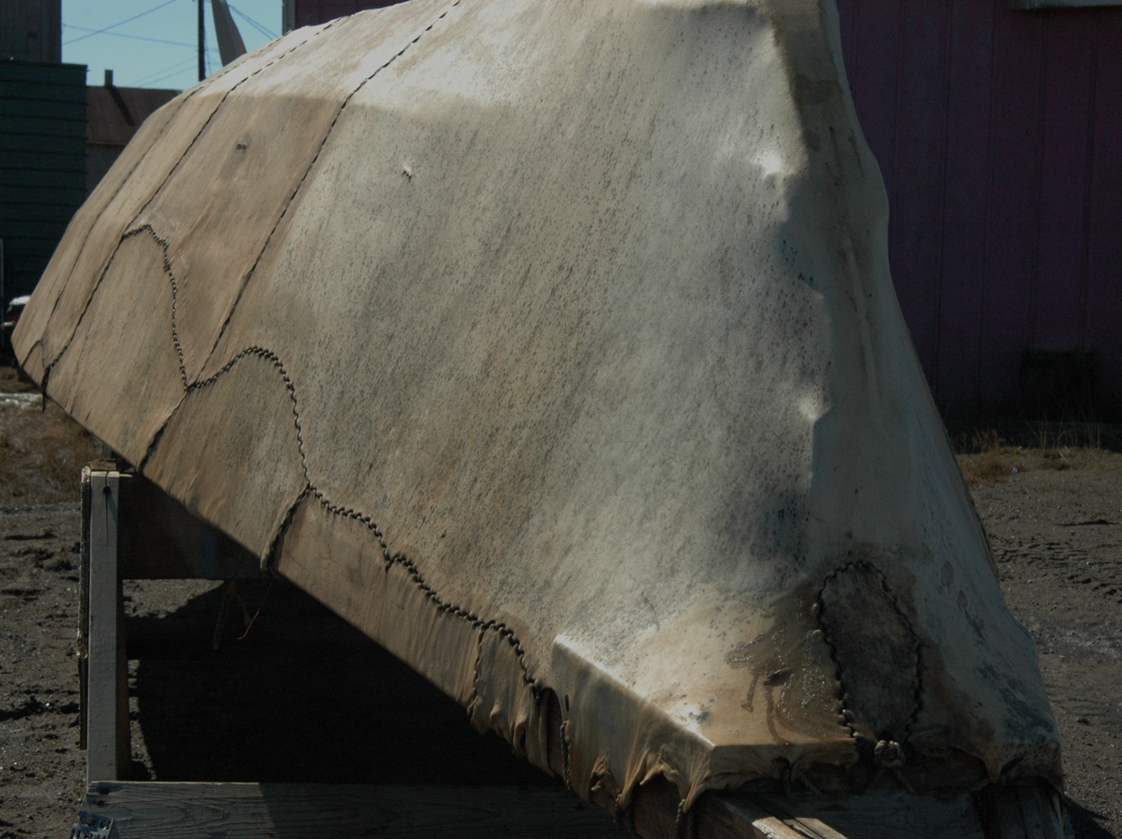
Traditional
Ecological
Knowledge
Local Knowledge
Expert Knowledge
Community Knowledge
Citizen Science
Indigenous Knowledge
Folk Knowledge
Notes:
What is knowledge
Observations that inform understandings and interpretation that shape choices and values, which are underpinned with worldview and ideology

Slide 14
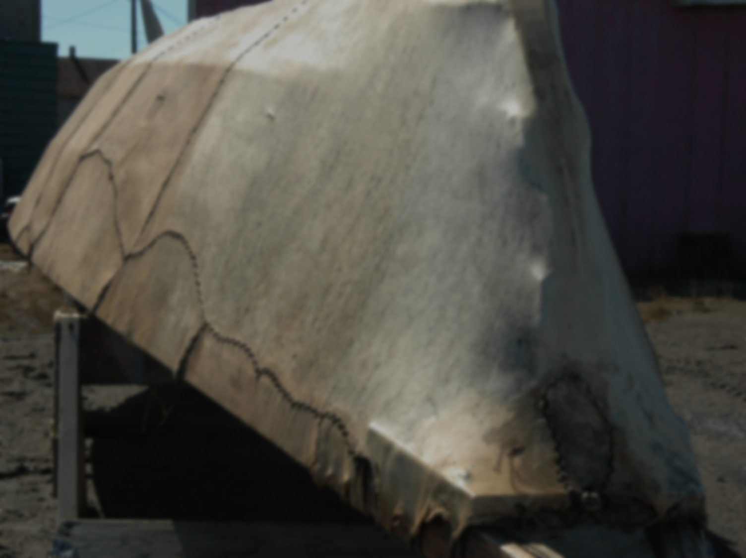
In 1962 Claude Levi-Strauss argued that there are two parallel modes of acquiring knowledge about the universe; two sciences that are fundamentally distinct in that “the physical world is approached from opposite ends in the two cases: one is supremely concrete, the other supremely abstract.”
Notes:
Early by anthros
Folk science

Slide 15
Information about fauna and flora of their habitat was every extensive. Of 103 bird species identified at Old Crow, Yukon Territory, in 1957, and ornithologist has found that … the [Gwich’in] has names for 99 species.”
Lawrence Irving 1958
Indigenous knowledge as ethnoscience

Slide 16
Oppositional view of knowledge systems
Comparison
Relationship
Dominant mode of thinking
Communication
Data creation
Prediction
Explanation
Biological classification
Indigenous
Subordinate
Intuitive (holistic)
Oral (stories, experiential)
Slow/inconclusive
Short-term cycles
(recognize the onset of long-term cycles)
Spiritual (the inexplicable)
Ecological (inconclusive, internally differentiating)
Western scientific
Dominant
Analytical (reductionist)
Literature/dialectic (academic, objective, positivist)
Fast/selective
Short-term linear (Poor long-term analysis)
Scientific Inquiry (hypotheses, laws)
Genetic and hierarchical (differentiating)

Slide 17
Functionalist perspective …
Hunters were not “conservationists,” but actors seeking to secure access to resources in conditions of high uncertainty. (Fienup-Riodan)

Slide 18

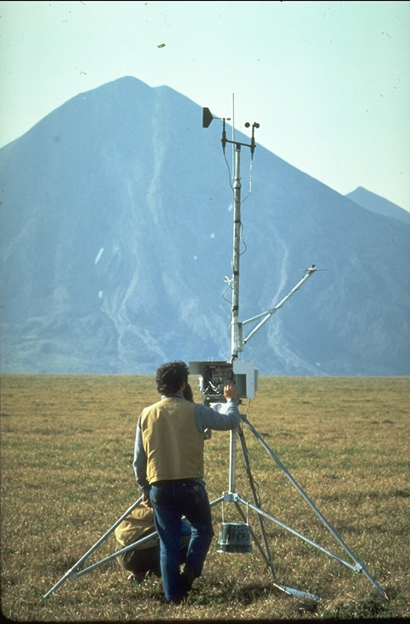
The Political Perspective
“If you want to be
involved, get an education…”
“Native hunters know more…”

Slide 19
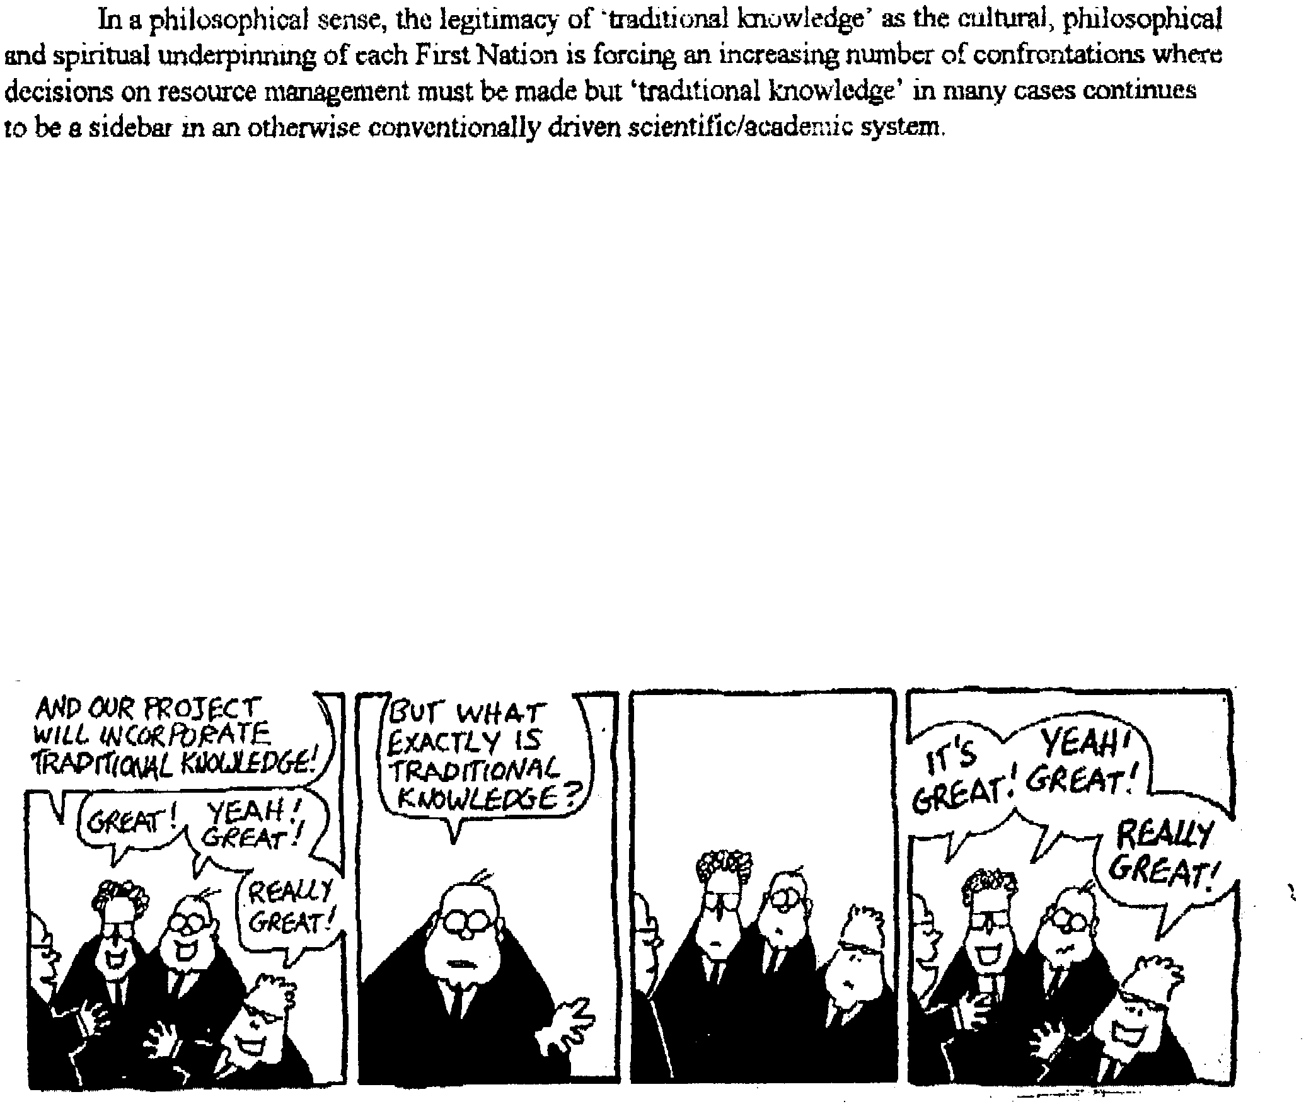
A grant writer’s perspectives

Slide 20
Local Ecological Knowledge;
Traditional ecological knowledge;
Indigenous knowledge
a cumulative body of knowledge, practice and belief, evolving by adaptive processes and handed down through generations by cultural transmission”
A way of life and a way of knowing
Distinction between knowledge as process vs. knowledge as the thing known
Dynamic
Berkes 2000, 2012

Slide 21
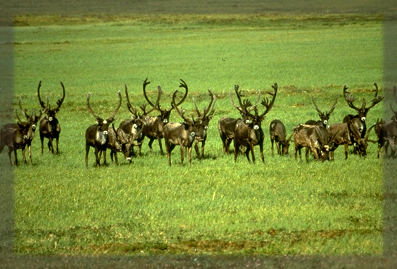
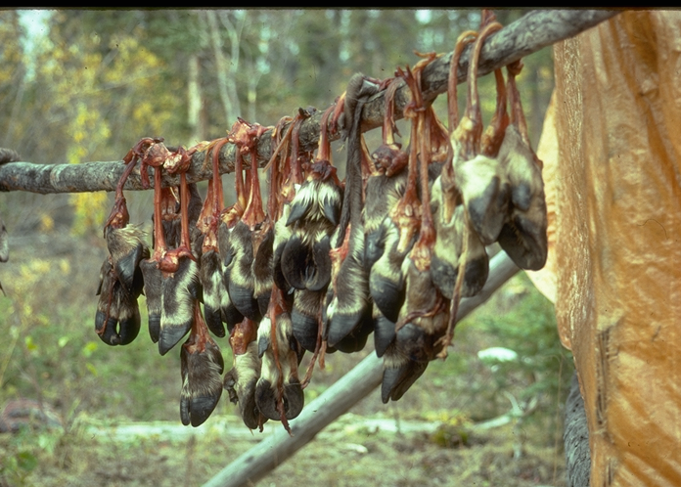
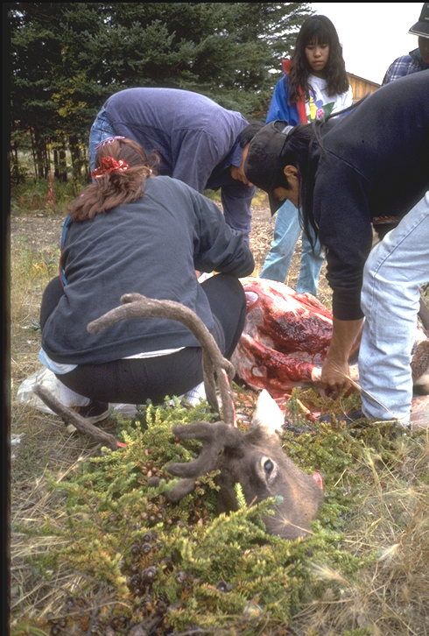
Worldview & Ideological Perspective
”…our people were caribou at one time, then we changed places with the people.”

Slide 22
Subsistence Sharing as a source of Resilience
All household receiving ties in Wainwright, Alaska: Caribou, moose, geese, ducks, salmon, berries, bowhead, and labor equipment, and cash…
Kofinas and BurnSilver
Wainwright with whaling

Slide 23
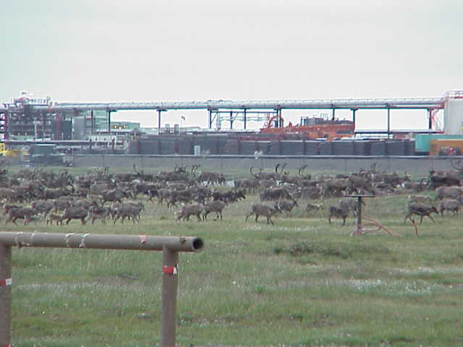
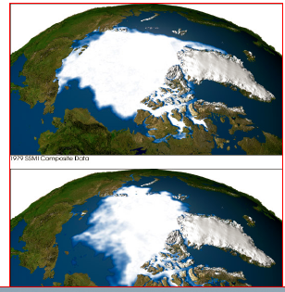
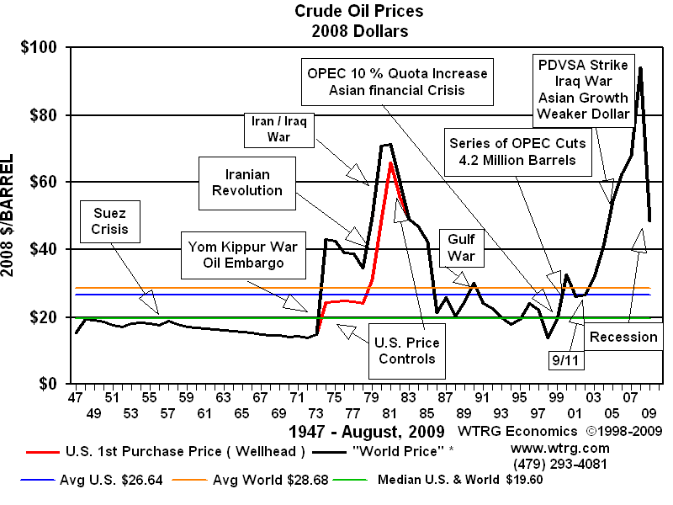
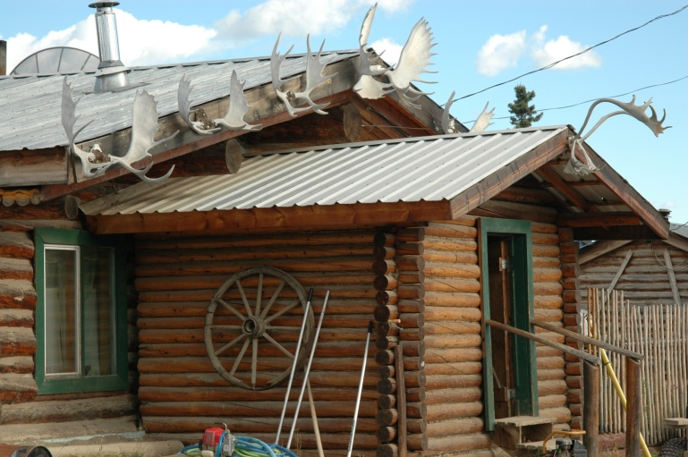
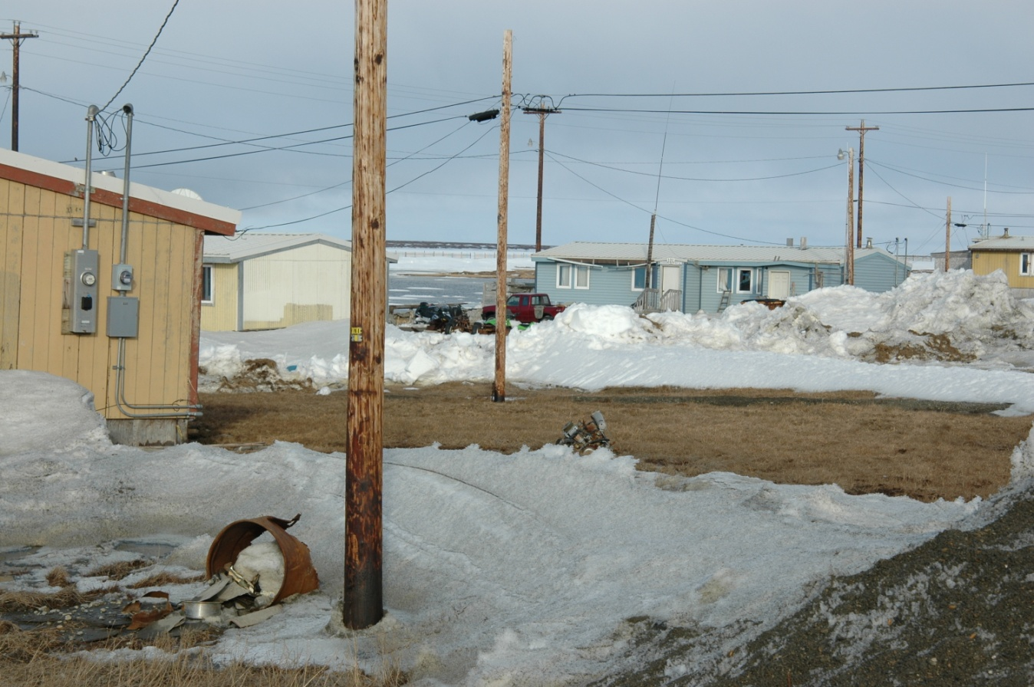
Sources: http://www.wtrg.com/oil_graphs/oilprice1947.gif
Notes:
Climate as recent shift in focus on drivers of change

Slide 24
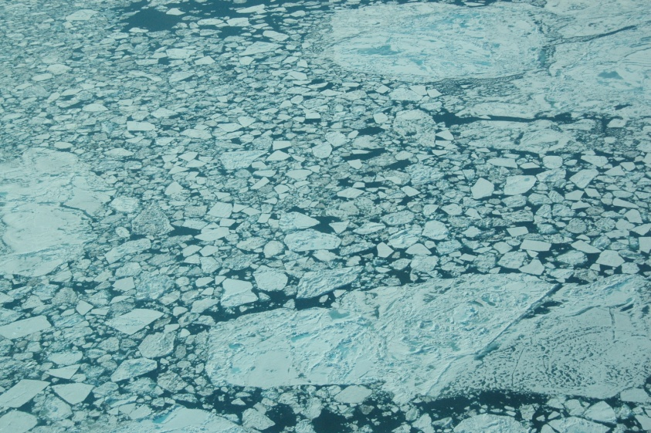
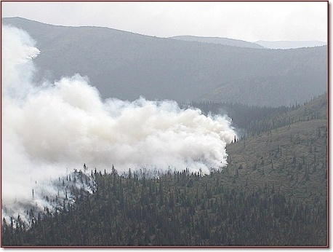
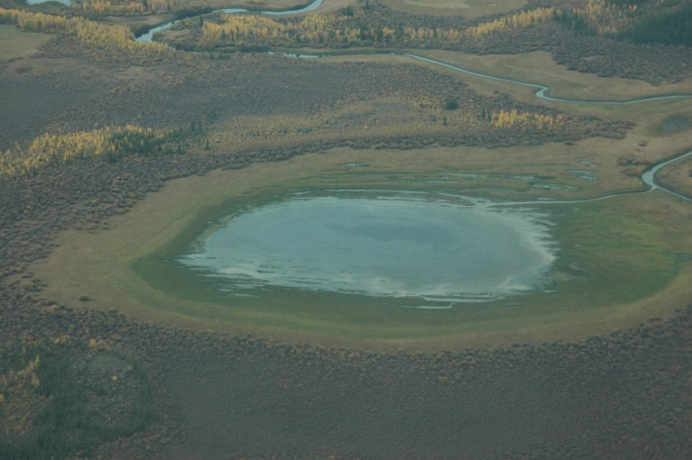
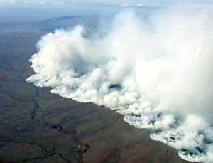
Most significant changes in land /sea surface conditions…
Melting ice
Increased fire frequency
2004 Venetie Fire
(2/3 of Venetie’s 1.8 million acres private lands
Sea Ice loss; late freeze up and melt)
2007 North Slope Anaktuvuk tundra fire
(1000 sq km)
Permafrost melting in Interior AK

Slide 25
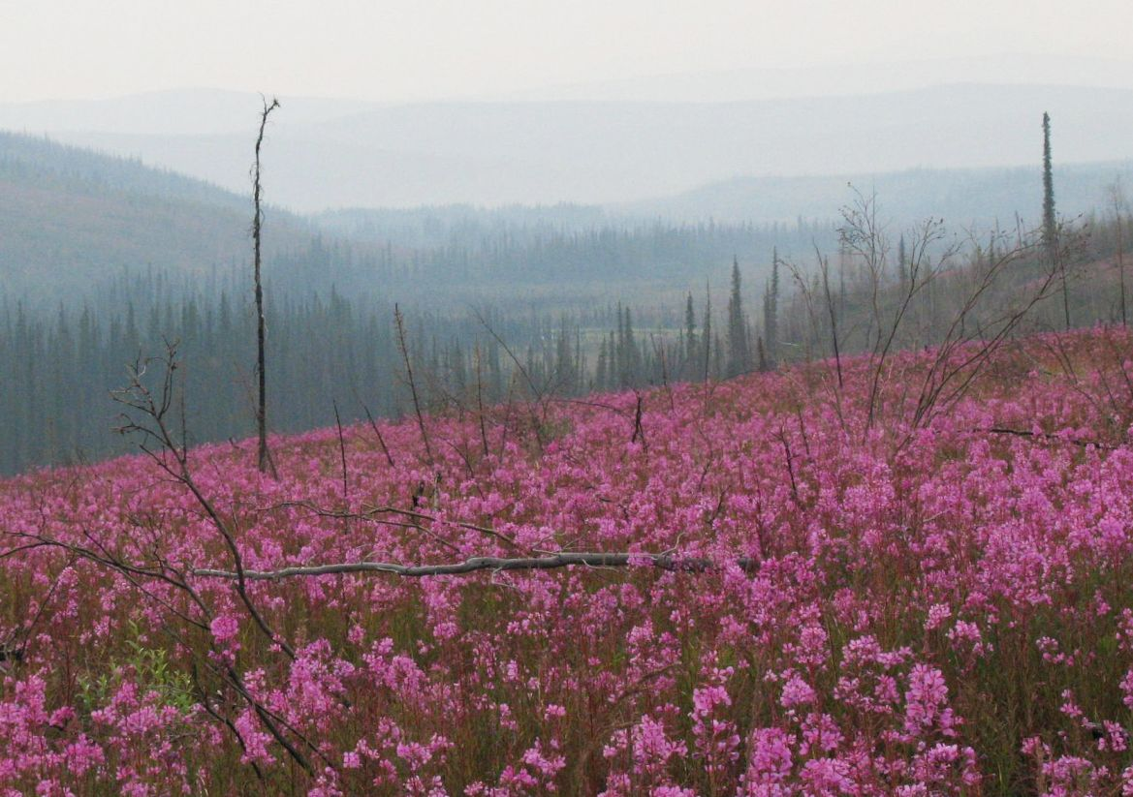
Disturbance effects
Legacy, disturbance severity, frequency, size

Slide 26
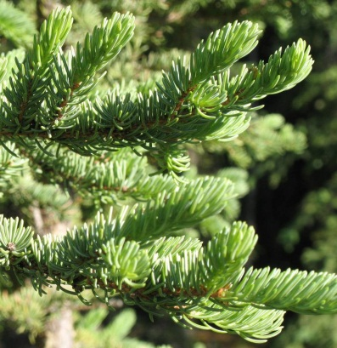
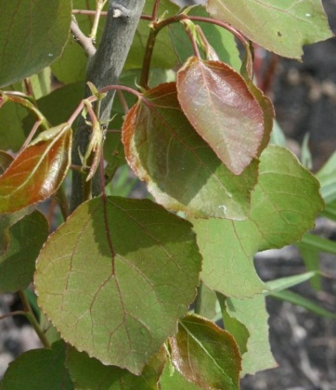
Alternate successional cycles
A. Black spruce domain
B. Broadleaf forest domain
Black spruce dominant
Broadleaf dominant
High moisture
High moss
Cool soils
FIRE
Low moisture
Low moss
Warm soils
FIRE
Local seed & Resprouting
Resprouting &
Seed dispersal
Slow growth
Rapid growth
Poor quality seedbeds (organic soil)
High quality seedbeds (mineral soil)
Slow nutrient turnover
Low competition
Rapid nutrient turnover
High competition
Johnstone et al. 2010, Can. J. Forest Research

Slide 27
Successional pathways
Stochastic pathways to
semi-deterministic endpoints?
Community Composition
Time (log scale)
Jill Johnstone BNZ LTER

Slide 28
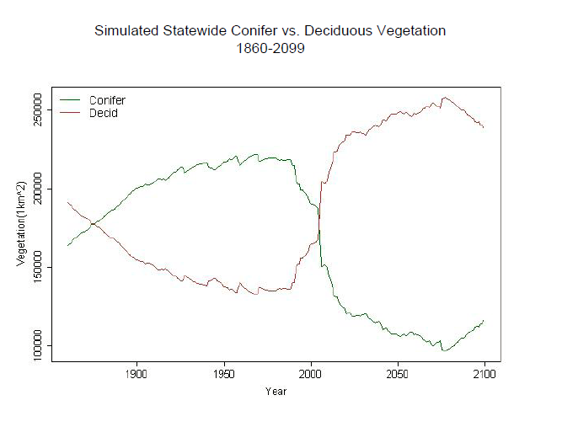
Rupp / SNAP

Slide 29
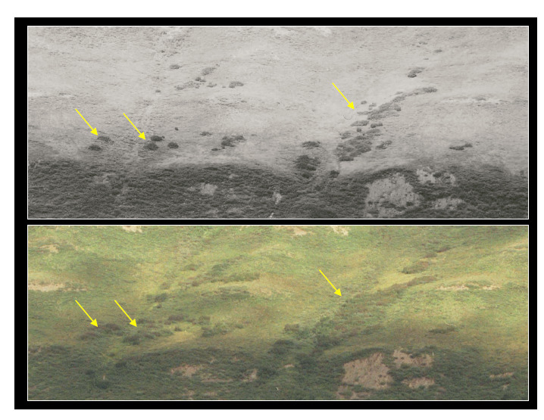
Shrubification of the Arctic
~1954
2004
K. Tape

Slide 30
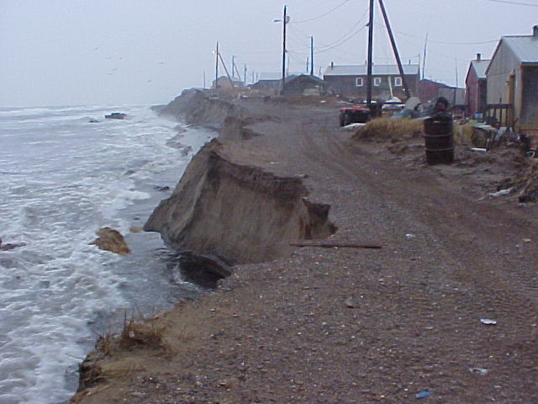
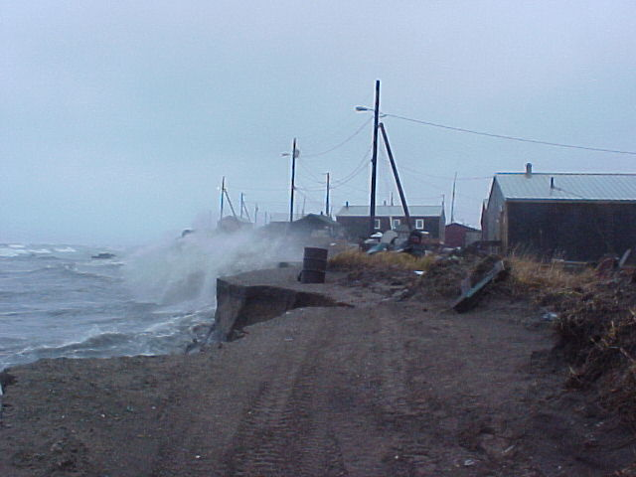
“Forced Migration”
12:37
2:32
Shishmaref, AK
Photos: T. Weyiouanna http://www.shishmarefrelocation.com/
Increasing
open water
Stronger wind
generated waves
Increased
coastal
erosion
Thawing permafrost
(Chris Petrich)

Slide 31
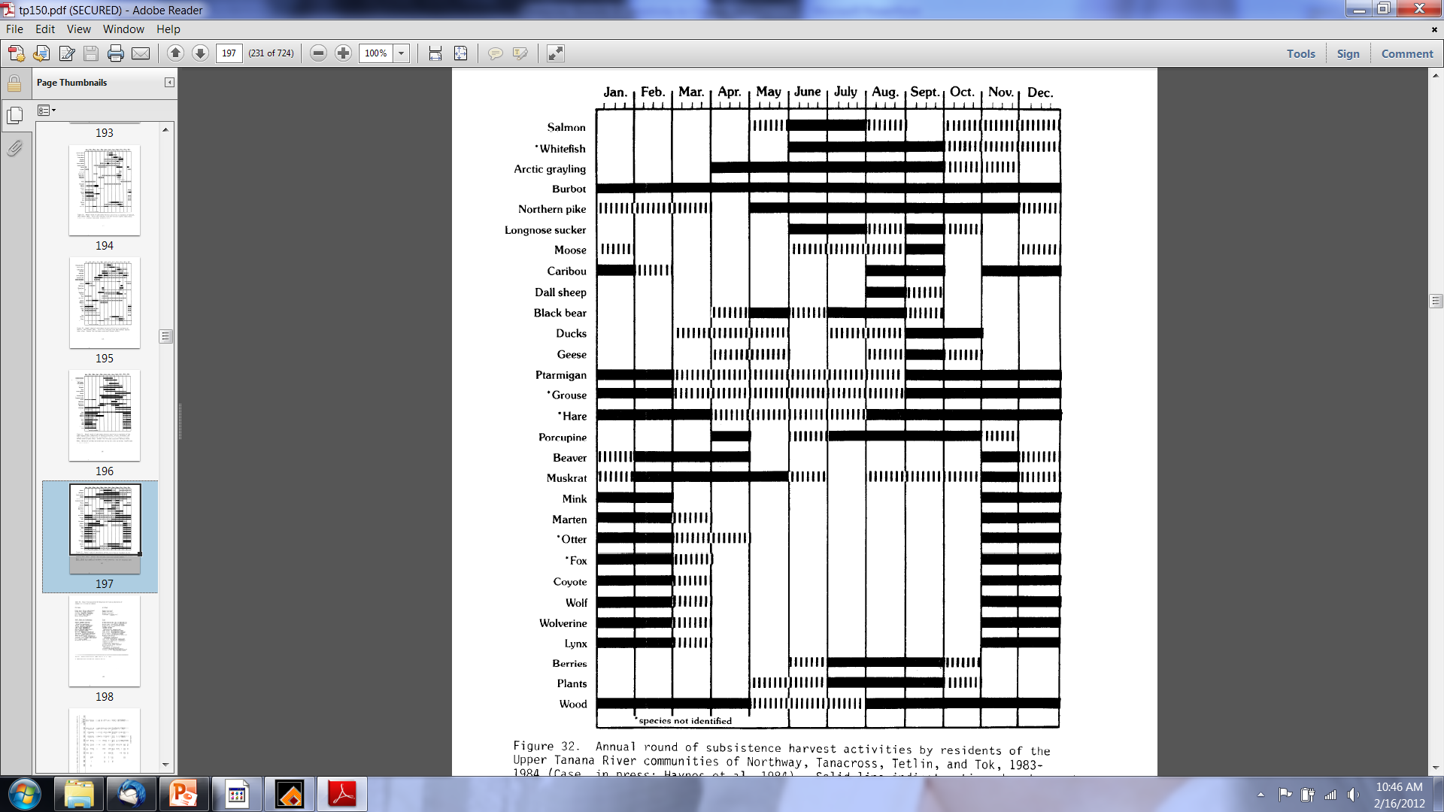

Slide 32
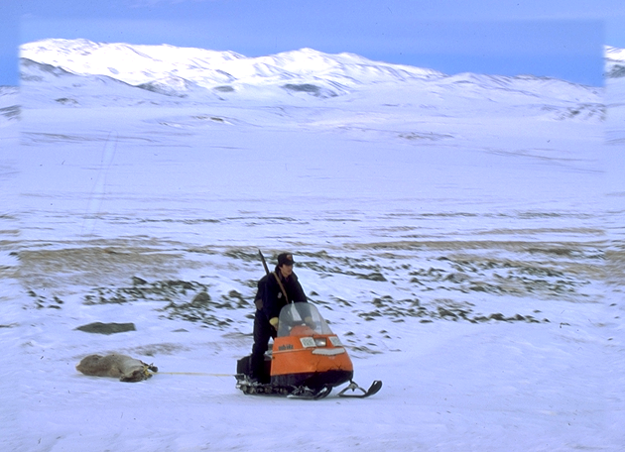
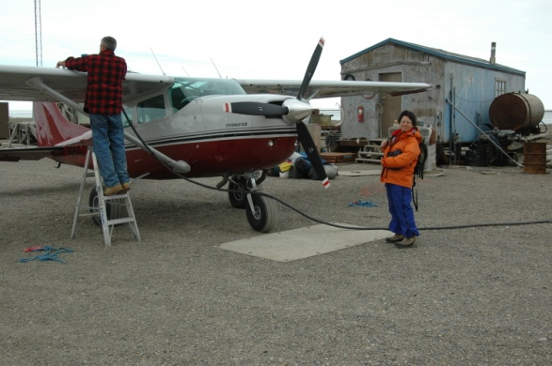
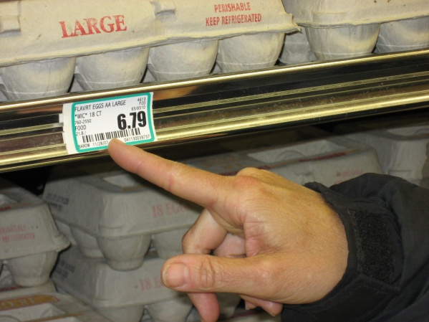
Fuel costs
 | Kaktovik | Venetie
Fuel spike in 2007 | 300% | 629%
subsidy | North Slope Borough fuel subsidy | Accepted Chavez’s gift of 100 gals to low income HHs

Slide 33
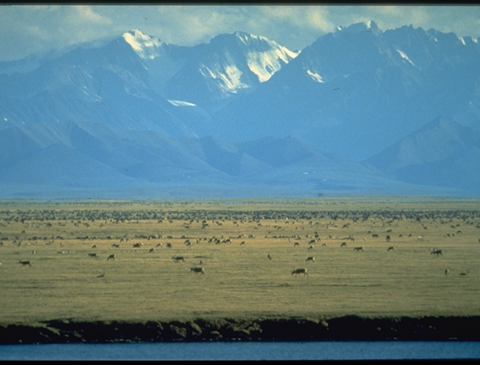
A Fragile Arctic Ecosystem?
Common assumptions
Notes:
Age old question
Fragile question in the face of rapid change forcing us to rethink ideas of sustainability…
Ecosystems
Low temperatures
Regeneration is protracted
Concentration of animals
Climate conditions produce more CO2 induced warming – greenhouse more pronounced in the northern latitudes
Dry
Long range transport
Sever weather and ice dynamics
Adaptability
Rapid culture change

Slide 34
NSF SEARCH - Study of Arctic Environmental Change
Understanding (mental and simulation modeling)
Observing (monitoring)
Responding
(adaptive
co-management)

Slide 35
NSF SEARCH - Study of Arctic Environmental Change
Understanding (mental and simulation modeling)
Observing (monitoring)
Responding
(adaptive
co-management)

Slide 36
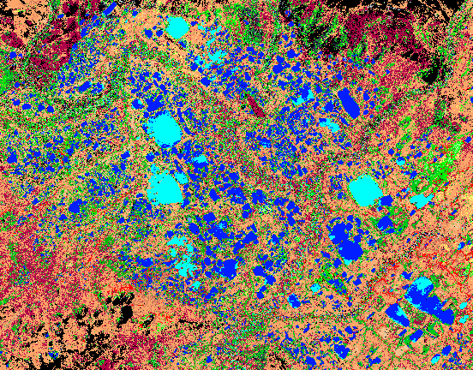
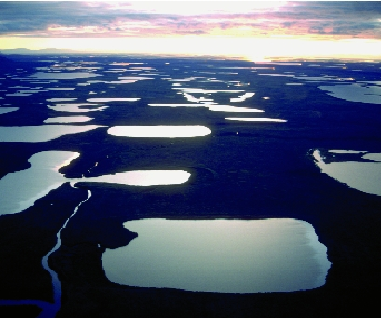
Crow Flat, Vuntut National Park, Yukon

Slide 37
Types of findings from community-based monitoring
Unusual Observations
Long-Term Trends
Emergent patterns
Social responses
Rules of Thumb

Slide 38
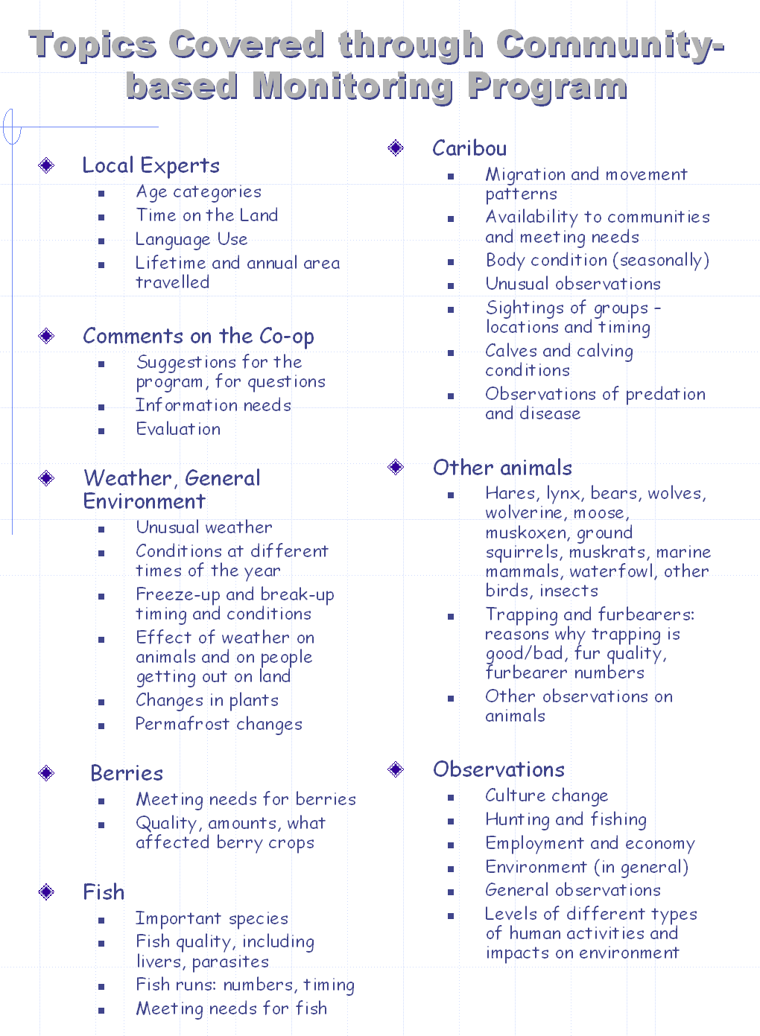

Slide 39
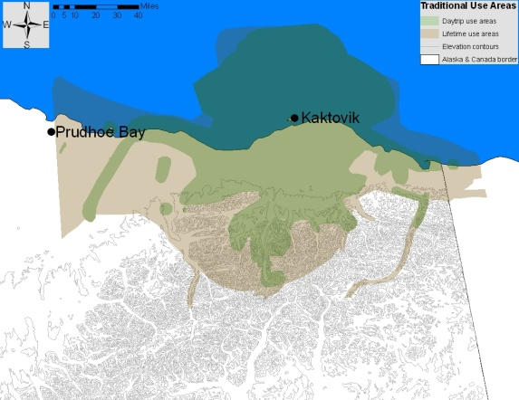
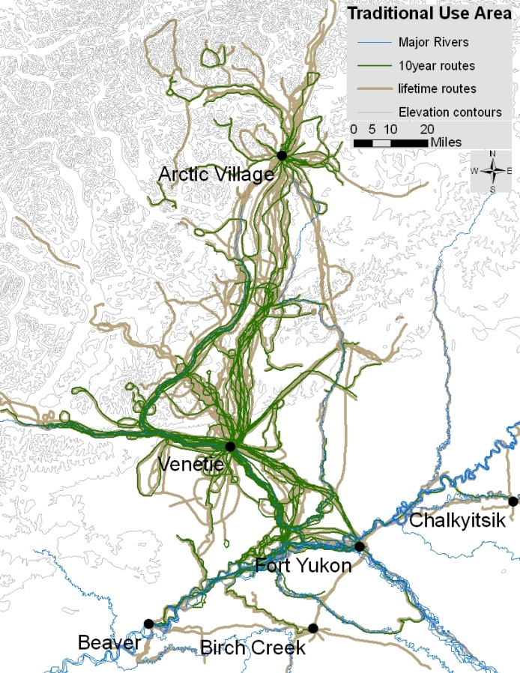
Traditional use area
Ten year and lifetime use areas defined by ~15 active harvesters per community
Venetie
Kaktovik
 | Reported lifetime use areas
Kaktovik | 67,200 sq km
Venetie | 108,900 sq km

Slide 40
NSF SEARCH - Study of Arctic Environmental Change
Understanding (mental and simulation models)
Observing (monitoring)
Responding
(adaptive
co-management)

Slide 41

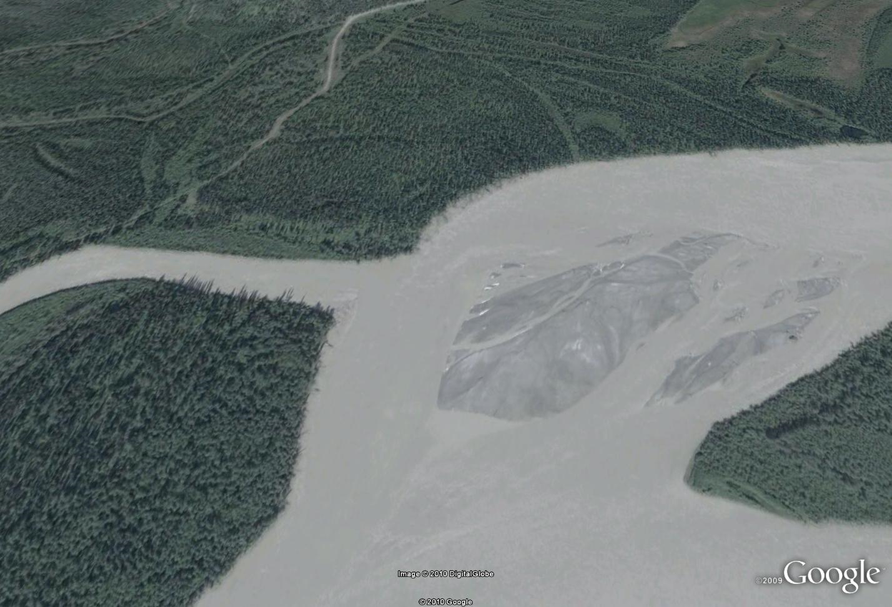

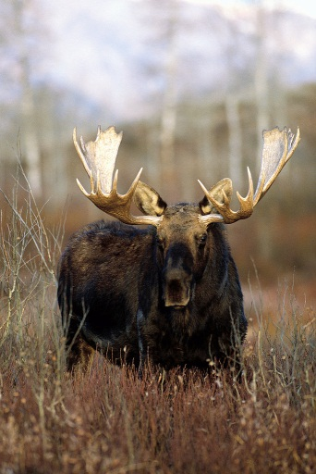
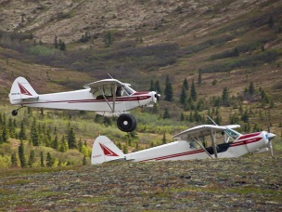
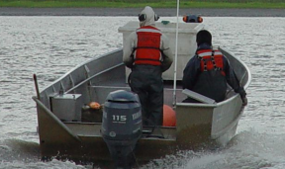
Availability = abundance + location + access

Slide 42


Berman and Kofinas 2002

Slide 43
moose | Temperatures | Rain & Drought | Snow | Freeze up /Thaw Date | Fire | Wind
Location | *↑temperatures = ↓moose activity & response to calls during rut *moose try to stay cool. | *Lake too flooded, moose to different lake to get to weeds on bottom. *If dry, move to wetter areas. *If wet, more habitat available. | *Avoidance of crusty, deep, and hard pack snow ↓snow = later migration Avoid north side of mountains because of windblown hard pack. | *Later freeze delays migration. *Earlier thaw brings moose down sooner | *Burns displace moose, but use areas more within a few years. *Big fire, big effect. *start using it 2-3 years | *Stronger wind in winter is avoid, and moose like wind when insects are around.
Access | * ↑temp = ↑willow = obstructed travel | ↓ rain = shallower and less navigable river *More rain reduces ATV access (ex. around Big Lake). |  |  | *Burns block trails, and create thick understory *Rough ground is hard on machines *Better visibility during first few years. *Big fire blocks all trails.
Abundance | * ↑temp = ↑willow = ↑ forage= ↑moose |  | ↓snow = ↓insulation Changes in snow depth changes efficiency of predators- more snow= less wolf predation. Too much snow, bad for young moose. |  | * ↑fire = ↑forage = ↑moose ↑understory = bears more efficient predators
Todd Brinkman

Slide 44
Moose | Fire
Abundance | +Creates better habitat
Seasonal Distribution | -Displaces initially, +then is selected for soon after
Hunter Access | -Destroys trails Regrowth -Obstructs sightability -Rougher travel conditions off trails -Destroys seasonal cabins
Caribou | Fire
Abundance | -Destroys habitat
Seasonal Distribution | -Pushes caribou away, caribou avoid burns for several human generations
Hunter Access | -Destroys trails Regrowth -Obstructs sightability -Rougher travel conditions off trails -Destroys seasonal cabins
Fish | Fire
Abundance | ?
Seasonal Distribution | -Alters channels and eddies in unpredictable ways
Hunter Access | -Loads debris in waterways: Tangles nets, Damages fish wheels -Creates dangerous travel conditions -Employment opportunities overlaps with peak harvest time
Todd Brinkman

Slide 45

Link Interactions with Future Projections
Best Science
Future Scenario of Availability
Future Scenario of Availability
Local Hunter Information
Future Scenario of Availability

Slide 46


Moose availability

Slide 47
NSF SEARCH - Study of Arctic Environmental Change
Understanding (mental and simulation models)
Observing (monitoring)
Responding
(adaptive
co-management)

Slide 48



Slide 49


Integration of LEK and Science in Scenario Planning
Prefered hunting areas, travel routes, and distance willing to carry based on local knowledge
Distribution of moose based on GPS collars
Shanley et al (submitted)

Slide 50

“LET THE CARIBOU LEADERS PASS”
Failed hunting regulations based solely on traditional ecological knowledge
E Robins

Slide 51






MALS: Maps and Locals Project
Integrate local knowledge with GIScience to understand LULCC and its implications to well being.
~11 LTER sites involved
Map analysis completed
Inventory of LK methods completed
Training workshop planned

Slide 52

Towards Network Level Science?
Questionable characters with good intentions
Oct 2010 – Fairbanks
June 2011 – Andrews Exp Forest

Slide 53



MAPS and Locals ( MALS)
North Slope landscape change
Maps and Locals (MALS) project
1990
2001
2010
Increase in surface standing water due to melting of ice-wedges between polygons
2001-2010
Martha Reynolds

Slide 54
North Slope landscape change
Maps and Locals (MALS) project
(1990, 2000, 2010 data new)
Hectares

Slide 55


Land Use Data: CLUC Codes
Data Types
Redlands 1994 (2512 ha dev)
Redlands 2006 (3179 ha dev)
Developed Land
Row Crops
Groves
Plant Nurseries
Laura Ogden FCE LTER
2 km
Fallow
Other Agriculture
Other Land
Notes:
55
55

Slide 56



Ethnographies of Place
Observational surveys 530 properties (photos, surveys)
Interviews with farmers, “gated community” residents, rural residential homeowners, and town residents
Pete Whidden being interviewed by L. Ogden.
Laura Ogdent FCE LTER

Slide 57



Rangeland Change/ Jornada LTER
Photos to document LEK
that historicizes S&T Model
State-and-transition model
for Malipi
1893
1983
Nathan Sayre

Slide 58
Ways local knowledge can fit
Questioning of underlying assumptions
Identification of key relationships
Alternative models / rules of thumb
Selection of indicators
Methods for data collection
Local-scale observations
observing
understanding
Responding
Local level interests and concerns of local users
Insight into adaptive capacity
Rules for sustaining the resource
Prioritizing future monitoring and research
Enhancing understanding of human need and perceived risk

Slide 59

Consideration for including LEK in LTER programs
Epistemological Pluralism - Parallel expressions vs. integration
Staying relevant to local partners AND to LTER scientists
Going slowly - building trust
Getting feedback & more feedback
Having adequate resources to do the work (time, money, people with skills)
Power issues and politics are always present

Slide 60

Acknowledgements
Community knowledge holders
Colette de Roo; Allison Woodward; Todd Brinkman; Shauna BurnSilver; Roger Ruess; Terry Chapin; Archana Bali; Laura Ogden, Nathan Sayre, Naomi O’Neal, Martha Reynolds, Skip Walker, and. . .
Resilience and Adaptation Program / UAF
NSF; BOEM; UAF; and…
Many many others

