Slide 1
Urban Water Sustainability
Claire Welty
UMBC
March 1, 2012

Slide 2
What does urban water sustainability mean for a humid, water-rich area?
Water availability
Water quality
Ecosystem health
Notes:
In the urban corridor of the eastern US, sustainability policies related to water focus on the impacts of urban development patterns and climate change on water supply, water quality, flood hazards, and ecosystem health. Exploitation of surface and groundwater resources can lead to water supply shortages, as well as lowered water tables and reduced base flow in streams, affecting biota dependent on in-stream flows. Burial of headwater streams in developed areas reduces connectivity of the landscape with subsurface flow paths and diverts water directly to stream channels; this can cause loss of ecosystem function in much of the drainage network. Loss of recharge from impervious areas lowers water tables as water is diverted to surface runoff. Lowering of water tables in riparian zones due to channel incision results in drying out of soils. These changes contribute to increased runoff flow rates and volume, leading to flooding as well as degradation of stream habitat and biotic communities
Water quality is compromised by urban runoff carrying contaminants deposited on the urban landscape. Groundwater can be contaminated by airborne compounds deposited on pervious surfaces, infiltration of urban runoff, leakage from sanitary sewers and surcharged storm sewers, and discharge of septic systems. In the Chesapeake Bay region, nitrogen is considered a critical contaminant because of its impact on the accumulation of excess biomass, reduced dissolved oxygen concentrations, and loss of aquatic habitat and living resources. As a result, Total Maximum Daily Load (TMDL) limits for nitrogen have been developed for the Chesapeake Bay and its tributaries (EPA 2009). There is particular concern about nitrate, the most mobile form of nitrogen and a prime driver of eutrophication in coastal waters (Boesch et al. 2001). In addition to increasing sources of nitrogen in watersheds, hydrologic changes associated with urbanization such as drying of wetlands reduce denitrification, the anaerobic microbial conversion of nitrate into nitrogen gases that functions as an important “sink” for nitrogen.

Slide 3
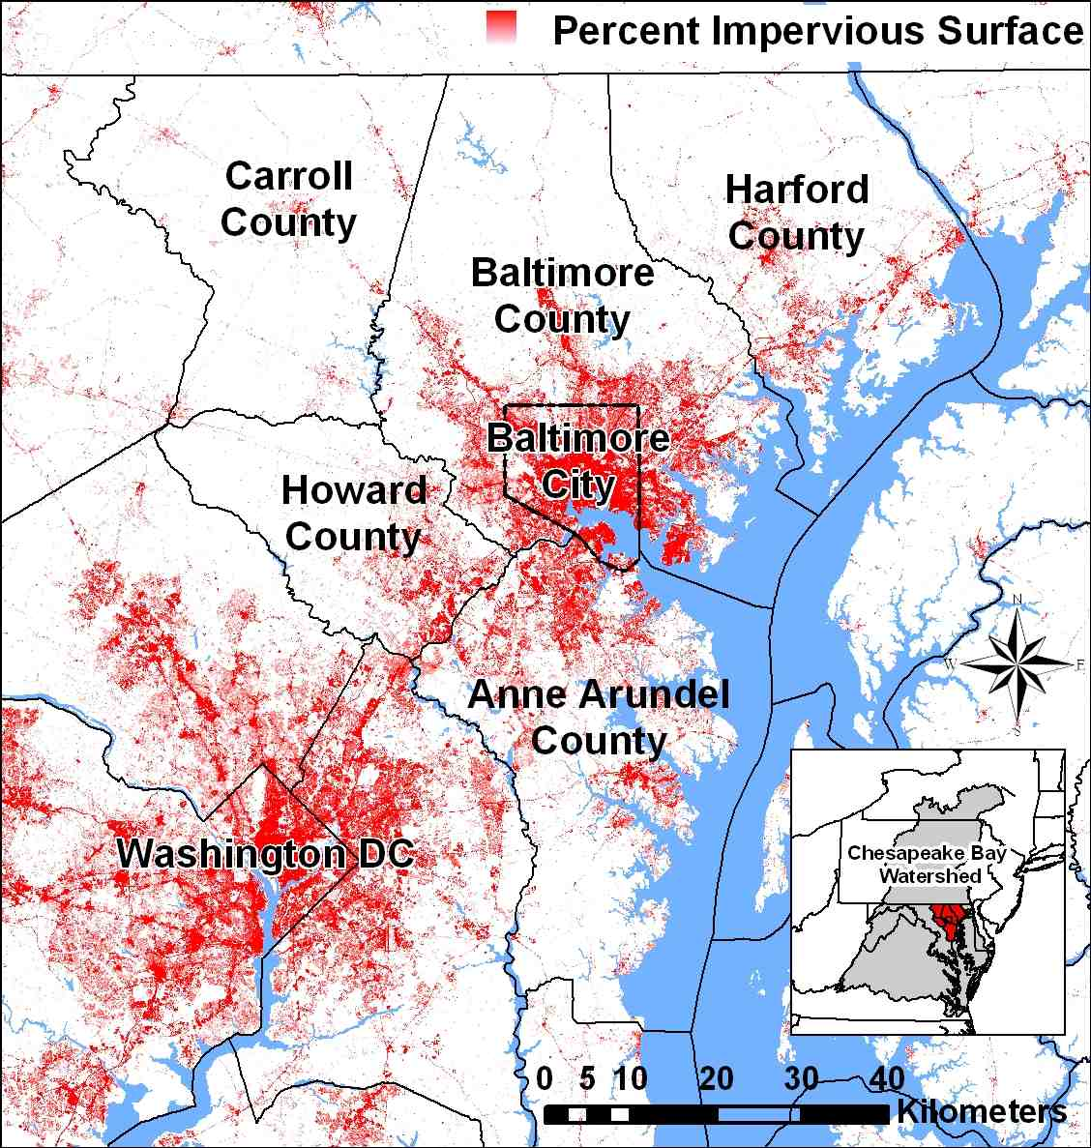
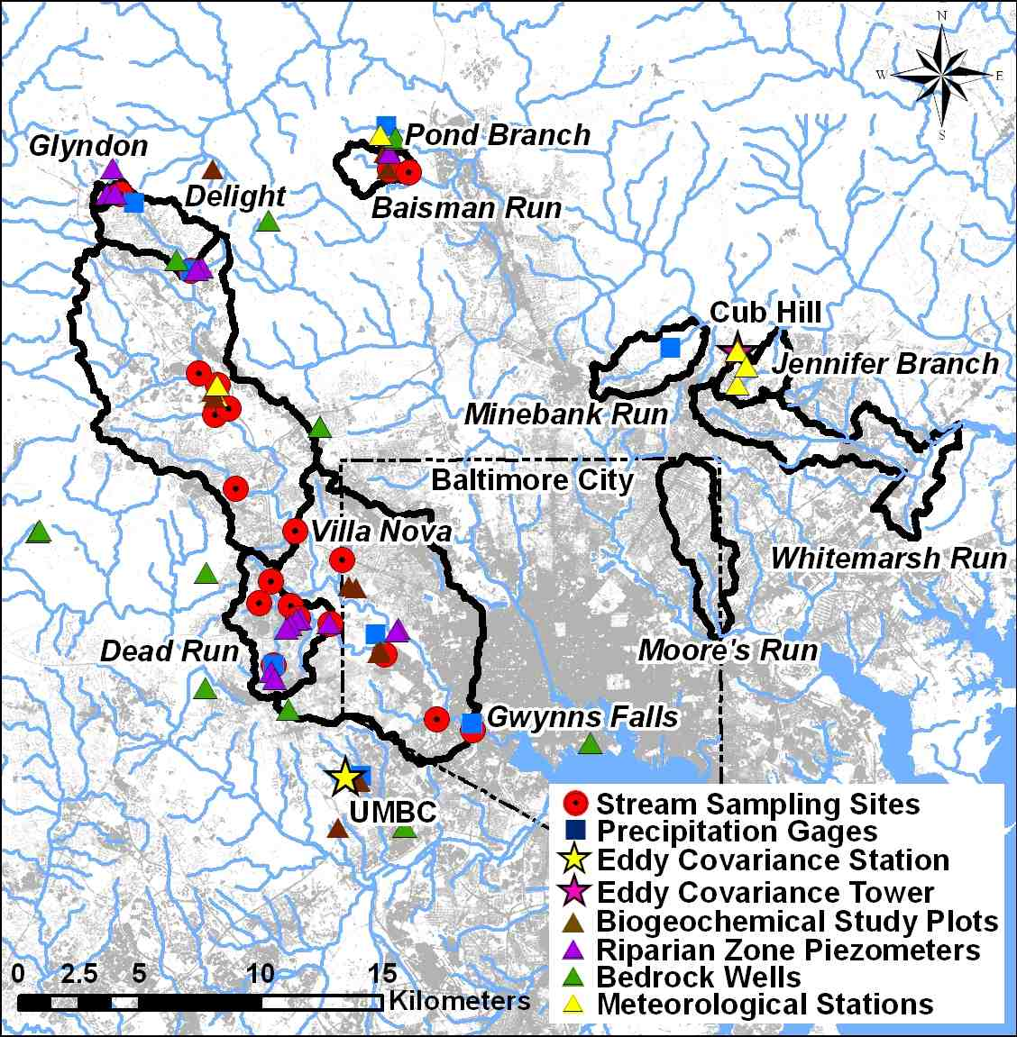
Baltimore Ecosystem Study LTER
Population 2.67 million (2010)
2.92 million (2030)
Notes:
LTER = Baltimore metro area, drainage to Chesapeake Bay
Building on the LTER backbone of sampling (14 yr), instrumentation and modeling
Hydrologic instrumentation + 2 eddy covariance towers

Slide 4
BES LTER
One of two urban LTER sites
Started in 1998
Phase 3 , 2011 – 2016
New theme
Adaptive Processes in the Baltimore Socio-Ecological System: From the Sanitary to the Sustainable City
New theoretical areas
- Locational choice
- The urban stream continuum
- Human behavior and metacommunity theory
http://beslter.org
Notes:
Strong interaction between social and natural sciences

Slide 5
BES as a platform for place-based research
Fluxes of water, carbon, and nutrients through the
terrestrial urban water cycle (14 years of BES LTER data)
Bias-corrected 1-km radar rainfall fields
Eddy covariance stations (water vapor flux)
Geology, soils, land cover/use, LIDAR topography
Roads, pipes, stormwater facilities, building footprints
High resolution orthoimagery
Parcel boundaries, parcel sales transactions, zoning, census, preserved lands, history of residential subdivision
“Legacy” data – e.g., MD State well permits
Mining of previous modeling studies (more legacy data)

Slide 6
Regional Climate Variability and Patterns of Urban Development:
Impacts on the Urban Water Cycle and Nutrient Export
Water Sustainability and Climate (WSC) Category 2 Project

Slide 7
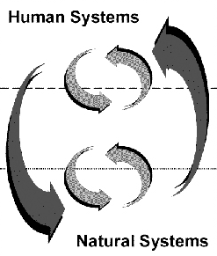
WSC overarching conceptual model
Human Choices
Regulatory
policy
Ecosystem
Services
Development
Patterns
Climate
Variability
Flow paths, fluxes, and
stores of water and nutrients
in urban areas
Notes:
Interactions and feedbacks between human choices and urban water and nutrient cycles
Water availability
How do human locational choices, water-based ecosystem services, and regulatory policies affect the supply of land and pattern of development over time?
How do the changing composition and variability of urbanizing surfaces affect local and regional climate?
How do patterns of development (including the engineered water system) and climate variability affect fluxes, flow paths and storage of water and nitrogen in urban areas?

Slide 8
Multidisciplinary team
Terrestrial Hydrology
Claire Welty and Andy Miller, UMBC
Ed Doheny, USGS
Hydrometeorology
Jim Smith and Elie Bou-Zeid, Princeton U.
Economics and Social Ecology
Elena Irwin and Allen Klaiber, Ohio State
Charles Towe, U MD
Morgan Grove, USFS
Biogeochemistry
Sujay Kaushal U MD
Peter Groffman, Cary Institute
Art Gold, U Rhode Island
Information Systems
Mike McGuire, Towson U.
Notes:
Red – terrestrial hydrology
Pink - hydrometeorology
Blue – natural resource economics;
Green – biogeochemistry
Purple – information systems
Dark Blue – social ecology

Slide 9
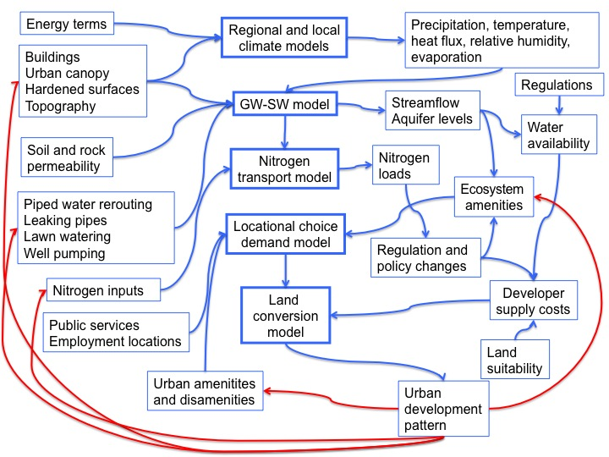
Modeling Approach
Notes:
Say at the beginning that I will step through this rather than at the end
Remove red arrows from all slides except the end,

Slide 10
Notes:
WRF – Weather Research and forecasting model –– 1 km, 3 km, 9 km resolution → 1 km resolution for regional climate analysis, 200 x 200 km domain; BC to be taken from operational weather model Eta (~30 km grid)
LES – large eddy simulation mode -

Slide 11
Approach
Simulate meteorological and land-atmosphere interaction dynamics over Baltimore using
WRF (Weather Research and Forecasting) model
at multiple scales
Regional 10⁴ km²
Local 10 km²
2. Investigate hydrological responses and microclimatological sensitivity to land-use changes during dry, average, and wet periods.
Notes:
WRF – Weather Research and forecasting model –– 1 km, 3 km, 9 km resolution → 1 km resolution for regional climate analysis, 200 x 200 km domain; BC to be taken from operational weather model Eta (~30 km grid)
LES – large eddy simulation mode -

Slide 12
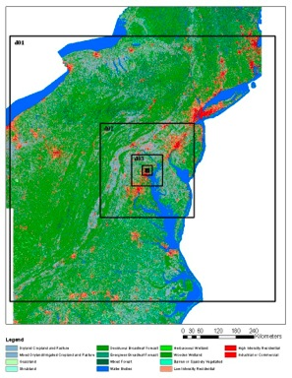
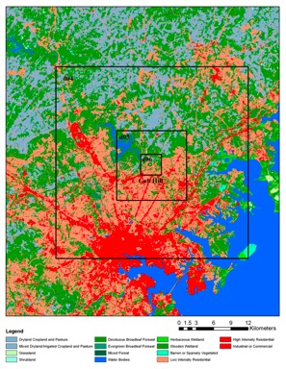
WRF modeling – nested scales
Regional
Local
Cub Hill
3.7 km
100 km
11 km
300 km
33 km
900 km
Jim Smith and Elie Bou-Zeid
Notes:
Clean up scale
WRF – Weather Research and Forecasting model - mesoscale numerical weather prediction system
6 nested scales – Northeast – largest; Cub Hill and other selected areas – smallest
9 km, 3 km, 1km, 333.3 m, 111.1 m, 37 m gridding
200x 200 km with 1 km grids for this project; 3 km grid middle domain, 9 km grid outer domain

Slide 13
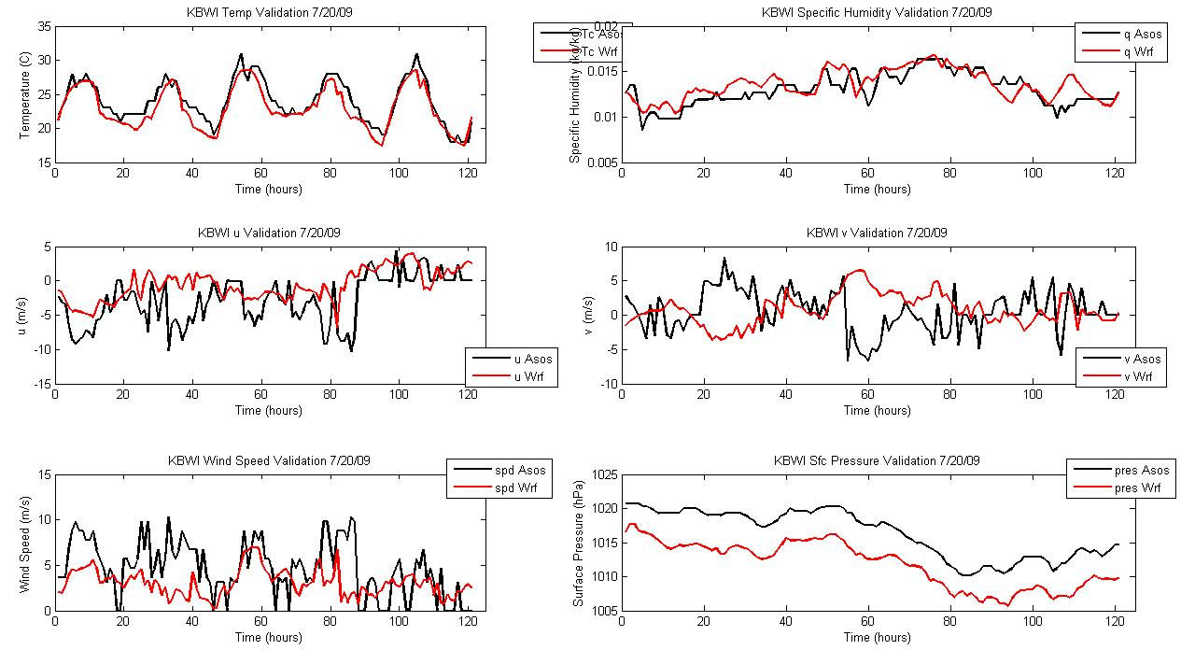
Regional WRF simulation –
temporal patterns
Temperature
Specific Humidity
u velocity
v velocity
Wind speed
Pressure
____ BWI ASOS (Automated surface observing system) station
____ Model output
Smith et al., 2011
Notes:
Put first and say that model also generates rain
WRF Model Validation for surface parameters at BWI airport for a 3-domain configuration (outer domain: 9 km grid spacing; middle domain: 3 km grid spacing; inner domain: 1 km grid spacing). The event simulated was a heavy rainfall event that affected the Baltimore metropolitan area from 20 to 25 July, 2009. The majority of the rain fell on the 23rd overnight into the 24th. Values from the WRF model (red) are compared with surface observations from the BWI ASOS (Automated surface observing system) station (black). Upper left panel displays 2-meter temperature comparison; middle left panel displays u velocity comparison; lower left panel displays wind speed comparison. Upper right panel displays specific humidity comparison; middle right panel displays v velocity comparison; lower right panel displays pressure comparison: sea-level pressure (ASOS) vs. surface pressure (WRF). The pressure offset is largely due to the elevation of the station.
Overall, the temperature, moisture, and pressure is simulated fairly well, but the winds display problems in both magnitude and direction. This is not uncommon for model simulations.

Slide 14
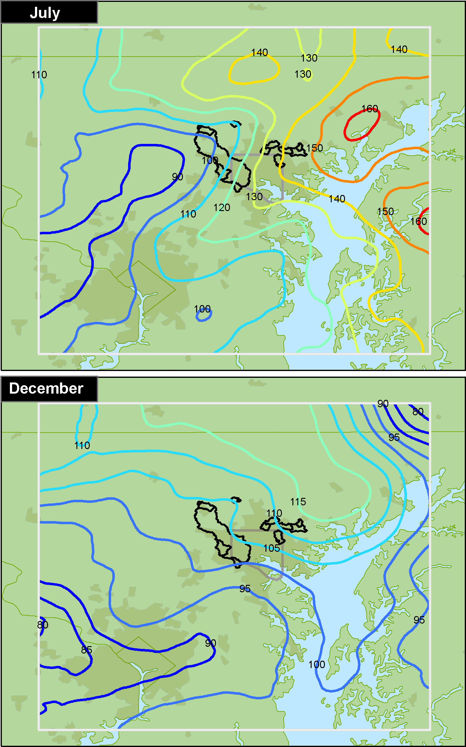
July rainfall climatology, 2000 – 2009
Radar rainfall analyses (1 km²; 15 minutes)
Mean Rainfall (mm)
•
BWI
Smith et al.
2012
In press
Notes:
Put after temporal data

Slide 15
Notes:
WRF – Weather Research and forecasting model –– 1 km, 3 km, 9 km resolution → 1 km resolution for regional climate analysis, 200 x 200 km domain; BC to be taken from operational weather model Eta (~30 km grid)
LES – large eddy simulation mode -

Slide 16


The urban hydrologic cycle
Interbasin
Transfers of
Water &
Wastewater
P
Impervious
Surfaces
Riparian &
Upland
Forest Patches
Stormdrains
ET
RO
E
RO
RO
I
Wells
Water
Table
Septic
Systems
Artificial
Channels
Wastewater
Conduits
Rooting
Zone
Water
Supply
Pipes
Local GW
Hyporheic &
Parafluvial Zones
Regional GW
Ken Belt (USFS)

Slide 17
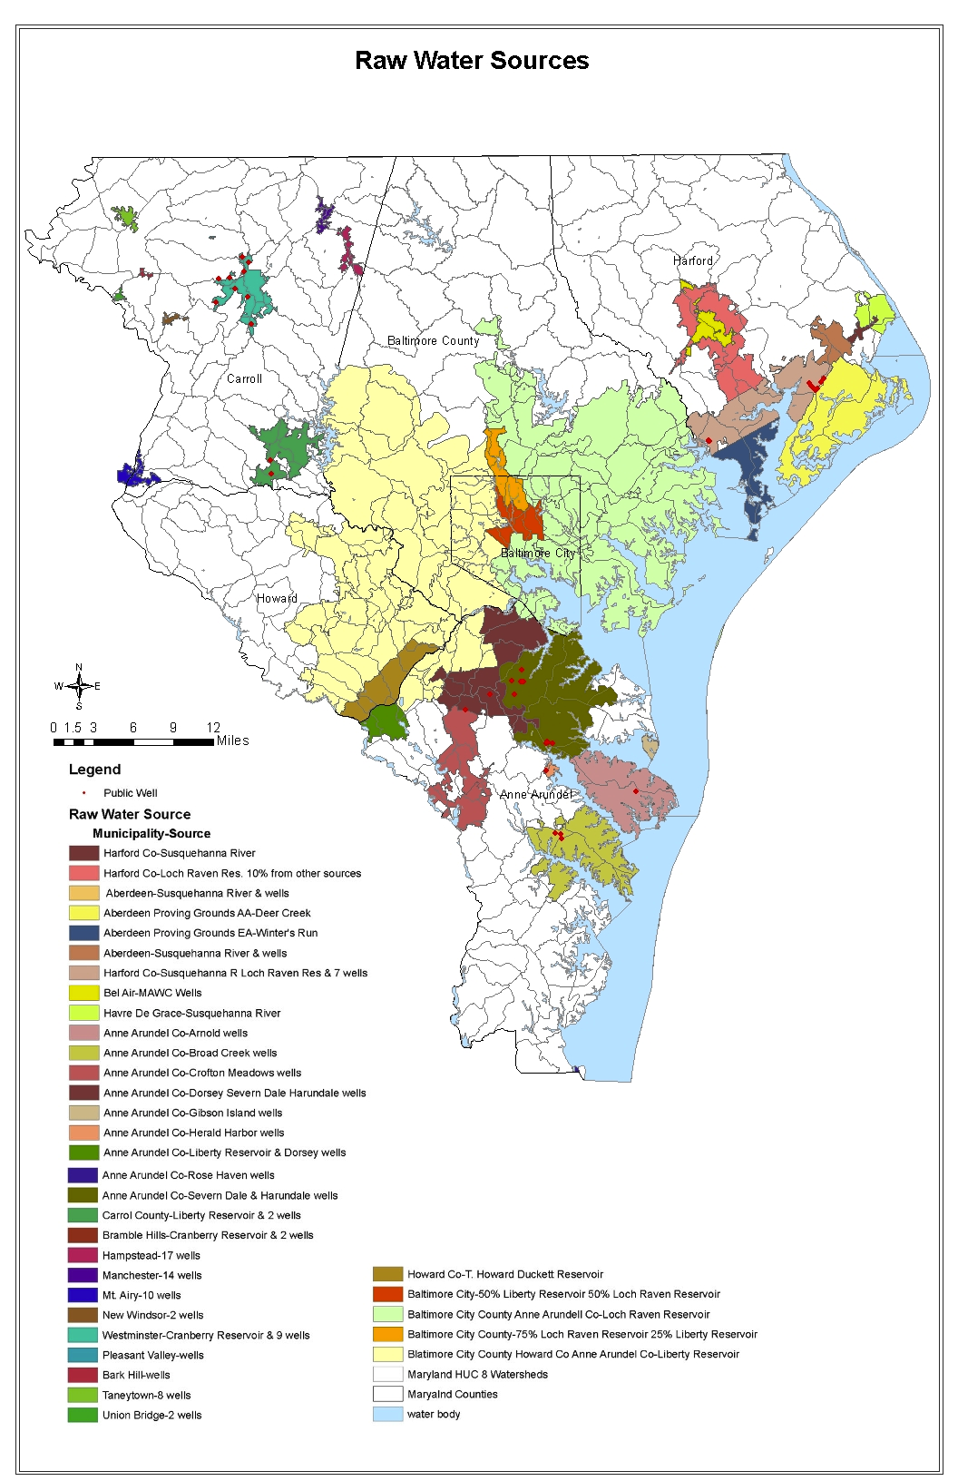
Footprint
of
municipal
service
areas
Harford
County
Baltimore
County
Carroll
County
Baltimore
City
Anne
Arundel
County
1.6 million supplied
Baltimore Central
System
Cole (unpublished, 2011)

Slide 18
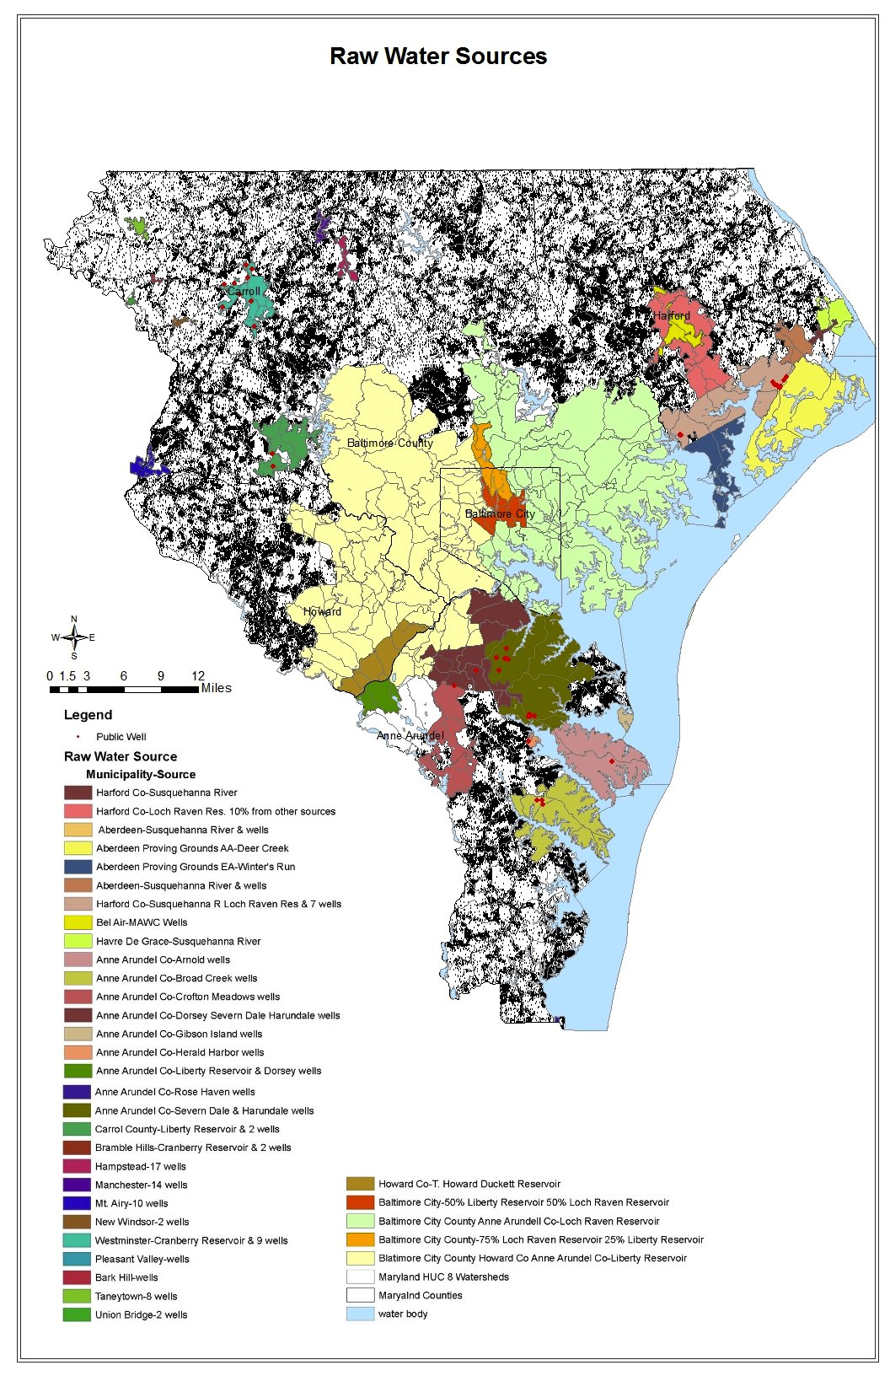
Served
areas +
private
wells
Cole (unpublished, 2011)

Slide 19
Piped flows alter water budget
Natural water balance components
P = precipitation
ET = evapotranspiration
Q = gauged streamflow
Additional urban water components
L = leakage from water supply pipes
I = irrigation (lawns)
I&I = infiltration & inflow into wastewater pipes
P 1135 mm
ET 830 mm
Rural Watersheds
N=32
Q 406 mm
P 1160 mm
ET 360 mm
Baltimore City Watersheds
N=2
L 159 mm
Q 465 mm
I 25 mm
I&I 565 mm
Bhaskar and Welty (2012)
Notes:
Say what the red means – additional urban flows
Maybe talk about relative terms – eg leakage rate of pipes, ET %

Slide 20
Approach
Simulate coupled groundwater-surface water interactions using ParFlow model at multiple scales
Regional 10³ km²
Local 10 km²
Capture interannual cycles of wetting and drying
Assess hydrologic sensitivity to development patterns
Generate flow fields for use in simulation of nitrogen transport
Notes:
WRF – Weather Research and forecasting model –– 1 km, 3 km, 9 km resolution → 1 km resolution for regional climate analysis, 200 x 200 km domain; BC to be taken from operational weather model Eta (~30 km grid)
LES – large eddy simulation mode -

Slide 21
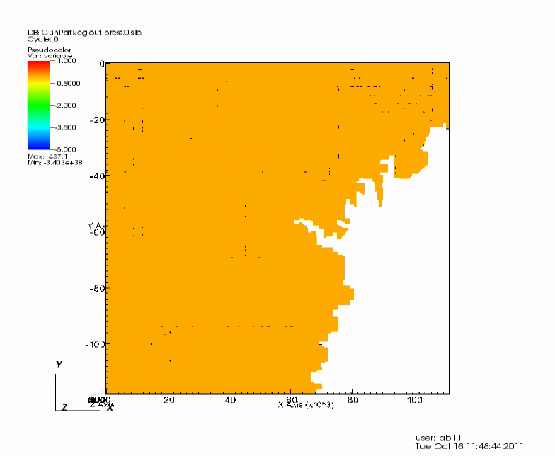
ParFlow modeling – regional scale
Bhaskar, Welty and Maxwell (2011)
Notes:
Initial condition: water table 10 m below land surface
5 hour timesteps used
Total of 7715 hours (10 months)
Boundary conditions:
No rainfall for 5 months
Then 21 in/year rainfall (4 days on, 8 days off)
Others are no flow boundaries

Slide 22
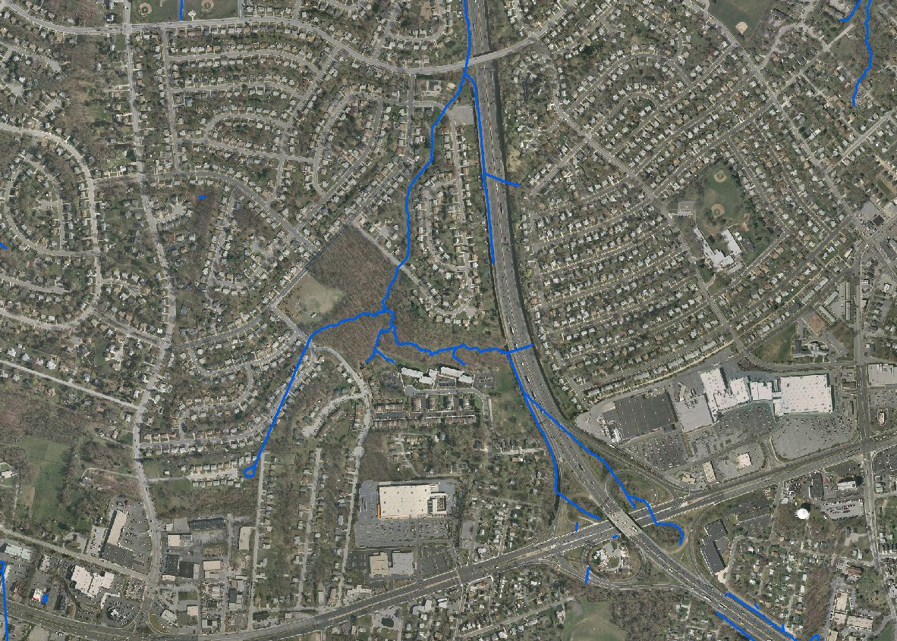
ParFlow modeling – local scale
1.5 km
2 km
Orthophoto Source: Baltimore County, MD

Slide 23
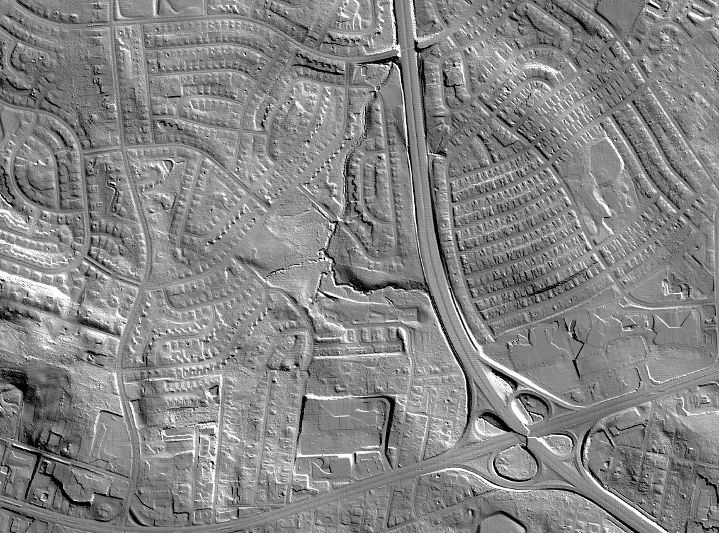
ParFlow modeling – local scale
ParFlow modeling – local scale
1.5 km
2 km
Lidar source: Baltimore County, MD

Slide 24
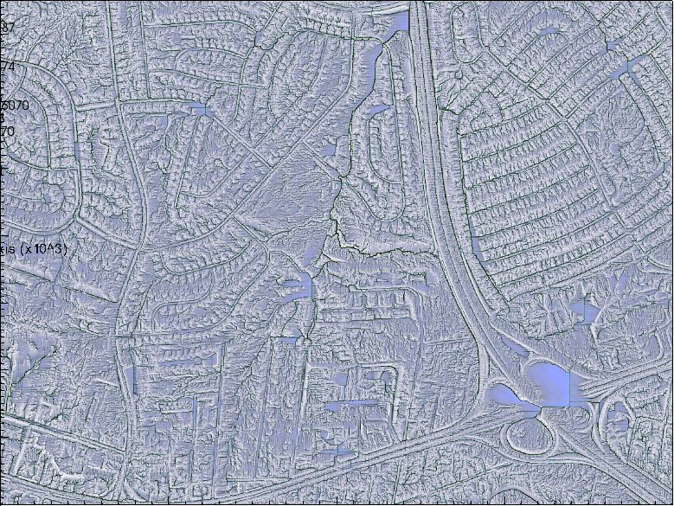
ParFlow modeling – local scale
1.5 km
2 km
Barnes, Welty, and Miller 2012 (unpublished)
Notes:
3 million – x-y direction @ 1 m x 1m gridding

Slide 26
Approach
Previous N work on quantification of N budgets inputs (atmosphere, fertilizer)
storage (soils, lawns)
outputs (streams)
2. Important reduction pathway is denitrification
(conversion of nitrate to nitrogen gas)
3. New work on impacts of stormwater infrastructure on denitrification
4. New work on N retention and uptake in streams

Slide 27
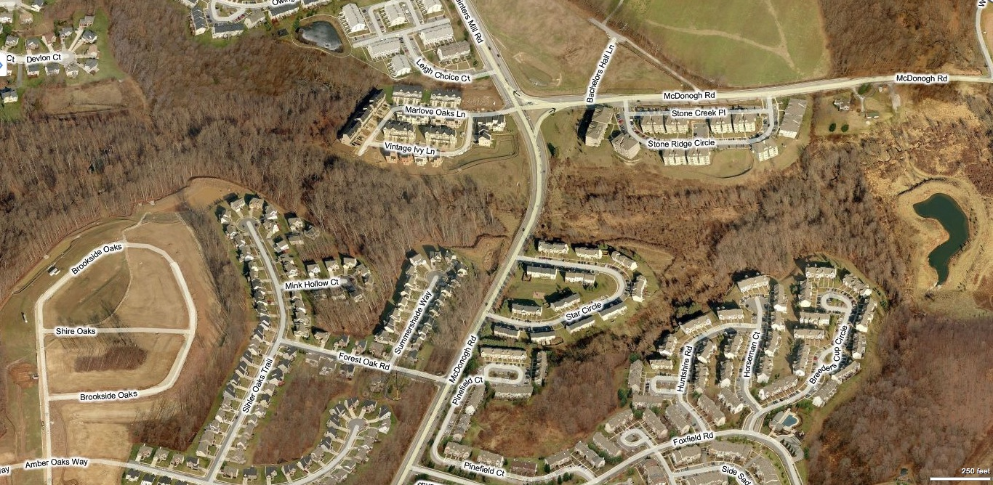
Stormwater management structures
½ mile x ¾ mile area
Bettez and Groffman (2011)
Notes:
13 structures in 1.25 km x .75 km (1/2 mile x ~ ¾ mile

Slide 28
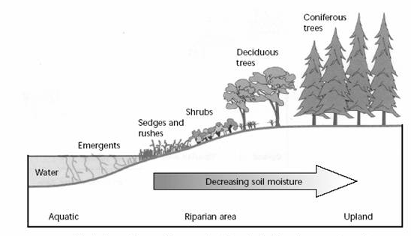
Natural Riparian Areas
Decreasing Soil Moisture
Bettez and Groffman (2011)
Notes:
We have lost a lot of riparian zones and wetlands, but what we have built …

Slide 29
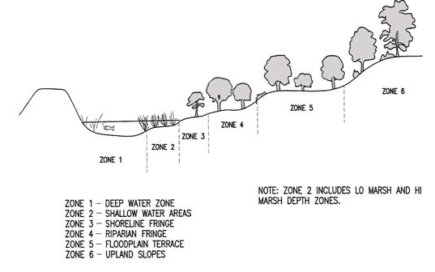
Stormwater management structures
Zone
6
Zone
5
Zone
4
Zone
3
Infrequently
Zone 1 and 2
Periodically
Regularly
Perennially
Frequency of Inundation
Decreasing Soil Moisture
Bettez and Groffman (2011)
Notes:
Perennially Regularly Periodically Infrequently
Have we recovered this function with stormwater structures?

Slide 30
Stormwater management structures and N removal
Type | Structure Type (TN removal efficiency) | Type of Structure
A | Wet Ponds and Wetlands (30%) | Shallow Marsh
 |  | Retention Pond
B | Dry Detention & Hydrodynamic structure (5%) | Bay Separator
 |  | Oil & Grit Separator
 |  | Still Basin
 |  | Underground storage
 |  | Detention Pond
C | Dry Extended Detention (30%) | Dry Ext Detention Pond
 |  | Ext Det Pond
D | Infiltration Practices (50%) | Porous Pavement
 |  | Swale
 |  | Infiltration Trench
 |  | Infiltration Basin
E | Filtering Practices (40%) | Dry Well
 |  | BIO-Retention
 |  | Sand Filter
Bettez and Groffman (2011)

Slide 31
Stormwater structure denitrification potential
Herbaceous Forested
Shallow
Marsh
Detention
Pond
Dry Ext
Detent
Pond
Infiltr
Basin
Sand
Filter
Bettez and Groffman (2011)

Slide 32
Nitrogen modeling
New particle tracking code for subsurface transport of nitrogen using ParFlow flow fields
as input
Goal is to conduct simulations of nitrogen transport at nested watershed scales, using previous and new observational data

Slide 34
Approach
1. Goal is to construct integrated model of urban land-use dynamics
  Link household locational demand and developer supply costs in land conversion model
  Simulate annual predictions of urban land development at the parcel, neighborhood, and jurisdictional scales
2. Model includes policy constraints on development location and effects of ecosystem amenities

Slide 35
Carroll County exurban development
Irwin et al. (2011)
Notes:
an exurban county within the Washington-Baltimore metropolitan area (Figure 1). Carroll County is located approximately 30 miles west of Baltimore and 55 miles northwest of Washington D.C. and until recent decades was a largely rural county. The development density is about 500 persons per square kilometer

Slide 36
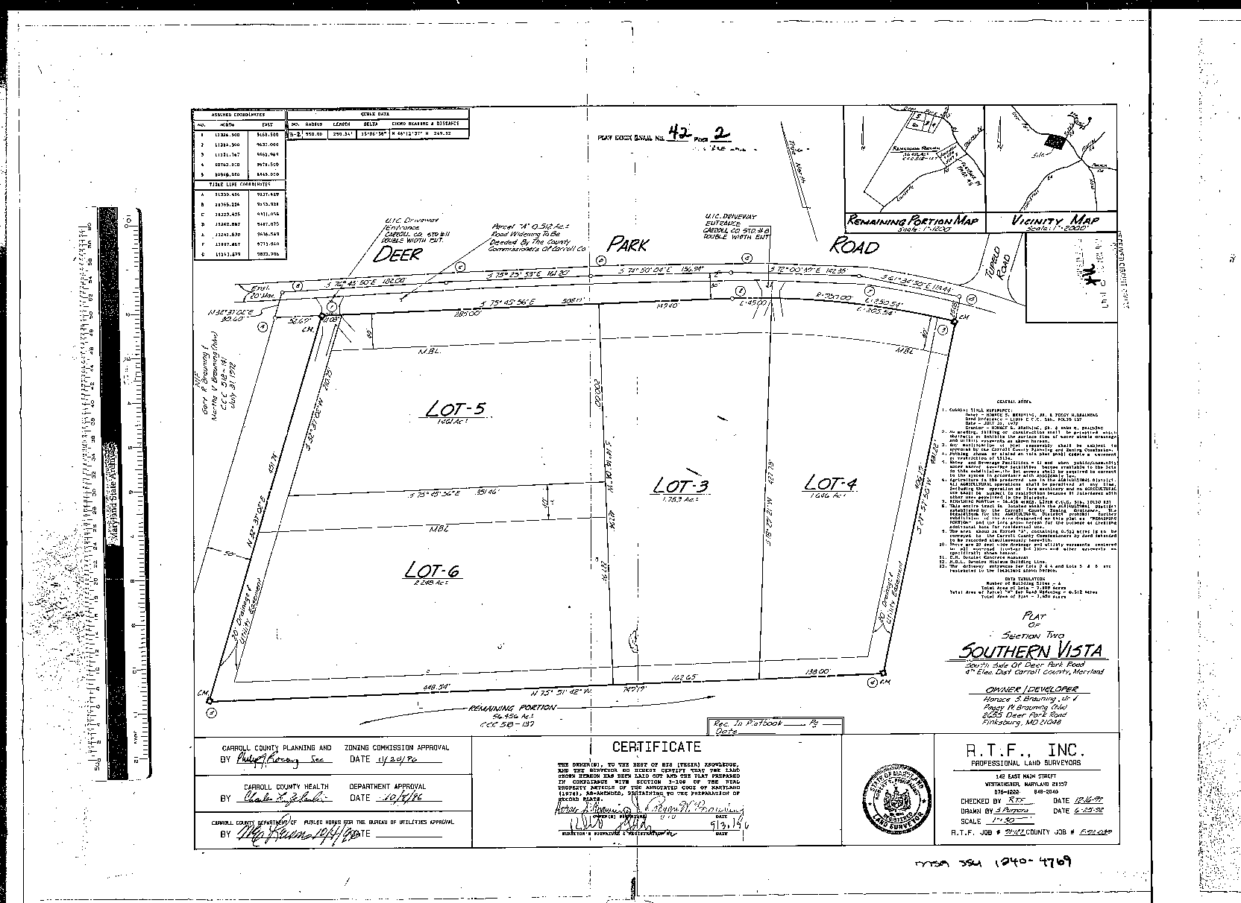
Example of historical subdivision data: Plat map
Source: State of MD Archives, mdplats.net

Slide 37
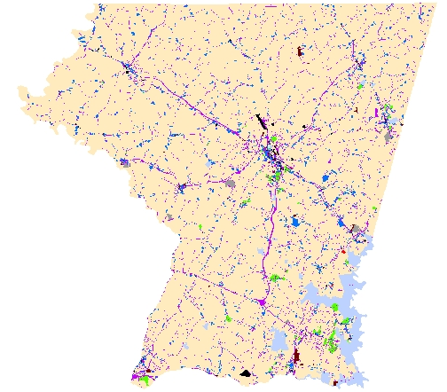
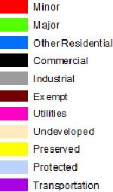
Land Use 1960
Irwin et al. (2011)

Slide 38
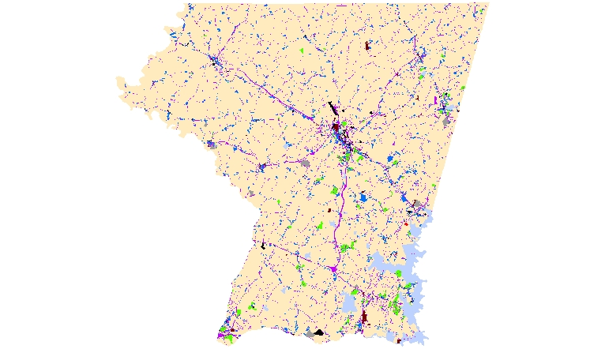
Land Use 1965
Irwin et al. (2011)

Slide 39
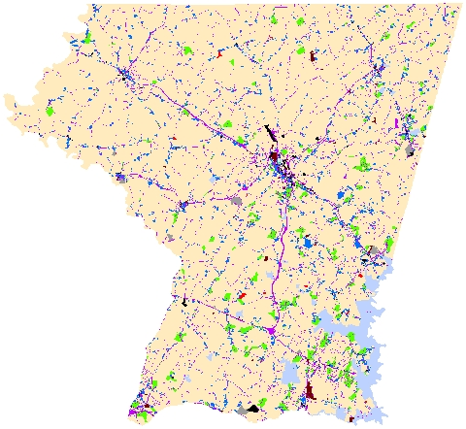
Land Use 1970
Irwin et al. (2011)

Slide 40
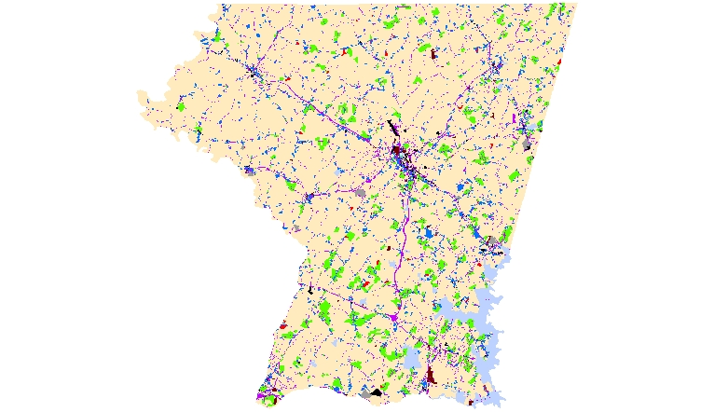
Land Use 1975
Irwin et al. (2011)

Slide 41
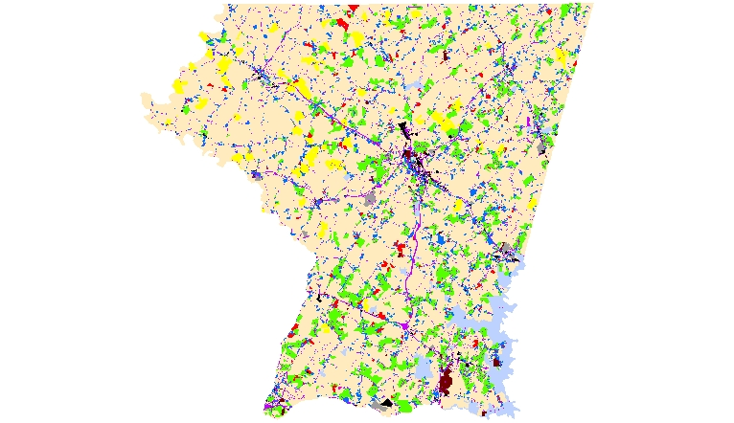
Land Use 1980
Irwin et al. (2011)

Slide 42
Land Use 1985
Irwin et al. (2011)

Slide 43
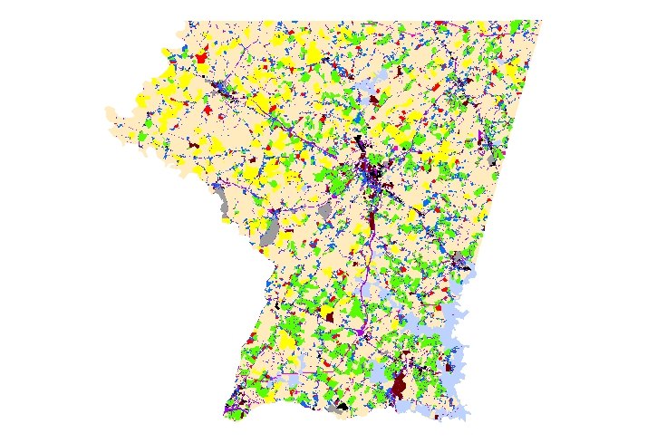
Land Use 1990
Irwin et al. (2011)

Slide 44
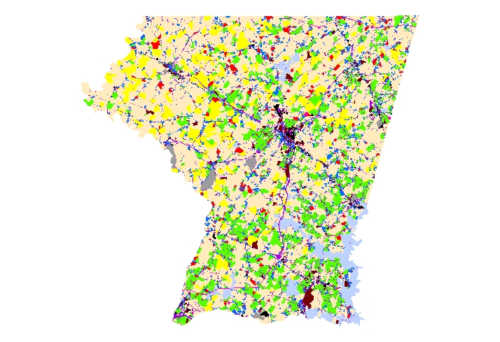
Land Use 1993
Irwin et al. (2011)

Slide 45
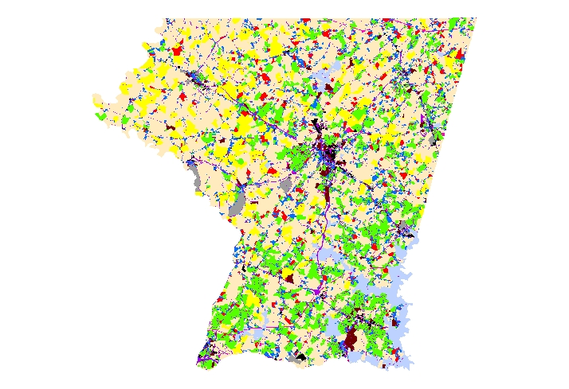
Land Use 1996
Irwin et al. (2011)

Slide 46
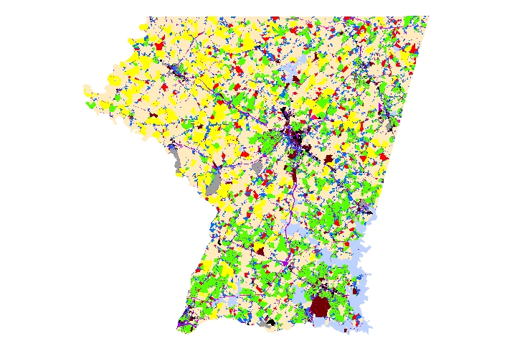
Land Use 1999
Irwin et al. (2011)

Slide 47

Land Use 2002
Irwin et al. (2011)

Slide 48
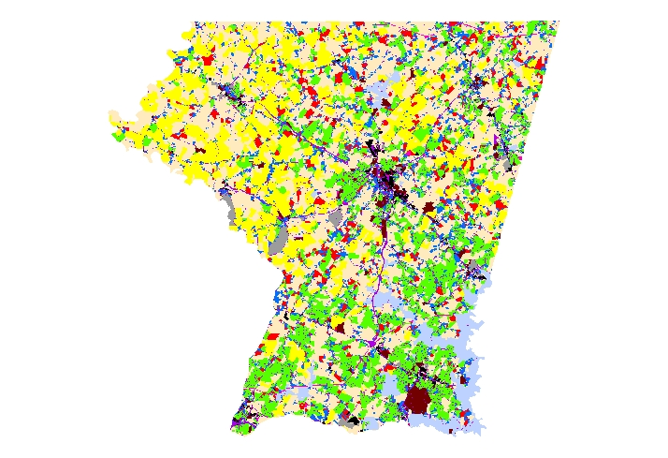
Land Use 2005
Irwin et al. (2011)

Slide 49
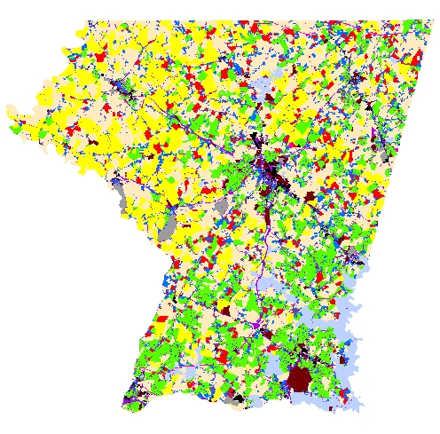
Land Use 2007
Irwin et al. (2011)

Slide 50
Coupling and feedbacks
Notes:
Point of the study is that all are linked together
Challenge is to couple models and integration - hard to do

Slide 51
Summary
Wealth of BES LTER amassed data can serve as platform for large multidisciplinary investigations
WSC project - opportunity to address issues of urban water sustainability
  → place-based approach
  → integration of biophysical processes and human decision making
Goal is to develop methodology transferable to other locations

Slide 52
Acknowledgements
NSF - BIO/DEB, ENG/CBET, GEO/EAR, EHR/DGE
Steward Pickett, BES PI/PD
Collaborators
Andrew Miller (UMBC)
James Smith, Elie Bou-Zeid (Princeton U.)
Reed Maxwell (Colorado School of Mines)
Sujay Kaushal, Charles Towe (U MD)
Peter Groffman, Neil Bettez (Cary Institute)
Ed Doheny, Jon Dillow (USGS)
Ken Belt, Morgan Grove (USFS)
Elena Irwin, Allen Klaiber (Ohio State)
Larry Band (UNC)
Art Gold (U RI)

