Slide 1
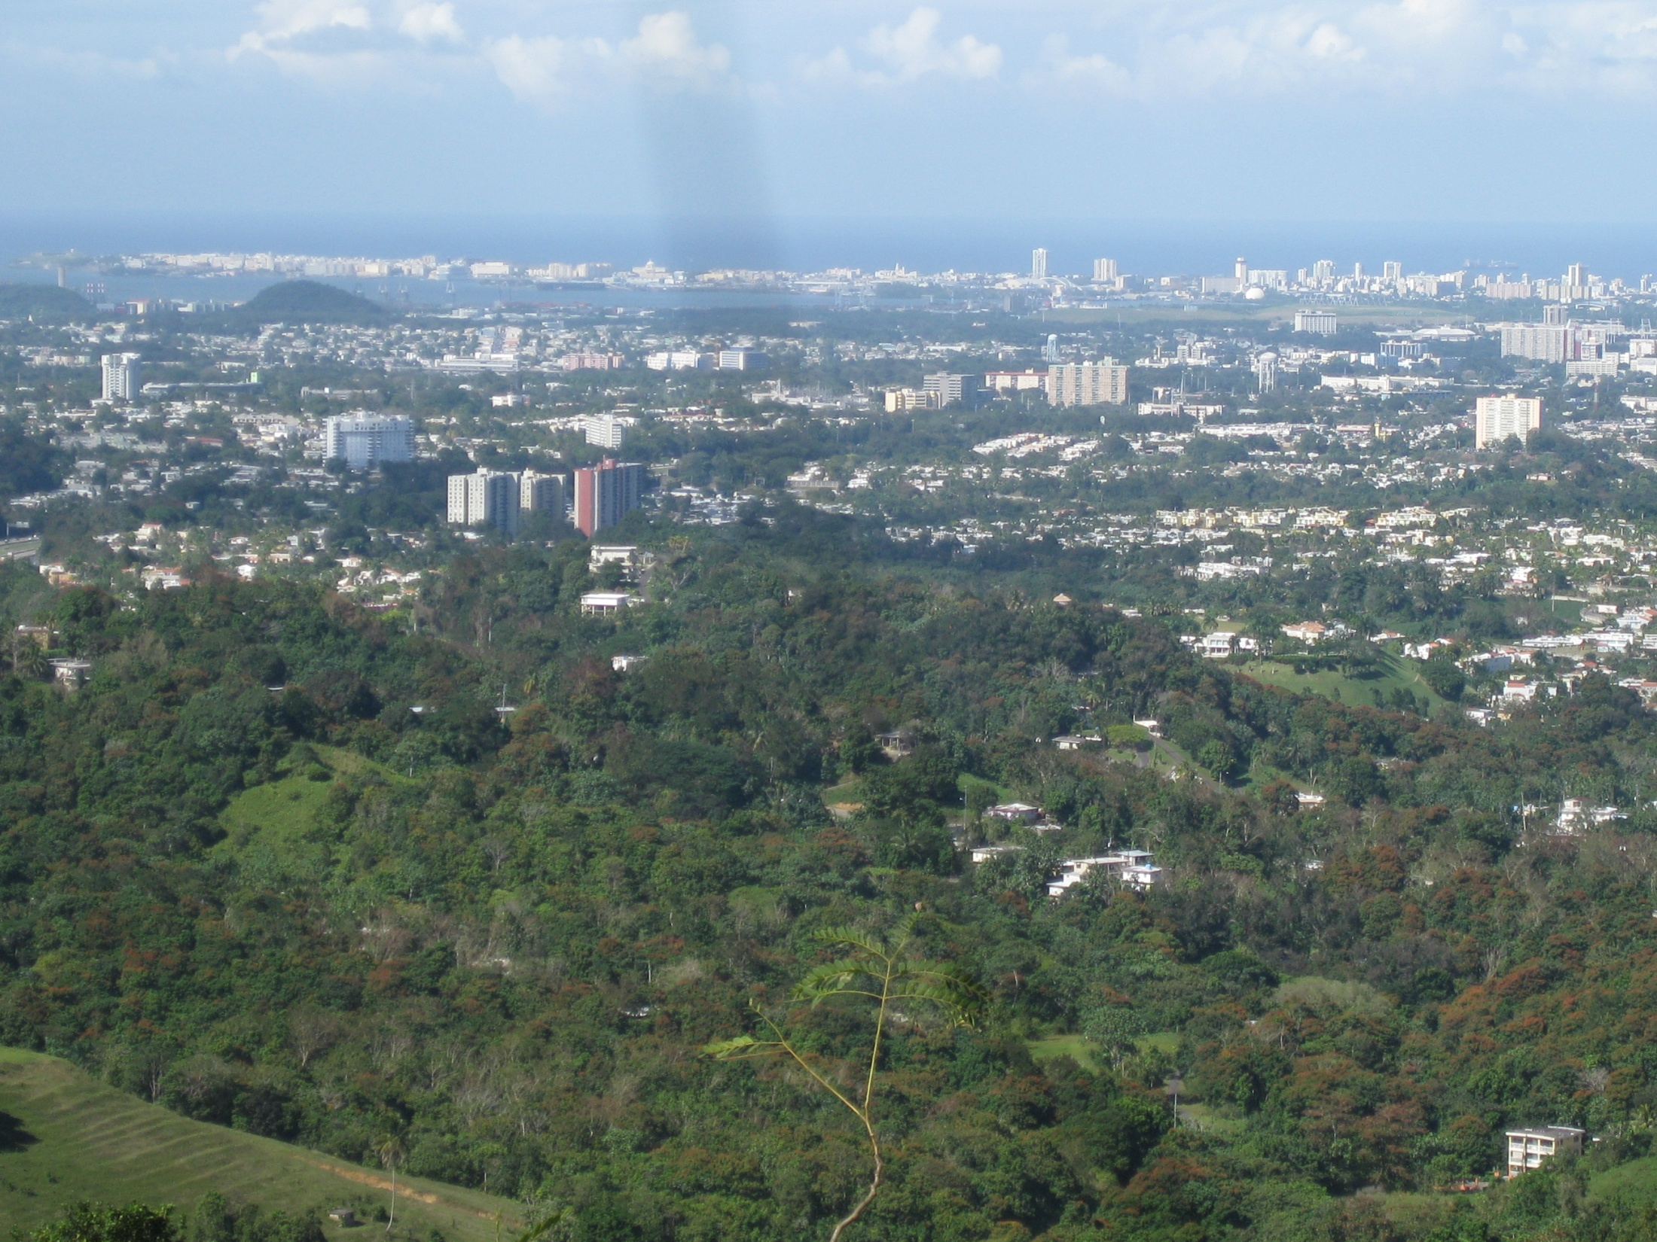





Building Knowledge-Action Systems for Urban Sustainability: Interdisciplinarity and Reflexivity in San Juan ULTRA-Ex
Tischa A. Muñoz-Erickson
School of Sustainability, Arizona State University
NFS IGERT Fellow
NSF LTER Mini-Simposium
March 1, 2012

Slide 2
Outline
Background on San Juan and ULTRA-Ex
Re-thinking how science informs action through knowledge systems analysis
Design criteria:
  context, reflexivity, polycentric networks
Towards effective long-term knowledge-action systems for sustainability

Slide 3
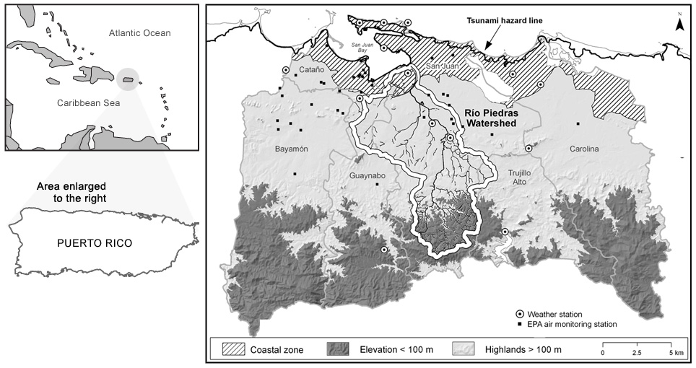
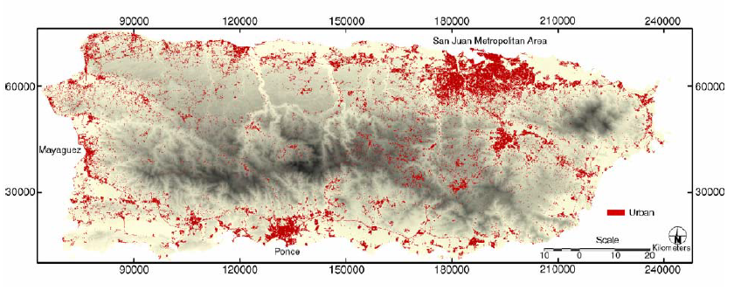
San Juan ULTRA and the Luquillo LTER in an urbanizing landscape
Notes:
Eventhough referring to examples from San Juan, the same applies to the area where the Luquillo LTER is located since most of the northeastern area is urbanized and Luquillo LTER has expanded to understand their urban-rural gradient. Great overlap between ULTRA and Luquillo LTER

Slide 4
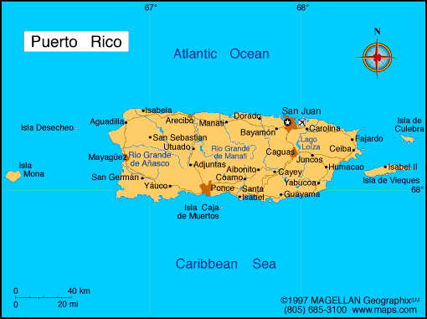
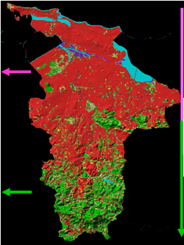
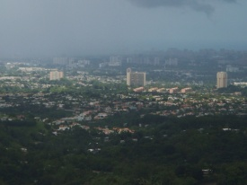
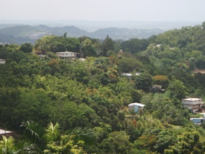
Urban Development, Green Areas and Vulnerability in San Juan
70% built 30% forest
70% forest 30% built

Slide 5
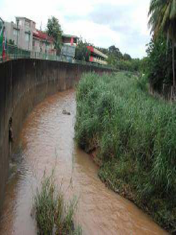
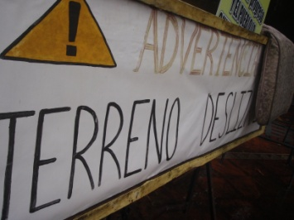
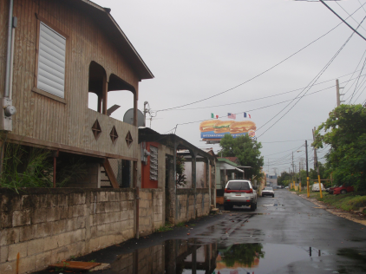
Urban Development, Green Areas and Vulnerability in San Juan
70% built 30% forest
70% forest 30% built

Slide 6
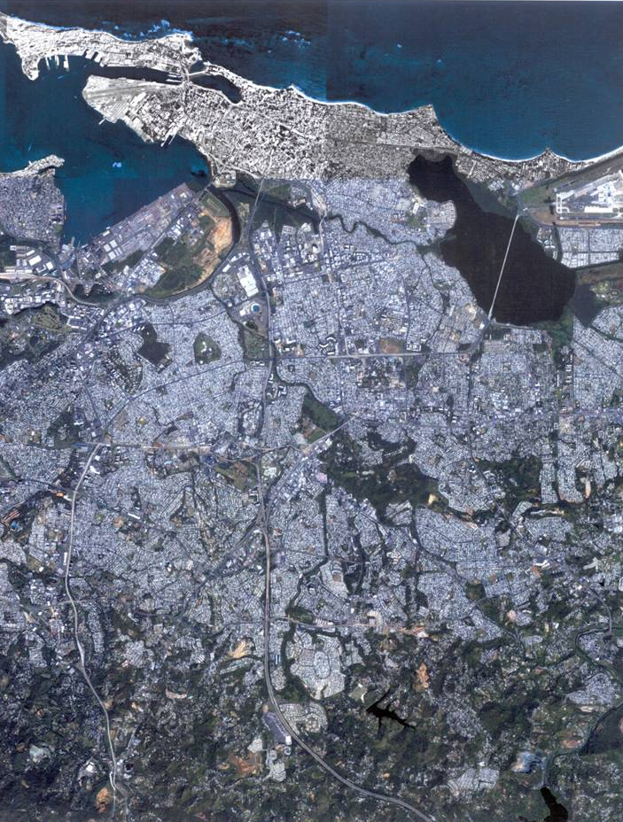
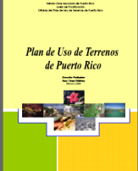
The Planning and Political Context in San Juan
  State-level Planning: PR Planning Board; PR Permit and Regulation Authority; PR Dept. of Environmental and Natural Resources; PR Environmental Quality Board

Slide 7
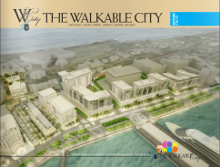

The Planning and Political Context in San Juan
  State-level Planning: PR Planning Board; PR Permit and Regulation Authority; PR Dept. of Environmental and Natural Resources; PR Environmental Quality Board
Municipality: San Juan Territorial Ordinance Plan in 2003 Municipality gains Autonomy in 2009

Slide 8
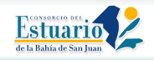


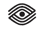

The Planning and Political Context in San Juan
  State-level Planning: PR Planning Board; PR Permit and Regulation Authority; PR Dept. of Environmental and Natural Resources; PR Environmental Quality Board
Municipality: San Juan Territorial Ordinance Plan in 2003 Municipality gains Autonomy in 2009
Numerous non-profit, community, and private initiatives seeking participation

Slide 9
Question
How do we create policy-relevant science in such a complex, dynamic, and contested governance context?

Slide 10
Re-Thinking Linkages between Science and Action
Science
Decision-maker
S
A
Notes:
Not as simple as engaging strategic stakeholders and letting the politics work out…The values, ideas, actions contested come from somewhere, have their own set of knowledge systems…Need to understand those..
Some of the issues I’m referring to include,
divergent perspectives on what counts as useful knowledge
fragmentation and mis-match of knowledge across jurisdictional and spatial scales
exclusion of marginal perspectives and rationalities in framing research and problem-solving
I argue that partly is because we are still working under several assumptions that make the boundary between science and decisionmaking persist, such as: (1) science is the only relevant source of knowledge for decision-making; (2) knowledge systems are solely accumulations of data, facts, and technical information, and (3) knowledge systems provide a unidirectional link between producers (scientists, researchers) and users (policymakers, industry, practitioners).
Example: knowledge on one side and action on the other

Slide 11
Re-Thinking Linkages between Science and Action
Science
Decision-maker
S
A
K
K
A
K
A
K
K
K
A
Notes:
Not as simple as engaging strategic stakeholders and letting the politics work out…The values, ideas, actions contested come from somewhere, have their own set of knowledge systems…Need to understand those..
Some of the issues I’m referring to include,
divergent perspectives on what counts as useful knowledge
fragmentation and mis-match of knowledge across jurisdictional and spatial scales
exclusion of marginal perspectives and rationalities in framing research and problem-solving
I argue that partly is because we are still working under several assumptions that make the boundary between science and decisionmaking persist, such as: (1) science is the only relevant source of knowledge for decision-making; (2) knowledge systems are solely accumulations of data, facts, and technical information, and (3) knowledge systems provide a unidirectional link between producers (scientists, researchers) and users (policymakers, industry, practitioners).
Example: knowledge on one side and action on the other

Slide 12
Re-Thinking Linkages between Science and Action
Science
Decision-maker
S
A
K
K
A
K
A
K
K
K
A
Knowledge Systems Analysis
Notes:
Not as simple as engaging strategic stakeholders and letting the politics work out…The values, ideas, actions contested come from somewhere, have their own set of knowledge systems…Need to understand those..
Some of the issues I’m referring to include,
divergent perspectives on what counts as useful knowledge
fragmentation and mis-match of knowledge across jurisdictional and spatial scales
exclusion of marginal perspectives and rationalities in framing research and problem-solving
I argue that partly is because we are still working under several assumptions that make the boundary between science and decisionmaking persist, such as: (1) science is the only relevant source of knowledge for decision-making; (2) knowledge systems are solely accumulations of data, facts, and technical information, and (3) knowledge systems provide a unidirectional link between producers (scientists, researchers) and users (policymakers, industry, practitioners).
Example: knowledge on one side and action on the other

Slide 13
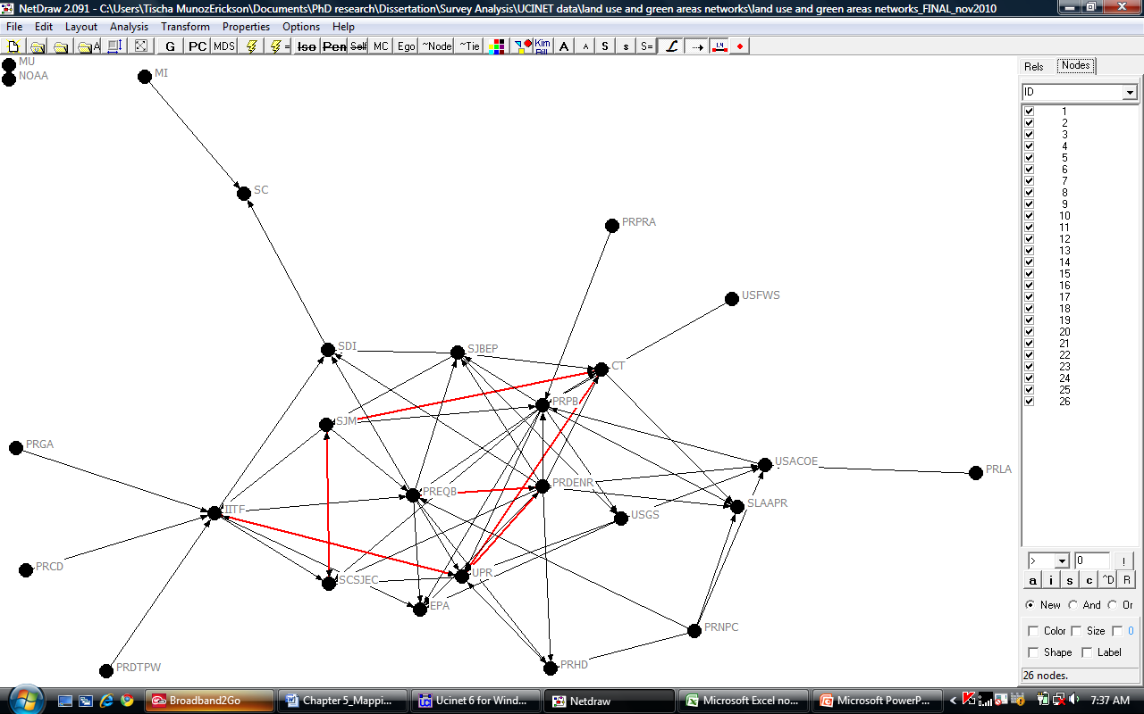
Map of stakeholder organizations involved in land use and green area planning in San Juan
26 Total organizations
16 government
6 NGOs
3 academic/research
80% collect data in-house
Notes:
. Network heterogeneity, calculated by the ratio of the 26 different organizations in this network to the composition of the initial survey population (n=110) shows that this knowledge network comprises twenty-five percent of total organizations.
fifteen organizations that specified whether they collect and produce their own information internally, twelve answered yes (80% of the network nodes), including three NGO’s. This suggests that most of the organizations in the network see themselves as knowledge producers and not just recipients of information

Slide 14
Role of ULTRA to facilitate co-production in the network
Federal
IITF
EQB
PB
DENR
State
SDI
UPR
SCSJEC
CT
City
SJTOP
Government agencies
Research Institutions
NGO’s
Notes:
COLOR LEGEND
GOAL – CO-PRODUCE LONG TERM KNOWLEDGE BETWEEN RESEARCHERS AND DECISION-MAKERS

Slide 15
Future Visions for the City
Economically Sustainable Vision - regional/state
Ecologically Sustainable Vision - regional/watershed
Modern Vision (Mayor’s vision) – urban cores
Livable Vision (Municipal Territorial Ordinance Plan)

Slide 16
Design Criteria for the Effective Co-Production of Science for Urban Sustainability
context
reflexivity
polycentric networks
Notes:
IN THE CONTEXT OF LONG-TERM RESEARCH
The city is ‘seen’ by different actors in different ways, and open deliberation of both the ‘knowledge’ and the ‘action’ is crucial in the formation of strategies for sustainability
Assumptions about how science and knowledge interact with decision-making and action can influence how we structure the co-production of knowledge.
Need to ask – is the system conducive to social learning prior to experimenting…

Slide 17
Context
Understand the decision-making and political context.
Foster inclusiveness.
Expose researchers to the social and political realities of the place they are studying in.
Notes:
Ethnograhic research approaches, such as field work, observations and unstructured interviews as useful tools to build epistemic context and initiate rapport, and hence trust, with local stakeholders.
to assess their needs, priorities, and existing knowledge systems.
– engage in multiple ways, formally and informally, and continuously follow-up and communicate with stakeholders. Have stakeholders part of the process (e.g. ownership) and have a role or contribution to make– do not consult without following-up.

Slide 18
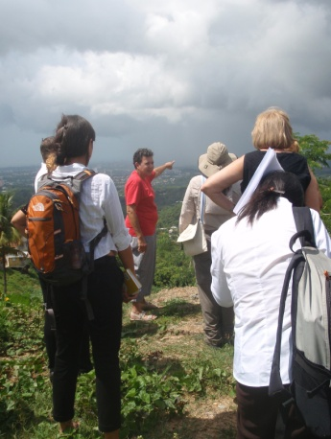
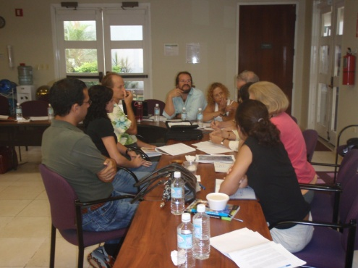
Context: Fostering inclusiveness through diverse and flexible engagement and collaboration methods.
Partnerships
Field trips
Needs assessment survey
Interdisciplinary workshops
Community forums
Participatory mapping
16 natural scientists, 10 social scientists
17 partner institutions
~70 stakeholder organizations

Slide 19
Reflexivity
Self-critic/evaluation of the research process.
‘Open-up’ the research process.
Monitor learning and adapt science when necessary.

Slide 20
Reflexivity in science and decision-making
Framing of Problem and Research Agenda
Sampling design and selection of methods
Results/output interpretation
Notes:
What is different is the degree to which outside knowledge and critic come in depending on what step you are in the process and the level of negotiation that is required among actors….

Slide 21
Reflexivity in science and decision-making
Peer review
Political debate
Framing of Problem and Research Agenda
Sampling design and selection of methods
Results/output interpretation
Application/ Decision/ Education
‘open up’ research process
Notes:
What is different is the degree to which outside knowledge and critic come in depending on what step you are in the process and the level of negotiation that is required among actors….

Slide 22
Reflexivity in science and decision-making
Framing of Problem and Research Agenda
Sampling design and selection of methods
Results/output interpretation
Application/ Decision/ Education
‘open up’ research process
Notes:
What is different is the degree to which outside knowledge and critic come in depending on what step you are in the process and the level of negotiation that is required among actors….

Slide 23
Reflexivity in science and decision-making
Stakeholder engagement and survey of needs
Framing of Problem and Research Agenda
Sampling design and selection of methods
Context Analysis
Results/output interpretation
Application/ Decision/ Education
‘open up’ research process
Notes:
What is different is the degree to which outside knowledge and critic come in depending on what step you are in the process and the level of negotiation that is required among actors….

Slide 24
Reflexivity in science and decision-making
Co-framing of questions through deliberative workshops
Stakeholder engagement and survey of needs
Framing of Problem and Research Agenda
Sampling design and selection of methods
Context Analysis
Results/output interpretation
Application/ Decision/ Education
‘open up’ research process
Notes:
What is different is the degree to which outside knowledge and critic come in depending on what step you are in the process and the level of negotiation that is required among actors….

Slide 25
Reflexivity in science and decision-making
Co-framing of questions through deliberative workshops
Advisory committee; informal interactions
Stakeholder engagement and survey of needs
Framing of Problem and Research Agenda
Sampling design and selection of methods
Context Analysis
Results/output interpretation
Application/ Decision/ Education
‘open up’ research process
Notes:
What is different is the degree to which outside knowledge and critic come in depending on what step you are in the process and the level of negotiation that is required among actors….

Slide 26
Reflexivity in science and decision-making
Co-framing of questions through deliberative workshops
Extended review; deliberative workshops
Advisory committee; informal interactions
Stakeholder engagement and survey of needs
Framing of Problem and Research Agenda
Sampling design and selection of methods
Context Analysis
Results/output interpretation
Application/ Decision/ Education
‘open up’ research process
Notes:
What is different is the degree to which outside knowledge and critic come in depending on what step you are in the process and the level of negotiation that is required among actors….

Slide 27
Reflexivity in science and decision-making
Co-framing of questions through deliberative workshops
Extended review; deliberative workshops
Support negotiation among actors
Advisory committee; informal interactions
Stakeholder engagement and survey of needs
Framing of Problem and Research Agenda
Sampling design and selection of methods
Context Analysis
Results/output interpretation
Application/ Decision/ Education
‘open up’ research process
Notes:
What is different is the degree to which outside knowledge and critic come in depending on what step you are in the process and the level of negotiation that is required among actors….

Slide 28
Reflexivity in science and decision-making
Co-framing of questions through deliberative workshops
Extended review; deliberative workshops
Support negotiation among actors
Advisory committee; informal interactions
Stakeholder engagement and survey of needs
Framing of Problem and Research Agenda
Sampling design and selection of methods
Context Analysis
Results/output interpretation
Application/ Decision/ Education
Monitoring and adaptation of science based on societal needs
‘open up’ research process
Notes:
What is different is the degree to which outside knowledge and critic come in depending on what step you are in the process and the level of negotiation that is required among actors….

Slide 29
Polycentric Networks
Awareness that in a network society power and knowledge happen in multiple places, not just scientific institutions or agencies.
Create and experiment with a variety of spaces and/or activities to link actors and organizations.
Consortiums with a common goal to keep the network together and allows actors to have ownership of the process

Slide 30
Role of ULTRA to facilitate co-production in the network
Federal
IITF
EQB
PB
DENR
State
SDI
UPR
SCSJEC
CT
City
SJTOP
Government agencies
Research Institutions
NGO’s
Notes:
COLOR LEGEND
GOAL – CO-PRODUCE LONG TERM KNOWLEDGE BETWEEN RESEARCHERS AND DECISION-MAKERS

Slide 31
Role of ULTRA to facilitate co-production in the network
Federal
IITF
EQB
PB
DENR
State
SDI
UPR
SCSJEC
CT
City
SJTOP
Government agencies
Research Institutions
NGO’s
Notes:
COLOR LEGEND
GOAL – CO-PRODUCE LONG TERM KNOWLEDGE BETWEEN RESEARCHERS AND DECISION-MAKERS

Slide 32
Conclusion: Towards long-term knowledge-action systems for sustainability
Understanding the decision-making landscape, including the values, visions, expectations, and knowledge of multiple actors is crucial to initiate and maintain co-production processes for sustainability.
Notes:
RELATE BACK TO THE IMPORTANCE LONG-TERM RESEARCH – LTER AND ULTRA

Slide 33
Conclusion: Towards long-term knowledge-action systems for sustainability
Understanding the decision-making landscape, including the values, visions, expectations, and knowledge of multiple actors is crucial to initiate and maintain co-production processes for sustainability.
As the problems that LTERs and ULTRAs encounter get more complex (e.g., sustainability) we will need to re-think and adapt our research process to fit current and future trade-offs.
Notes:
RELATE BACK TO THE IMPORTANCE LONG-TERM RESEARCH – LTER AND ULTRA

Slide 34
Conclusion: Towards long-term knowledge-action systems for sustainability
Understanding the decision-making landscape, including the values, visions, expectations, and knowledge of multiple actors is crucial to initiate and maintain co-production processes for sustainability.
As the problems that LTERs and ULTRAs encounter get more complex (e.g., sustainability) we will need to re-think and adapt our research process to fit decision-making context.
LTERs and ULTRAs are in a unique position of conducting both fundamental research for sustainability as well as how the science-action linkage can be improved to inform current and future societal concerns.
Notes:
RELATE BACK TO THE IMPORTANCE LONG-TERM RESEARCH – LTER AND ULTRA

Slide 35
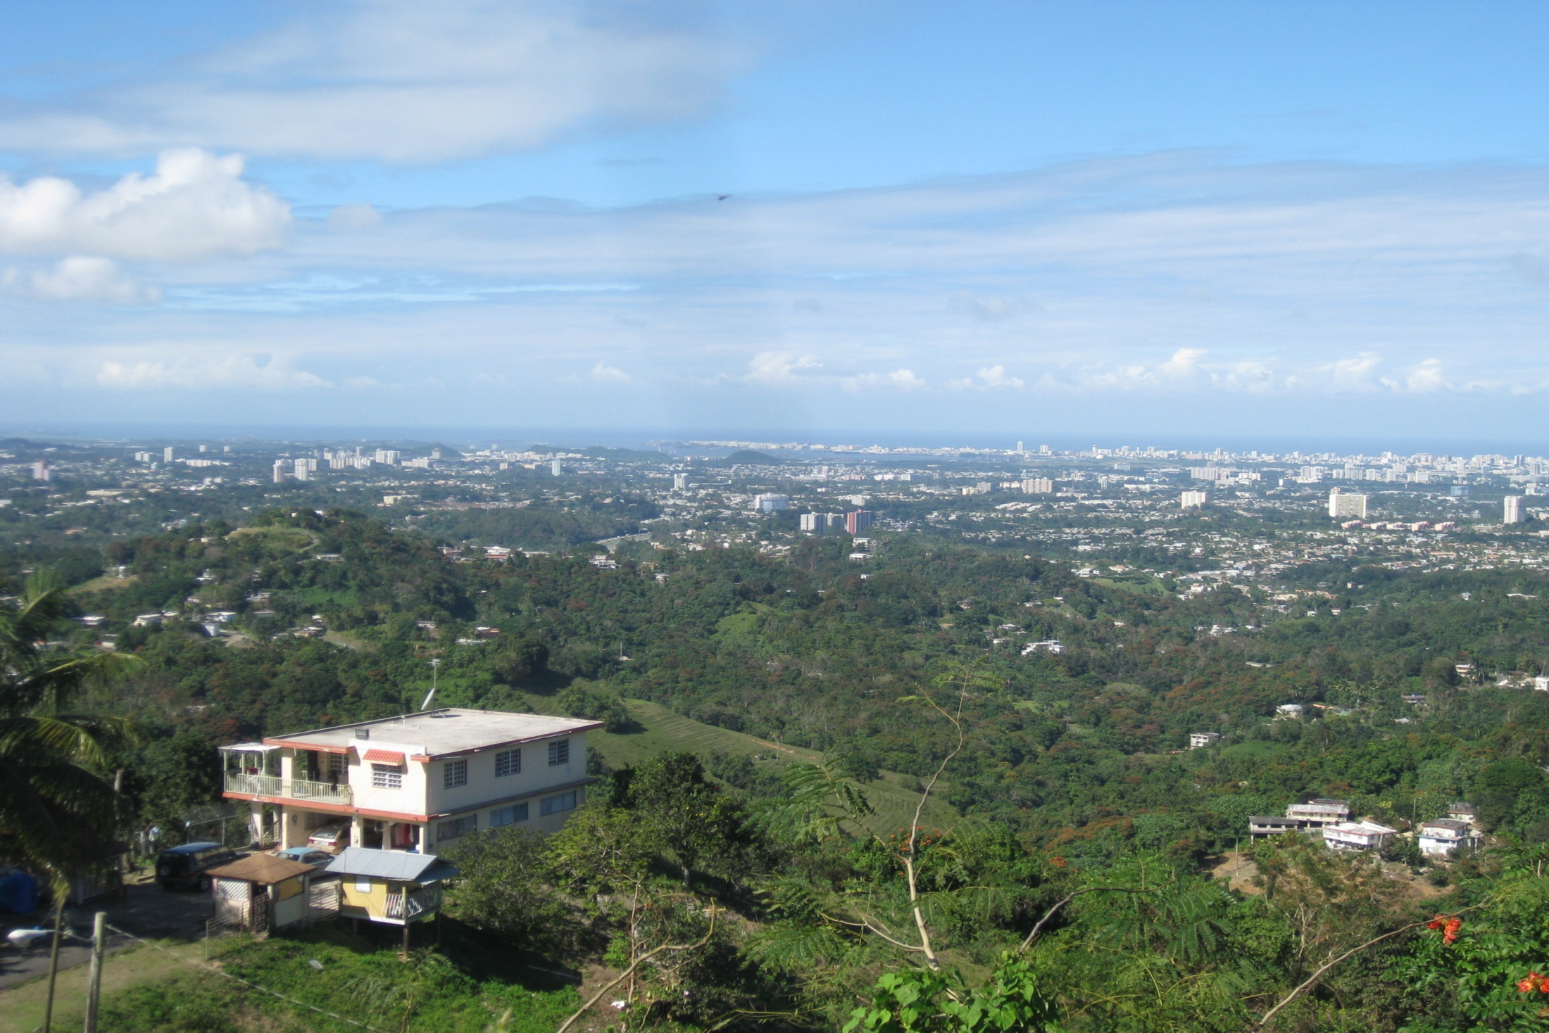
Acknowledgements
San Juan ULTRA-Ex Science Team
National Science Foundation
US Forest Service, International Institute of Tropical Forestry
Fundación Puertorriqueña de Conservación
University of Puerto Rico
Luquillo LTER
ASU School of Sustainability and IGERT Program in Urban Ecology
Social Science Research Council
Advancing Conservation in a Social Context
C. Redman, K. Larson, C. Miller, B. Cutts, T. Miller, A. Wiek, C. Monfreda
University of New Hampshire
SUNY Syracuse
Clark University
University of California, Los Angeles
Municipio de San Juan
Autoridad de Energía Eléctrica
CATEC
CAUCE
Centro Para Puerto Rico, Fundación Sila M. Calderón
IGERT, Universidad de Puerto Rico
www.sanjuanultra.org

