Slide 1


Using the Landscape to Mitigate Vulnerability and Enhance Resilience
B. L. Turner II
Arizona State University
Central Arizona Phoenix

Slide 2

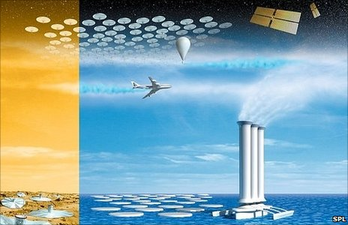
Solutions for Sustainability
Theme:
behavioral modification extremely difficult
geoengineering/infrastructure development extremely costly
design/redesign of landscape undervalued
  already shapes human-environment outcomes & thus vulnerabilities and resilience
  de facto part of adaptation
  thus can mitigate as well

Slide 3
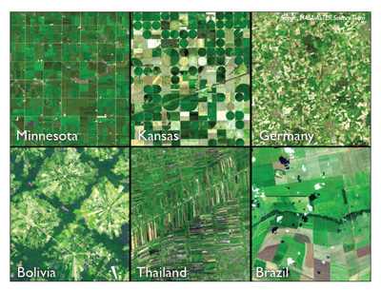
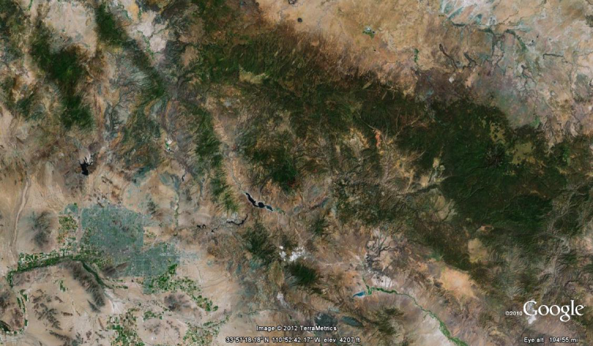
Land Architecture
Definitions
mosaic of land covers/uses (or land systems)
amount, shape, pattern, connectivity of land covers/uses
  urban core to wildlands

Slide 4
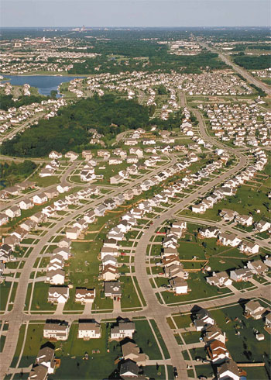
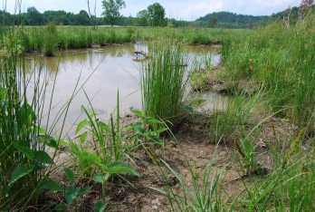
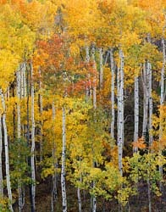
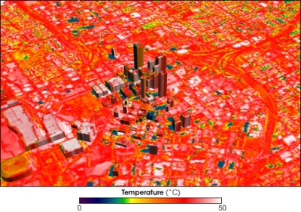
Multiple Birds with One Architecture
Land(scape) architecture affects tradeoffs
among multiple environmental services
between services and human outcomes/conditions
among multiple human outcomes/conditions
water quality
desired housing
carbon storage
UHI health

Slide 5


Thus…
IPCC Fourth Assessment & Americas Climate Choices (NAS)
  Land systems for mitigation and adaptation noted
International Council of Science
  Land systems = a grand challenge
NAS America’s Climate Choices
Notes:
For these reasons, land systems make all grand challenges

Slide 6
So What is the Science?
know little about LA-multiple tradeoffs by biome or environment
know even less about shape and pattern
minimal examinations of services to human outcomes
virtually no attention to scalar dynamics on tradeoffs
  can get one LA scale (local) “right” but is offset by that of the ascending scale

Slide 7
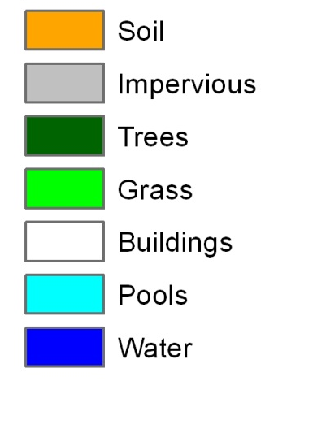

Regressions = increased significance when land configuration (architecture) included.
Mesic Residential
Xeric Residential
Industrial/Comm.
240m
240m
METRIC | VALUE
Temp | 303.9
ED | 1857.9167
LSI | 12.1475
SHDI | 1.4465
Build_ED | 576.6667
Build_LSI | 9.3165
Build_FRAC | 1.0867
Grass_PLAND | 12.28
Imp_PLAND | 9.35
Build_PLAND | 15.45
METRIC | VALUE
Temp | 30.52
ED | 1713.3333
LSI | 11.28
SHDI | 1.4459
Build_ED | 385
Build_LSI | 8.3621
Build_FRAC | 1.0909
Grass_PLAND | 17.61
Imp_PLAND | 17.29
Build_PLAND | 8.31
METRIC | VALUE
Temp | 303
ED | 872.0833
LSI | 6.2325
SHDI | 0.9653
Build_ED | 722.0833
Build_LSI | 6.3113
Build_FRAC | 1.2308
Grass_PLAND | 0.41
Imp_PLAND | 32.6
Build_PLAND | 56.62

Slide 8
Area_MN = mean
ED = edge density
PD = patch density
PLAND = % of given cover
FRAC_AM = fractal dim.
LSI = landscape shape index
Only beginning to explore LA on land system/ecosystem/landscape function, environmental services, and human outcomes, their tradeoffs, and use in designing sustainable HE systems.
Pearson’s correlations between LST and class metrics. * p < 0.05 ** p < 0.01

Slide 9
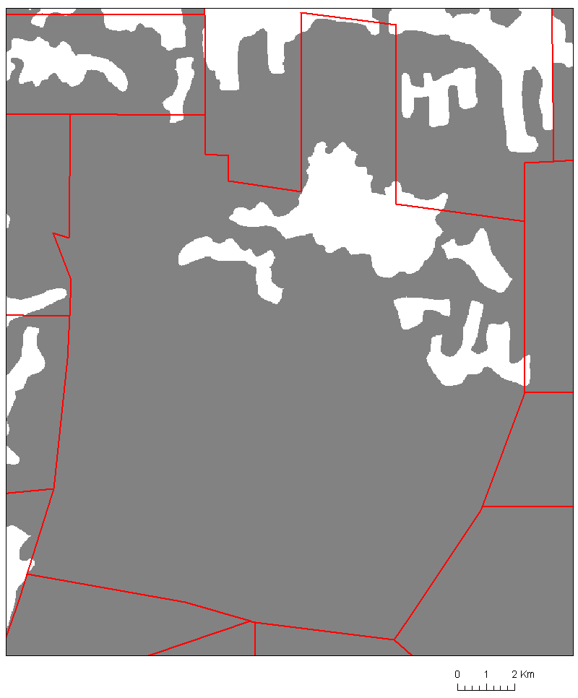
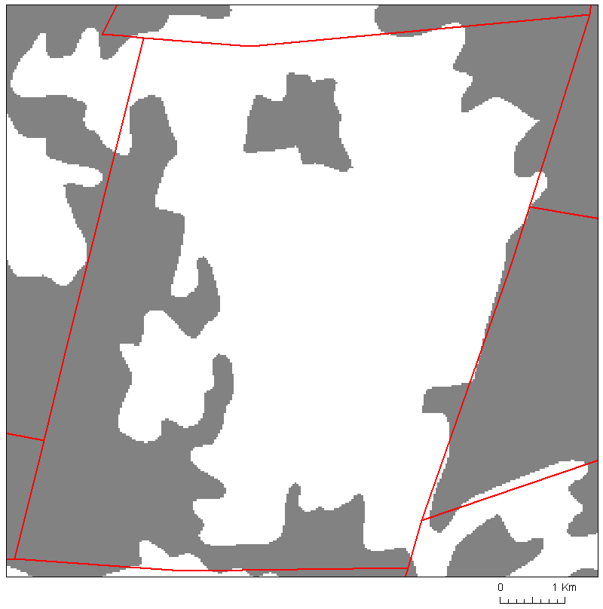
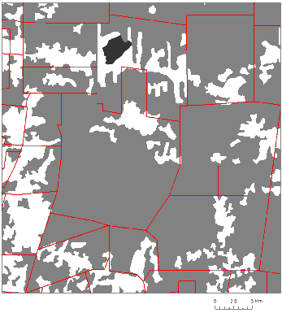
Rudimentary Example
Accounting for kind, amount, shape, pattern of land-use/cover + spatial dynamics – on ecosystems, services, and human outcomes
Local pattern A
Ascending Scale
Local pattern B
PD, ED, LSI ↑
Forest structure ↑
Biomass ↑
Carbon ↑
Biodiversity ↑
P Capture ↑
Bracken fern ↓
Evapotrans. ↑
Farm income ↓
Degrad. fram land. ↑
Req. off farm income ↑
PD, ED, LSI ↓
Forest structure ↓
Biomass ↓
Carbon ↓
Biodiversity ↓
P Capture ↓
Bracken fern ↑
Evapotrans. ↓
Farm income ↑
Degrad. Farm land ↓
Req. off farm income ↓
Biodiversity ↓
Habitat restriction ↓
Precipitation ↓?
Ecotrourism ↓
Farm Yields ↓
pattern and scalar interactions matter and must be treated more concretely with human outcomes
B Turner 2010. Land Use Policy.
Notes:
Examples of how different scales give diff answer + scalar interactions

Slide 10
Are We Ready?
Huge advances in
remote sensing
GIS
spatially explicit agent-based to econometric modeling
tradeoff assessment

Slide 12
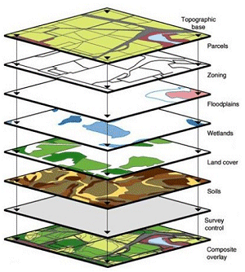
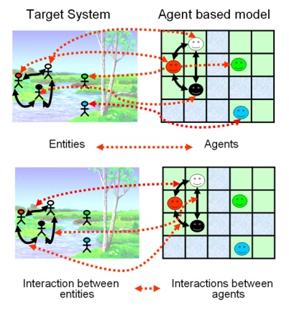
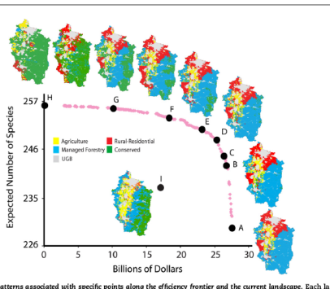
Are We Ready?
Huge advances in
remote sensing
GIS
spatially explicit agent-based to econometric modeling
tradeoff assessment
  but need to be made spatially explicit

Slide 13
We Can Do This
Capacity to create spatially dynamic and explicit model to handle multiple tradeoffs/outcomes
Prove important for a large number of science problems
Variants of the model → planning/decision making tool (co-produce from start)

