Slide 1

International Long Term Ecological Research (ILTER) Network: Past, Present, and Future
Kristin Vanderbilt, Ph.D.
Co-chair, US ILTER Committee
Department of Biology
University of New Mexico
Notes:
The International Long-Term Ecological Research network (ILTER) is a network of networks of scientists engaged in long-term,
site-based ecological and social-economic research, with over 40 member networks across the globe. It provides a unique
research platform for understanding local-to-global ecosystem changes by scaling up and synthesizing knowledge gained at
site/landscape levels in a variety of ecosystems with different environmental and economic drivers across the globe.

Slide 2
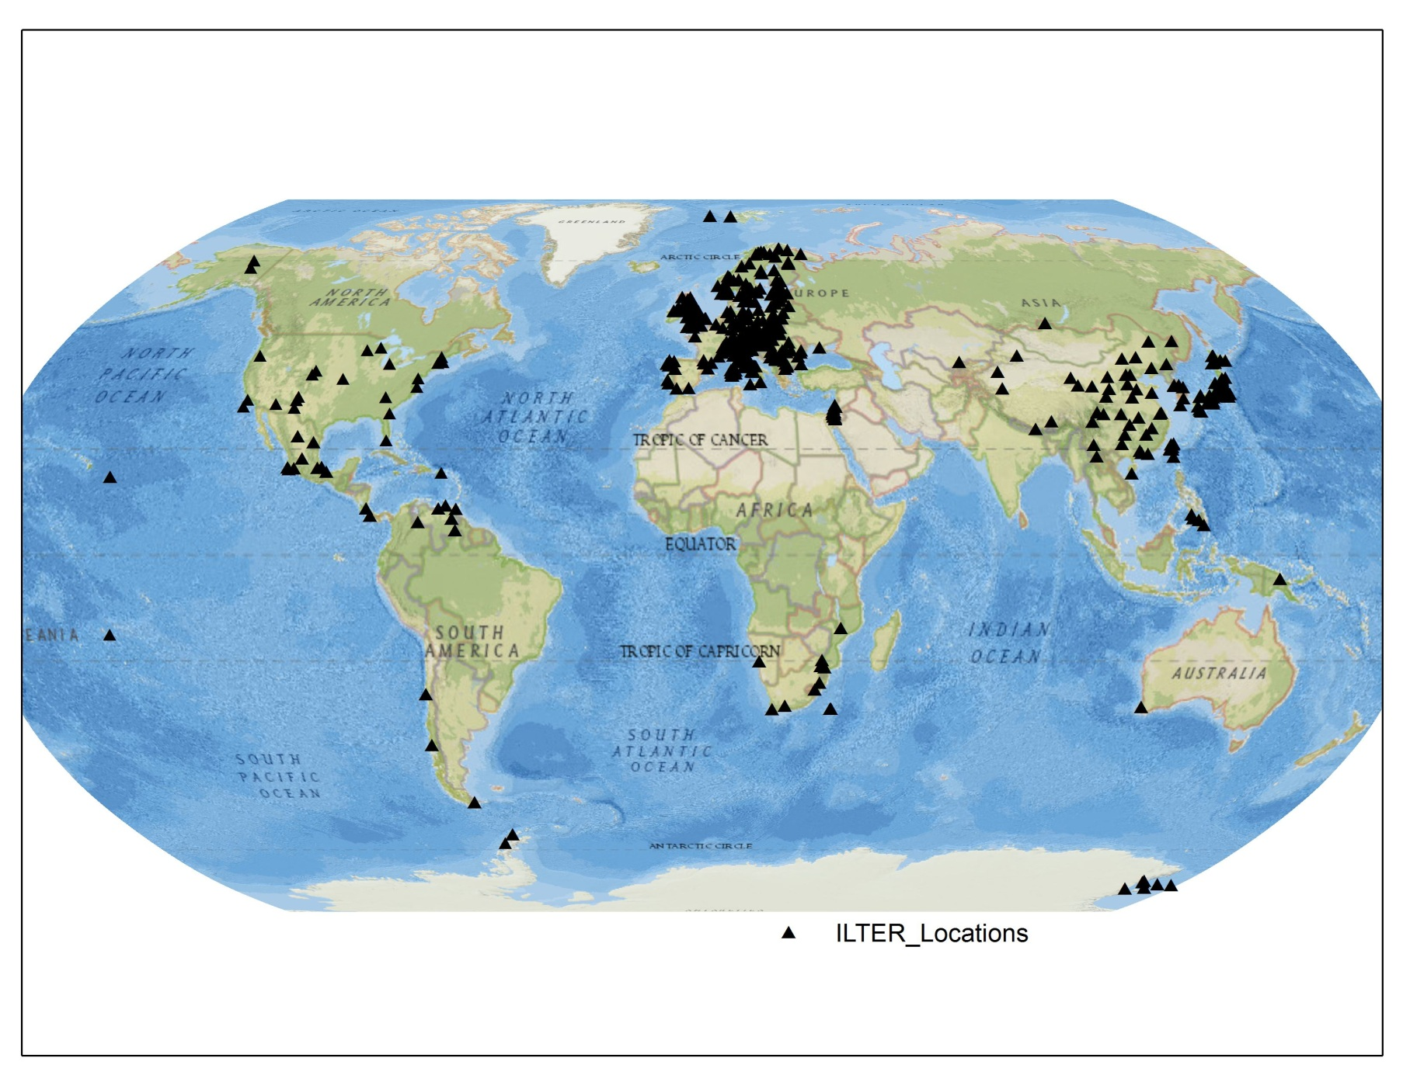
ILTER: A Network of Networks
ILTER: A Network of Networks
Figure: John Porter

Slide 3
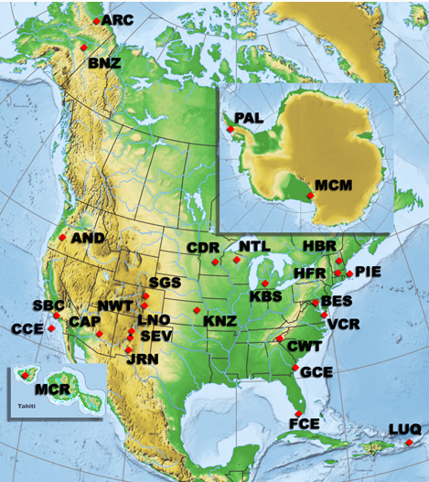
US LTER Network
Initiated in 1980
26 sites + Network Office
Ecosystems: desert, alpine, forests, coastal, grassland, urban, agricultural, Antarctic
Same core processes are being studied at all sites
Projects include integrative, cross-site, network-wide research to address questions at broad temporal and spatial scales
Notes:
Long Term Ecological Research (LTER) program concentrates on studies of ecological processes that play out at time scales spanning decades to centuries. Long-term data sets from the LTER program provide a context to evaluate the nature and pace of ecological change, to interpret its effects, and to forecast the range of future biological responses to change.
NSF instituted the LTER program with a call for proposals in 1980 that resulted in the selection of six sites. The network has matured steadily, adding individual sites and shifting focus from individual site research to a broader synthetic view aimed at searching out general ecological principles that apply to many ecosystems at many different scales. In 2006, LTER formalized its governance structure with the establishment of a Science Council of all site principal investigators to plan and develop Network level science.
At each of the Network’s 26 sites there is an extraordinary amount of knowledge about the organisms and processes important at the site, about the way the site’s ecosystems respond to disturbance, and about long-term environmental change. A growing number of cross-site observations and experiments also have revealed much about the way that key processes, organisms, and ecological attributes are organized and behave across major environmental gradients.
As the LTER program approached its fourth decade, the Network challenged itself to develop additional advancements in Network science and a new kind of transdisciplinary science – one that ranges from local to global in scope, and that blends ecological and social science theories, methods, and interpretations in order to better understand and forecast environmental change. A set of research themes will be pursued over the next decade and beyond: future scenarios of change, inland climate change, the disappearing cryosphere, and coastal vulnerability. These research themes will be addressed with new long-term datasets, cross-site experiments, and modeling activities.

Slide 4
US LTER Network…
During 1990s, NSF supported LTER scientists to reach out to colleagues around the world to catalyze development of LTER Networks in other countries
NSF had strong relationships with the National Academy of Science in most member countries
Notes:
One of the constant barriers in major global research projects is the lack of continuous data over time from sites around the world and the ability to do comparisons among them.
ILTER grew out of a realization within the U.S.-LTER that it was not broad enough to
effectively describe long-term ecological phenomenon in the context of global change. If the
scientific community was going to be able to provide the information necessary to implement
Agenda 212, it would need long-term data from a diversity of ecosystems across the globe. With
this realization emerged an interest on the part of the U.S. National Science Foundation (NSF) to
help catalyze the development of long-term ecological research programs in other parts of the
world. NSF funded U.S. scientists to reach out to colleagues throughout the world to help them
establish long-term ecological research networks. Using its existing and new bilateral
relationships, NSF throughout the 1990's funded efforts several dozen countries to support travel
of U.S. scientists to help establish networks and joint research programs.
Since ILTER’s establishment in 1993, global long-term ecological research programs have
expanded rapidly, reflecting the increased appreciation of the importance of long-term research
in assessing and resolving complex environmental issues. As of February 2006, 32 countries
have established formal LTER programs and joined the ILTER network. Several more are
actively pursuing the establishment of national-level networks and many others have expressed
interest. ILTER began grouping its national-level networks into regions in 1996, and now has six
regional networks – East Asia/Pacific, Central/Eastern Europe, Western Europe, Africa, North
America, and Central/South America.

Slide 5
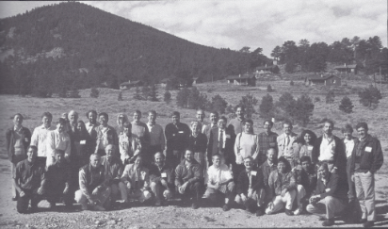
International Summit in Estes Park, CO (1993)
1993 -39 scientists and administrators representing 16 countries participated in this meeting hosted by US LTER
Notes:
Argentina, Brazil, Australia, Canada, Chile, China, Costa Rica, France, Hungary, Mexico, Mongolia, New Zealand, Russia, Taiwan, United Kingdom, and the United States represented

Slide 6
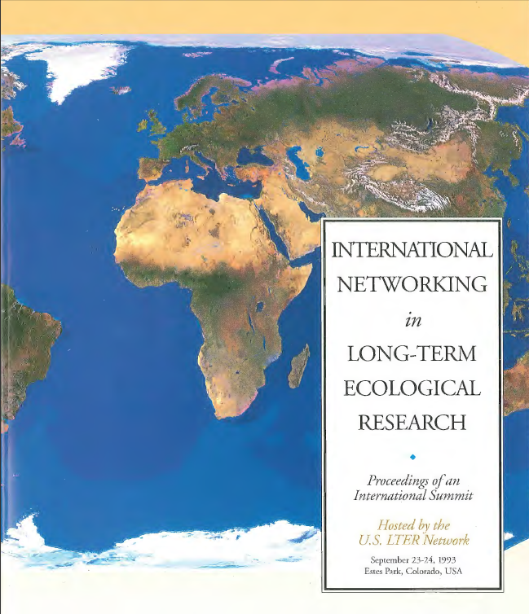
LTER Network Office Publication #17
Notes:
LTER Network Office Publication #17: International Networking in Long-Term Ecological Research: Proceedings of an International Summit This book, published in 1994, represents the nascent effort to solidify an International LTER network. Hosted by the NSF and the LTER Network Office, representatives from 16 countries presented their long-term research and their interests in forming an International LTER Network

Slide 7
The ILTER is…
a global network of research sites located in a wide array of ecosystems
a network of scientists engaged in long-term, site-based ecological and socioeconomic research
a platform for understanding environmental change across the globe

Slide 8
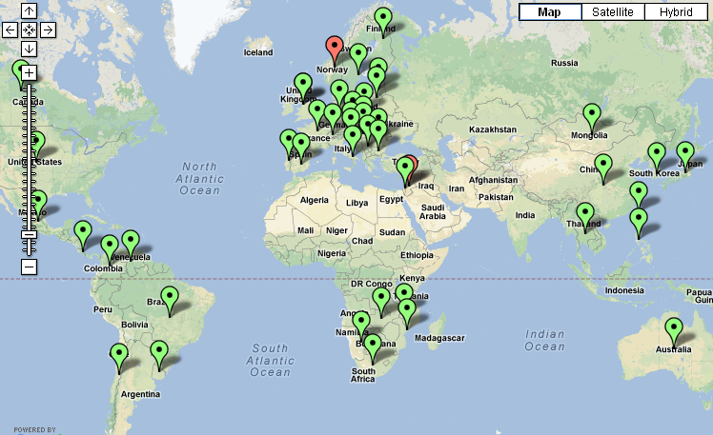
ILTER Members

Slide 9
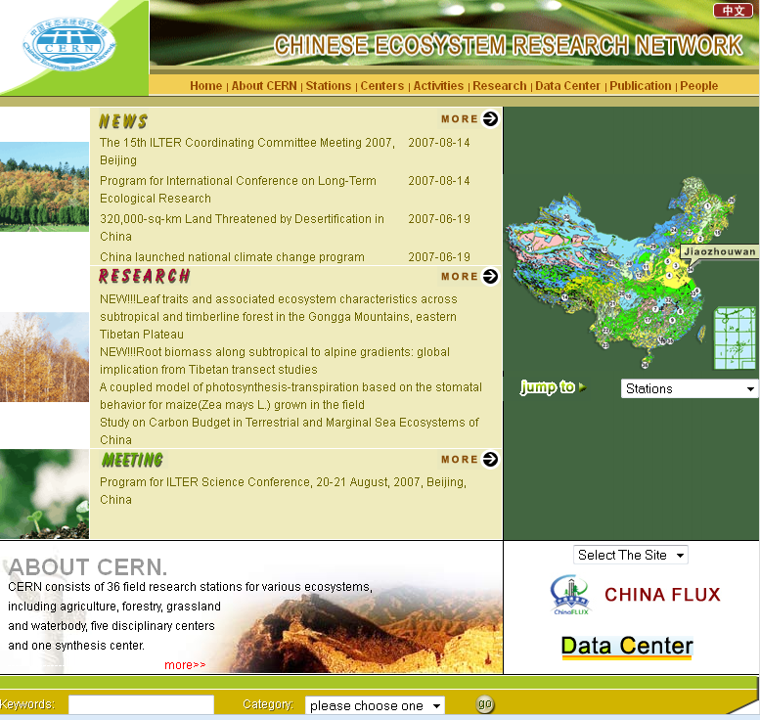
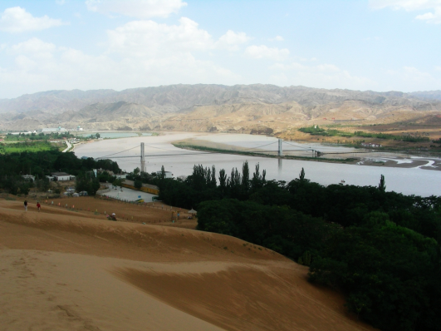
Chinese Ecosystem Research Network (CERN)
Notes:
36 sites, five disciplinary centers, Network office

Slide 10

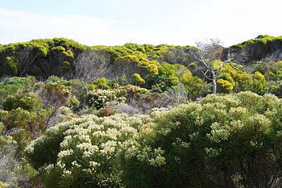
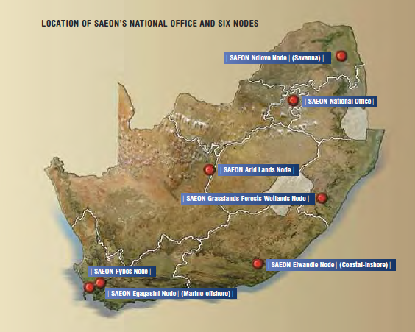
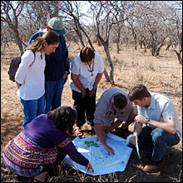

Slide 11
US LTER/NSF Supported Many Interactions with other ILTER Members
Scientist exchanges
Student exchanges
ILTER Regional meetings and workshops
ILTER Annual Coordinating Committee Meetings
US LTER All Scientist Meetings

Slide 12
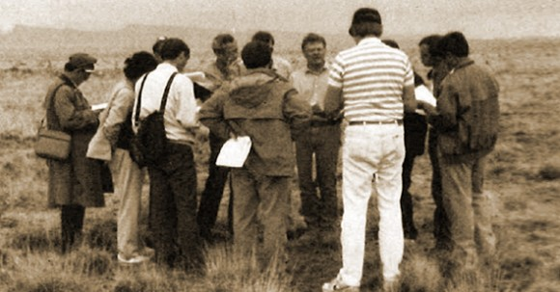
1991: US – China Exchange
Photo by Beryl Leach/NAS
Jim Gosz, ILTER Chair (1995 – 2002)

Slide 13
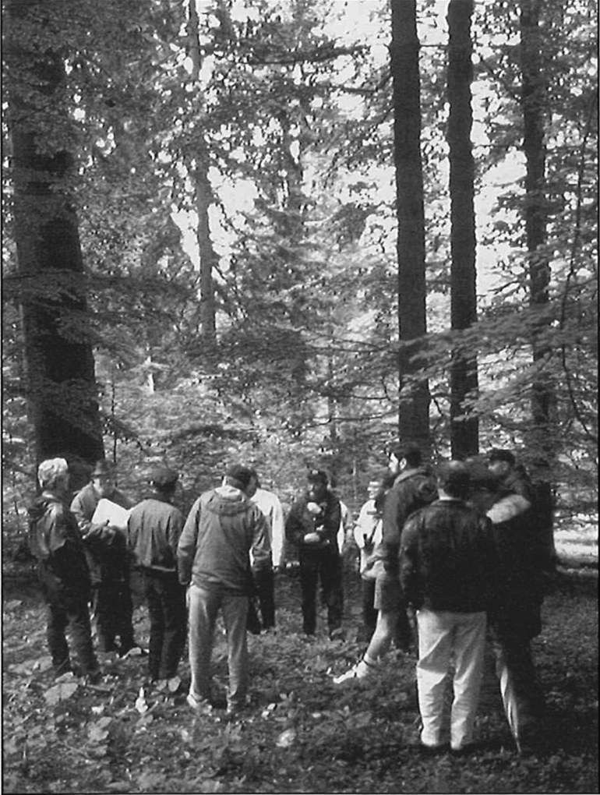
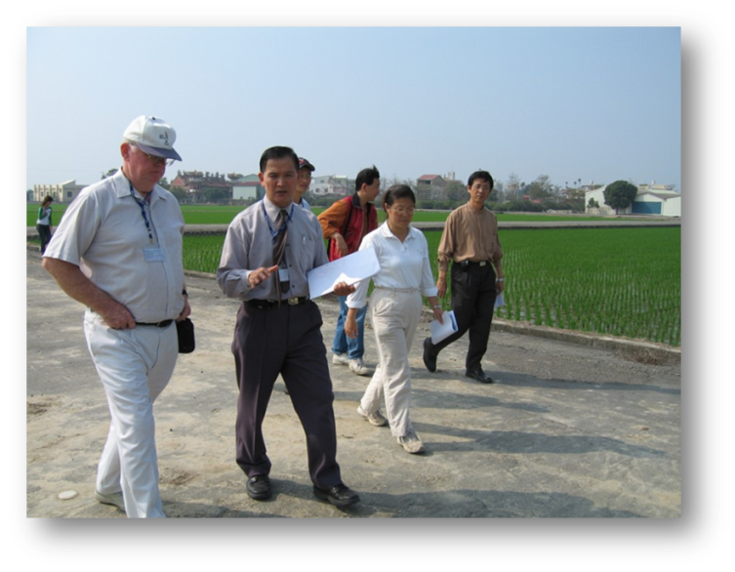
Reciprocal Scientist Exchanges
Czech Republic, Hungary, Poland -- 1995
Portugal, Spain – 1996
Venezuela -- 1996
Southern Africa – 1999
Taiwan
Kellogg Biological Station Researchers at Yuin-Lin Experiment Station, Taiwan 2006
Photo: Andrew Corbin
Sumava National Park, Czech Republic
Photo: Jim Gosz

Slide 14
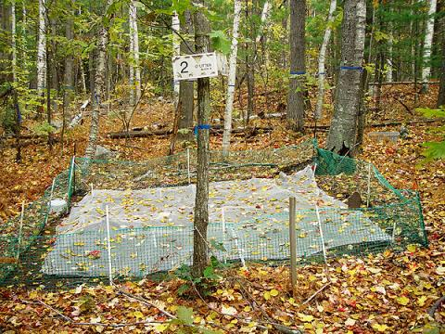
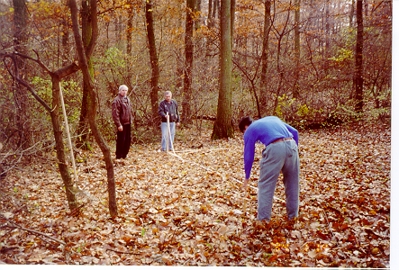
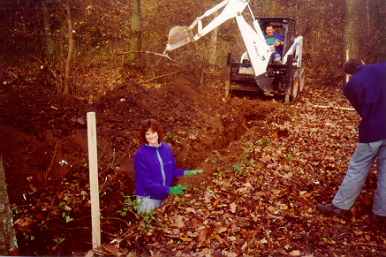
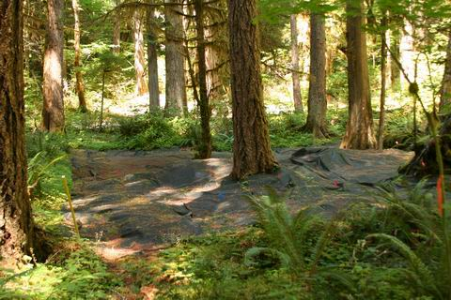
“Cooperation in Long Term Ecological
Research in Central and Eastern Europe”, 1999: Co-organized by Kate Lajtha, HJA LTER
Detritus Input and Removal Treatments (DIRT) Project replicated in Síkfőkút Forest LTER Site, Hungary in 2000
HFR
Photo: http://harvardforest.fas.harvard.edu
HJA
Photo: Lina DiGregorio

Slide 15
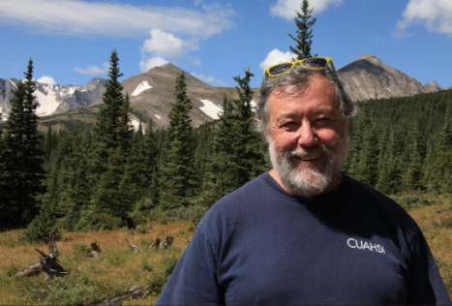

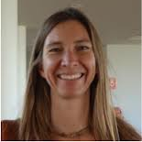
Mark Williams (Niwot LTER): Establishing the International Mountain LTER Network
Byron Adams (McMurdo Dry Valleys LTER): The McMurdo Dry Valleys Terrestrial Observation Network: An International Effort to Coordinate Management, and Environmental Stewardship
Tiffany Troxler (Florida Coastal Everglades LTER): A Focus on Tropical Systems: ILTER Research Highlights from the Florida Coastal Everglades (FCE)
Instaar.colorado.edu
News.byu.edu
Casgroup.fiu.edu

Slide 16
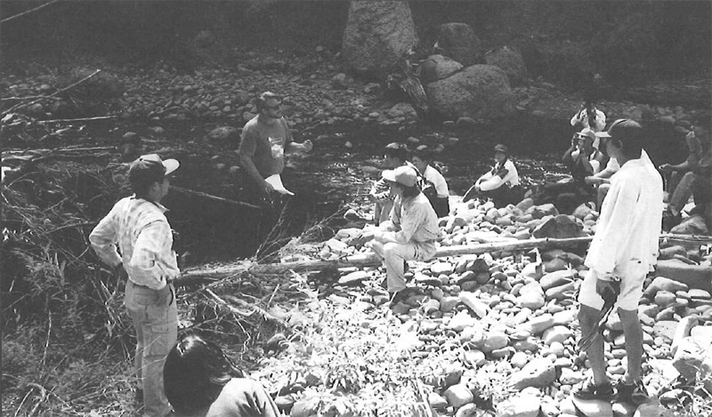
Japanese and Taiwanese students visited HJ Andrews LTER, 1997

Slide 17
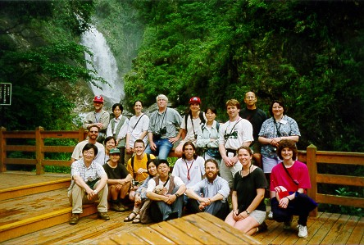
US LTER Grad Students Visit LTER Sites in Taiwan and China, 1998

Slide 18
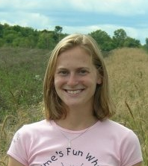
Megan Woltz (Kellogg Biological Station LTER): Expanding Dimensions in Landscape Agroecological Research: an ILTER Cross-site Collaboration
Photo: Student.lternet.edu

Slide 19
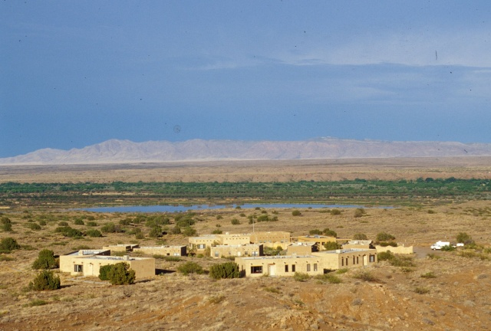
Information Management Training (Capacity Building)
1993 – 5 Chinese Ecological Research Network (CERN) data managers attended 12-week course at Sevilleta LTER to learn basic concepts of information management
  Chinese participants taught IM classes to other Chinese
Notes:
In 1992, Ims met with CERN personnel to co-design the workshop to be held at Sevilleta.

Slide 20
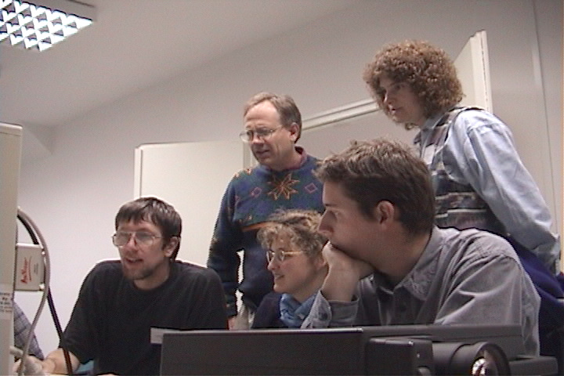
CEE-ILTER IM Workshop, Hungary, 2000
Photo: John Porter

Slide 21
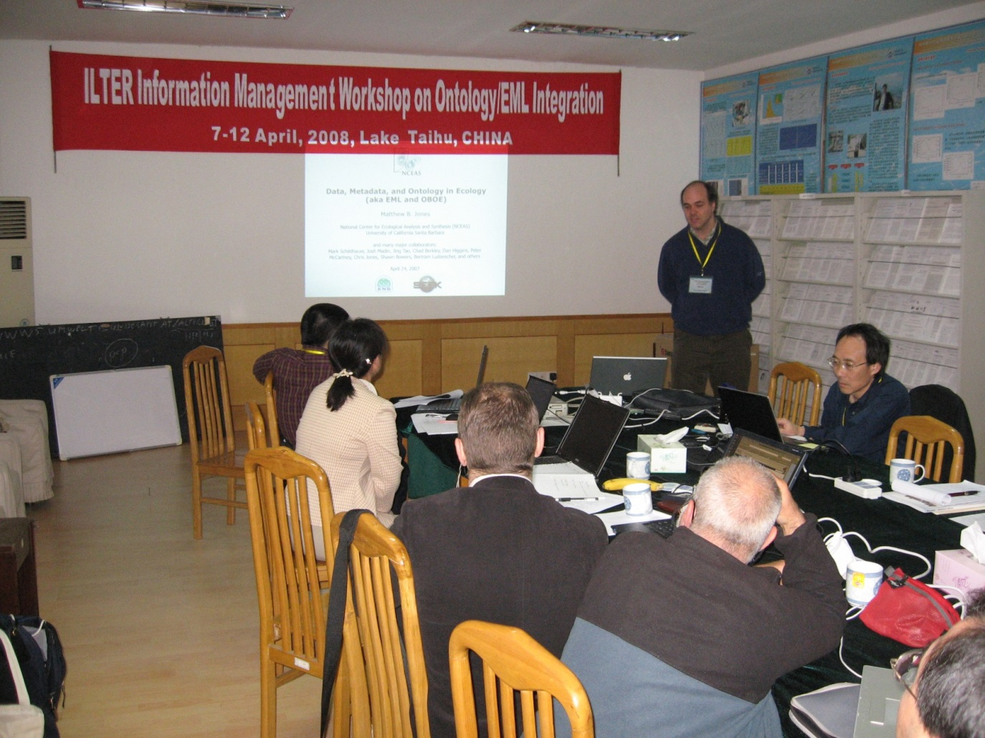
IM Workshop, Lake Taihu LTER, China, 2008

Slide 22
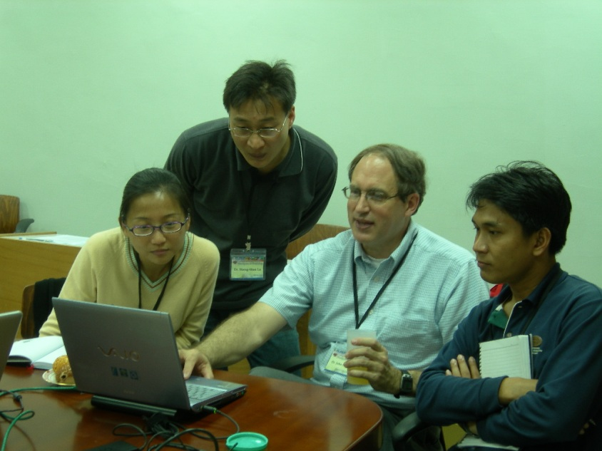
John Porter (Virginia Coast Reserve LTER): Many Hands: Fostering Ecological Data Sharing through ILTER Information Management Collaborations

Slide 23
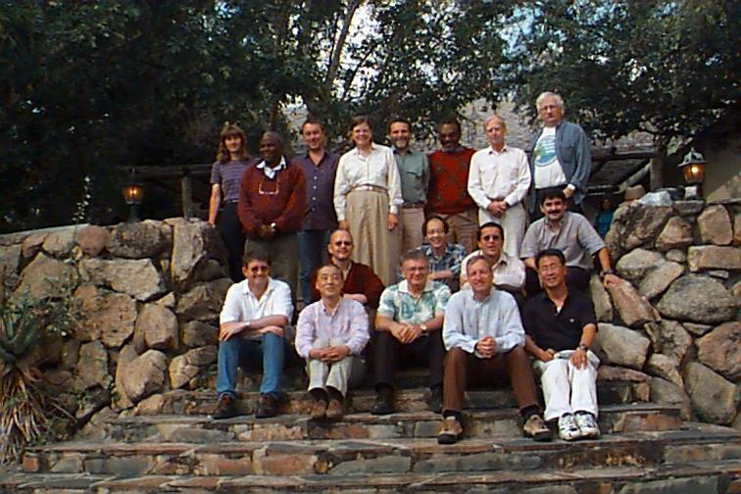
Annual ILTER Coordinating Committee Meeting, Skukusa, South Africa 1999
Photo: John Vande Castle
Notes:
JVC photograph

Slide 24
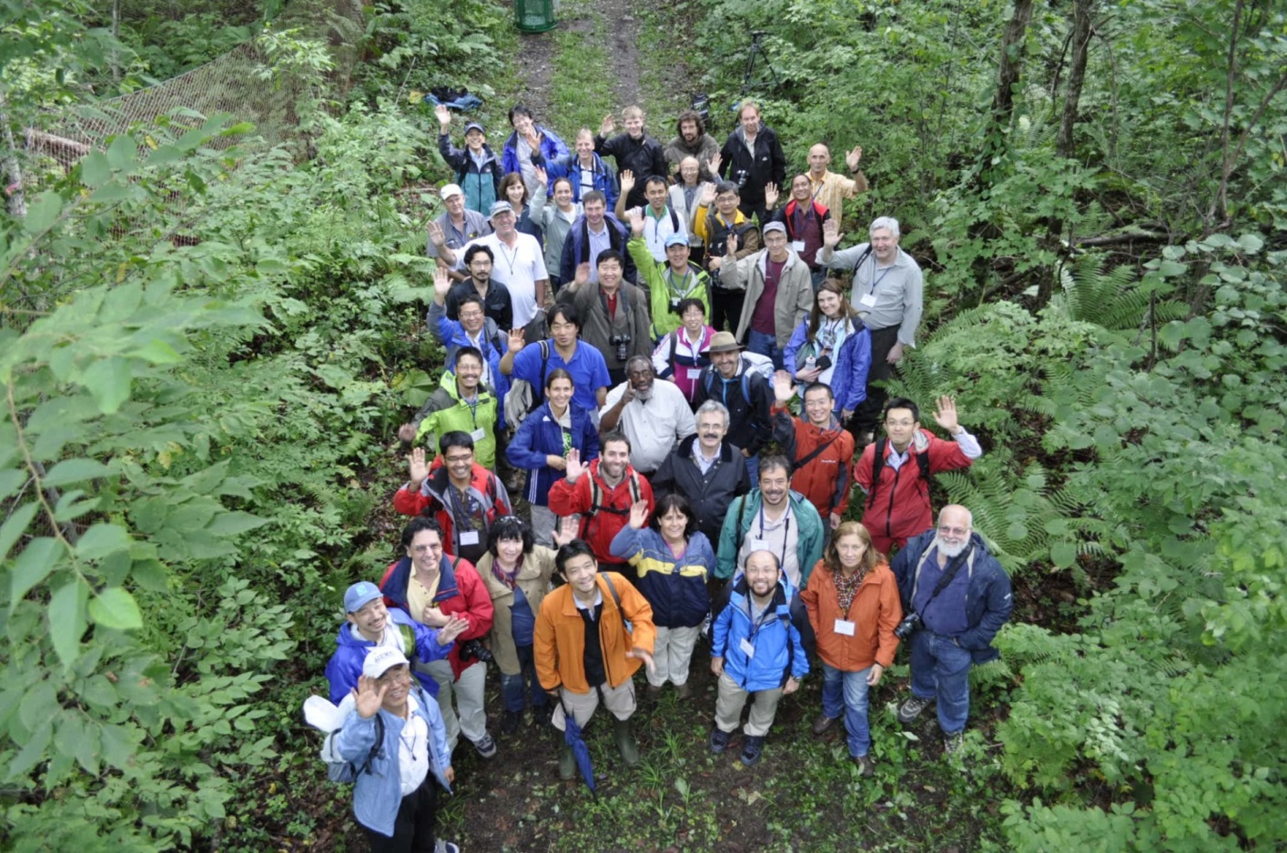
2011 ILTER CC Meeting (Tomakomai Experimental Forest, JaLTER Core Site)

Slide 25
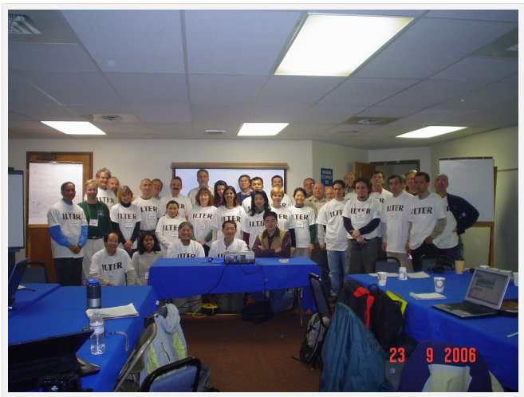
2006 US LTER All Scientists Meeting

Slide 26

Saleit Ron (Israel LTER): A Joint Schoolyard ILTER Project for Students in Israel and the US

Slide 27
2002: Time for an ILTER Organizational Change
  ILTER was an extremely successful effort to share the philosophy of LTER around the world and to support establishment of national networks
  By 2002, ILTER was a collection of individual LTER Networks with an umbrella committee that met annually
  ILTER, with NSF support, restructured in order to realize the goal of doing network-scale research

Slide 28
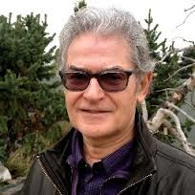
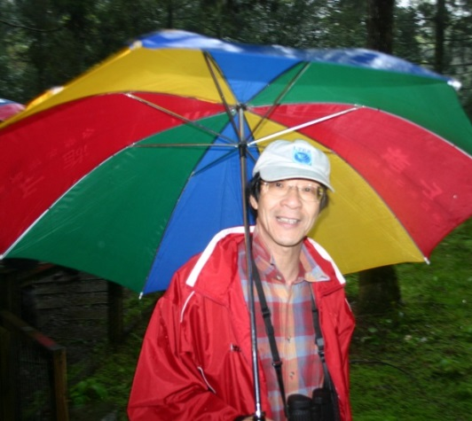
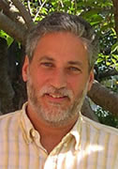
Restructuring the ILTER
NSF supported consultants to prepare ILTER Strategic Plan
Hen-Biau King (Taiwan) Chaired ILTER network
Patrick Bourgeron and Steve Hamburg chaired US ILTER Committee
PATRICK BOURGERON
HEN-BIAU KING
STEVE HAMBURG
Photo: John Vande Castle

Slide 29
ILTER Strategic Plan 2006:
Staffing and Governance
Executive Committee
Coordinating Committee
Science Committee
Public Policy
Fundraising and Marketing
Information Management

Slide 30
ILTER Funding: Dues
Member Dues and In-Kind Contributions
  $10K/year paid by US LTER
  ILTER Budget is very small
Seed money for IM improvements and ILTER research efforts
Notes:
Pay someone to manage the listserv for ILTER.

Slide 31

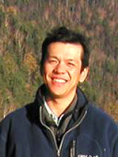

ILTER Science and Programs Committee
ILTER-wide Research Initiatives
  “Interactions between Ecosystem Services, the dynamic behavior (thresholds/tipping points) of the ecosystems delivering these services, and their restoration potential: Impact of culture on ES perception (stakeholders’ non-economic valuation) and their use” – led by Patrick Bourgeron (US LTER, Chair ILTER Science Committee)
  “Socio-biogeochemistry of nitrogen cascades and interactions” by Hideaki Shibata (JaLTER)
  “Ecosystem based local-scale impacts and adaptation practices in relation to global change drivers” by Martin Forsius (FinLTSER)

Slide 32
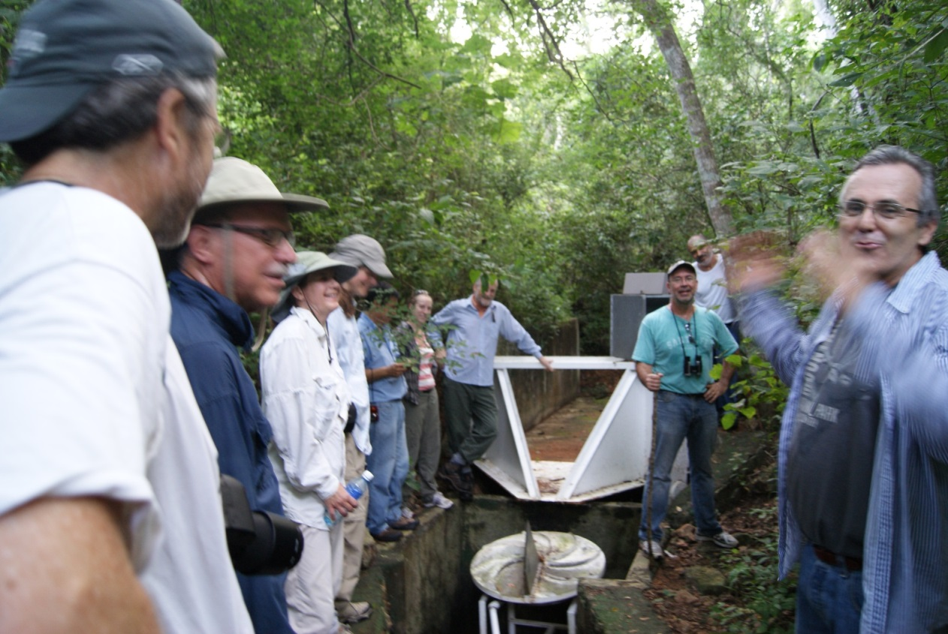
ILTER Future
Manuel Maass (LTER Mexico) – ILTER Chair as of September 2012

Slide 33
In Summary:
NSF and US LTER invested substantially in the ILTER during past 20 years

Slide 34


US-Dominated Federation of Sites
FLEDGELING
LTER Networks in
Other Countries
SUCCESSFUL
US LTER MODEL
ILTER Network Driven by US Funds

Slide 35

US-Dominated Federation of Sites
FLEDGELING
LTER Networks in
Other Countries
SUCCESSFUL
US LTER MODEL
ILTER Network Driven by US Funds
Owned by International Community
Building A
Sustainable Model

Slide 36
US-Dominated Federation of Sites
FLEDGELING
LTER Networks in
Other Countries
SUCCESSFUL
US LTER MODEL
US Returns on Investment:
Membership in ILTER provides research and education opportunities all over the world for LTER scientists and students
Mechanism to access long-term data from a wider variety of ecosystems
Mechanism to bring new programs in to US
ILTER membership means participation in a global network that is like no other
ILTER Network Driven by US Funds
Owned by International Community
Building A
Sustainable Model

Slide 37
Thank you!
Organizing Committee: Evelyn Gaiser (FCE), John Vande Castle (LNO), Dan Childers (CAP), Jeb Barrett (MCM)
Memories and photos: Jim Gosz (SEV), Fred Swanson (HJA), James Brunt (LNO), John Vande Castle (LNO), Leanne Yanabu (LNO)

Slide 38
Questions?

