Slide 1
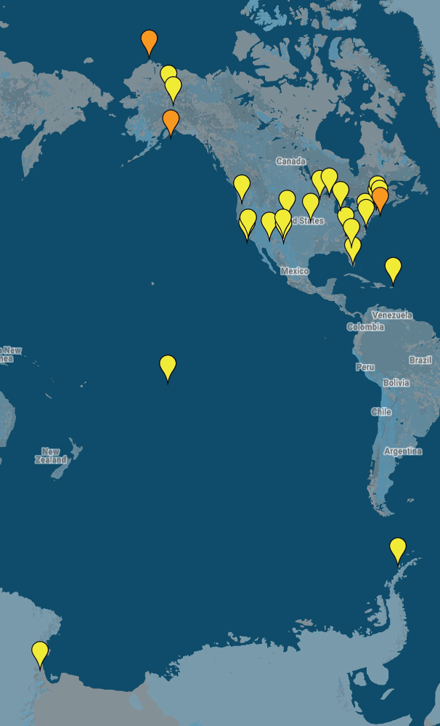

The Long-Term Ecological Research Network
25 (soon to be 28) sites
37 years
2300 investigators
>5911 public datasets
>16,000 journal articles
Welcome to: Northeastern U.S. Shelf (NES), Northern Gulf of Alaska (NGA), and Beaufort Lagoon Ecosystem (BLE), starting autumn 2017.
Long-term ecological and environmental studies allow us to better understand the inherent variability of natural systems, to discern trends and shifting baselines, and to witness rare events and unanticipated ecological surprises.
--Hughes et al. Bioscience, 2017

Slide 2
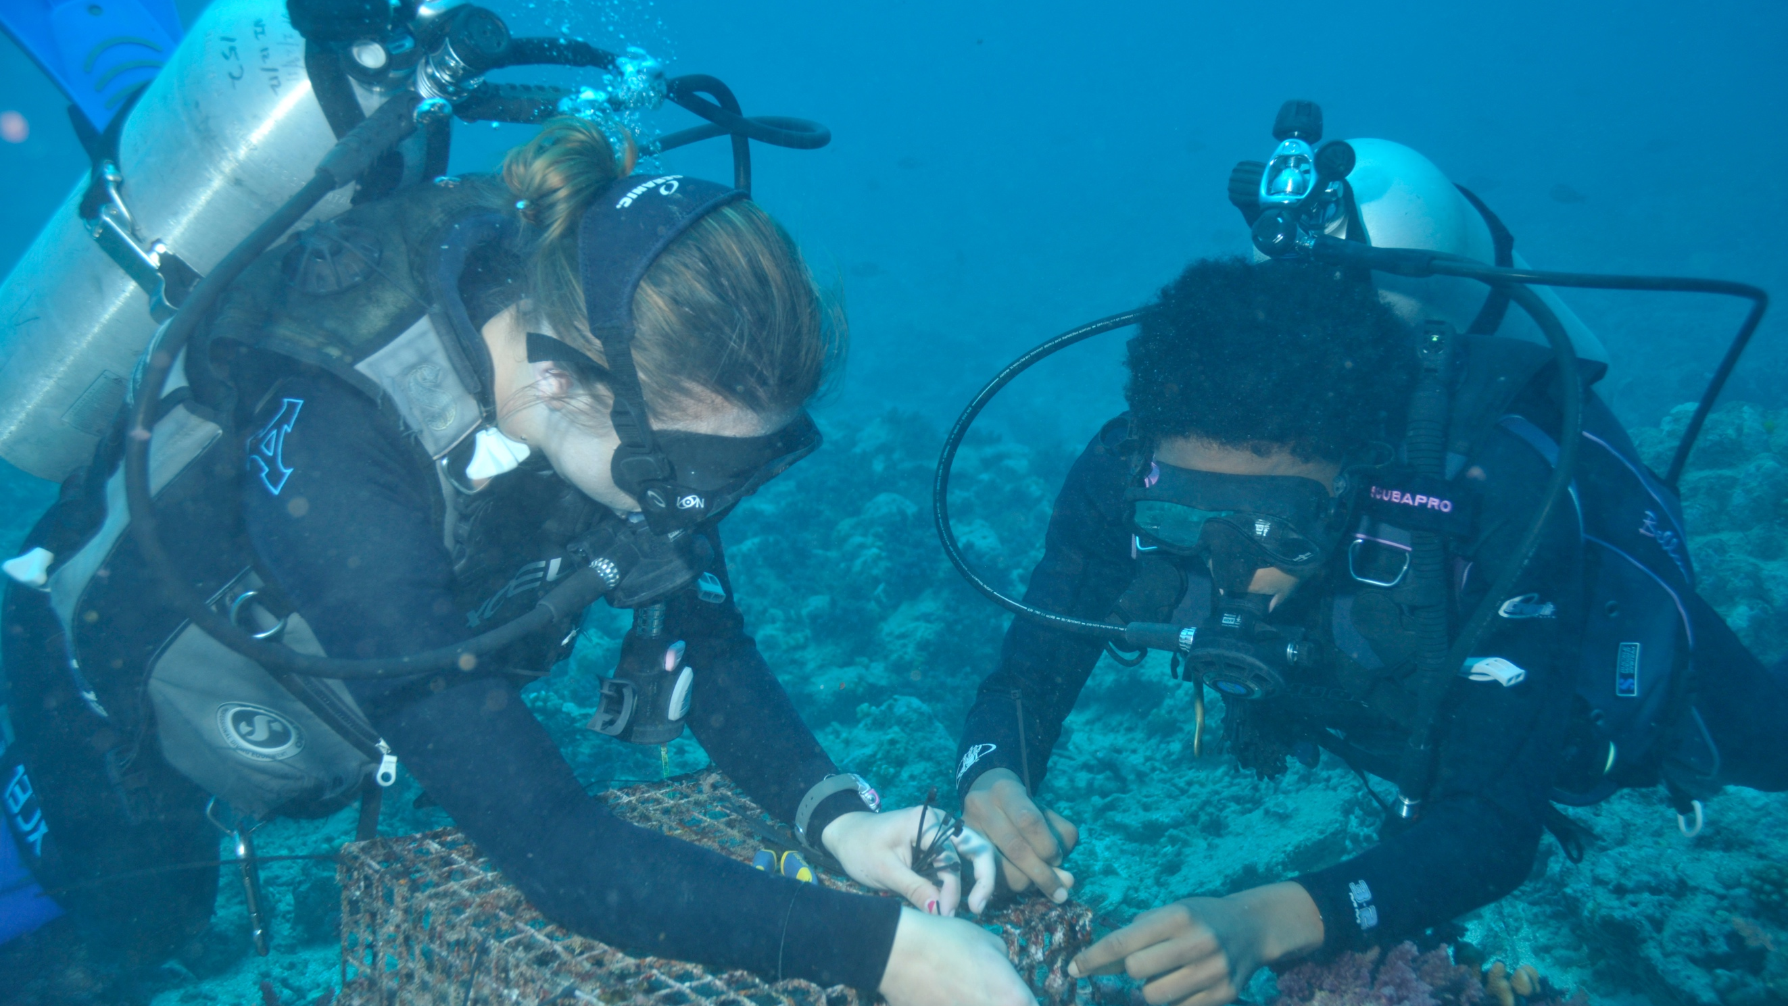
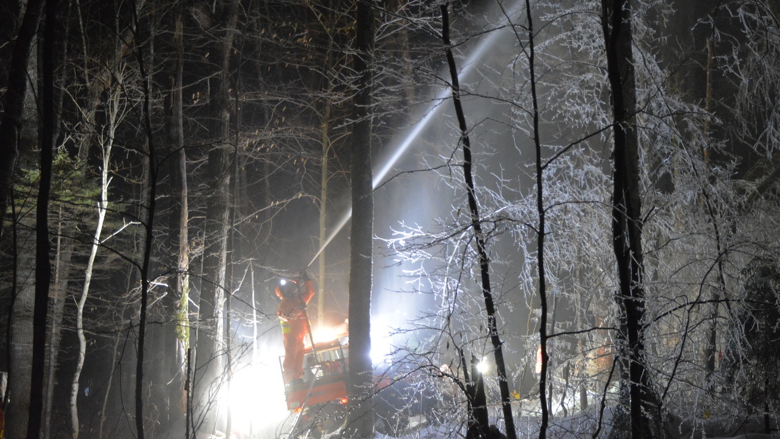
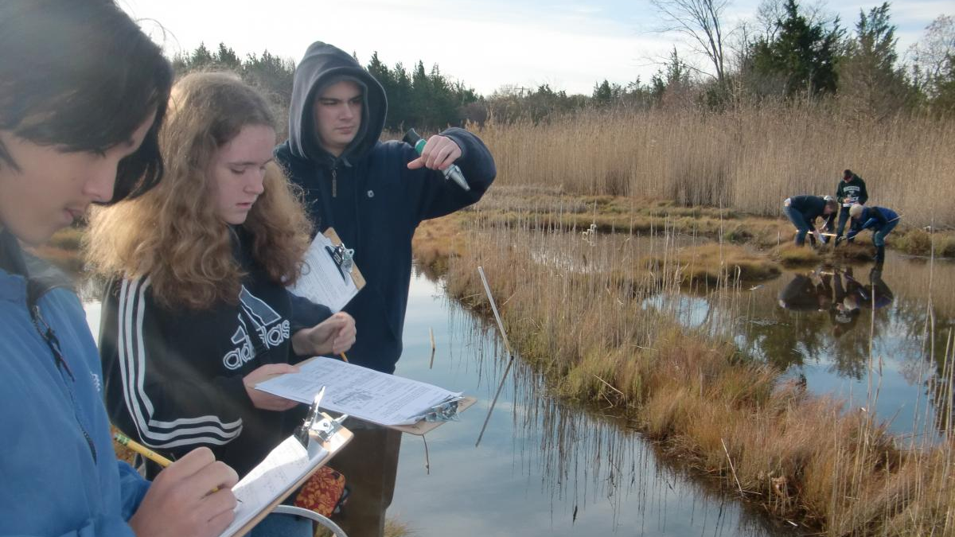
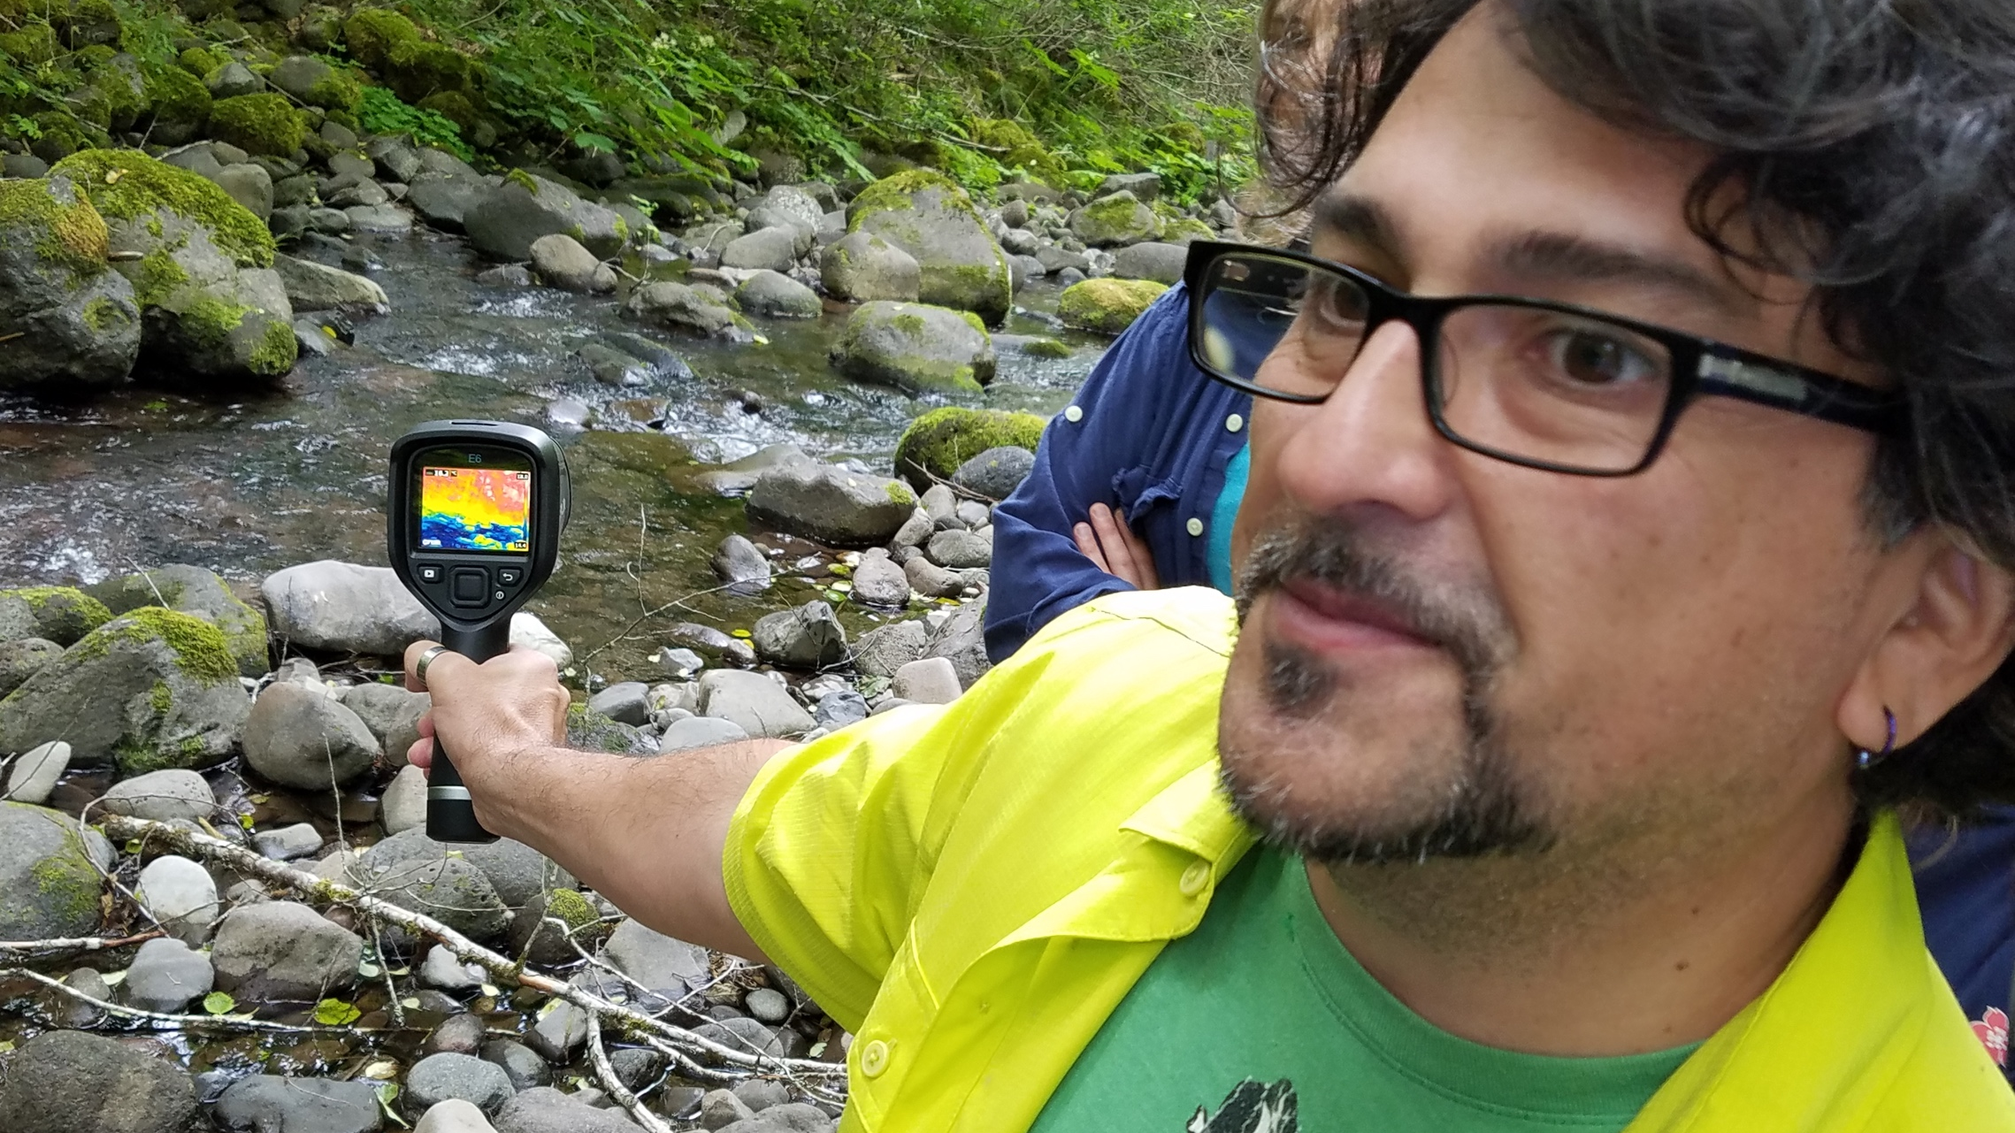
Long-Term Observations
Each site maintains long-term records of key parameters for that ecosystem, providing critical context for shorter-term studies and cross-system comparisons.
Long-Term Experiments
LTERs maintain experimental manipulations that test potential influences on ecosystem change, which extends the range of simulation models.
Long-term ecological and environmental studies allow us to better understand the inherent variability of natural systems, to discern trends and shifting baselines, and to witness rare events and unanticipated ecological surprises.
—Hughes et al. Bioscience, 2017
Expanding Opportunities
LTERs bring together groups of researchers with diverse backgrounds. Each new generation of scientists applies new tools and explores new questions in systems where the context is well understood.
Long-Term Relationships
LTER sites build trusting relationships with resource managers, educators, and landowners in their regions.

Slide 3

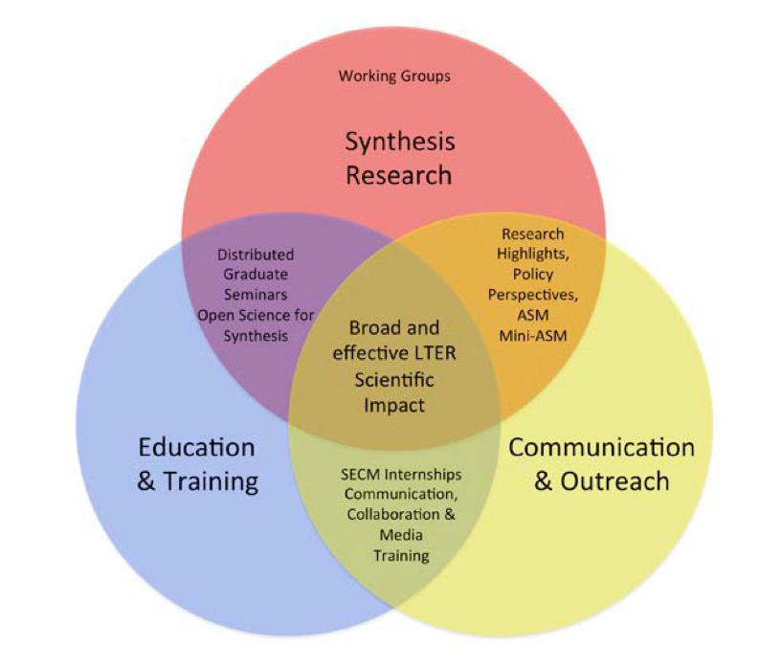
LTER Network Communications Office
Synthesis Working Groups
Stream Elemental Cycling
LTER Metacommunities
Communities-to-ecosystems
LTER Synchrony
Biodiversity & Productivity
Science Update (monthly)
News from the NCO
Web sites
Social media
Print materials
Meeting outreach
Education & training partnerships
Data nuggets
Schoolyard LTER book series
ESA workshops
Distributed graduate seminar

Slide 4
The nature of ecological change:
Has been a signature topic in Ecosystem Science since the 1960s.
A challenge to our fundamental understanding of ecosystems as units of nature and units of study.
Response to “disturbance” has been a critical topic at the interface between science and society.
Interest in ecological change has accelerated with the nature and extent of global environmental change.
Long-term ecological research (LTER) is critical for progress in this important area.

Slide 5
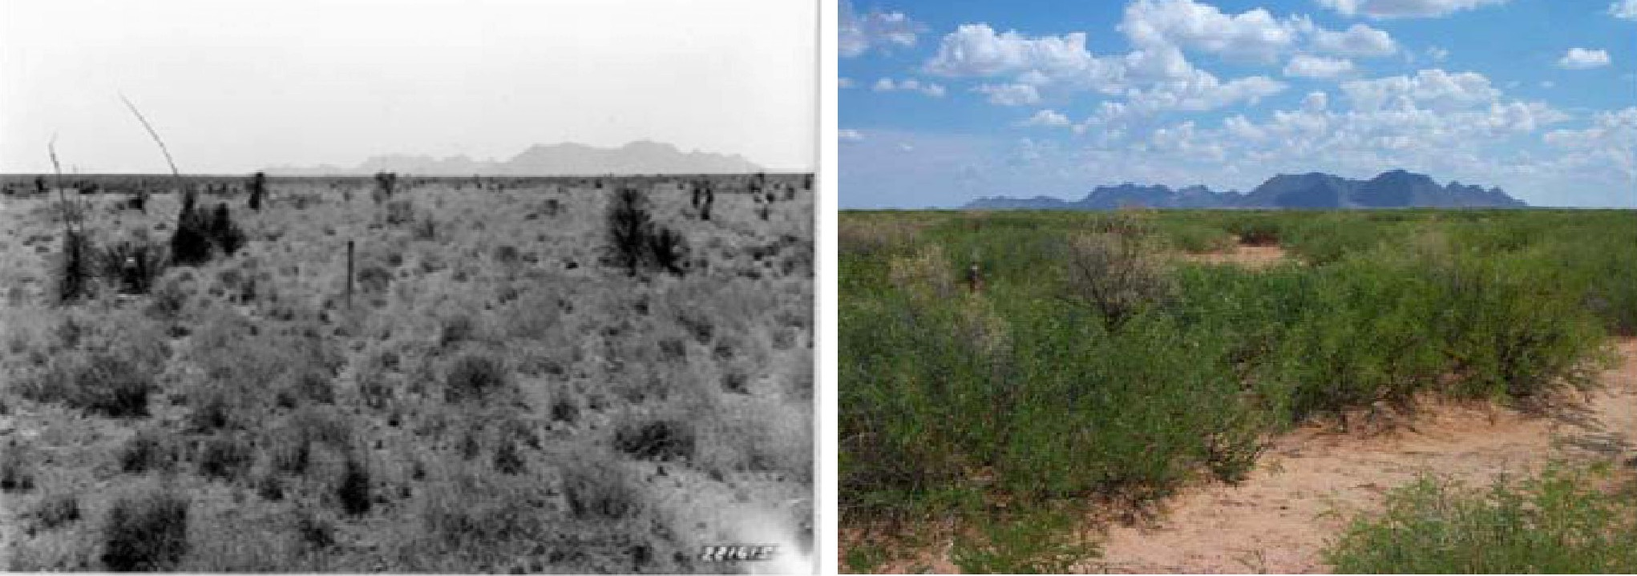
Grasslands to shrublands . . . .
1933
2003
Source: Brandon Bestelmeyer

Slide 6
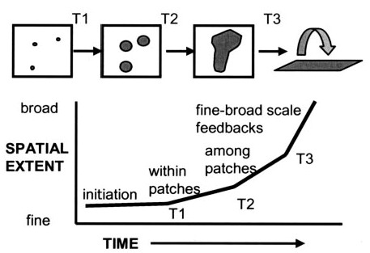
Cross-scale interactions, non-linearities, and irreversible change . . .
Source: Peters et al. (2004)

Slide 7
Regime shifts in lakes:
Shift from clear to turbid state driven by:
  Eutrophication, e.g., P input.
  Trophic cascades, e.g., decline of Daphnia
Sometimes reversible, sometimes not . . .
  Sediment P pools provide internal source (e.g. Okechobee, Mendota).
Predictable?
  Changes in variability as an indicator of change?
  Facilitated by new sensors, new networks, new models.
Source: Carpenter et al. (2011)

Slide 8
Moving from LTER to very (V)-LTER to address the hardest questions about ecological change:
Extreme clearcutting experiments at Hubbard Brook (watershed 2) suggest remarkable resilience.
Would we get the same response after 50 years of acid rain and climate change?
What do we learn from 50 years of LTER research that we can’t learn from 30 years of research?

Slide 9
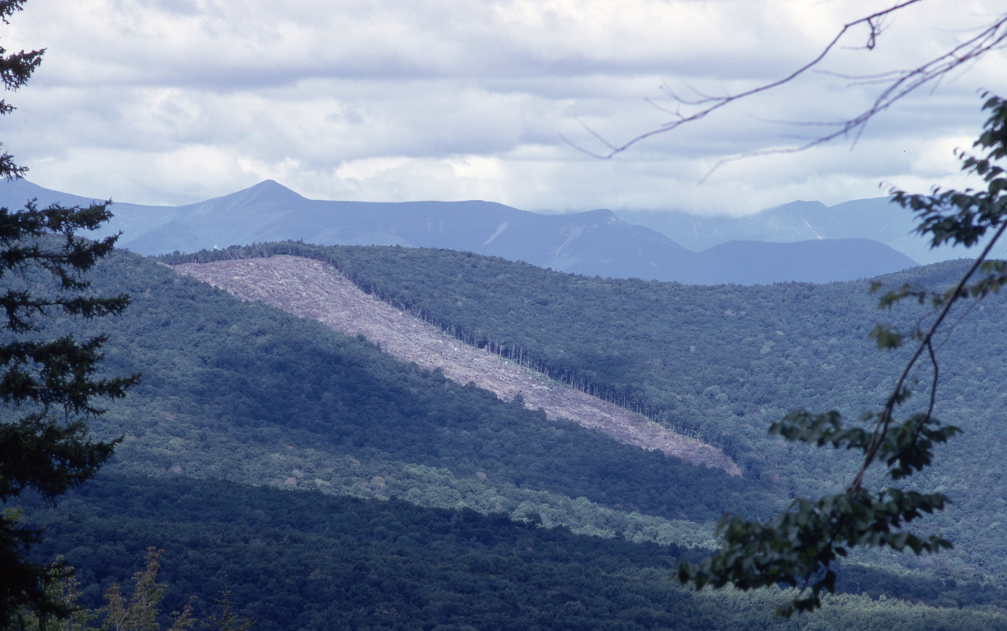
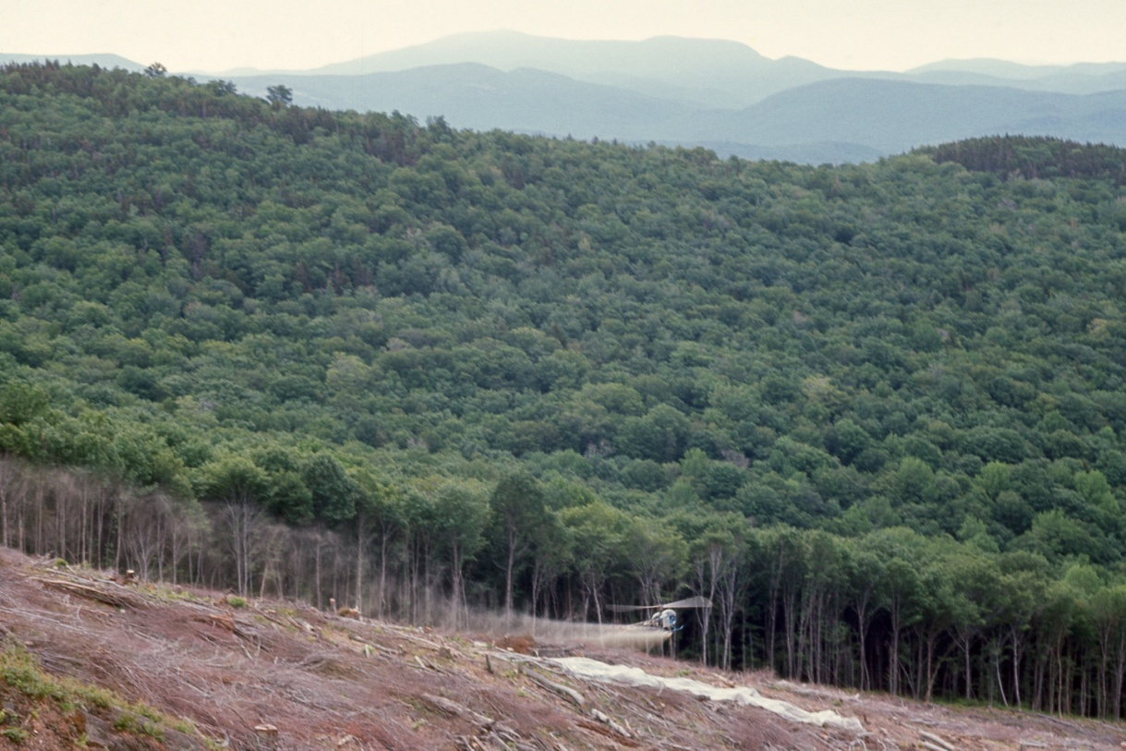
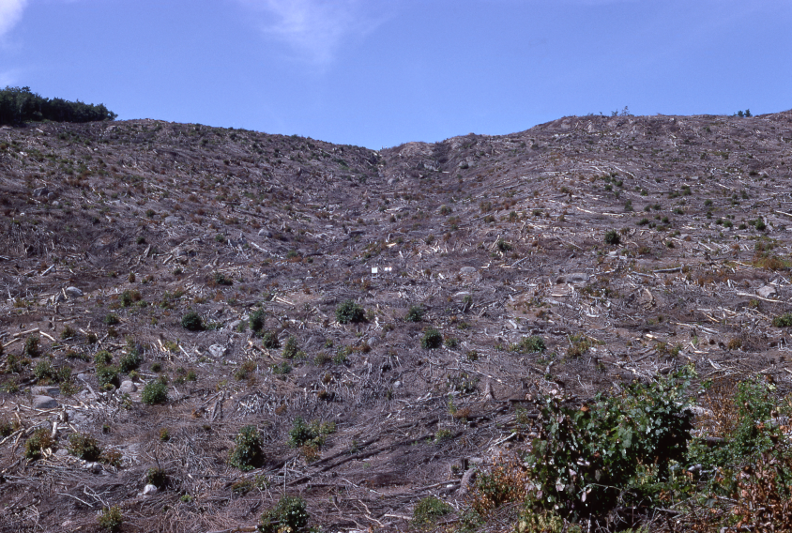
The watershed 2 experiment at Hubbard Brook:
All trees cut and left on top of the snow (1965).
Herbicides applied to prevent regrowth for three years (1966, 1967, 1968.
Photos from: http://hubbardbrook.org

Slide 10
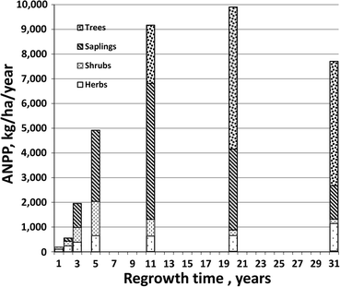
Resilience: After 30 years, productivity and composition similar to other sites in the region:
Reiners et al. (2012)
Notes:
The original question posed in this study was whether 3 years of post-cutting herbicide treatment affected resilience—defined here as the trajectory of regrowth as expressed by ANPP and biomass accumulation. There can be no question that those treatments reduced the fertility of the site with respect to nitrogen and major base cations (Likens and others 1978). Our data show that densities of pin cherry, the primary early successional, woody species were initially lower than recorded in comparator, clear-cut sites in the region, but that these differences became increasingly smaller by the 31st year of recovery. Evidence suggests that sprouting was reduced by the herbicide treatment. We conclude that the herbicide treatment did diminish the three primary ingredients for promoting rapid growth: site fertility, sprouting, and pin cherry establishment.
ANPP was initially lower than found in comparator sites but within a decade, it fell within their range of variation. Thus, treatment effects on resilience as measured by ANPP were temporary and slight. Biomass accumulation for the lower, more fertile third of the watershed was indistinguishable from that of comparator sites, but the middle and upper two-thirds of the watershed appeared to increasingly lag by the 20th year. This lag may be exaggerated in that some comparator sites may not have been on terrain as steep and rocky as the upper two-thirds of W2. Furthermore, this apparent lag cannot be justified in terms of comparator data for lack of sufficient comparisons. A lag is more strongly suggested on the basis of a biomass accumulation trajectory formed by many young sites and a few sites older than W2. The herbicide treatment definitely influenced watershed-ecosystem resilience in the early years of recovery, but the reduction was relatively slight by 20 years and more detailed assessment is conditional to time of regrowth and place on the watershed landscape.

Slide 11
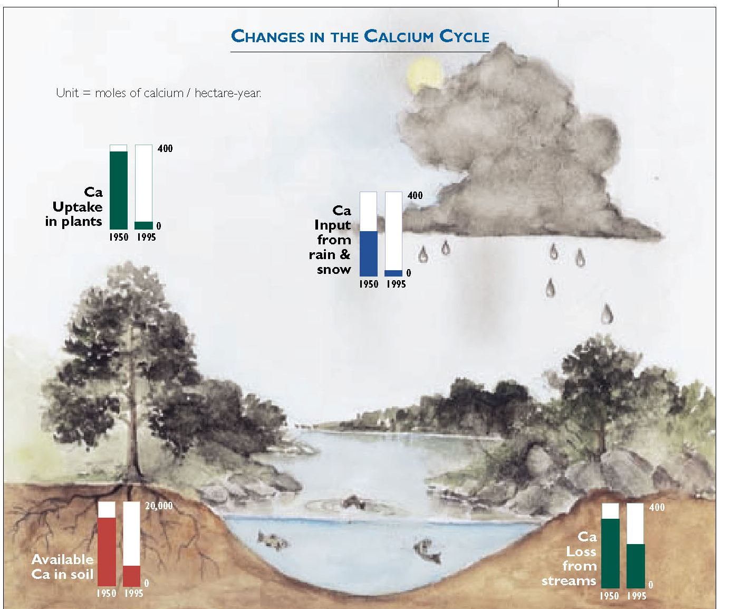
Would we get the same response now after 50 years of acid rain and base cation depletion?
Driscoll et al. (2001)

Slide 12
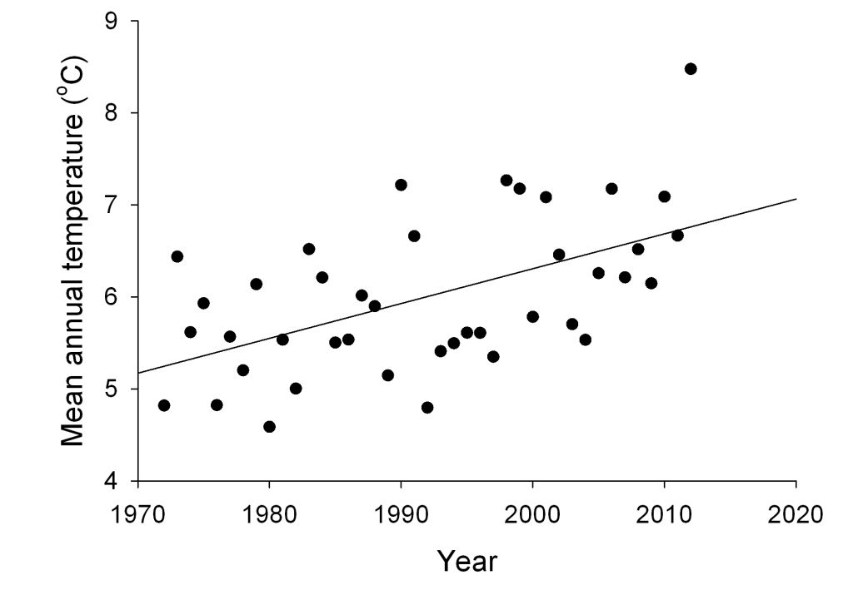
Would we get the same response after 50 years of climate change-driven nitrogen oligotrophication?
Duràn et al. (2016)

Slide 13
Taking ecological change to the next level:
Need to be able to make some predictions:
  How
  Where
  What
Need to be able to do something about it:
  How can we manage for resilience?
  Can we reverse regime shifts?
  Can we monitor more effectively?
These things can only be accomplished with long (and very long) term ecological research.

Slide 14
Dedication
“Art was a wonderful person who cared a great deal about LTER and worked tirelessly for education, sci-art collaboration, and diversity and inclusion.”
“Suzanne was a valued and cherished member of the KBS community who impacted the lives of many of us in her role as a science data manager and enthusiastic supporter for bike riding and educational activities in the community. She will be sorely missed by all of us.”
Art Schwartzchild
Virginia Coast Reserve LTER and
Anheuser Busch Coastal Research Center
Site Manager/Education Coordinator
Suzanne Jean Sippel
Kellogg Biological Station LTER
Data Manager

